Slide 1
NXT-R Series Thermostatic Expansion Valves
Product Training

Slide 2
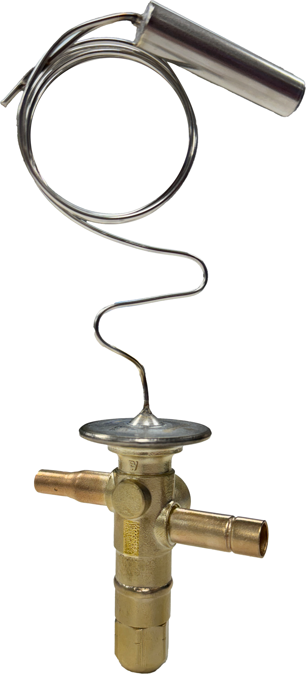
NXT-R Series Thermostatic Expansion Valves
Fractional Tonnage Refrigeration Applications
NXT-R Series combines the compact size of the A Series and the superheat control of the B Series, built with the reliability of the NXT product line.
Extends the advantages of the current NXT Series product line into refrigeration applications for fractional tonnages down to 1/10 of a ton
A Series and B Series Valves will be phased out in 2025

Slide 3
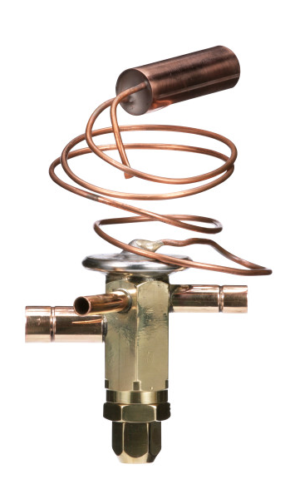
Comparing A Series to NXT-R Series Design
Laser welded stainless steel sensing bulb and capillary tubing prevents corrosion and increases durability
Compact design with a smaller footprint
Kept same copper fitting lengths for easy replacement
Removed threaded joints for hermetic leak-free construction

Slide 4
Superior performance, reliability and valve life
Laser etched identification markings for permanent legibility
Unique identification (UID) for precise tracking on every valve
Enhanced power element design offers superior extended life
Forged brass body

Slide 5
Features and Options
Hermetic leak-free construction of all joints allows for use in A2L and A3 refrigerant systems
Wide variety of refrigerant compatibility
Accurate superheat control; optimized for refrigeration systems
Balanced port construction
Internal equalizer is standard, other configurations available
Available in adjustable or non-adjustable superheat
Variety of brazed and SAE flare connections and sizes available

Slide 6
Specifications
Maximum Working Pressure - 700 psig (48 bar)
Operating temperature ranges by bulb charge type/system refrigerant and capacity range:
B – (R-448A, R-449A, R-452A); 1/5 – 5-1/2 tons; -50F to +50F
D – (R-450A, R-513A); 1/8 - 3 tons; -30F to +50F
H – (R-22, R-407C); ¼ - 5 tons; -50F to +50F
M – (R-134a); 1/8 – 1 ton; -30F to +30F
S – (R-404A, R-502, R-507); 1/8 – 3 tons; -50F to +50F
T – (R-290); 1/5 – 1 ½ tons; -50F to +50F
UL File Number ................................................................................................ SA5312

