Slide 1
50M56U-751 IFC
Direct OEM Replacement
Carrier / ICP Single Stage IFC

Slide 2
Business and Product Overview

Slide 3
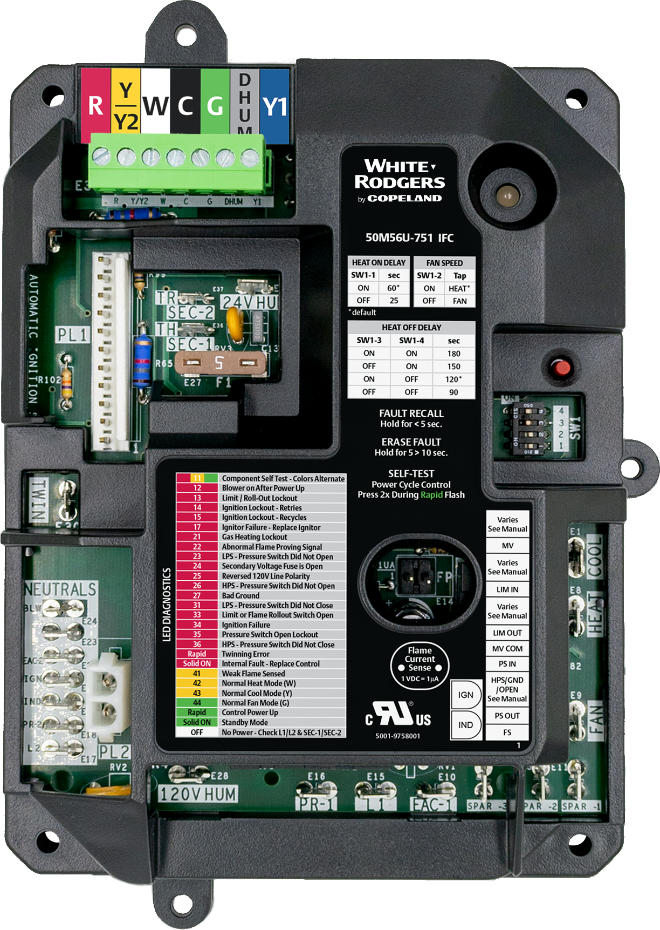
White-Rodgers 50M56U-751 IFC
  Upgraded in 2020, the 50M56U-751 Integrated Furnace Control offers a direct replacement option for 33 controls in the Carrier/ICP family. Replacing an estimated 10 Million units, across the US*.
Including
    Carrier Single Stage + PSC
      (1994-2019)
    ICP Single Stage + PSC
      (2005-2019)
Plus, the 50M56U-751 offers:
    Tri-Color LED
    Fault Recall
    Easily-accessible Flame Current Test Pins
* White-Rodgers Internal Projections
50M56U-751

Slide 4
Replace More Parts with One SKU
Competitive Comparison:
 | White-Rodgers | Carrier/ICP | ICM282A
Cross Reference Coverage | 1 Control for 33 Cross Refs | 5 Controls for 33 Cross Refs | 1 Control for 7 Cross Refs
OEM Mounting | ✔ | ✔ | ✔
Tri-Color LED | ✔ | ✘ | ✘
Fault Recall & Clearing | Simple Push Button | Jumper Twin & C Terminals | 1 Fault Only
Robust FR4 PCB Material | ✔ | ✘ | ✔
Component Self Test Mode | ✔ | ✔ | ✔
Flame Current Test Pins | ✔ | ✘ | ✘
Constant Fan Speed & Dehum Mode | Included | 1 Control Only | ✘
No Harness for Most Applications | ✔ | ✔ | ✘
Cross Reference:
Carrier/ICP Brands 1172550 1183599 1184594 1184783 1186024 1186115 | 325878-751 CEPL130437-01 CEPL130437-01-1 CEPL130438-01 CEPL130590-01 CEPL131004 CEPL131004-02 | CEPL131004-20 CEPL131004-20-ICP CEPL131012-01 CEPL131012-01-1 CEPL131012-02 CEPL131012-02-1 CEPL131012-20 | HK42FZ004 HK42FZ007 HK42FZ008 HK42FZ009 HK42FZ011 HK42FZ013 HK42FZ016 | HK42FZ018 HK42FZ034 HK42FZ036 HK42FZ045 HK42FZ061 HK42FZ062 | ICM ICM282A Johnstone L43-837 L47-385 | White-Rodgers 50M56-751 50M56U-751
(SKU’s with boxes around them are old “White Cover” cross references)

Slide 5
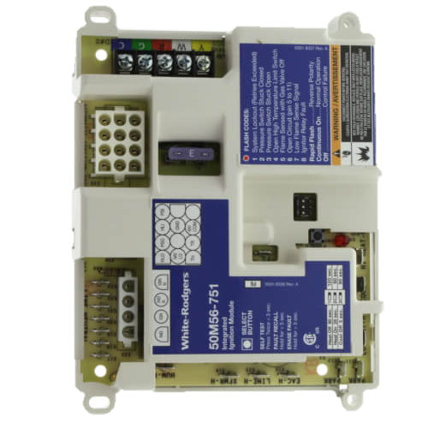
Product Improvements
  To improve the installation experience and increase our cross references, White-Rodgers has made significant product improvements.
    New ICP Harness
    12 Pin Molex Upgraded to 11-Pin In-Line Connector
    4 Pin Inducer/Ignitor Molex Upgraded to 2-Pin
    24v Detachable Thermostat Bus + Y2 and Dehum I/O
    24v or 120v Humidifier
    Fan-Only Speed Dipswitch
    Flame Current Test Pins
    Twinning
    Mounting options
Then,
White Cover
Now,
Black Cover
*WR Estimate

Slide 6
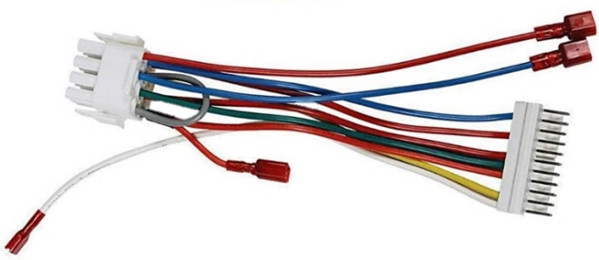

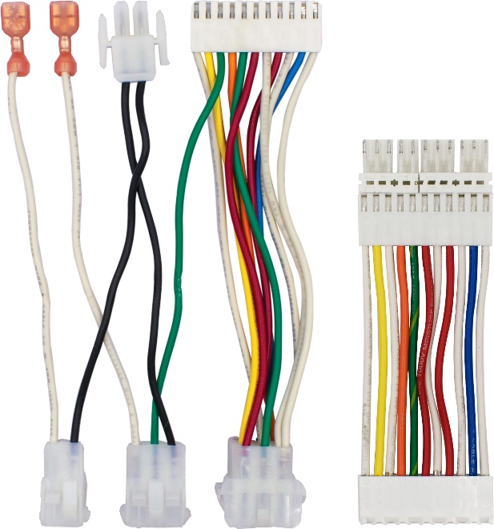


Improved Adapter Harnesses
2 Previous “White Cover” Harnesses
2 New “Black Cover” Harnesses
    Harnesses connect to the old controls 12 pin
    Molex plug.
    Harnesses connect to the new controls 11 pin
    in-line plug.
      Eliminates secondary harness
      New “Flip Harness” provides ICP compatibility
TECH TIP: With the majority of existing Furnace Harnesses being 11 pin connectors, the new control will not need any adapter!

Slide 7
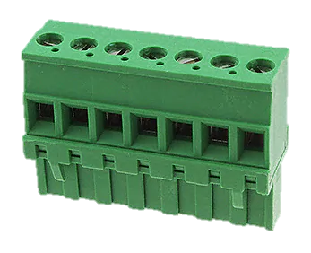
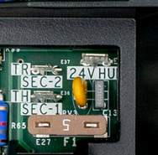
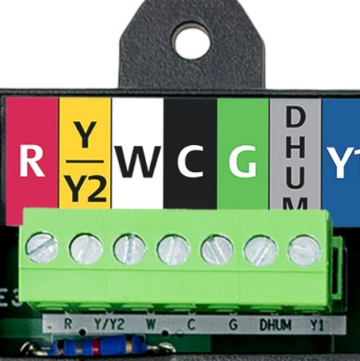
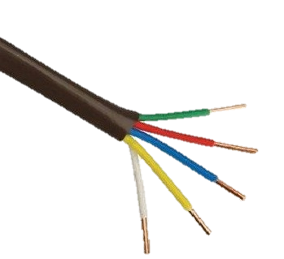
Key Features
Detachable T-Stat Bus
24v Humidifier Spade
Y2/Dehum
    Bus disconnects from the control to allow for easy thermostat wiring.
    The “white cover” control allowed for 24v humidification through an adapter harness.
    The new “black cover” has a designated spade on the control.
    Two-stage outdoor cooling ready
    Dehum terminal for lower
    blower speed

Slide 8
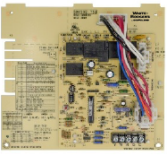
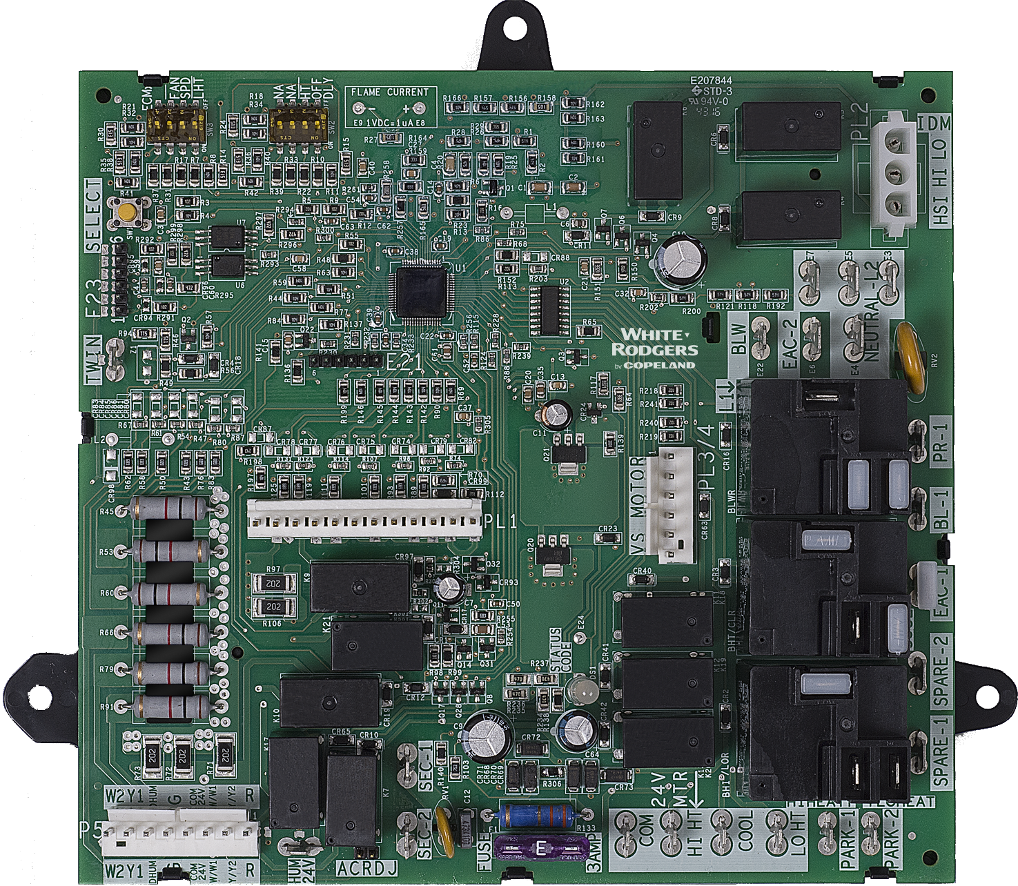
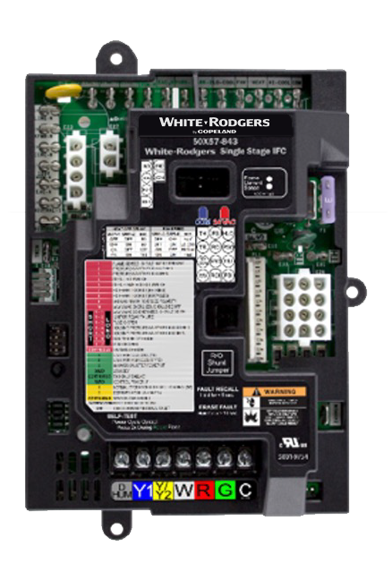
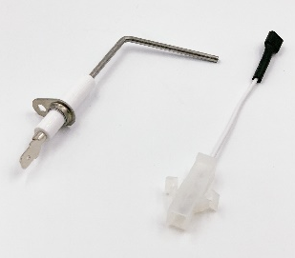
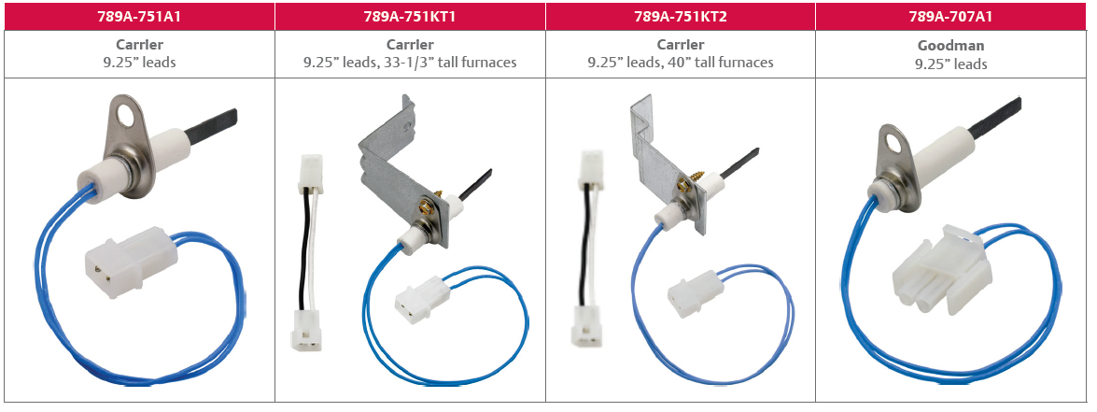
White-Rodgers HSI Gas Furnace Components –
Carrier Family
CARRIER | CARRIER | CARRIER | CARRIER/UNIVERSAL
50M56U-751 | 50M56D-751 | 21V51D-751 | 50X57-843
IFC - PSC | IFC - PSC | IFC – 2 Stage | IFC - ECMx
CARRIER / ICP | CARRIER / ICP | CARRIER ICP | CARRIER / ICP
790-751A1 | 789A-751A1 | 789A-751KT1 | 789A-751KT2
Flame Sensor | Ignitor | Ignitor Kit – 33 1/3" | Ignitor Kit – 40"

Slide 9

Rest Assured, We Know The Industry
Automatic Configuration
    50M56U-751 matches its functional operation to the OEM controls being replaced.
    System design variations, such as with or without a Housing Pressure Switch, are automatically recognized and properly handled.
Enhanced Code 31 Software
    50M56U-751 features automatic recovery from intermittent high wind conditions without going into an unnecessary 3-hour lockout.

Slide 10
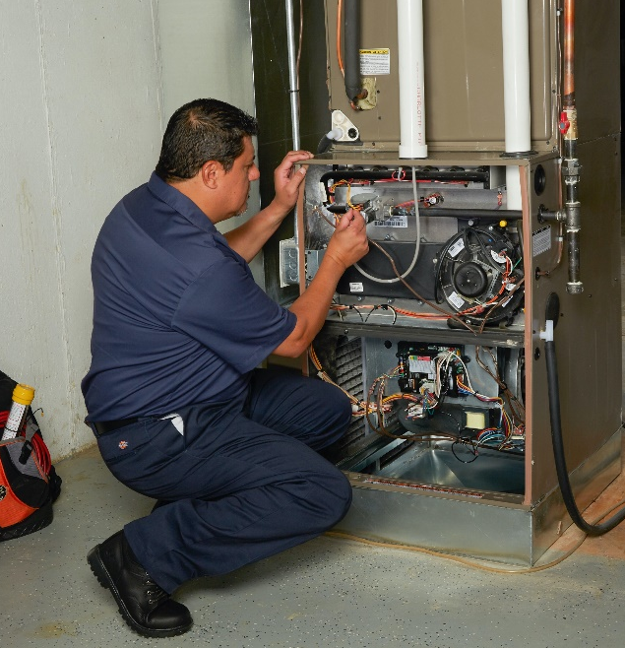
What Our Customers are Saying About 50M56U-751 IFC
  “I was so impressed with this furnace circuit board. I installed it in a generic Carrier type brand furnace. It came with necessary wiring harnesses for each type of furnace and the install was a piece of cake.”
  ― January, 2020
  “This White Rodgers board is an excellent replacement board that comes with a nice plastic cover protecting it from the elements. The instructions were simple to follow and this was an easy installation.”
  ― July, 2019
  “This was very easy to install when using the instruction booklet, which is included. Everything is step by step and the LED diagnostic helps guide you if you've made a mistake.”
  ― December, 2018

Slide 11
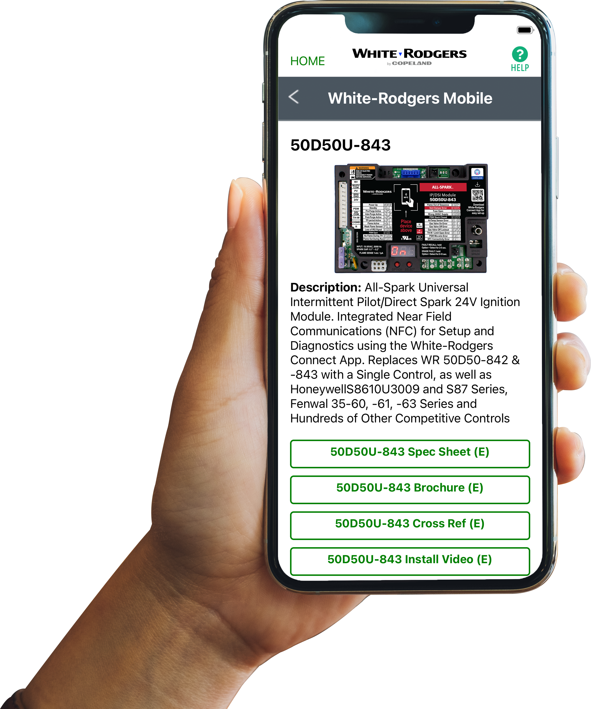




Comprehensive Cross Reference & Product Information
Find the right part while on the job.
  Your on-the-go resource for:
  Complete cross reference
  Product information and spec sheets
  Installation information and videos
  Wiring diagrams
  Select product by features
  Priority technical support
  WR Mobile App
  Search for “WR Mobile” in both Apple
  and Google Play Stores
  Desktop Version
  Access the online version HERE
Search by OEM, Competitor and White-Rodgers part numbers.

Slide 12
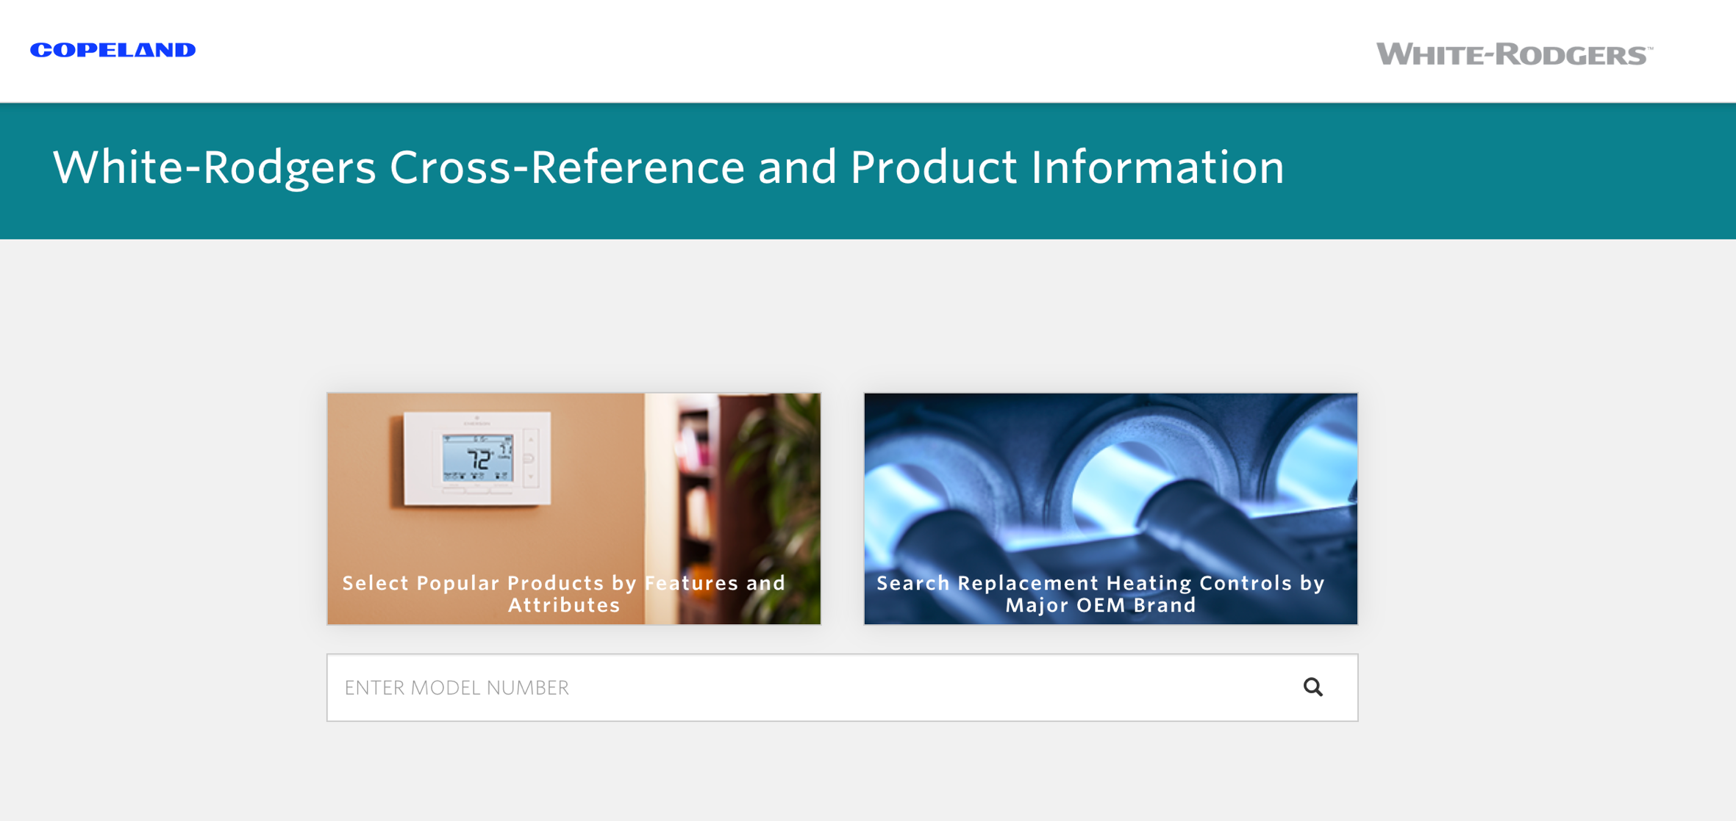
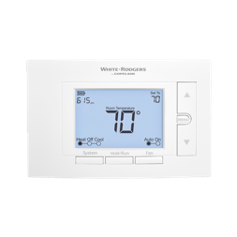
White-Rodgers Cross Reference
  Go to: https://webapps.copeland.com/wrproductselector/
    Enter the Model Number or click on: Search Replacement Heating Controls by Major OEM Brand

Slide 13
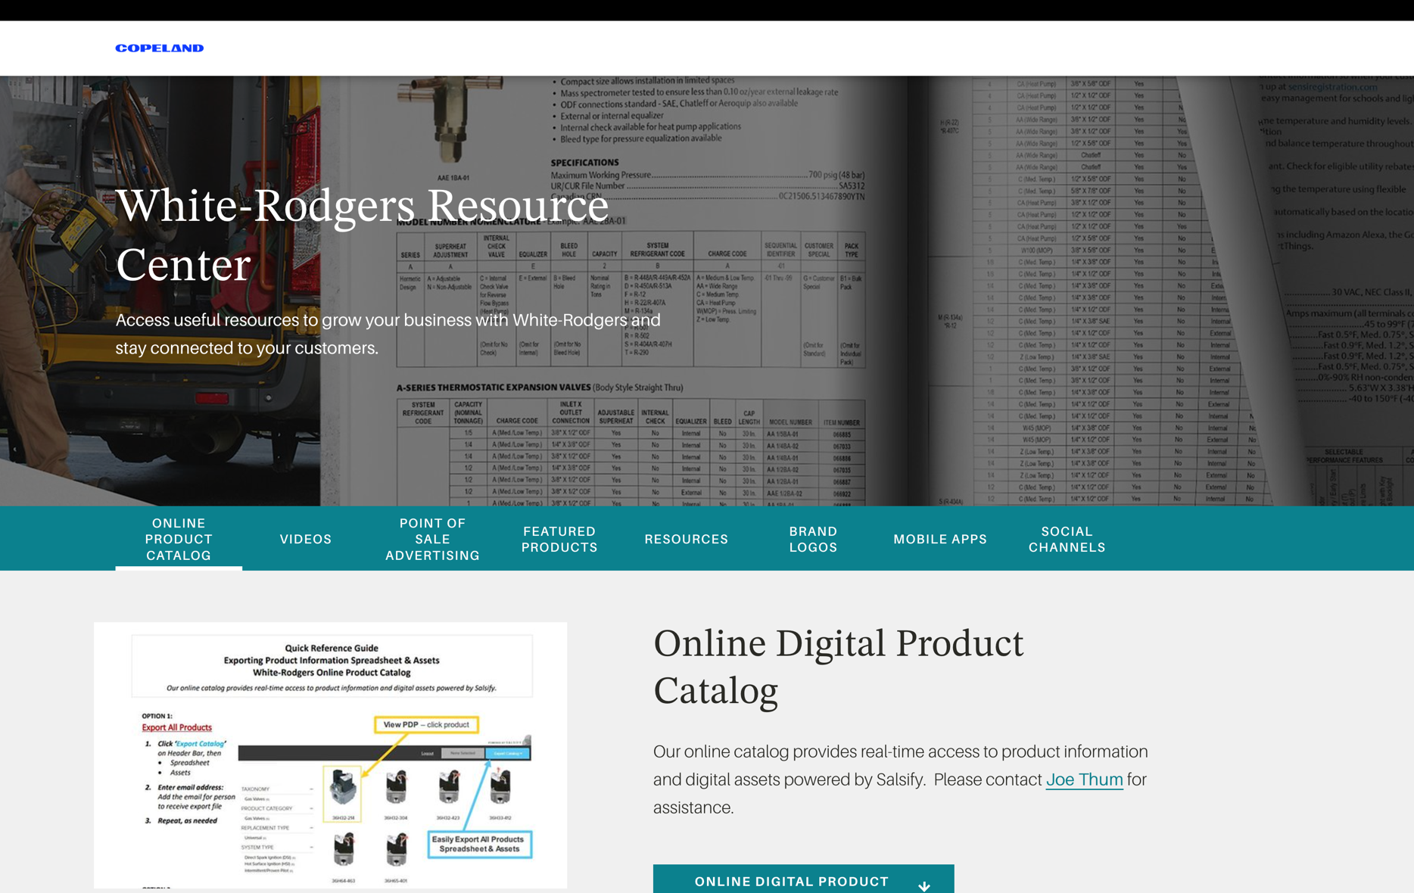
Wholesale Resource Site
  Access useful resources to grow your business.
  Visit: https://www.copeland.com/en-us/brands/white-rodgers/white-rodgers-wholesaler-resource-center
  You’ll find videos, stocking lists and product launch information for the following product families:
    Heating Controls
    Cooling Controls
    Sensi Smart Thermostats
    Traditional Thermostats
    Contractor Rewards
    Product Merchandising

Slide 14
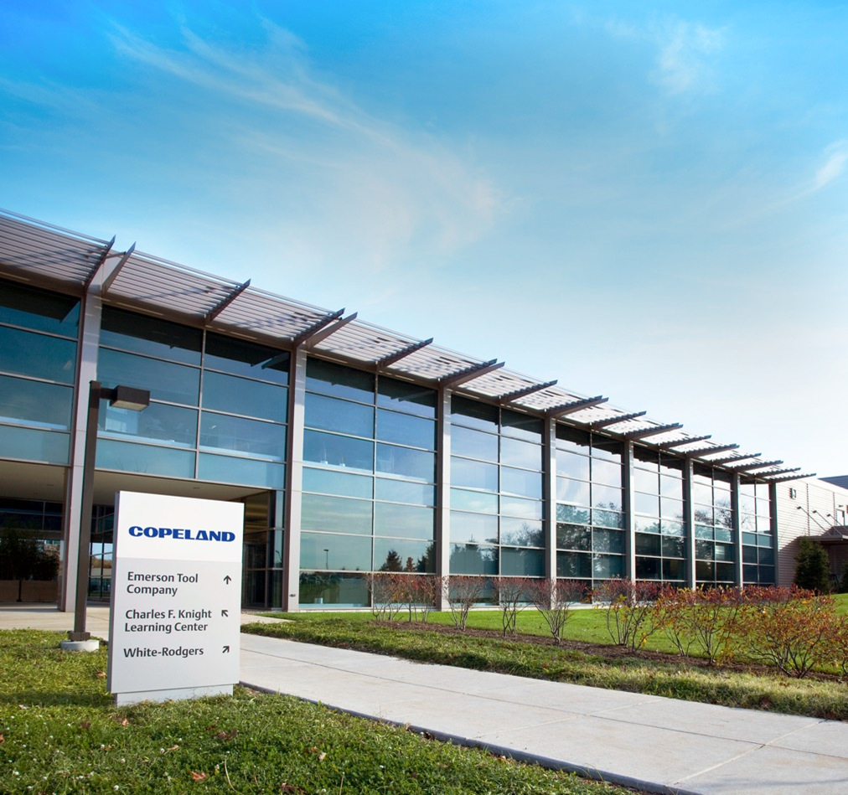
Our commitment to you
Industry Leading Products
    Used by more OEM’s
    Offering the widest range of Universal
    Replacement Controls
Ease of Installation
    Simple, easy to understand instructions
Product Reliability
    Quality Control assures reliable products
Affordable
    Competitive pricing
Supported by Knowledgeable Representatives
    Contractor direct phone support

Slide 15
Technical Overview

Slide 16
White-Rodgers 50M56U-751 IFC
  Upgraded in 2020, the 50M56U-751 Integrated Furnace Control offers a direct replacement option for 33 controls in the Carrier/ICP family. Replacing an estimated 10 Million units, across the US*.
Including
    Carrier Single Stage + PSC
      (1994-2019)
    ICP Single Stage + PSC
      (2005-2019)
Plus, the 50M56U-751 offers:
    Tri-Color LED
    Fault Recall
    Easily-accessible Flame Current Test Pins
* White-Rodgers Internal Projections
50M56U-751

Slide 17
White-Rodgers Carrier 50M56U-751 Components
24V Components:
120V Components:
    Removable 24V Thermostat Bus
    Status/Fault LED
    11 Pin Inline Connector
    Twinning Spade
    24V Transformer Spades
    24V Humidifier Spade
    5a Low Voltage Fuse
    Fault Recall Button
    Heat On/Off, Fan Dipswitches
    Flame Sense Test Pins
    3 Tab or 4 Corner Mounting Options
1
2
    PSC Blower Heat Spade
    PSC Blower Cool Spade
    PSC Blower Fan Only Spade
    3 Extra Blower Speed Park Spades
    120V EAC Spade
    120V to Transformer Spade
    Line 120V Input Spade
    120V Humidifier Spade
    7 Line Neutral Spades
    2 pin Inducer/Ignitor
    Molex Plug
5
3
6
8
7
9
4
10
13
21
12
14
20
19
18
17
16
15
11
50M56U-751

Slide 18

Test Pins
  2 pins extend from the Control Board to the surface of the Black Cover.
To Test:
    The furnace must have a call for heat + burners producing flame.
    Set a multimeter to vDC and place a meter probe on each pin.
    Convert vDc to MicroAmps using a 1:1 ratio.
    A good flame sense reading will be between 1.0 – 5.0 μA.
50M56U-751

Slide 19
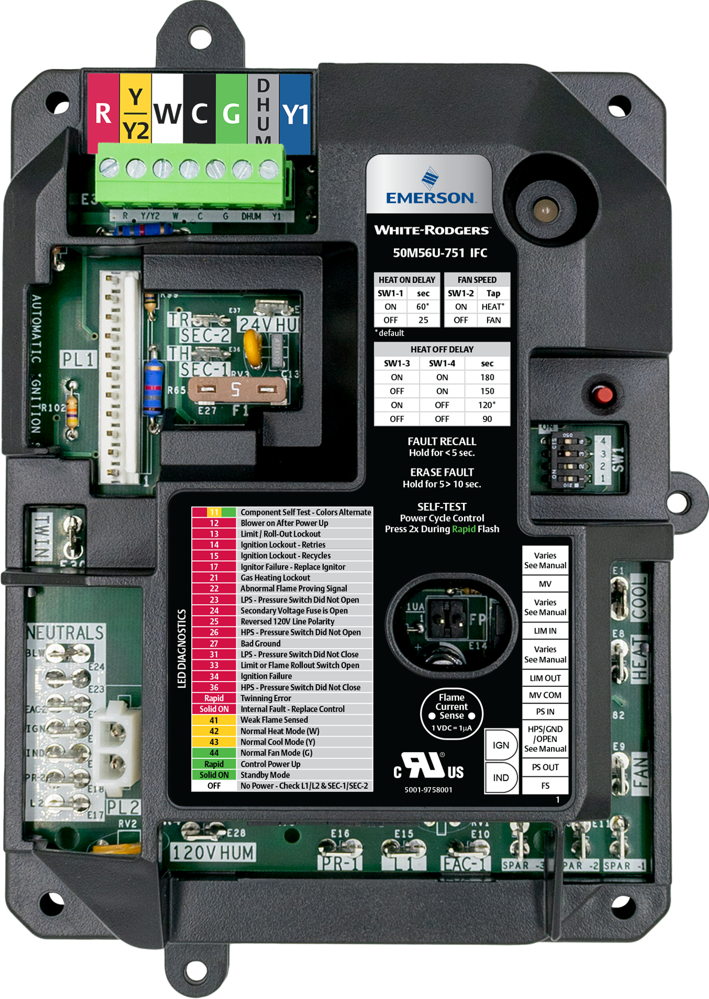
Twinning
  Two 50M56U-751 Controls can be connected to operate simultaneously.
    Twinning requires a connection of the Twin Terminal on both boards using an 18ga wire.
    The Board with the Thermostat connection will
    fully function including the LED indicator and Dipswitch settings.
    The Twinned Board will operate simultaneously as determined by the wired board unless “W” or “Y” are powered to it.
    The Twinned unit can be wired for Heat to come on by utilizing the “W” terminal either with the 1st unit or as a 2nd stage.
50M56U-751

Slide 20
Mounting Options
3 mounting tabs match existing boards for easy replacement.
  The raised molded base provides space between board and unit mounting plate. With two unique mounting options.
Option 1
    3 tabs match some OEM models with a tray.
      3x ½" screws are provided
Option 2
    4 mounting holes that match some OEM boards give additional options for alternate mounting.
      4x 1" screws are provided
4 mounting holes match some OEM boards for alternate mounting.

Slide 21
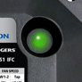
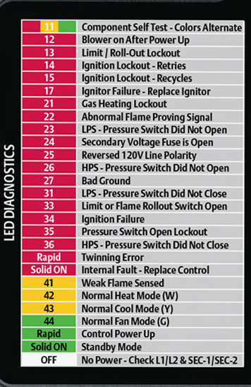
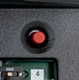
Status & Fault Codes for Troubleshooting
Tri-Color LED
  Fault Button Offers:
    5 Fault Recall
    Fault Code Erasure
    Self-Test Mode
  Troubleshooting made easy with a Fault Code Label on the control cover.
50M56U-751
Updated Fault Code 31 Software
Notes:
The software code has been modified with new pressure switch criteria. When the pressure switch trips 3 times, there is a 3-hour lock-out.

Slide 22
Installation Overview

Slide 23
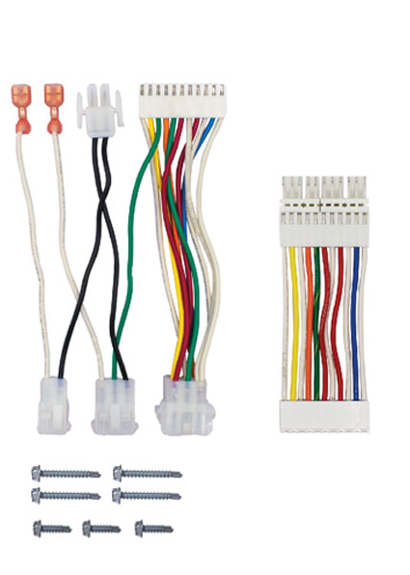
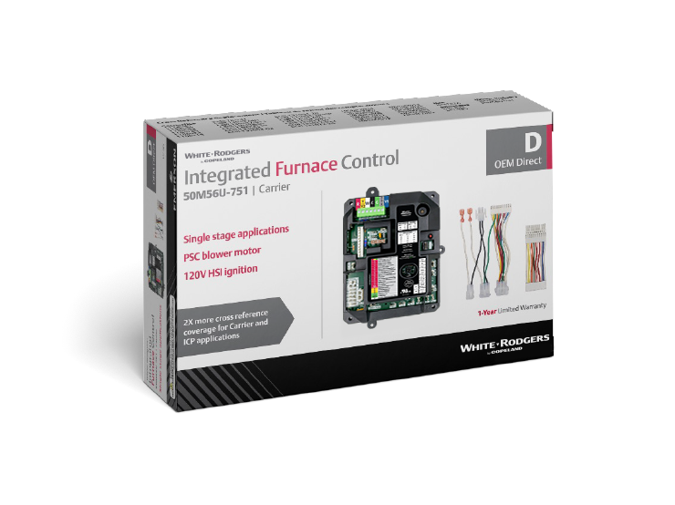
What’s in the Box?
  50M56U-751 Integrated Furnace Control
    9-Pin Adapter Harness
    “Flip” Adapter Harness for ICP
    4 – 1" Sheet Metal Screws
    3 – ½" Sheet Metal Screws
    Installation Instructions
TECH TIP: Smaller box in the new 50M56U-751 for additional truck space.

Slide 24
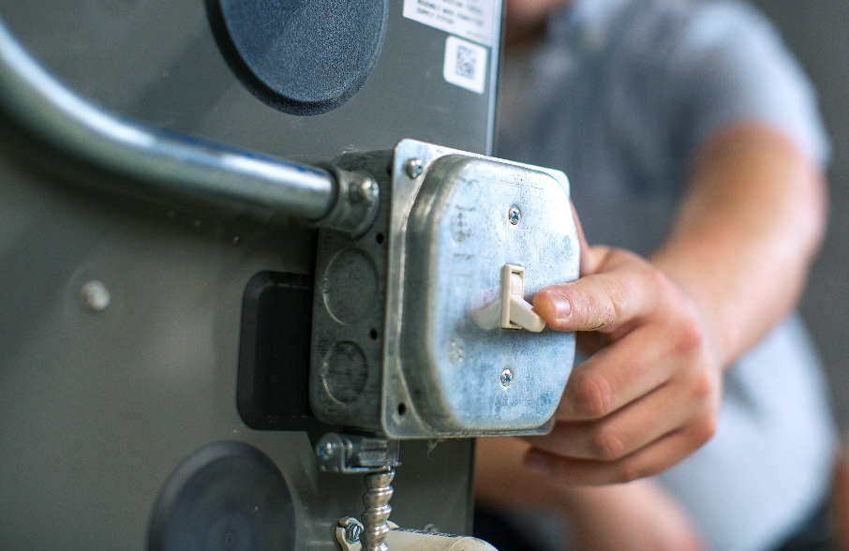
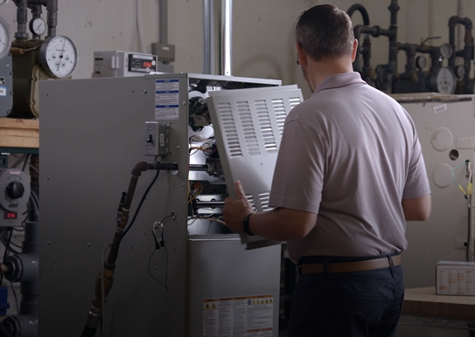
Installation – Step 1
1
  Turn off the power and gas to the furnace and remove the access panels.

Slide 25
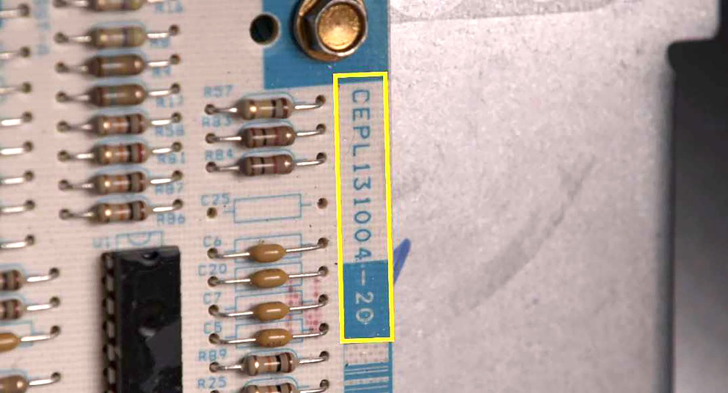
Installation – Step 2
2
  Check the part number on the part replaced against the 50M56U-751 Cross Ref on the package or on the White-Rodgers Mobile App.

Slide 26
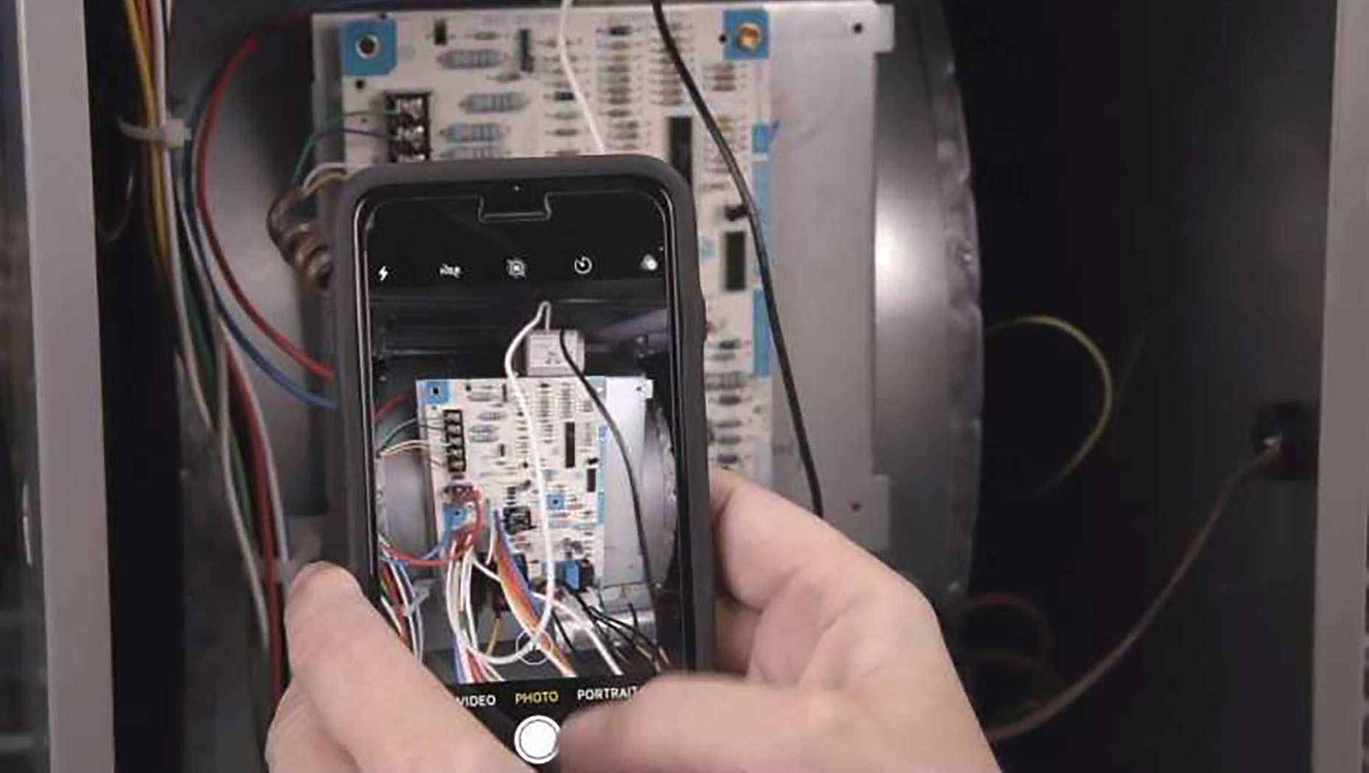
Installation – Step 3
3
  Take a photo of the existing setup.

Slide 27
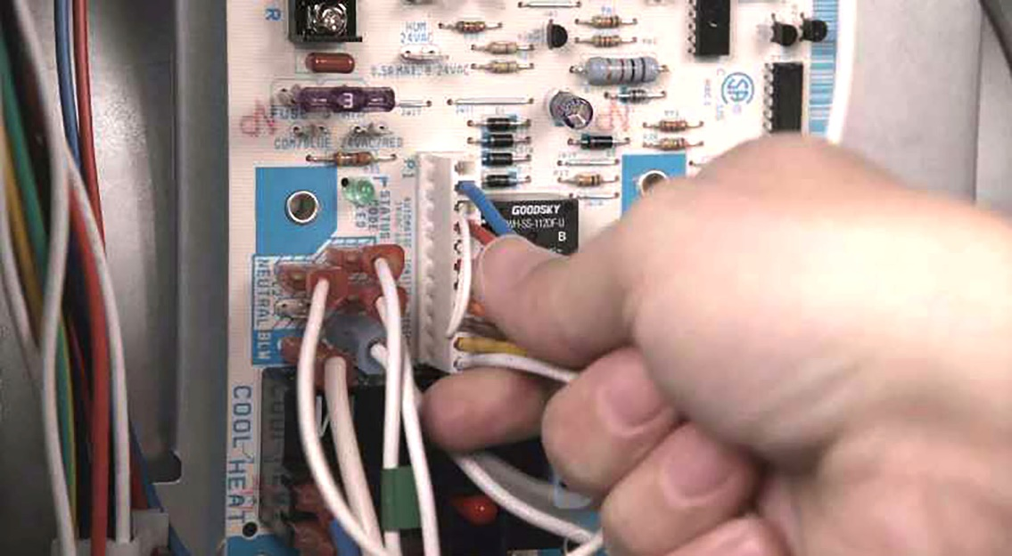
Installation – Step 4
4
Remove the Wiring:
    Disconnect Thermostat Wiring
    Disconnect 24v Transformer wires
    Remove Carrier Inline plug
    Remove 120v Power and Neutral
    Transformer Wires
    Remove 120v Power and Neutral Wires
    Disconnect 2 Pin Molex Hot Surface Inducer Plug and Neutral Wires
    Remove Blower Motor Wires (Note all colors)
    Remove the Board

Slide 28
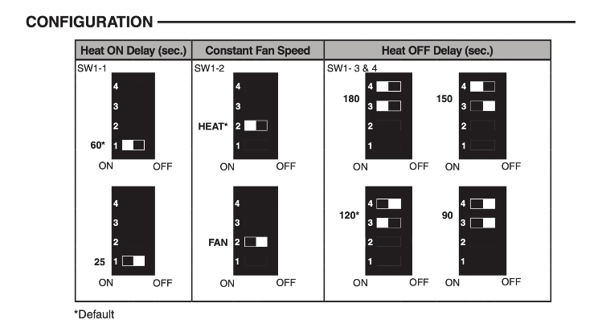
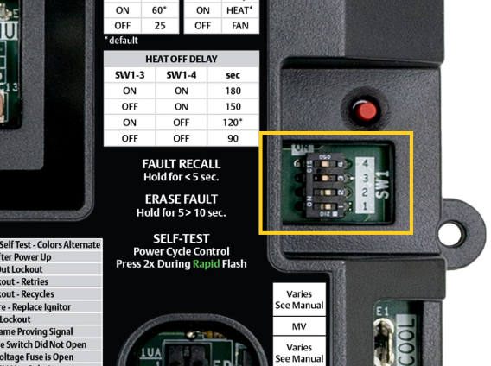
Installation – Step 5
5
  Match the board’s dipswitch settings to the existing control. Use a screwdriver to push the dipswitches to their required locations according to the supplied install instructions

Slide 29
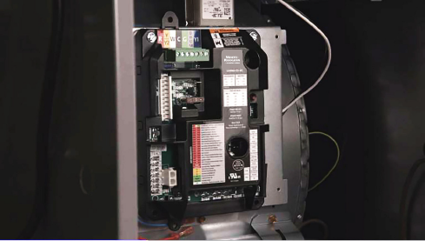
Installation – Step 6
6
  Mount the new board. Select corner mounts, tab mounts, or custom, depending on application.

Slide 30
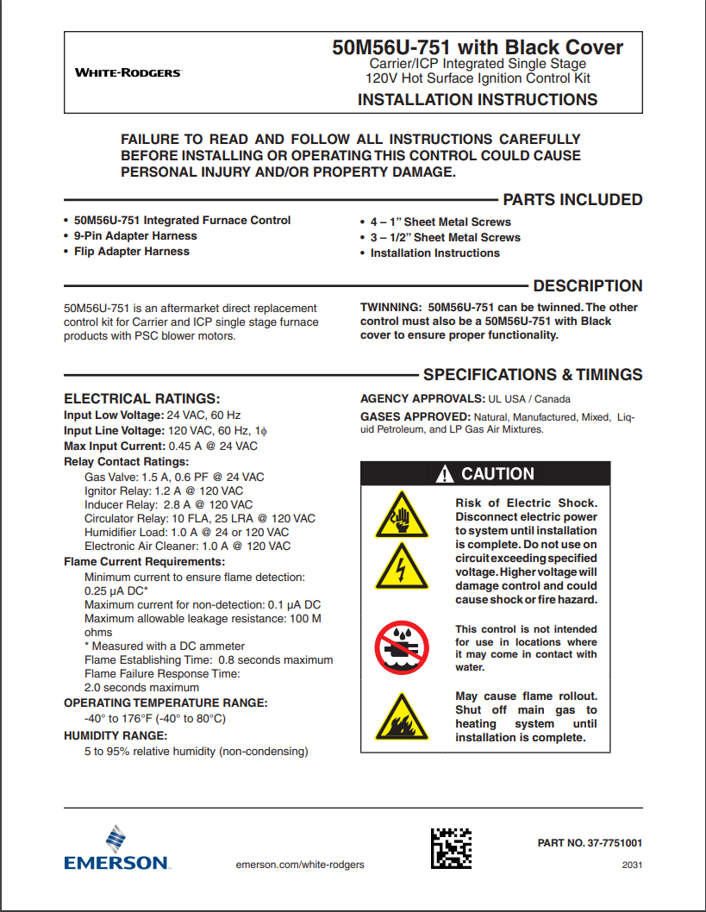
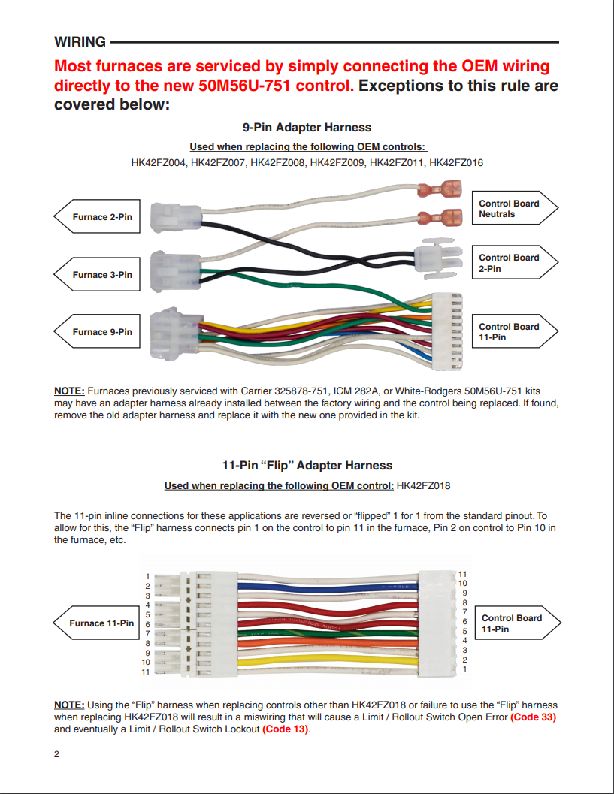

Installation – Step 7
7
  Refer to instruction sheet to determine if harnesses are required for your application. Connect if required.

Slide 31
Installation – Step 8
8
Wire the New Board:
    Plug in the Carrier Inline Plug
      If required, use the 9 pin adapter harness
      If required, use Flip Harness to connect directly to the control (ICP)​
    Plug-in the 2 Pin Molex Hot Surface Inducer Plug and Neutral Wires​
    Attach Blower Motor Wires​
    Connect 120v Power and Neutral Transformer Wires
    Connect 120v Power and Neutral Wires
    Connect 24v Transformer wires
    Connect Carrier Inline Plug
    Remove T-Stat Block and install thermostat wires
      Plug Block back into Control

Slide 32
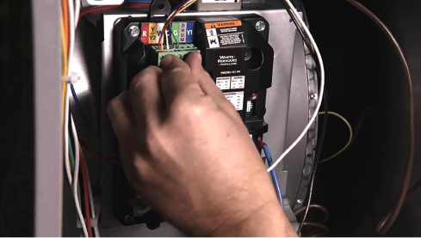
Installation – Step 9
9
  Doublecheck Wires for sound connection,
  ensure unused blower wires are plugged into spare terminals.

Slide 33
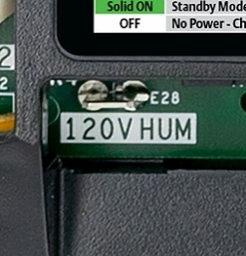

Installation – Step 10
10
  If desired, connect EAC/ Humidifier.
50M56U-751

Slide 34
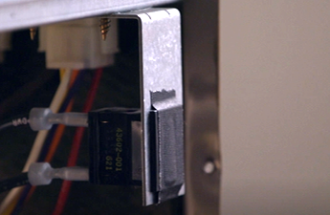
Installation – Step 11
11
  Tape down door switch. Reconnect the power and gas to the furnace and enter Self-Test mode. ​

Slide 35
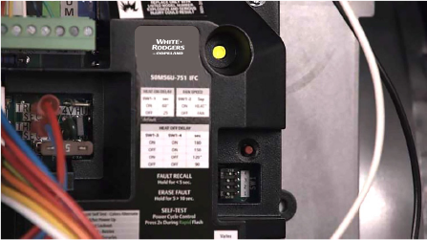
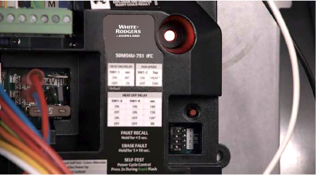
Installation – Step 12
12
  Enter Self-Test mode by pressing fault recall button twice within three seconds. LED will flash last faults in red.
  During Self-Test, the LED will flash Code 11 between green, amber, and red, while doing a systems check. When complete, control goes into stand-by mode.

Slide 36
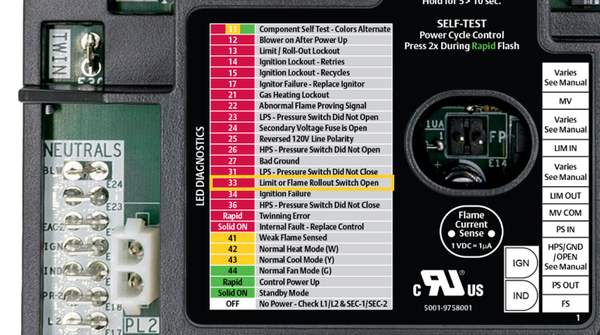
Installation – Step 13
13
  Verify ignition by making a call for heat. If a fault is detected, reference the Tri-Color LED flash code against the fault code list on the control.
TECH TIP: Hold fault/recall button for
5-10 seconds to erase fault code history.

Slide 37
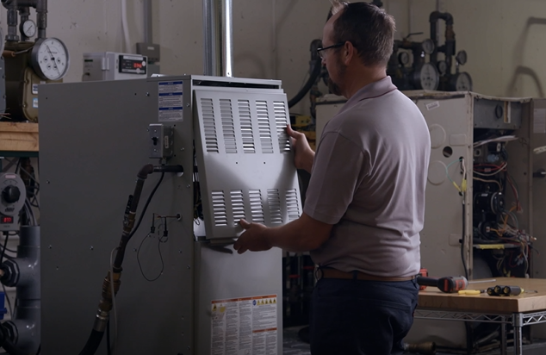
Installation – Step 14
14
  Re-attach furnace panel, and you’re good to go!

Slide 38
Thank you.
R-5262-2. ©2024 Copeland LP.

