Slide 1
White-Rodgers and Sensi Overview
January 2024

Slide 2
Table of Contents
White-Rodgers / Sensi Overview
 | Overview
1 | Universal Controls
1 | Heating Controls
1 | Cooling Controls
1 | Thermostats
1 | Additional Support

Slide 3
Copeland: The Opportunity Ahead
Copeland is a new standalone company serving the global HVACR market, enhancing opportunities to support our customers as a focused company.
Focus as a Standalone Company
Build on a Strong Foundation to Drive Value
Accelerate
Profitable Growth
Create New
Opportunities
Combining our team’s world-class talent and Blackstone’s expertise, Copeland will advance it’s leadership positions through focused investment aligned with attractive market opportunities for sustainable growth.
Copeland is a new global organization that continues to:
Build on its legacy
Create innovative and sustainable solutions for customers
Steward positive change
Through our differentiated technology, manufacturing capabilities and customer focus, Copeland will build on its leading position across markets as a focused, standalone company.
This change will improve the business’ agility and ability to create new value with our customers and provide employees an improved path for personal and professional development.

Slide 4
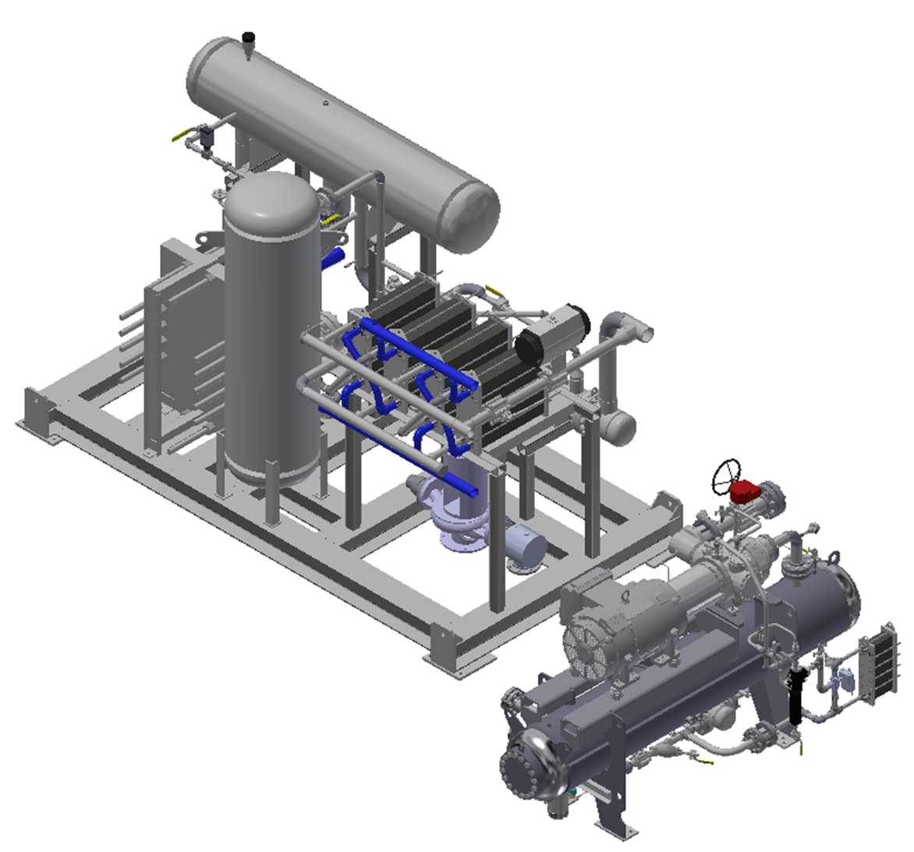
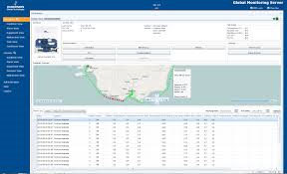
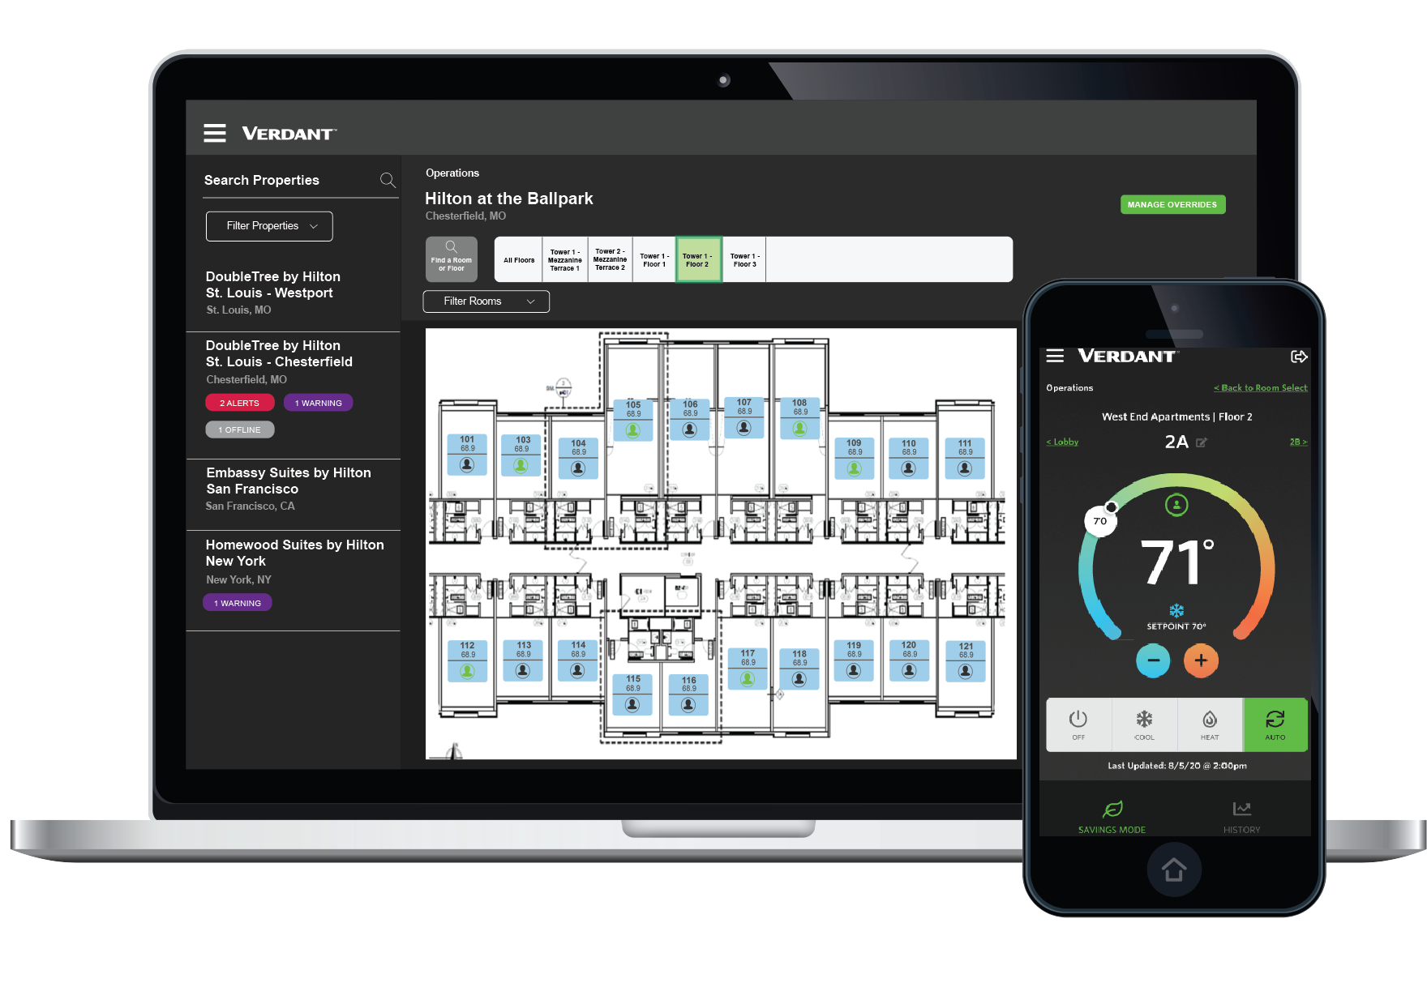
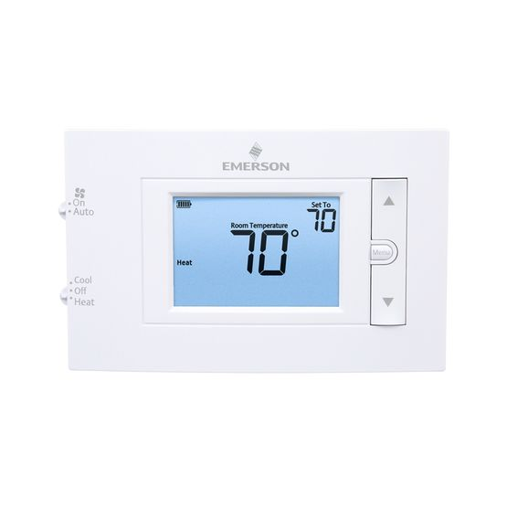
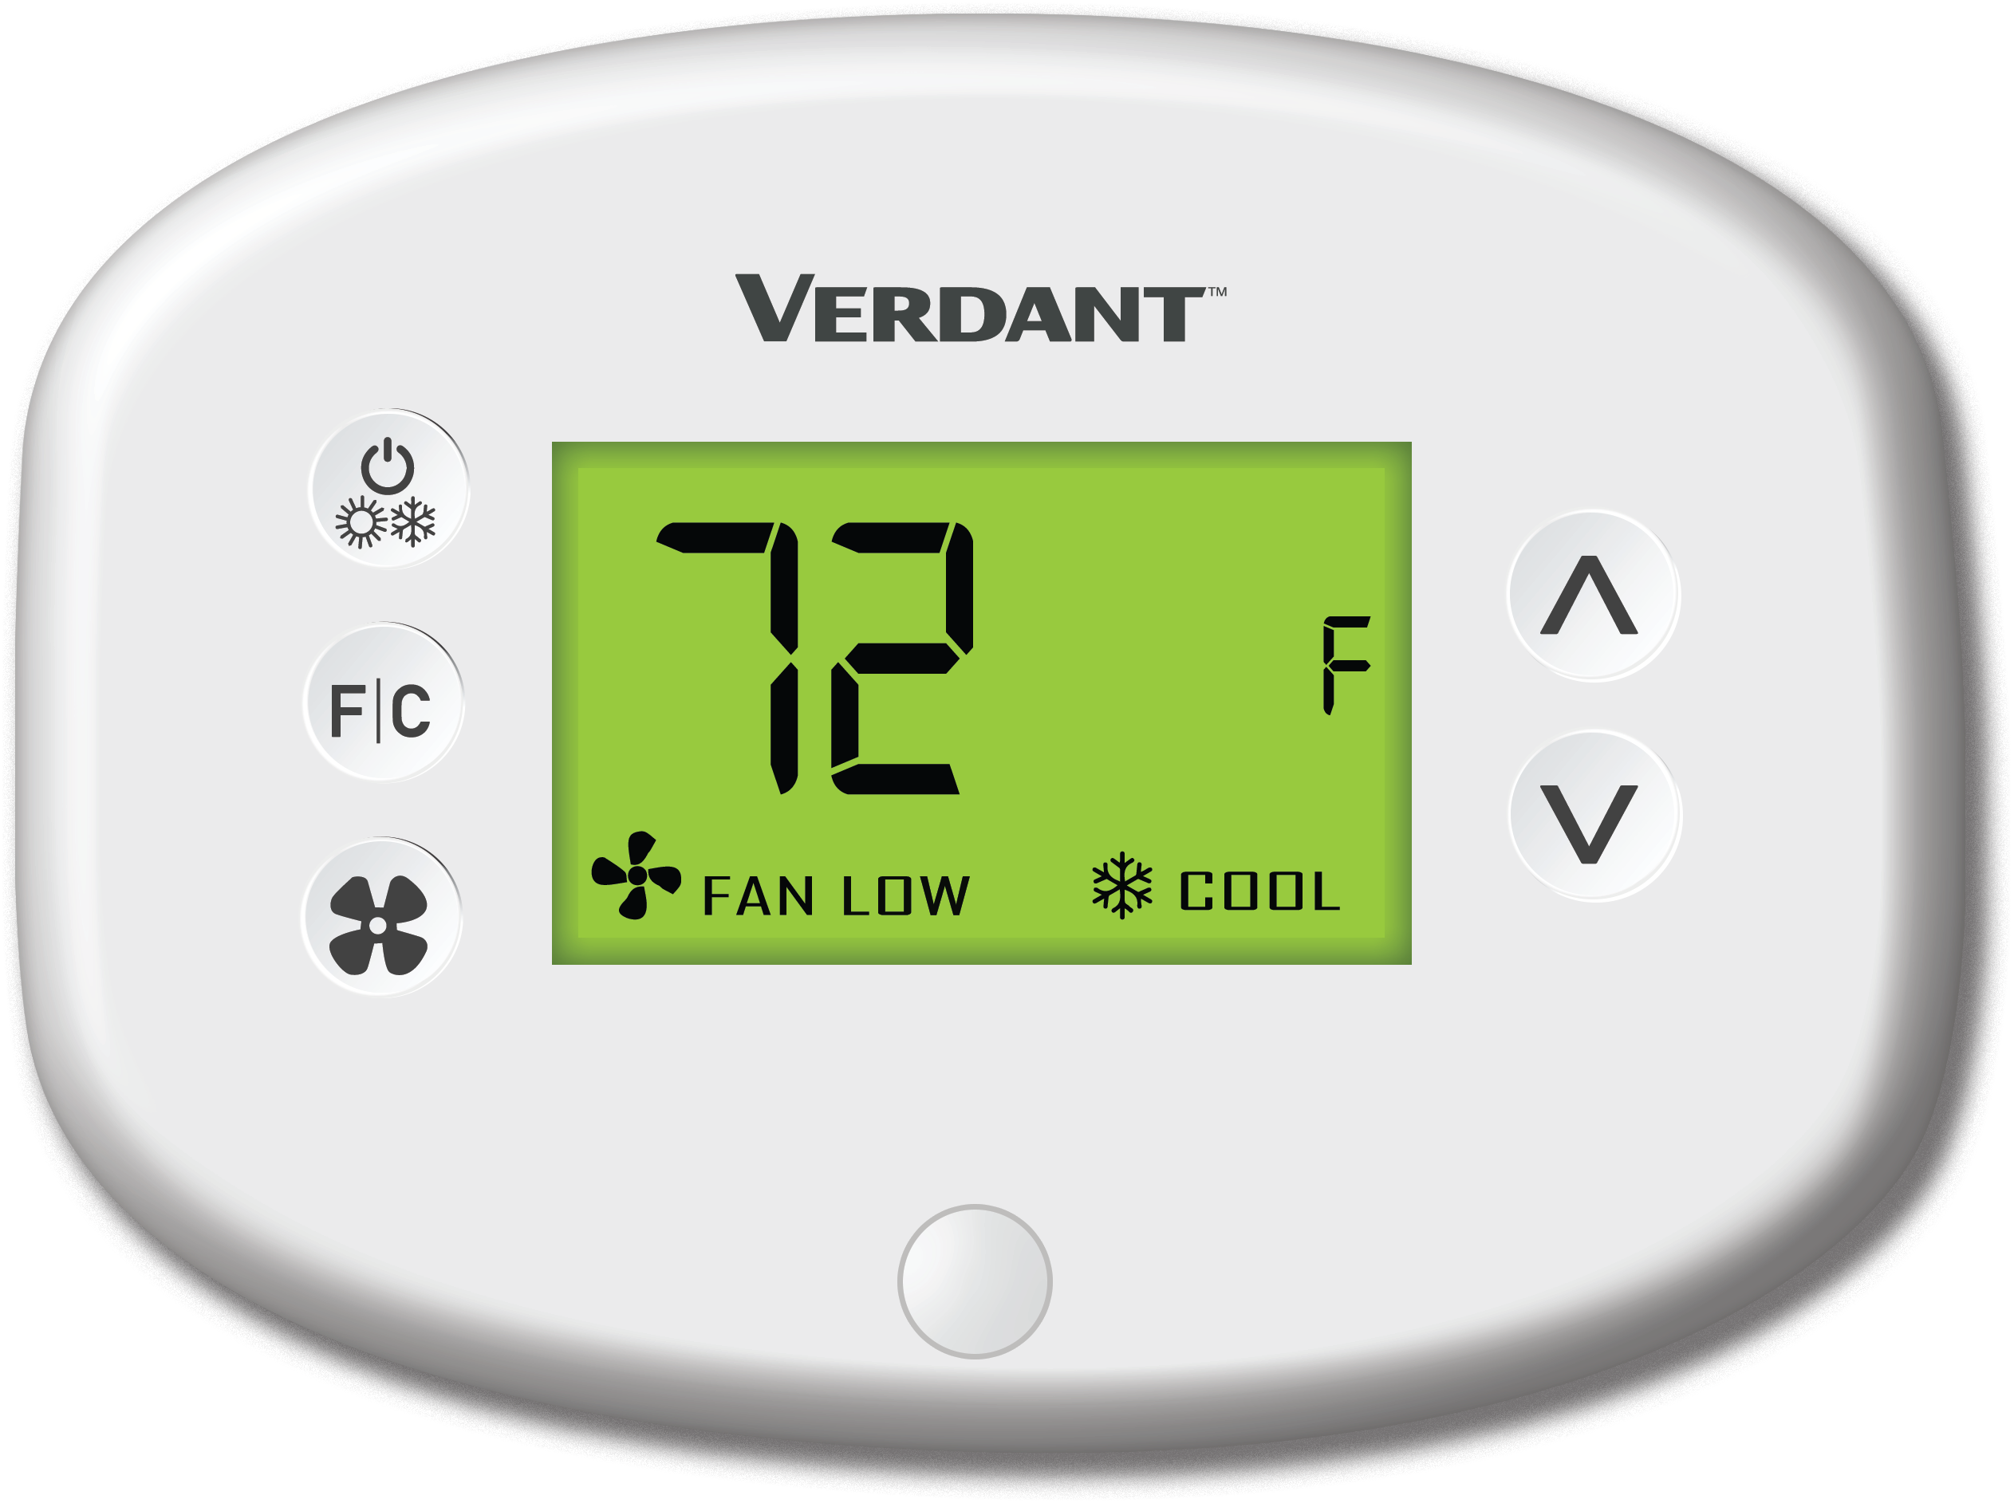
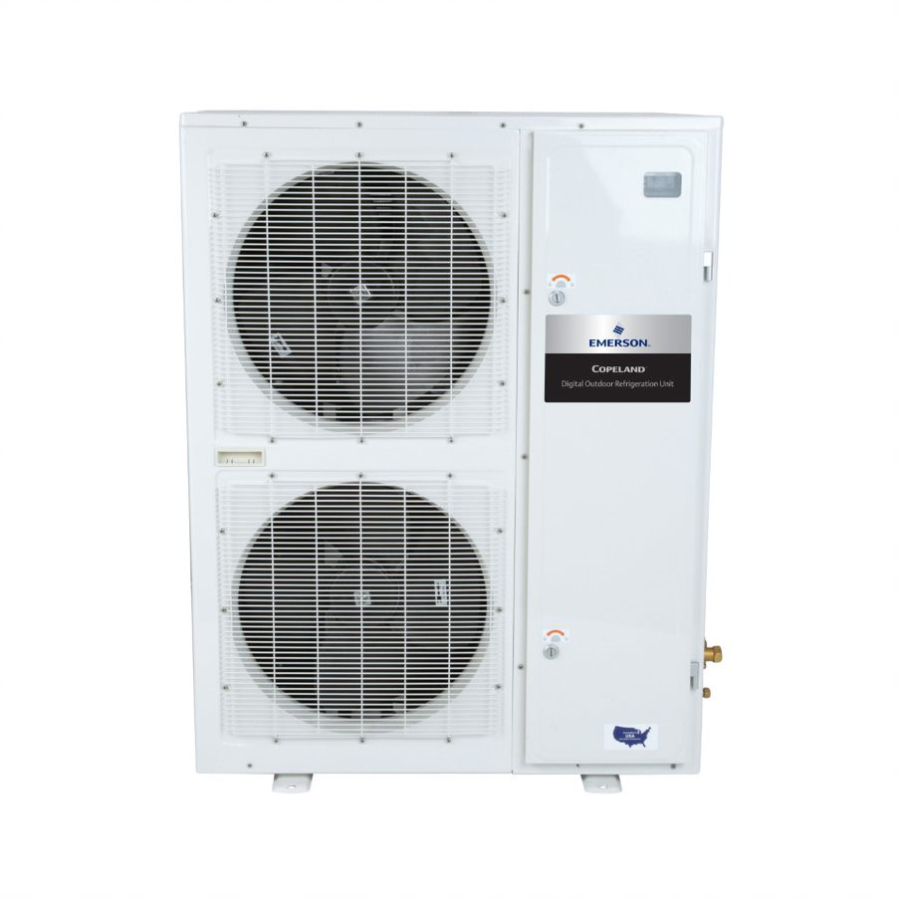
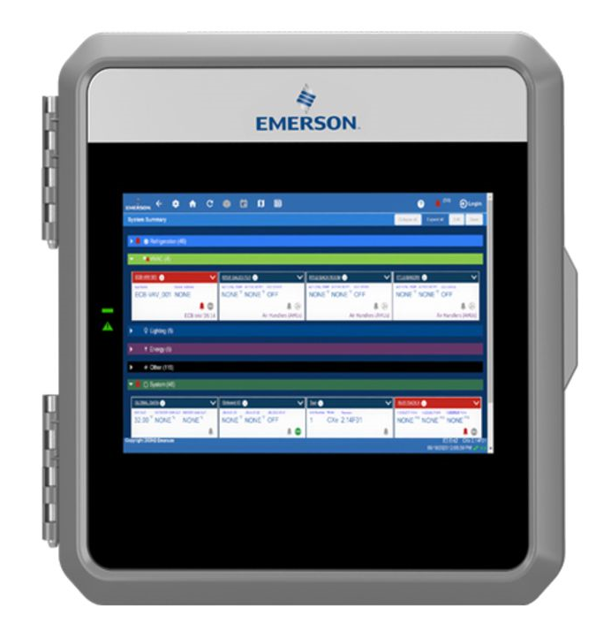
Our Portfolio Of Products
HVACR Technologies
Cold Chain
Comfort Control
OUR BRANDS
OUR PRODUCTS
Compression Technologies
Industrial Soltuions
Controls & Monitoring
Energy Management & Monitoring Solutions
INDUSTRIES SERVED
Residential, Commercial, Industrial, Transport, Refrigeration & Heating
Food Retail, Food Service, Cargo, Marine and Healthcare
Residential, Commercial, Hospitality and Multi-Dwelling Units
MARKETS
SERVED
Heating & Air Conditioning Technology, RNG & Carbon Capture
Cold Chain Software & Technology
Heating & Air Conditioning Technology, Smart Thermostats, Energy & Facility Management Solutions
OUR CUSTOMERS
Carrier Global Corporation, Lennox, Trane Technologies, United Refrigeration
Amazon, Heatcraft Refrigeration Products, Hussmann, Walmart
Daikin, Hilton Hotels, Marriott International, Rheem
We provide sustainable HVACR solutions and software to meet our customers’ unique needs

Slide 5
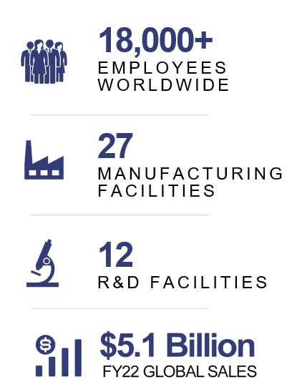
Copeland: One Global Business
Europe
Employees ~1,500
Mfg. Sites 5
R&D Sites 5
Americas
Employees. ~12,000
Mfg. Sites 17
R&D Sites 4
AMEA
Employees ~4,500
Mfg. Sites 5
R&D Sites 3

Slide 6
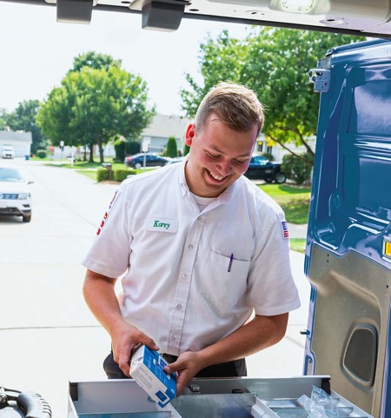
A Name Contractors Trust
OVER 100 YEARS of HVAC experience
MAJORITY OF RESIDENTIAL HVAC SYSTEMS feature Copeland parts
ONE IN FIVE HOMES in the U.S. has a Sensi or White-Rodgers thermostat
LARGEST MANUFACTURER of gas valves in North America

Slide 7
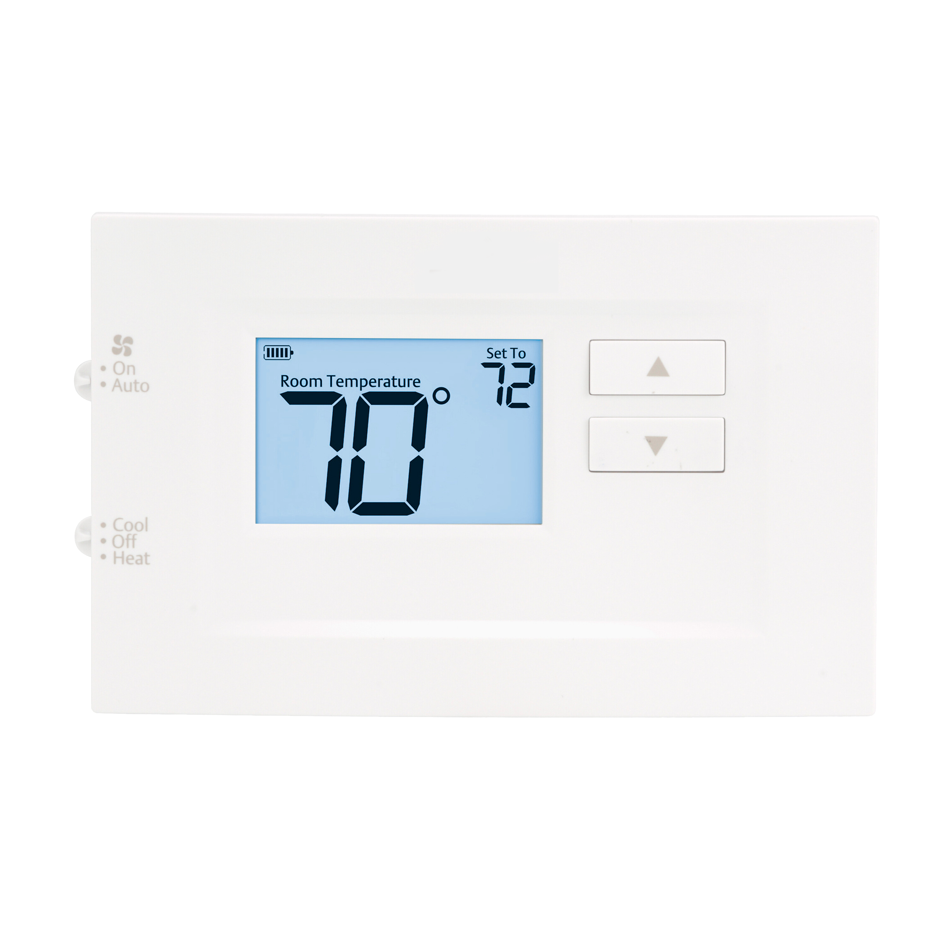
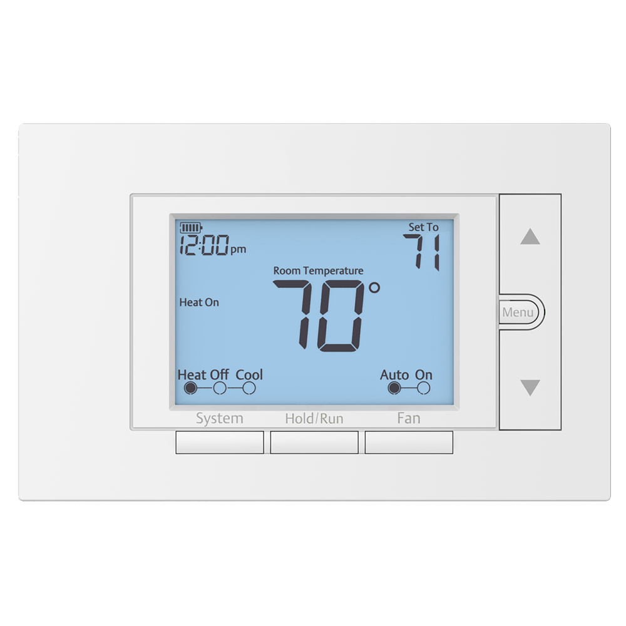
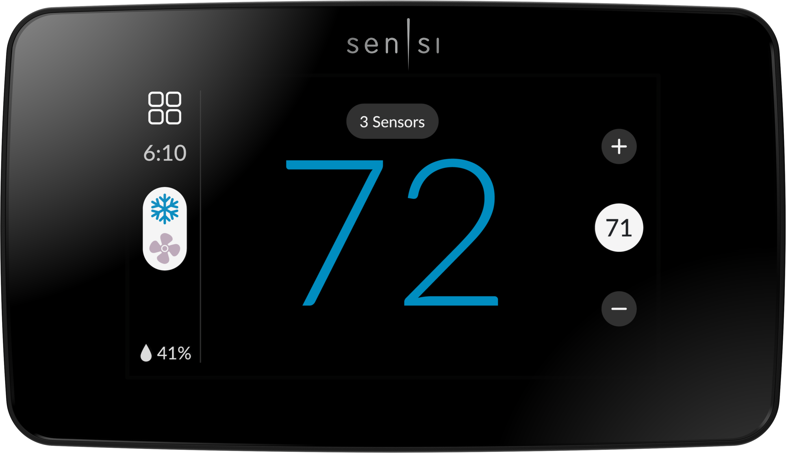
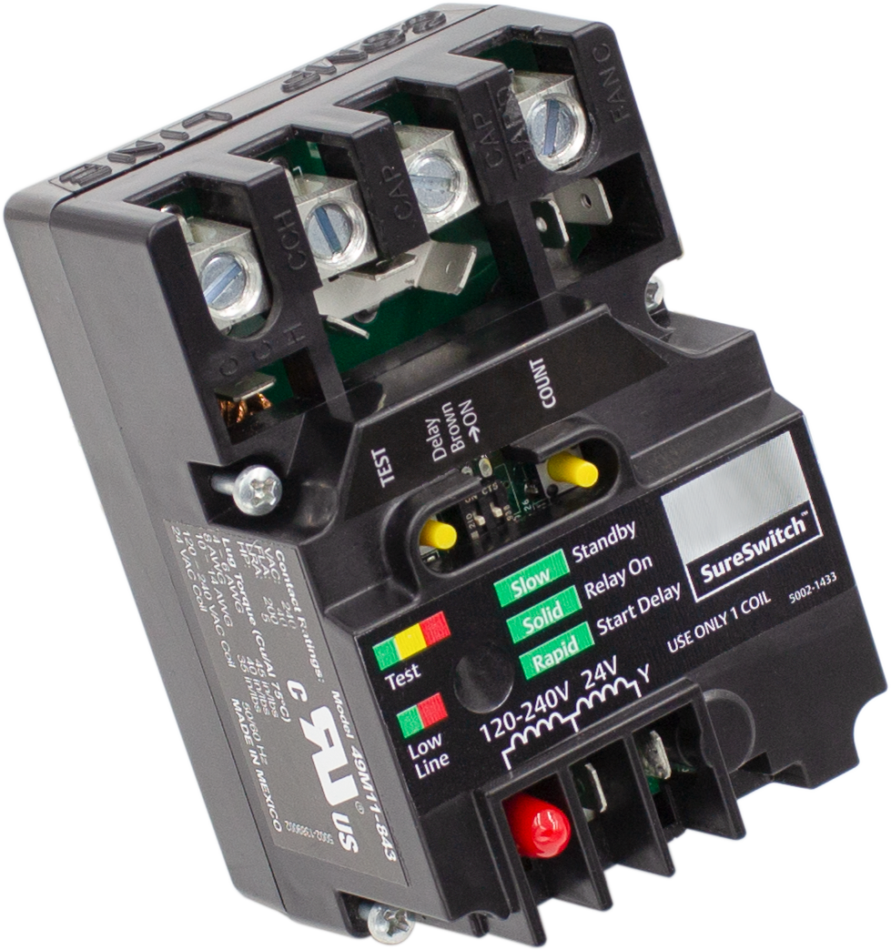
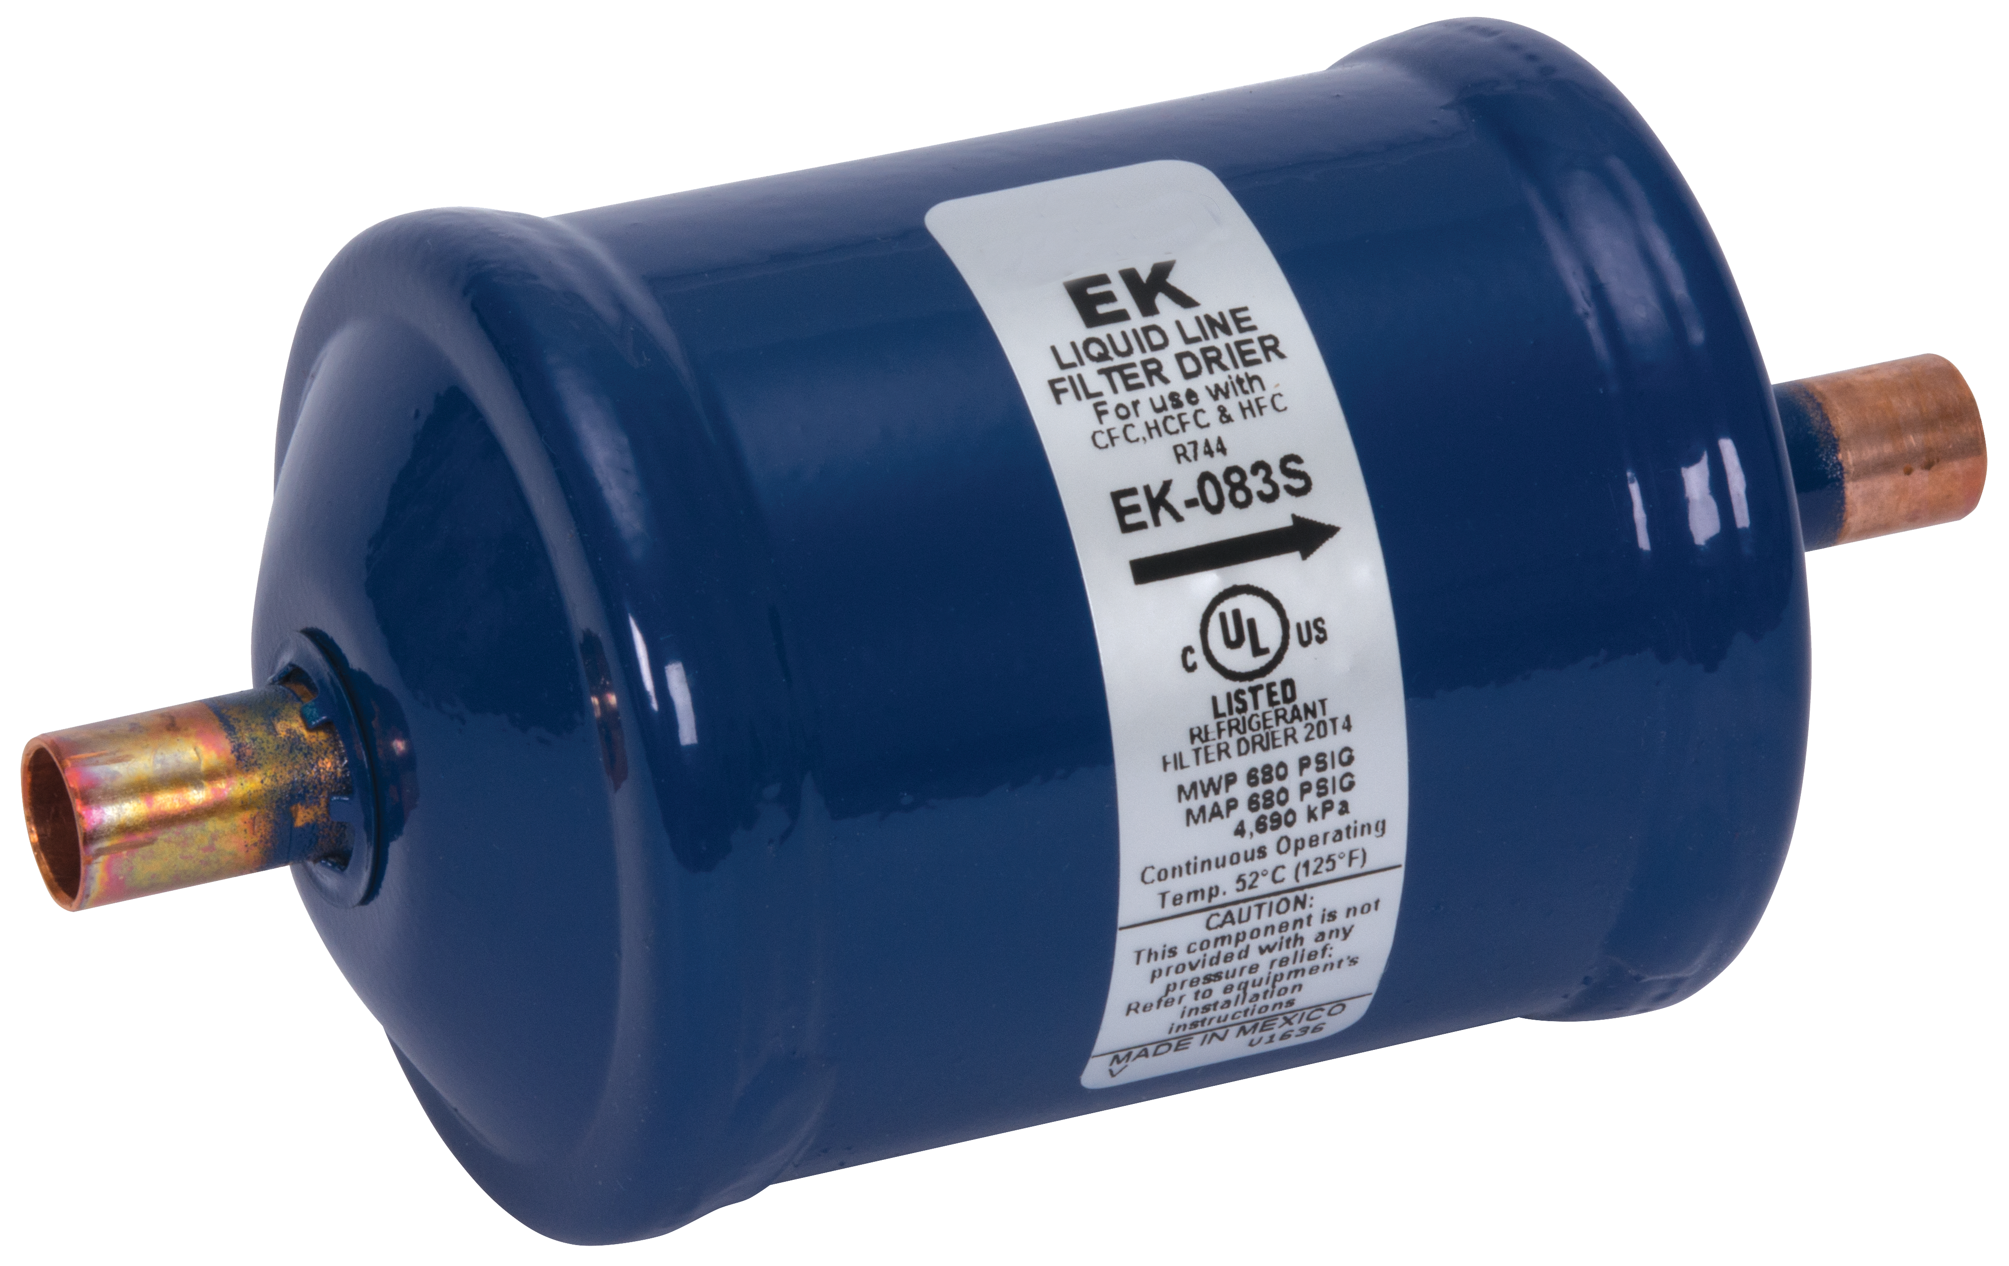
Offering a Strong Portfolio of HVAC Products
THERMOSTAT
Traditional Thermostats
Smart Thermostats
AIR CONDITIONER
HEAT PUMP
SureSwitch Contactor
Heat Pump Defrost Control
TXV Thermal Expansion Valves
Filter Driers
FURNACE
CLOTHES DRYER
WATER HEATER
Integrated
Furnace Control
Gas Valve
Ignitors & Flame Sensors
NGA Control
25M Gas Valve

Slide 8
Universal Controls
Cover more applications with fewer controls

Slide 9
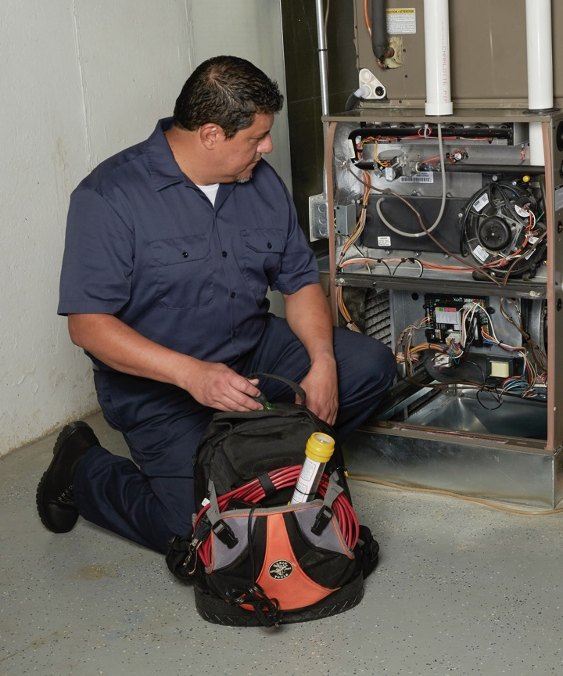
Meet All of Your Customers Needs
Parts designed for multiple OEM applications
Footprint
Mounting
Wiring
Setup
Increase productivity & profitability
Reduce truck stock
Cover more applications with fewer controls
Eliminate extra trips
Serve more customers

Slide 10
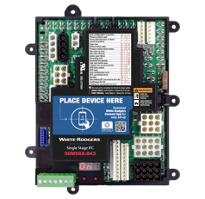
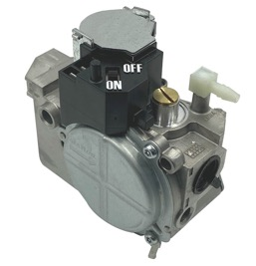
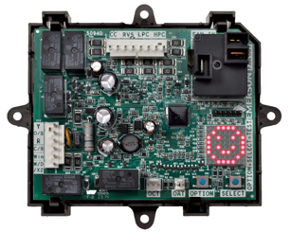
Universal Control Overview
Have the right part at the right time
Heating
Replace thousands of part numbers
Cooling / Heat Pumps
Replace most applications regardless of manufacturer
Thermostats
Replace most low voltage models
Ignitors & Flame Sensors
Integrated Furnace Controls
Ignition Modules
Electronic Fan Timer
Gas Valves
Contactors
Filter Driers
Thermostatics Expansion Valves
Defrost Control
Temperature Control
Touch screen
Wi-Fi compatible
Programmable/non-programmable
Various price points

Slide 11
Over Twice As Many Cross References As Resideo
WHITE-RODGERS |  |  | RESIDEO / HONEYWELL
MODEL NUMBER | DESCRIPTION | X-REFS | PART NUMBER | DESCRIPTION | X-REFS
50M56X-843 | 1-Stage IFC PSC/ECMx 80V/120V | 550+ | S9200U 1000 | IFC PSC 120V | 204
50E47U-843 | Hot Surface Ignition Module | 325+ | S8910U 3000 | Hot Surface Ignition Module | 107
21M51U-843 | 2-stage IFC PSC 80V/120V | 92 | — | — | —
21V51U-843 | 2-stage IFC Variable Speed 80V/120V | 59 | — | — | —
50D50U-843 | All-Spark™ IP/DSI Module | 1020 | S8610U 3009 | IP Module | 457
50I56D-905 | Intelligent Valve Retrofit Kit | 53 | SV9501 M2528 & SV9502 H2522 | SmartValve™ | 18
50F06-843 | Electronic Fan Timer | 162 | ST9120U 1011 | Electronic Fan Timer | 49
21D64-44 | HotRod™ EX Ignitor | 278 | Q3200U 1004 | Glowfly Ignitor | 114
790-843A1 | Flame Sensor | 159 | — | — | —
47D01U-843 | Defrost Control | 438 | DB7110U 1000 | Defrost Control | 264
49M11-843 | SureSwitch™ Multivolt Contactor | 362 | — | — | —
— | — | — | Y8610U 6006 | Standing Pilot Retrofit | —
— | — | — | R7284U 1004 | Oil Primary | 70
WHITE-RODGERS
TOTAL: 3,498+
CROSS REFERENCES
HONEYWELL/RESIDIO
TOTAL: 1,283+
CROSS REFERENCES

Slide 12
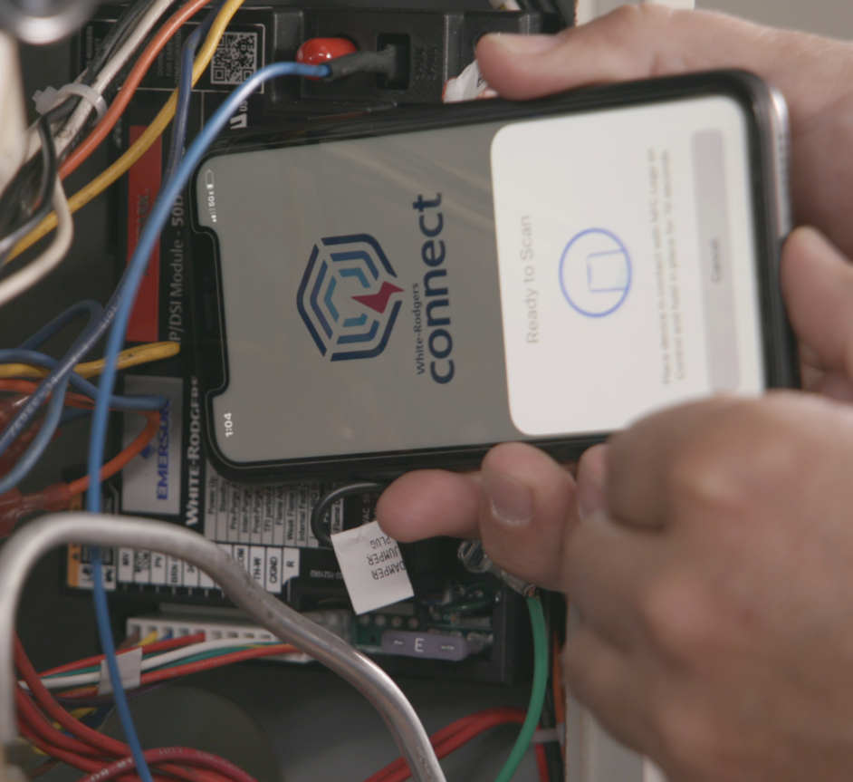
White-Rodgers Heating Controls
Trusted by more OEMs

Slide 13
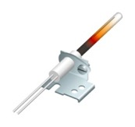
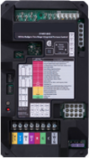
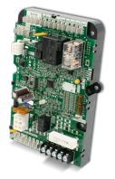
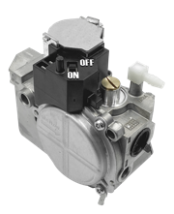
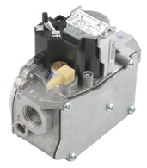
Heating Controls
Category
Products
Ignition Controls & Modules
Integrated Furnace Controls
Integrated Commercial TRU & Package Unit Ignition
Non-Integrated Ignition Modules
Non-Integrated Commercial RTU & Package Unit Ignition
Gas Valves
36C Series
36G/J Series
36 H Series
Gas Pilot Safety, Fireplace Valves
Hot Surface Ignitors
Universal Nitride Upgrade Ignitor Kits
120v Hot Surface Ignitors
80v Hot Surface Ignitors
Flame Sensors
Universal Flame Sensors
Direct Replacement Flame Sensors
Fan & Limit Controls
Electronic Fan Timer
Plenum Mount Fan & Limit Controls
Fan Coil

Slide 14
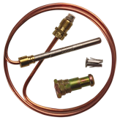
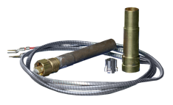
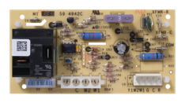
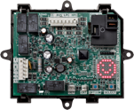
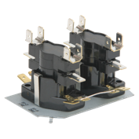
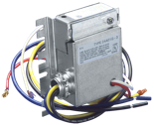
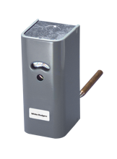
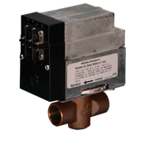
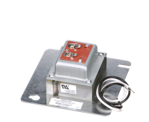
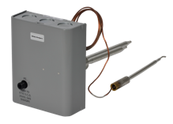
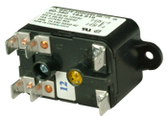
Heating Controls (continued)
Category
Products
Standing Pilot Thermocouples & Generators
Standing Pilot Thermocouples
Standing Pilot Generators
Standing Pilot Generators & Pilot Burners
Outdoor Condenser, Heat Pump & Air Handler Controls
AC or Heat Pump Controls
Heat Pump Defrost Controls
Air Handler Controls
Electric Heat Sequencers & Level-Temperature Controls
Electric Heat Sequencers
Electric Heat Level – Temp Controls
Hydronic Zone Valves & Temperature Controls
Hydronic Zone Valves
Hydronic Temperature Controls
Hydroniz Zone Valve Change – Over Switches
Water Heater Controls
Gas Water Heater Controls
Electric Water Heater Controls
Electric Water Heater Thermostats & Limits
Relays & Transformers
Relays
Transformers

Slide 15
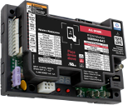
Offering the Widest Range of Universal & Direct OEM Replacement Furnace Controls
Universal controls designed to replace thousands of part numbers
Direct OEM
replacements
Maximum cross references
Simple installation
Training & installation videos
Easy access to cross reference & product information with White-Rodgers Mobile
Match OEM mounting & wiring for drop in replacement
Designed with features to maximize applications

Slide 16
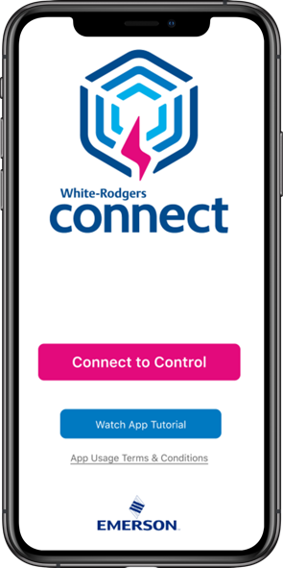
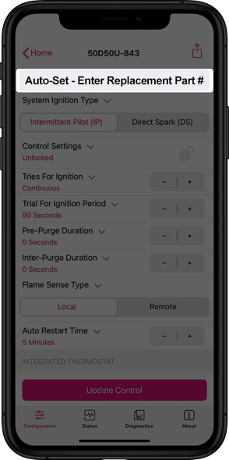
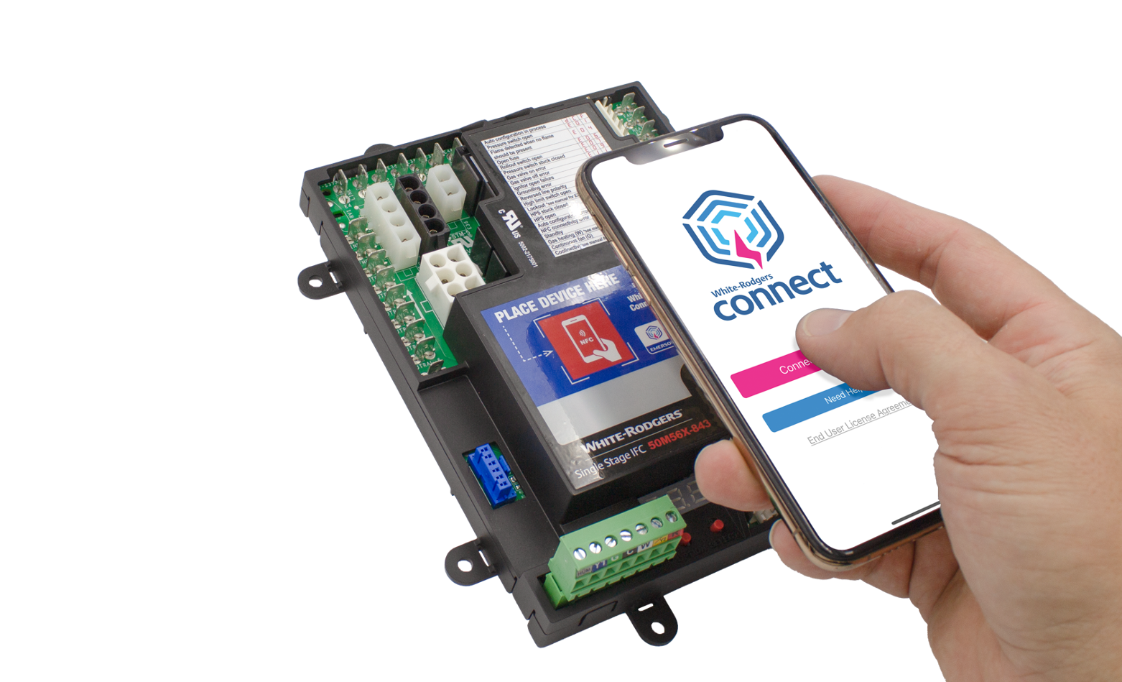
White-Rodgers Connect App Speeds Up Installs
Configure, Diagnose, Troubleshoot from your smartphone
Near-field communication (NFC) allows your mobile device to communicate with a compatible White-Rodgers control.
Quick configuration without power, prior to install
Configure using preloaded OEM settings or customize module configurations
Diagnose fault codes & troubleshoot confidently
View status & details about the control
No-Wi-Fi or login required
For more info visit Copeland.com/WRConnect

Slide 17
Integrated Furnace Control
Simple configuration and diagnostics with White-Rodgers Connect
Universal Single Stage Furnace Control 50M56x-843
Replaces over 550 part numbers ​​for both PSC & ECMx blower motors
Direct plug-in of OEM harnesses, no additional harnesses required​​
120v HotRod Ignitor included for upgrading 80v applications
Digital display provides alternate method to configure & diagnose
Detachable thermostat bus connector for easy wiring
Flame current readout on digital display or use of test pins​​

Slide 18
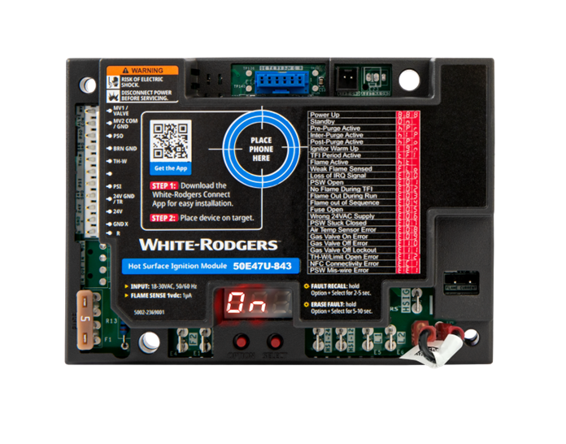
Universal Non- Integrated Ignition Modules
Simple configuration and diagnostics with WR Connect
Universal Hot Surface Ignition Module 50E47U-843
All-Spark Ignition Module 50D50U-843
Replaces over 325 HSI part numbers that us 24V, 120V or 240V ignitors
Controls an inducer motor and monitors a pressure switch
Replaces over 1,000 part numbers for intermittent pilot & direct spark ignition
Rajah & spade spark terminals on-board eliminate the need for an external adapter
Ignition Module Features
Transfer control wiring before removing the existing control with the easy-install harness
Applications include pool heaters, water heaters, unit heaters, gas furnaces, boilers, cooking equipment, laundry equipment, infrared heaters
Digital display provides alternate method to configure, diagnose and check real-time operation status & flame current(50E47U-843 only)
Use F67-8535 to maintain temperature without an external thermostat for infrared & tube heaters

Slide 19
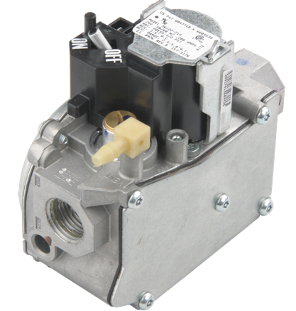
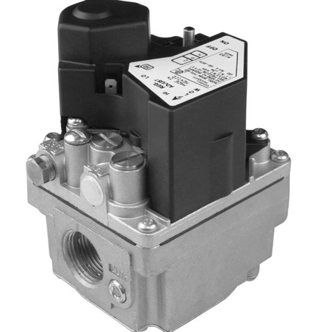
Our Gas Valves Are Trusted by More OEMs
Largest Manufacturer of gas values in North America
Easy installation
Quick connect spade terminals
LP conversion kit (most models)
Reducer bushing kit (most models)
36G/J Series - Replaces 95% of residential furnaces made in the last 18 years
36H Series - Designed for commercial HSI/DSI/IP systems

Slide 20
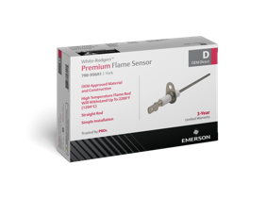
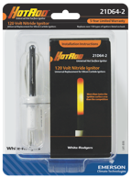
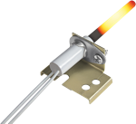
Universal Ignitors & Flame Sensors
Direct OEM drop-in replacements also available
Universal HotRod Ignitors 21D64-2, 21D64-44
Universal Flame Sensor 790-843A1
Replaces over 270 part numbers ​
Includes mounting brackets & ceramic wire nuts
Upgrade from silicon carbide for longer life & fewer callbacks
5-year limited warranty
Available in a 5-pack
Bend and or cut to replace over 150 part numbers ​
Protective sleeve included with detailed bend instructions
High temperature rod withstands 2,200ºF
30” lead wire with ¼” & 3/16” quick connects
3-year limited warranty
Available in a 5-pack

Slide 21
Cooling Controls
Reliable system protection and control for residential, commercial & refrigeration applications

Slide 22
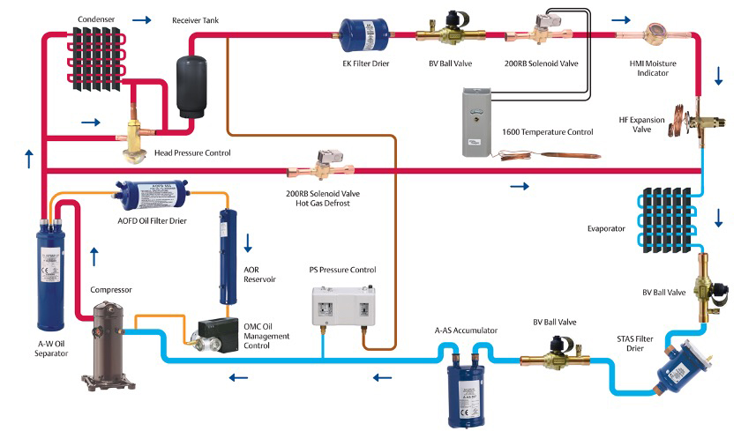
Offering a Broad Portfolio of Air Conditioning and Refrigeration Products
A glimpse of how White-Rodgers products fit into the refrigeration cycle

Slide 23
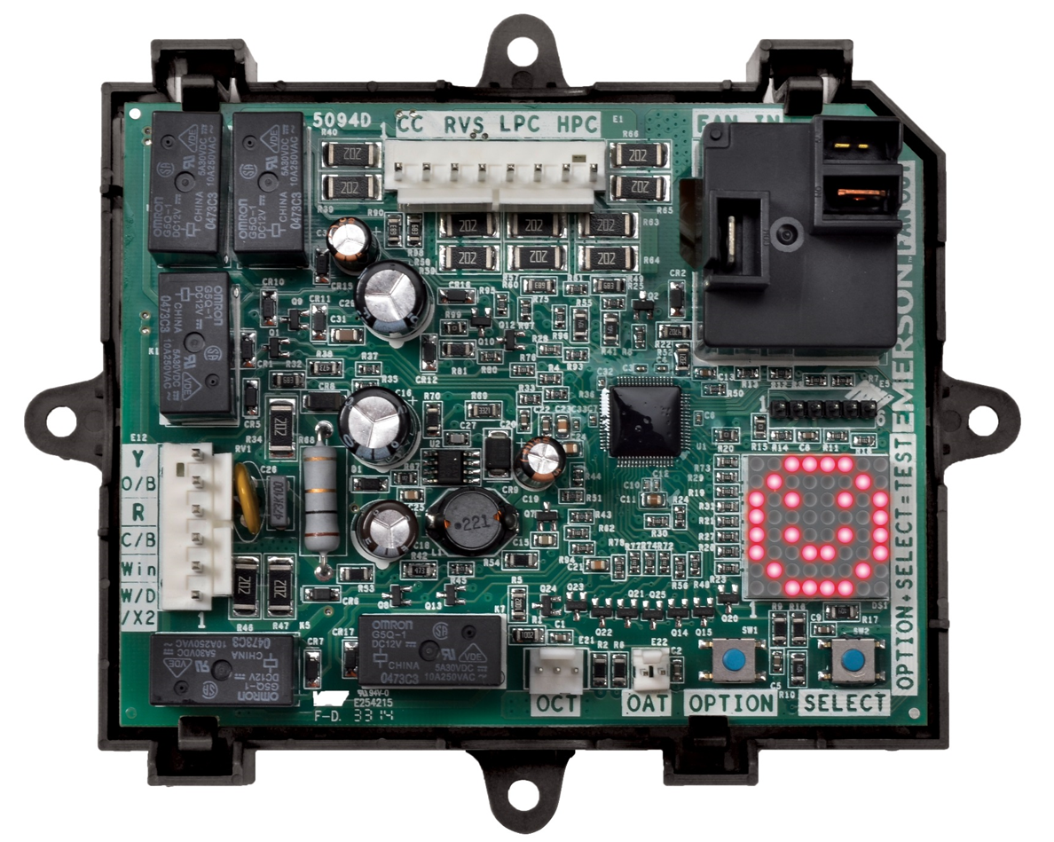
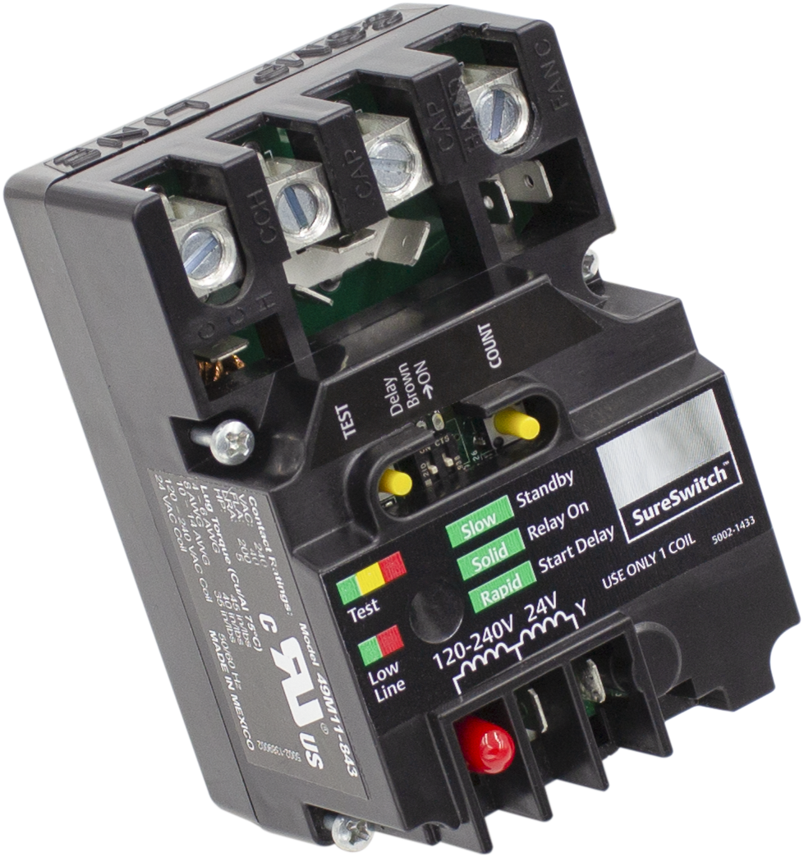
Universal Air Conditioning & Heat Pump Products
Universal Heat Pump Defrost Control 47D01U-843
Replaces over 400 part numbers
Selectable demand or timed defrost modes for greater efficiency
Integrated thermostat provides energy and cost savings
Brownout and short cycle protection
1-year limited warranty
SureSwitchTM Multi-Volt Contactor 49M11-843
Replaces most single-phase contactors
Services air conditioning and refrigeration applications for 24/120/208/240V coils
5X the life of traditional contactors, 1M+ cycles
Totally sealed switch keeps out ants, pests and debris
5-year limited warranty

Slide 24
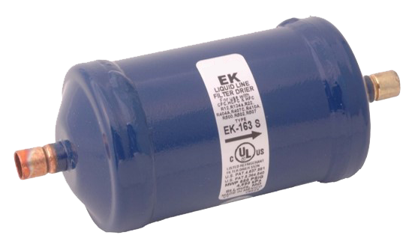
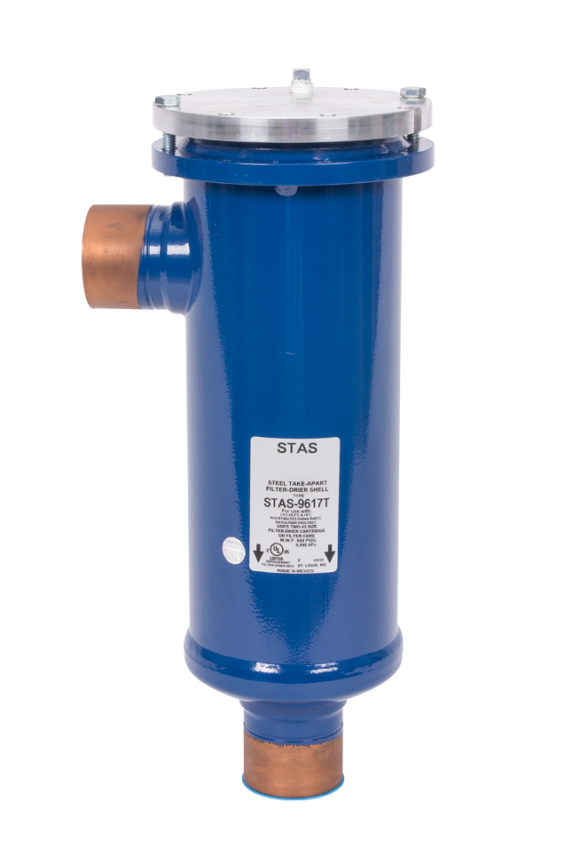
Filter Driers to Fit Any Application – Liquid Line
Take-Apart Filter Driers - Shells
Hermetic Filter Driers – Liquid Line
STAS Series
Steel Shell and internals for liquid or suction line
Uses 48 cubic inch cores
EK Series (premium) & BSL Series (Economical)
20-micron filtration
Compacted bead construction
ADKS Series
Steel Shell and plastic internals for liquid or suction line
Uses 100 cubic inch cores
CU Series Spun Copper
All copper construction for extreme corrosion resistance
100% molecular sieve solid core drier
BTAS Series
Brass Shell for corrosion resistance in suction line
Uses filter or filter-drier cartridges
Cores
H48 & UK48 (premium)
For STAS and competitive models
H100 & UK 100 (premium)
For ADKS and competitive models
A*F & A*F-D
For BTAS and competitive models
Bi-Directional Heat Pump
BFK Series (premium) &
BSB Series (Economical)
40-micron filtration
Solid core construction

Slide 25
Filter Driers to Fit Any Application – Suction Line
Suction Line Filter Driers
Usually installed in the field after a compressor failure or for systems with higher contamination levels
They have a larger diameter shell to reduce pressure drop & can incorporate a shorter lay-in length
Compacted Bead
ASD series
Premium suction line filter drier
Optimized for high moisture and acid protection
Compacted Bead
CSFD series
Good for moisture & acid removal
Small layin or ‘pancake’ design, available only in 14 cubic inch sizes
Compacted Bead
SFD series
Standard Suction Line Filter Drier
Smaller lay in length, available in a variety of sizes
Compacted Bead
ASK Series
Activated carbon blend for moisture, acid and wax removal
Available in 16 and 30 cubic inch sizes

Slide 26
Moisture Indicators/Sight Glasses
HMI Series
Hermetic, leak-free construction
Senses to 3% relative humidity
Large viewing lens, ease of monitoring
Solid copper connections, all brass body
AMI Series
Take-apart, replaceable lens assembly
Senses to 3% relative humidity
Large viewing lens, ease of monitoring
Solid copper connections, all brass body
A-IHL Series
Take-apart, replaceable lens assembly
Senses to 3% relative humidity
Saddle design for large diameter tubing
Solid copper connections, all brass body

Slide 27
Expansion Valves for Residential, Commercial & Refrigeration
Emerson Valve Series | Field Serviceable | Tonnage (R-404A) | Tonnage (R-410A)
A | No | 1/8 to 3 | 1 to 5
NXT | No | n/a | ½ to 15
HF | Yes | 1/8 to 10 | n/a
TRAE | Yes | 14 to 35 | n/a
TX7 | No | n/a | 20 to 50
Univeresal TXV Connect Kits for residential AC & Head Pumps
ODF TXV with internal check, Chatleff & Aeroquip adapters, external equalizer connection and bulb strap
Universal kits that fit residential systems regardless of manufacturer
R-410A & R-22 kits in multiple capacities

Slide 28
Electronic Expansion Valves
EXD-SH1, EXD-SH2 Controllers and kits
Designed for precise superheadt control or temperature control for EX valves
EXD-SH1K and EXD-SH2K Kits contain all necessary components to operate
Other function include low pressure switch and freeze protection
EX Valves are multi-functional
Expansion Device
Defrost Control
Head Pressure Control
Suction Gas Throttling
Linear with precise flow control
Short opening/closing time
Patented ceramic slide and orifice
PM Series are Pulse Width Modulating Expansion Valves
Gate-type, direct acting with six fixed-capacity sizes
Positive shut-off function eliminates need for solenoid valve
Typical applications include:
Display cases
Frozen beverage dispensers

Slide 29
Refrigeration Temperature Controls for Electronic or Hydraulic Applications
16E09-101
Electronic
Refrigeration or Heating
1609-101
Electro-Mechanical
Refrigeration
Application
Convenience store
Supermarket display case
Pump control
Freezer control
Boiler control
Walk-in cooler
Space and return-air temperature
Reach-in cooler
Condenser fan cycling

Slide 30
Refrigeration Solenoid Valves & Coils
 | OPERATION |  | TWO TYPES
Valve Series | Normally Closed | Normally Open | Direct Acting | Pilot Operated | Design | Optional Mounting Stud or Manual Stem | MWP (PSIG)
100RB | x |  | x |  | Piston |  | 500
200RB | x |  |  | x | Piston | x | 680
250RA | x |  |  | x | Diaphragm | x | 680
500RB |  | x |  | x | Piston |  | 680
540RA |  | x |  | x | Diaphragm | x | 500
AM Series coils fit all valve series and sizes
Snap-on coil design for easy installation
Valves with extended copper ends for easy installation
Emerson Valve Series | Field Serviceable | Tonnage (R-404A) | Tonnage (R-410A)
A | No | 1/8 to 3 | 1 to 5
NXT | No | n/a | ½ to 15
HF | Yes | 1/8 to 10 | n/a
TRAE | Yes | 14 to 35 | n/a
TX7 | No | n/a | 20 to 50
200RB with Coil
250RA with Coil

Slide 31
Shut-off Valves
Ball Valves
ACK Check Valves
BVSS Series
Brass locking seal caps
All are fully ported
Standard lay-in length
Hermetic, forged brass body
Up to 3-1/8” line and port sizes
Hermetic Spun-copper design
Magnetic check action
Built-in 30 mesh strainer
Can be installed in any position
Connections from ¼” through 2-5/8”
BE & BVS Series
Valve Stem cap retained by strap
Fully ported through 2” size
Mounting holes
Hermetic, forged Brass Body
Approved for CO2 and Propane

Slide 32
Other Vessels
Oil Separators
Separates the oil from the refrigerant
Oil Reservoirs
Holding vessel for necessary oil
ADR Series
2,3,4 gallon models available
Suction Line Accumulators
Prevents liquid refrigerant from slugging the compressor
A-F, A-W, A-WZ Series
Hermetic or bolted flange models
Supermarket racks and commercial a/c
A-AS Series
3 thru 6 inch diameter models
6 thru 6 inch diameter models
½ “ to 1-5/8” connections
Hold up to 25 tons of R-404A
A-Fc & A-WC Series
Hermetic or bolted flange models
Centrifugal for ultra-low temps

Slide 33
Oil Controls
Oil Level Controls
Maintains proper oil levels in the compressor crankcase
Oil Filters & Driers
Designed to specifically clean the oil line.
OMB/C Series
Electronic control with alarm
Compressor lockout feature
Magnet for debris retention
W-OLC Series
Mechanical oil control
Three models with sight glass options
AOF Series
AOF
Hermetic, filter only
AOF -23S
Take-apart shell
Uses a F023 filter cartridge
AOFD 553 Series
Contrains soild core desiccant for moisture removal

Slide 34
Thermostats
A trusted name offering reliable control and cutting-edge innovation

Slide 35
Thermostats to Meet All Your Customer’s Needs
Model | 70 Series™ Thermostats | 80 Series™ Thermostats | Sensi™ Smart Thermostats
Number of Models | 6 | 8 | 4
Program Options | Programmable/Non-Programmable | Programmable/Non-Programmable | Programmable
Single Stage/Heat Pump/PTAC | Single Stage/Heat Pump/PTAC | Universal/Single Stage/Heat Pump | Universal/Multi-Stage
Wi-Fi Connectivity | - | -
Cost | $ | $$ | $$-$$$

Slide 36
Turn Jobs Quicker with Easy Installation
Traditional thermostats install in as little as 5 minutes
Smart thermostats in stall in as little as 30 minutes
Compatible with majority of residential HVAC systems
Built in bubble level (on some models)
Standard footprint eliminates the need for patching/painting
No C-Wire requires with Sensi Lite and Sensi Smart Thermostat

Slide 37
Top-Rated Thermostats Reduce Callbacks
Traditional Thermostats
Simple user experience
Large easy-to-read numbers
Smart Thermostats
Top-rated online
#1 rated mobile app in both Android and Apple Stores
4.6 stars, 66k reviews
4.5 stars, 6k reviews

Slide 38
Stay Top of Mind with Free Contractor Branding
Printed Branding
Digital Branding
Free printing on all thermostats with orders of 12+ (excluding Sensi Lite & Touch 2)
Add full-color logo or custom text
Free shipping
With Sensi smart thermostats, add contractor’s information on the following locations:
Thermostat home screen
Mobile app
Monthly usage report

Slide 39
Meet Sensi
Thermostats
Model | Sensi Lite Smart Thermostat 1F76U-22WFB | Sensi Smart Thermostat 1F87U-42WF | Sensi Touch 2 Smart Thermostat 1F96U-42WFB (Black) 1F96U-42WF (White)
Screen Type/Size | LCD/2.25" | LCD/3.4" | Color Touchscreen/4.3"
System Type | 2H/1C or 1H/2C | 4H/2C | 4H/2C
C-Wire Not Required¹
Works with Sensi Room Sensors
Dedicated Accessory Terminals
Mobile App | iOS, Android | iOS, Android | iOS, Android
Smart Home Compatibility | Alexa, Google, SmartThings | Alexa, Homekit, Google, SmartThings | Alexa, Google, SmartThings
Wi-Fi Network Compatibility | 2.4GHz | 2.4GHz | 2.4GHz 5GHz
Contractor Branding | Digital | Digital + Printed | Digital
PRO Warranty | 5 years | 5 years | 5 years

Slide 40
Save Energy with Smart Thermostats
All Sensi smart thermostats are ENERGY STAR® certified
Save about 23% on HVAC energy by adjusting the temperature, using flexible scheduling, remote access and geofencing¹
First smart thermostat to win the ENERGY STAR Partner of the Year
1 Energy savings calculated by comparing operation time for a nationwide sample of Sensi users with temperature adjustments averaging 4° vs. users with no adjustments. Savings vary based on equipment type/condition, insulation, climate & temperature adjustment size/frequency.

Slide 41
Sensi Multiple Thermostat Manager – A Lightweight Building Management System
Simple & Affordable
Easy setup process to manage comfort at a much
lower cost than traditional building management systems
Extensive Compatibility
Works with HVAC systems in most facilities
Easy-To-Use Portal
Access thermostat control from anywhere through the intuitive portal featuring drag-and-drop functionality
Energy Saving Feature
Flexible batch scheduling can minimize energy waste and hep you save money
Smart Alerts
Enable optional notifications that let you know when and where extreme temperature or humidity changes are detected

Slide 42
Eliminating Consumer Data Privacy Concerns
Sensi’s privacy promised to our customers:
Sensi DOES NOT SELL your personal information
Sensi DOES NOT UTILIZE your thermostat activity data for other targeting/advertising purposes
Sensi DOES NOT MAKE CHANGES to your thermostat based on assuptions about your priorities

Slide 43
Additional Support

Slide 44
Additional Support to Help Drive Sales
 | NATE-Certified Product Training
 | Comprehensive Cross Reference
 | Product Information Management (PIM)
 | Printed Merchandise
 | Contractor Rewards
 | Technical Product Support

Slide 45
Free NATE-Certified Training
NATE-certified courses for ongoing education credits
Online, webinar and in-person training options
Gain expertise on the latest products from Emerson
View installation, technical and product modules for Thermostats, Heating, AC, Heat Pump & Refrigeration
Benefits for all departments including sales, installation and service
Access Training Modules HERE

Slide 46
Comprehensive Cross Reference & Product Information
Search by OEM, Competitor and White-Rodgers part numbers
Your resource for:
Complete cross reference
Product information and spec sheets
Installation information and videos
Wiring diagrams
Select product by features
Priority technical support
WR Mobile App
Search for “WR Mobile”
in both Apple and
Google Play Stores
Desktop Version
Access the online version HERE

Slide 47
Quickly Set Up New Products Through Our Online Digital Catalog
Access the most up-to-date product information and digital assets through our PIM (product information system).
Includes all wholesale part numbers
Search by part number or filter by product category or family
Product information includes descriptions, spec, features, weights, UPC and more
View online, export digital assets or export data via spreadsheets
Access Digital Catalog HERE
Password: WR-Confidential

Slide 48
Free Point-of-Sale Merchandise
Take advantage of our free printed marketing materials to help you drive sales.
Customizable fliers available for counter and training days
Laminated Counter
Reference Cards
Cross Reference Book
Posters
End Cap Displays
Product Display Box
Wobblers
Shelf Talkers

Slide 49
Contractor Rewards – Build Loyalty With Your Customers
Easy. Rewarding. Free.
Contractors can sign up to participate in this free rewards program
Contractors upload invoices of participating programs for points
Contractors redeem points for products or gifts
Build contractor loyalty by bulk uploading purchases for contractors (speak to your sales rep about participating)
Learn more about Contractor Rewards and join now

Slide 50
A Product Expert is Just A Click or Call Away
Our customer support team is ready to help answer any technical or support questions that you may have.
White-Rodgers
1-888-725-9797
wr.wholesale.mail@emerson.com
Sensi Smart Thermostat
1-888-605-7131
support@sensicomfort.com

Slide 51
Your Sales Support Team
Dedicated to helping you grow your business

Slide 52
Sales Support Team
Add Your
Photo
Here
Tim Hall
Chuck Hernandez
Territory Sales Manager
707-685-2211
Tim.hall@copeland.com
Regional Sales Manager
775-513-2045
chuck.hernandez@copeland.com

Slide 53
Sales Support Team
Add Your
Photo
Here
Name
Brian Cosens
Territory Sales Manager
XXX-XXX-XXXX
name@copeland.com
Regional Sales Manager
443-239-7510
brian.cosens@copeland.com

Slide 54
Sales Support Team
Add Your
Photo
Here
Name
Joe Trimbach
Territory Sales Manager
XXX-XXX-XXXX
name@copeland.com
Regional Sales Manager
937-609-8635
joe.trimbach@copeland.com

Slide 55
Sales Support Team
Add Your
Photo
Here
Name
Brad Popejoy
Territory Sales Manager
XXX-XXX-XXXX
name@copeland.com
Regional Sales Manager
830-730-2814
brad.popejoy@copeland.com

Slide 56
Thank You
Explore our full product catalog to see how we can help grow your business.

