Slide 1
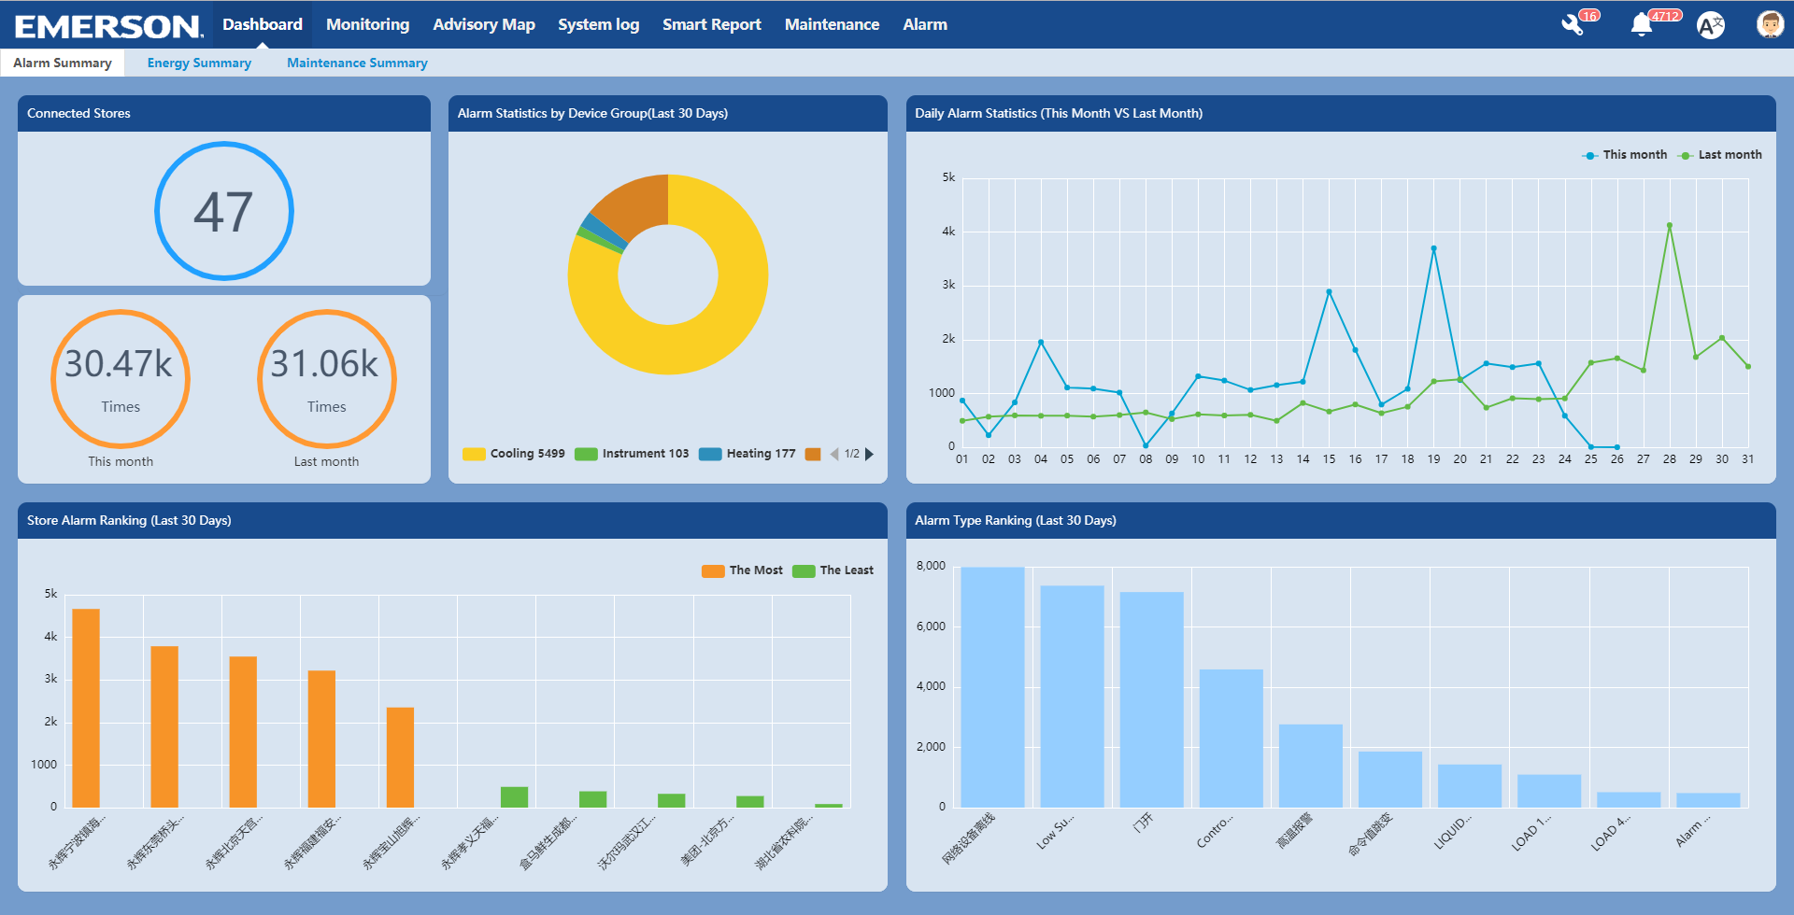
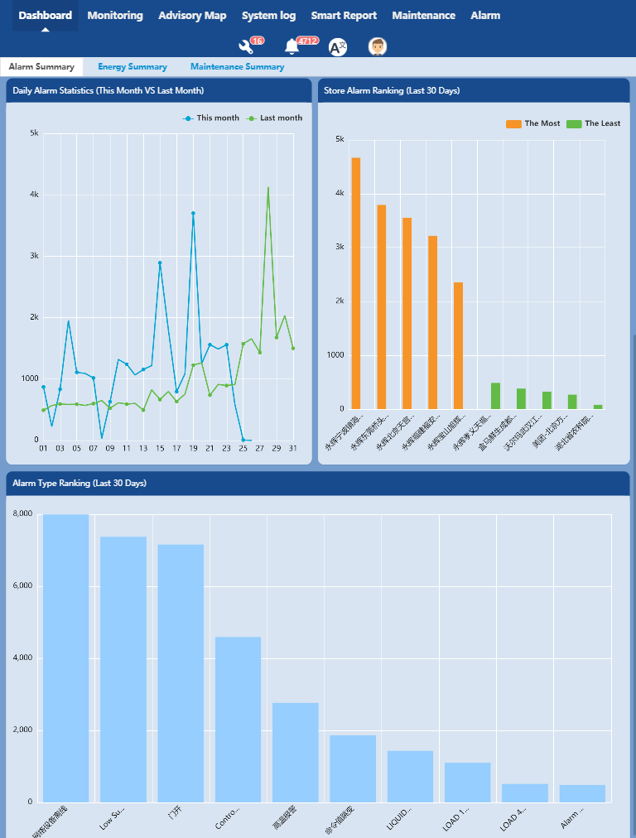
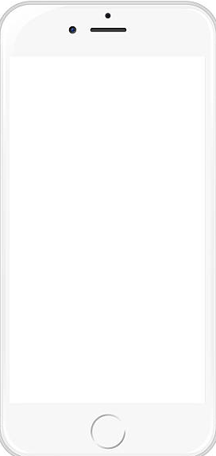
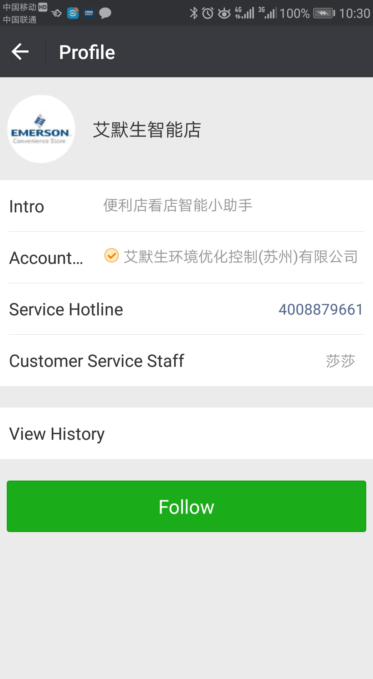
Emerson Smart Connect
Smart Connect & Smart Store - Cloud platform
Manage your sites from local to enterprise level

Slide 2
1
Smart Connect introduction
Smart Connect, an enterprise level software, provides centralized monitoring service for the devices in each store.
It is a cloud service, an integrated system and an optimal solution for store remote monitoring.
Smart Connect provides accurate data and real-time monitoring service remotely. Users are able to manage their sites/stores globally, check the equipment and devices inside the stores at anytime, anywhere.
General functions:
Customer benefits :
Supervisory systems centralized control
Multi-site data acquisition and analysis
Instant alarming and device exception reporting
Accurate and long time data record and statistic
Convenient and effective maintenance management
Dual Language support.
Reduce time and cost spending on store monitoring
Liberate store staff from redundant data processing work and focus more on customer satisfaction
Decline device downtime, keep food fresh and safe, reduce food loss, improve reputation and sales
Help make energy saving strategy easy and reduce energy consumption
1

Slide 3
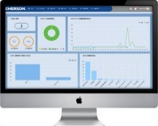
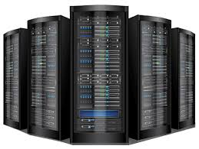
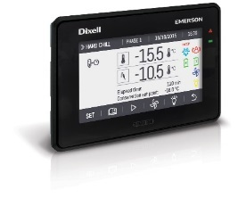
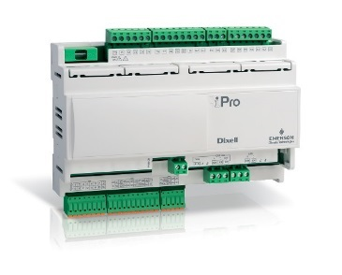
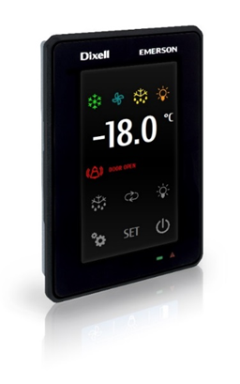
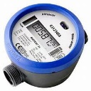
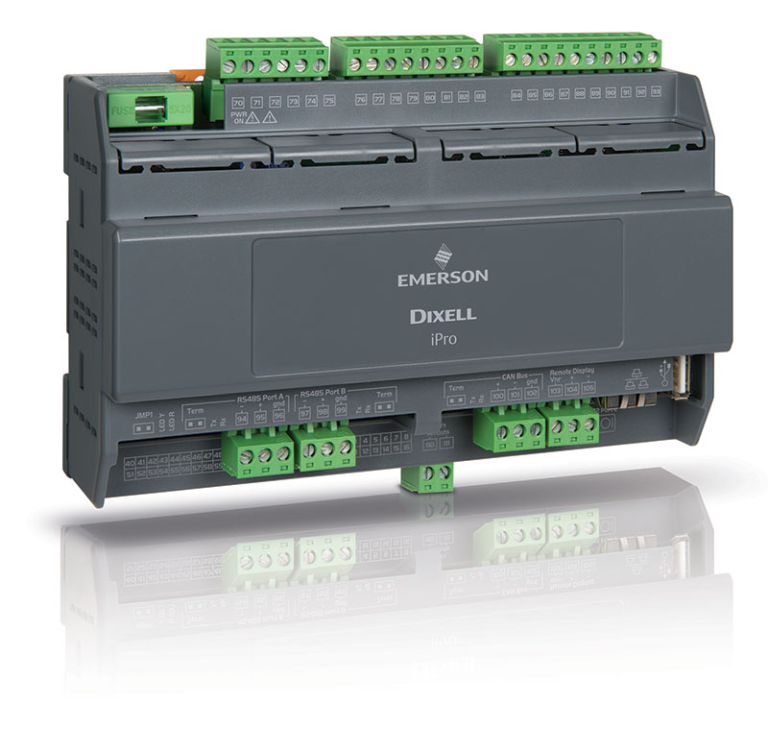
2
System Hierarchy
Global Level
Smart Connect Cloud Service
Smart Connect Web
Alarm
Maintenance
Monitoring
Smart Connect
Smart Reports
Energy
Map & Floor Plan
Enterprise level supervision & analysis
Smart Connect WeChat
Store Leve monitoring & maintenance
Smart Connect DB
Local Level
Store 1: XWEB
Store 2 : XWEB
Store …. : XWEBs
Electronic devices
Electronic devices
Electronic devices
2

Slide 4
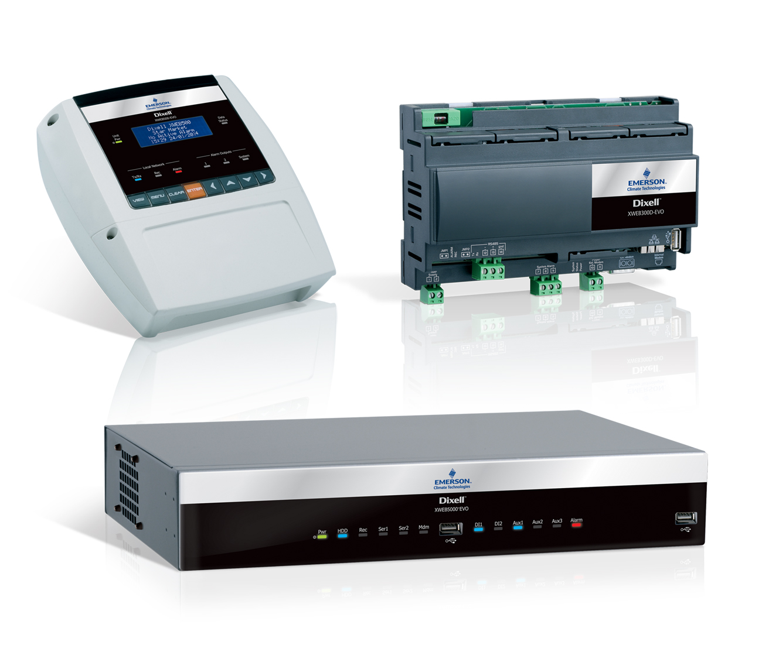
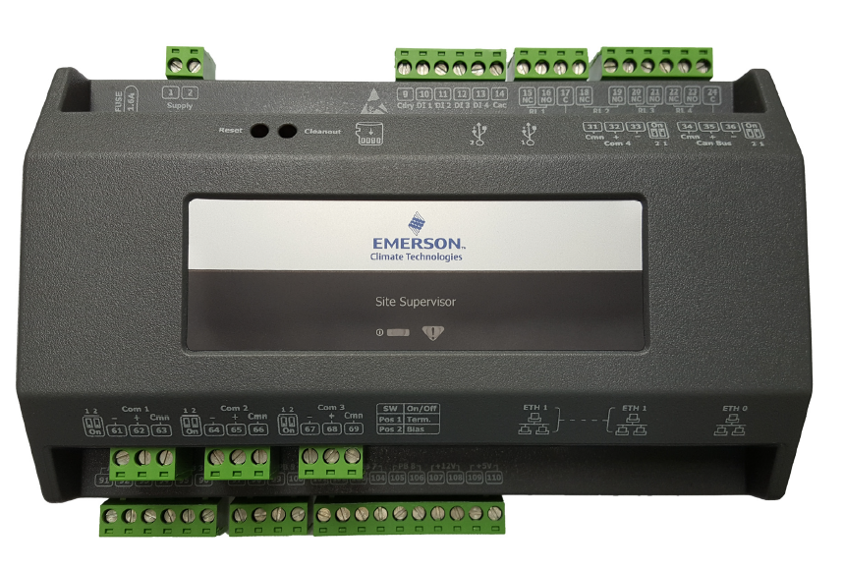
3
Integrated Supervisory Systems
X-WEB EVO series
Site supervisor
3

Slide 5
4
Smart Connect functions
Centralized Management
Real-time Monitoring
Energy Consumption Statistic
Connect stores from different places/regions on one platform.
Check, monitor and analyze store operating status in a convenient way globally
Check device status and track issues anytime and anywhere.
Extract accurate and real-time point value timely.
Get the precise energy cost of all stores’ devices
Analyze energy consumption trend by enterprise, store, device level etc.
Advisory Map & Floor plan
Advisory Notification
Maintenance Management
Locate alerting sites, quick indicate all exceptional stores and devices.
Intuitive floor plans make the device easy to recognize and discover
Receive alarm immediately once it occurs.
Find out potential issue and improvement points from alarm history
Find device issues and fault information in time .
Arrange maintenance plan, keep your device always in best condition
Smart Reports
Dual Language
Mobile Application
Design your own reports based on your demand.
Switch freely between English and Chinese
Monitor you device by opening the application on WeChat
3

Slide 6
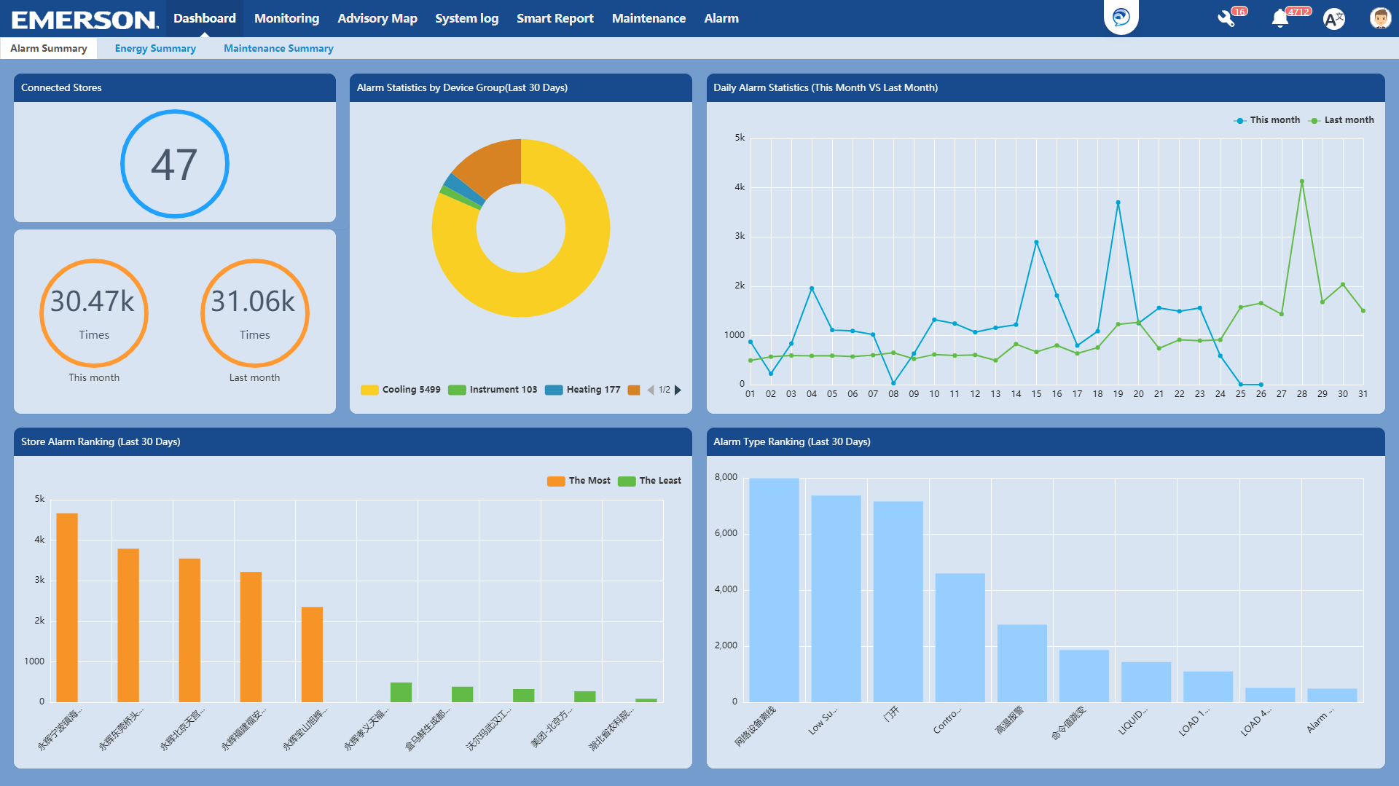
Centralized Management
All stores are connected to one platform which enables you to:
Overview and manage all your sites or stores centrally.
Monitor the real-time status of
each device globally.
Generate data summary for all stores or devices with Intuitive diagrams
From device level to store or even group level, assist users to compare and analyze the data that they are concerned with intuitive UI.
3

Slide 7
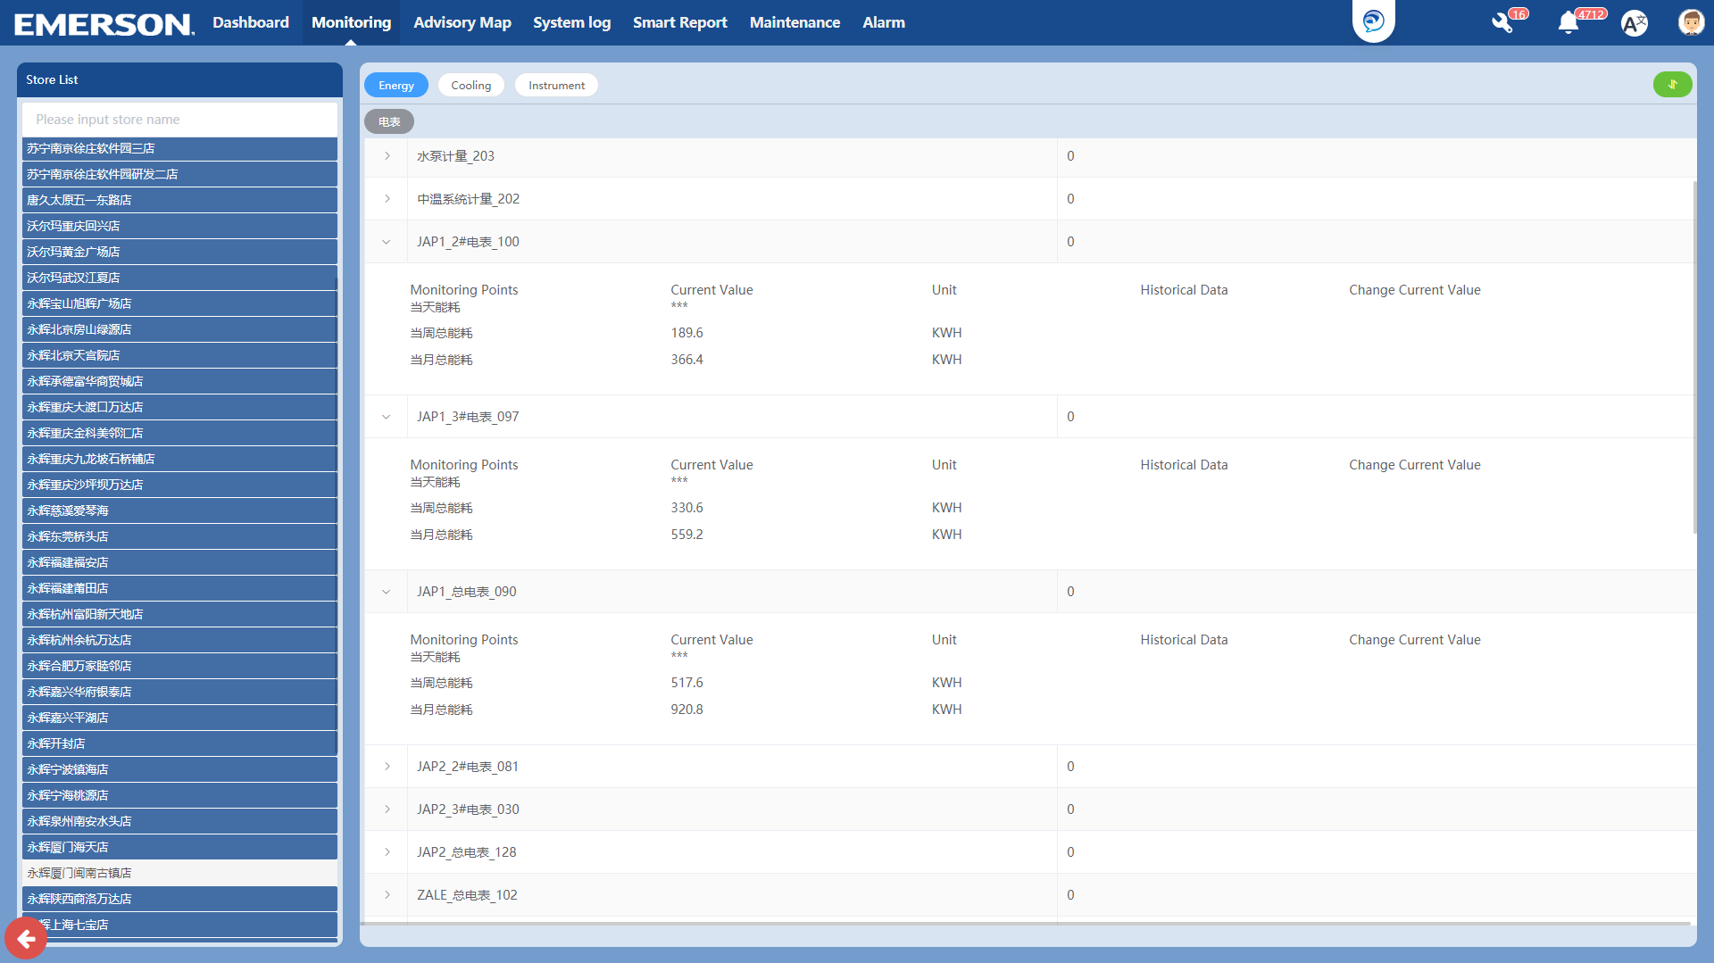
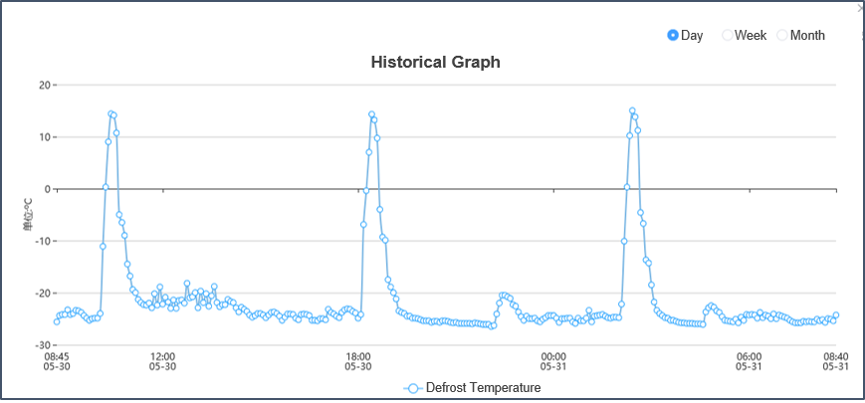
Real-time Monitoring
By integrating with all main control systems, all monitoring points can be checked on the platform instantly.
Check device’s detail of all stores by expanding the device group (Refrigeration equipment, Facility equipment, Heating equipment and Energy devices)
Viewing all the monitoring points such as current value ,set points, temperature etc.
Monitoring device’s real time value as well as its historical record
3

Slide 8
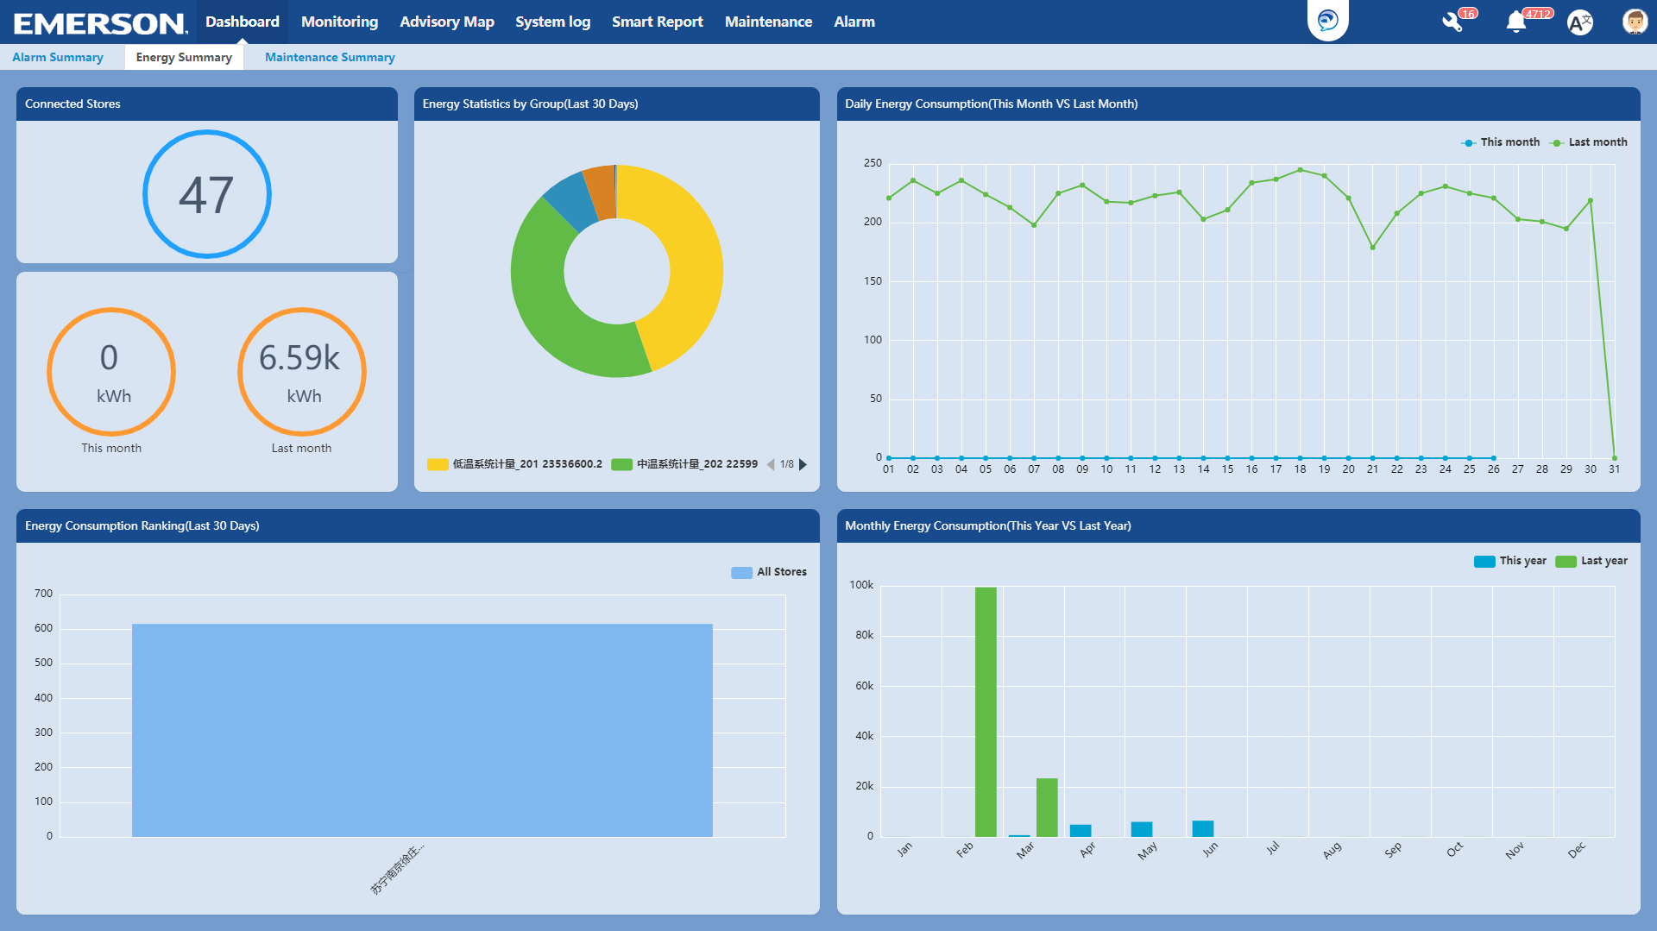
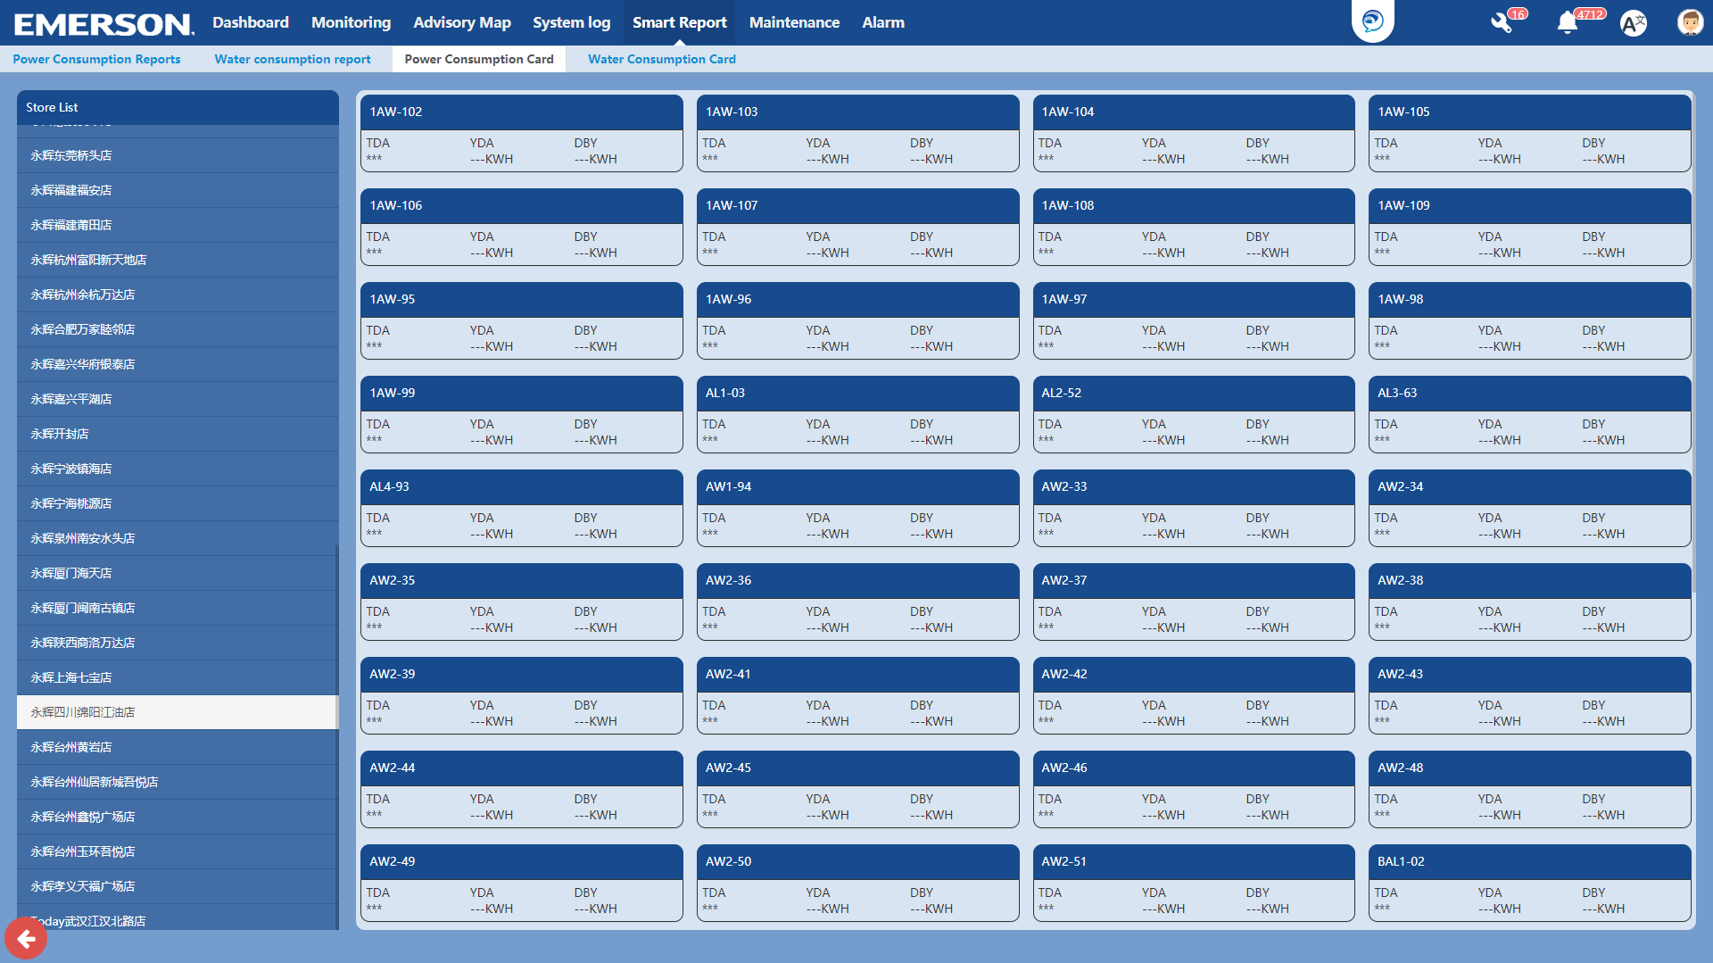
Energy consumption statistic
Graphical interface and reports give users a quick and clear overview to energy consumption data
Energy consumption dashboard – reflecting the consumption data by devices, sites and group level
Curve diagram - enabling store manager to know the hourly and monthly consumption data
Stacked column graph – making clear comparison for different sites and months.
Three days energy consumption – telling customer how much energy has been consumed today and two days before.
3

Slide 9
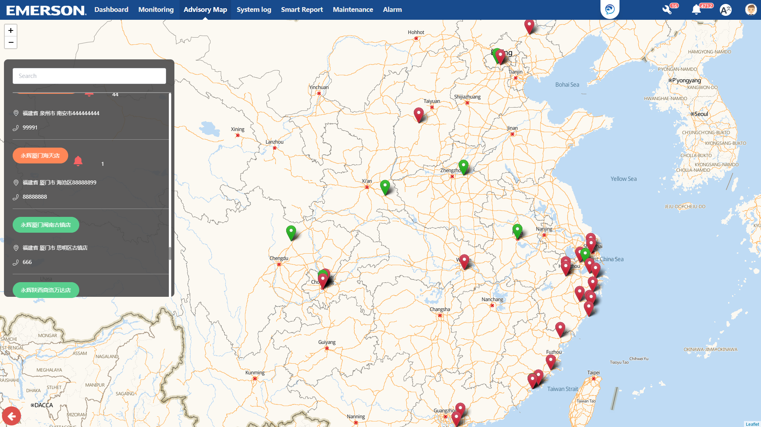
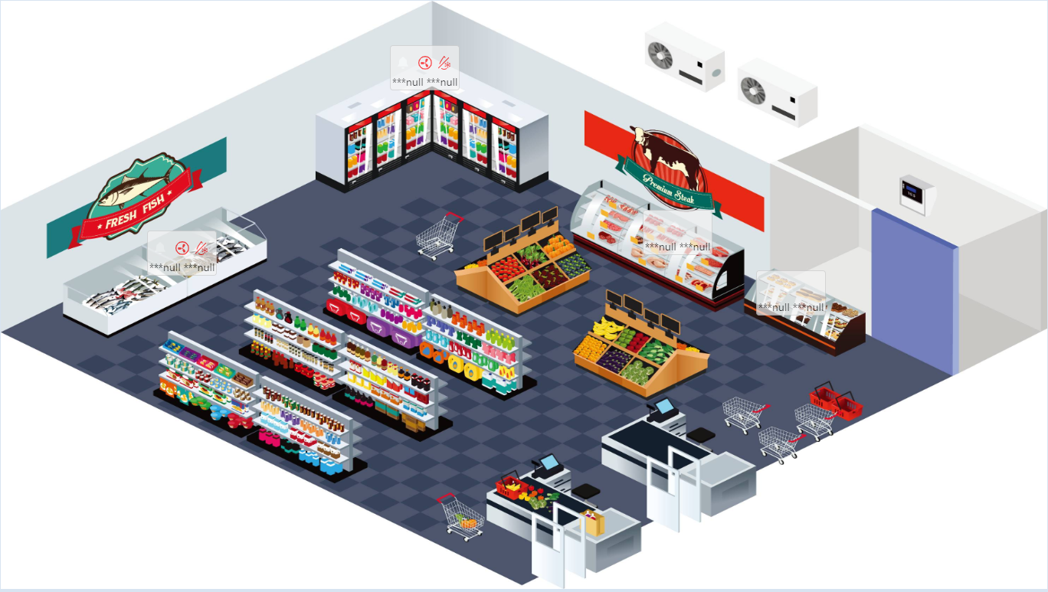
Advisory Map & Floor plan
Use advisory map to help you indicate exceptional stores and
jump to the store detail page and check device’s details
get contact with servicer or store manager, solve urgent issues directly and efficiently
mark store equipment on floor plan, enable recognition easily and quickly
glance at device’s detail and status on floor plan without moving to device page
3

Slide 10
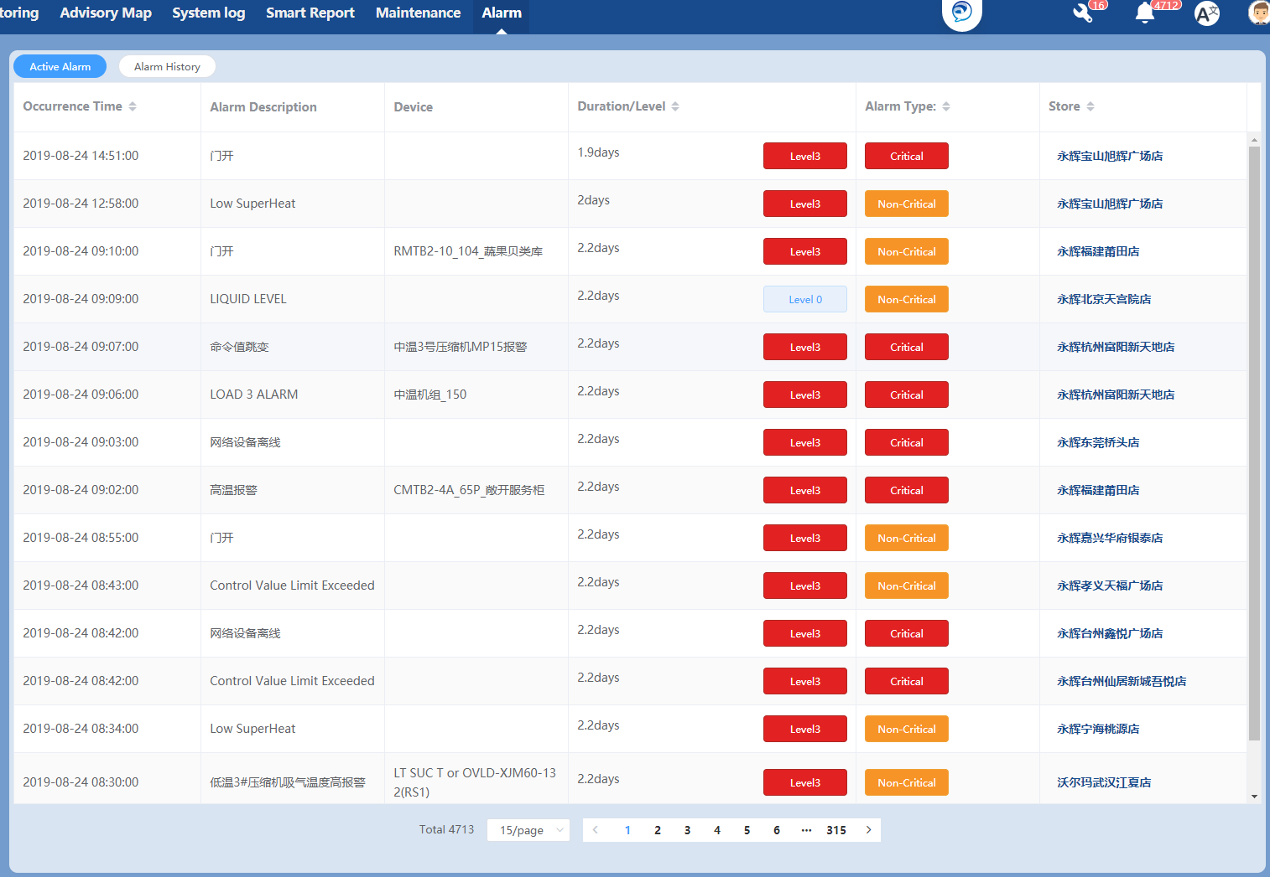
Advisory Notification
Inform device exceptional message to users instantly and make them:
look over alarm message of all stores by site, device and alarm level
sort out alarms with different severity and find out potential faulty point or trouble spot
Analyze alarm distribution and exceptional data , help detect device potential issue
Unhandled alarm will be escalated to high level manager
3

Slide 11
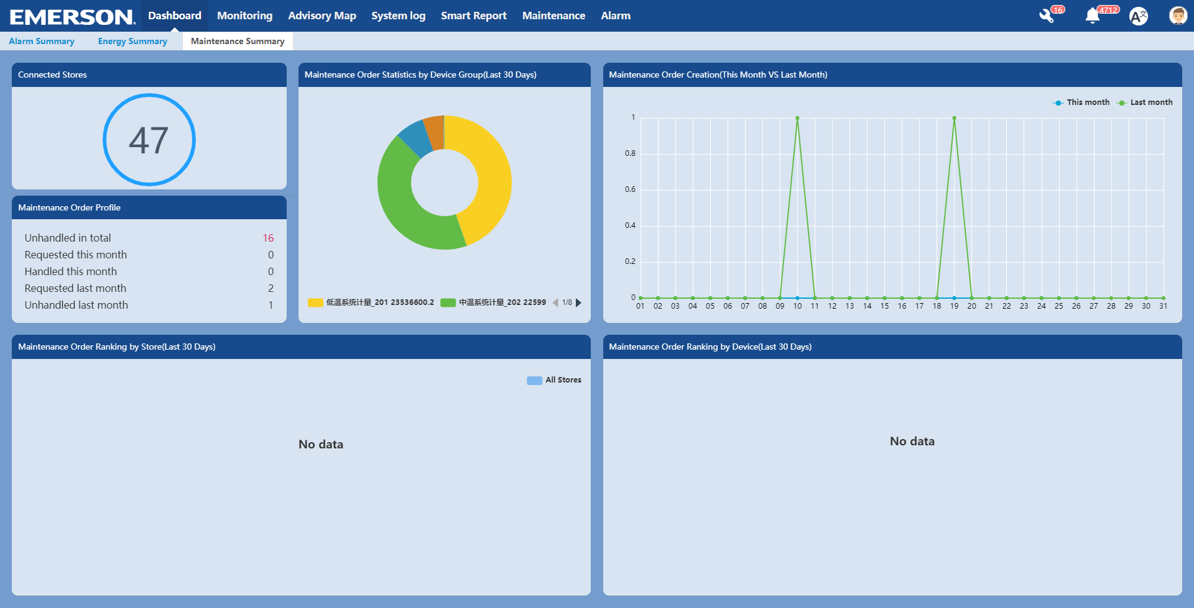
Maintenance management
Manage device maintenance, form a complete service history for each service provider and
Record every device’s maintenance data and sum up the total number of maintenance task for all stores.
Generate servicer’s performance report and find more about the service quality.
Trace the progress of maintenance tasks ( no response, handling or completed )
3

Slide 12
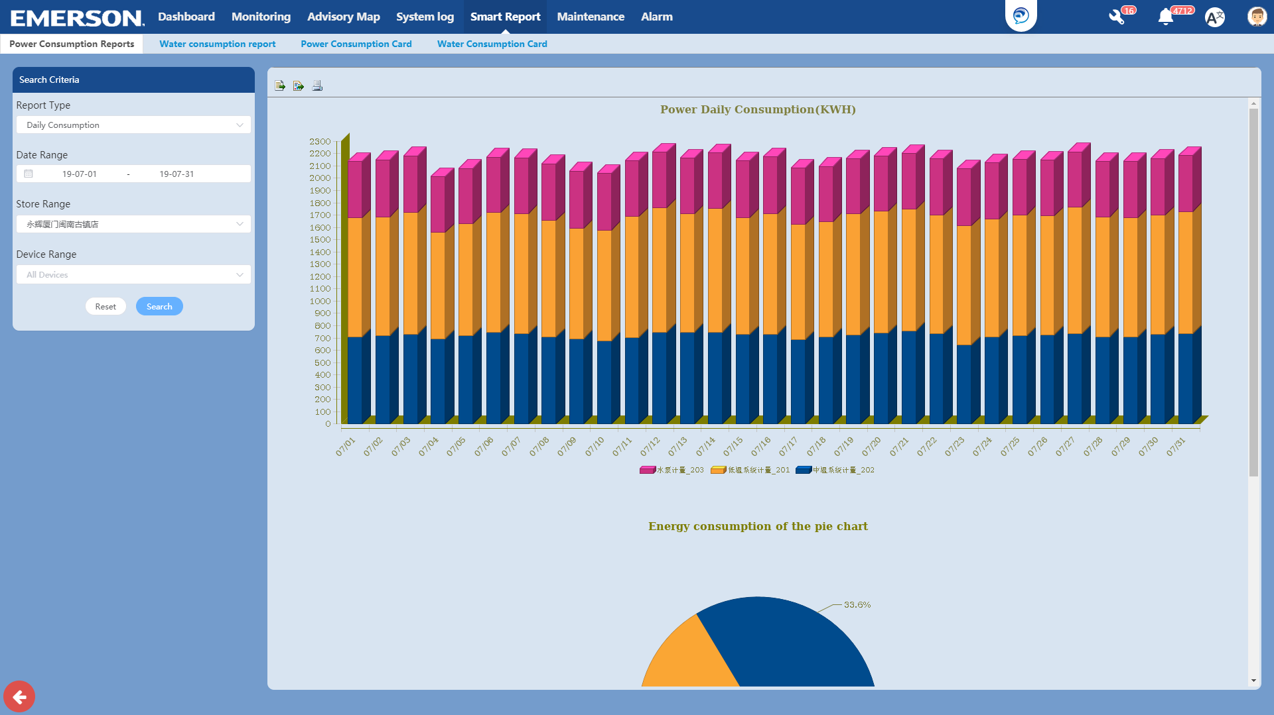
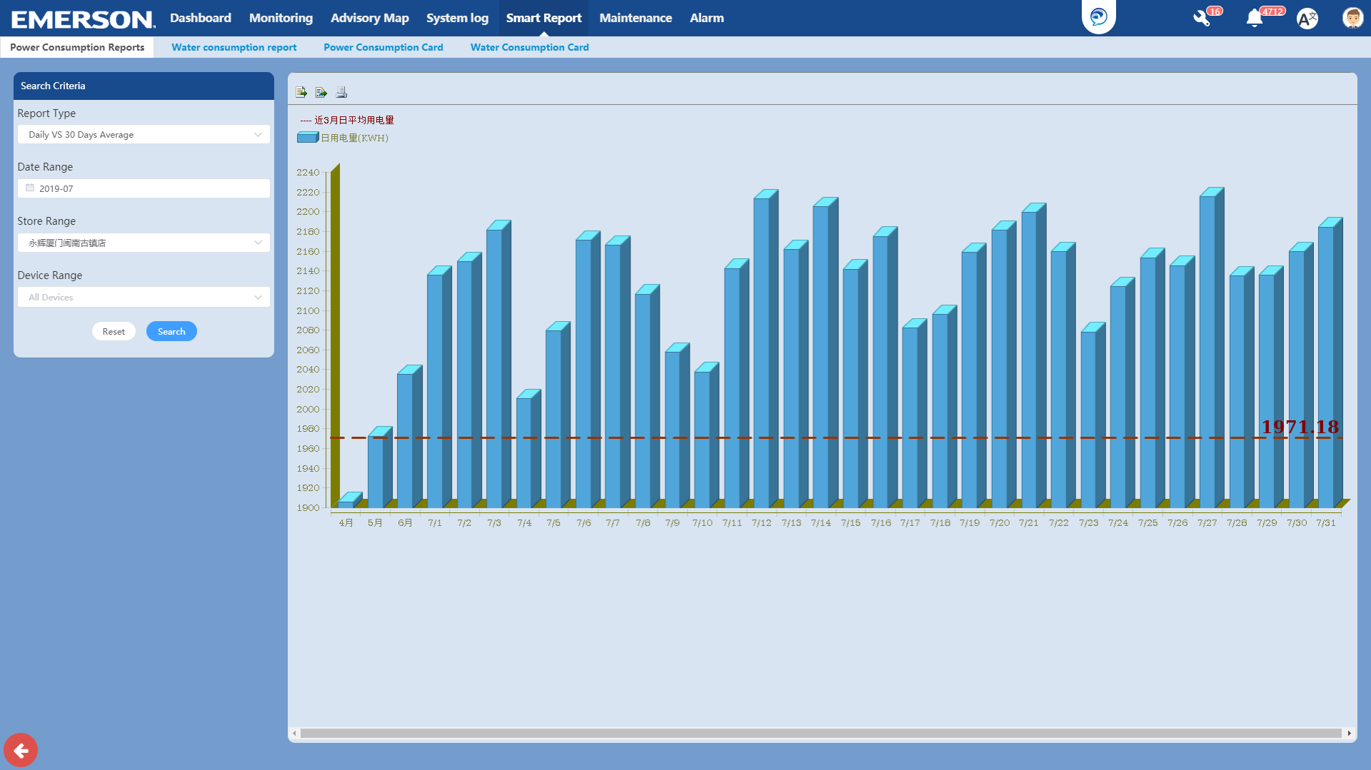
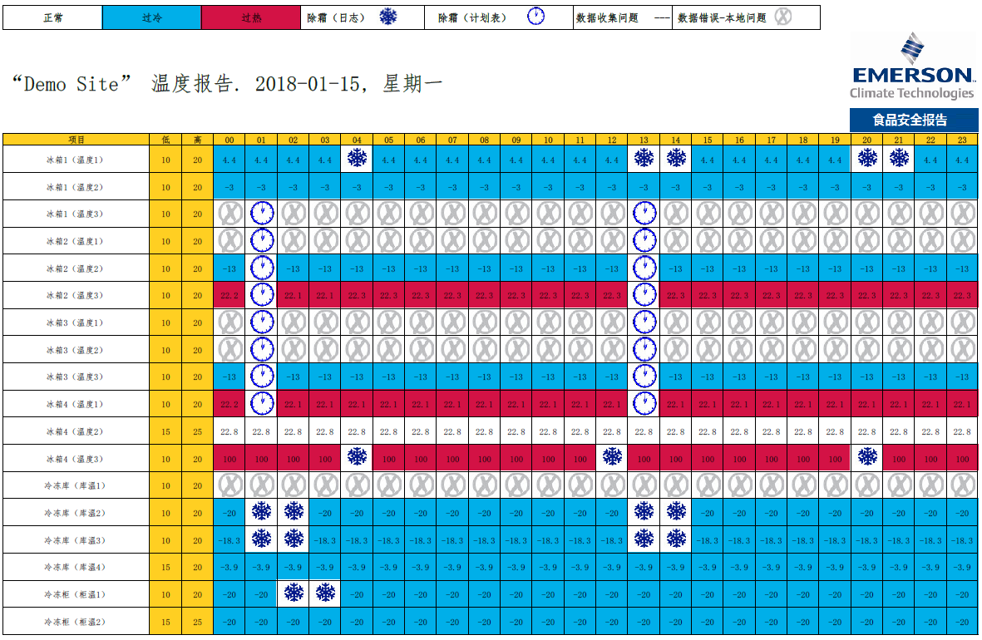
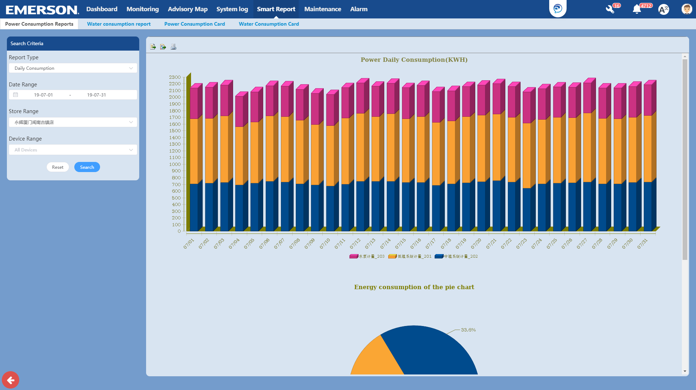
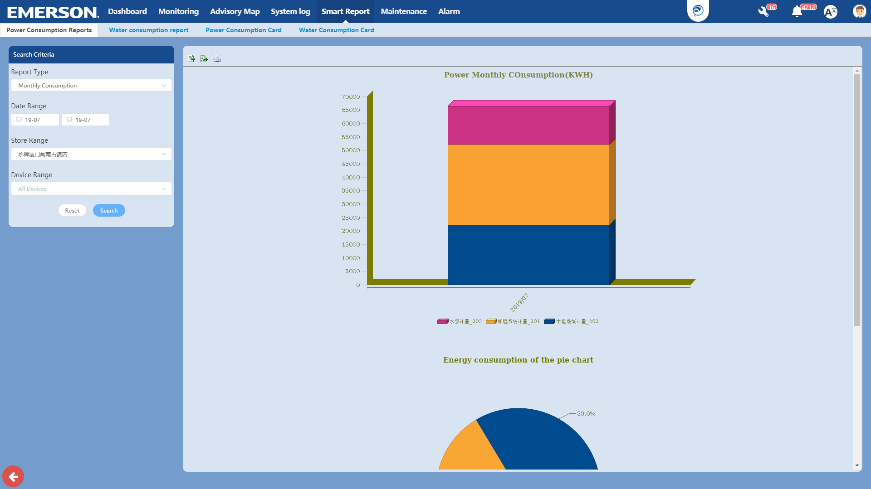
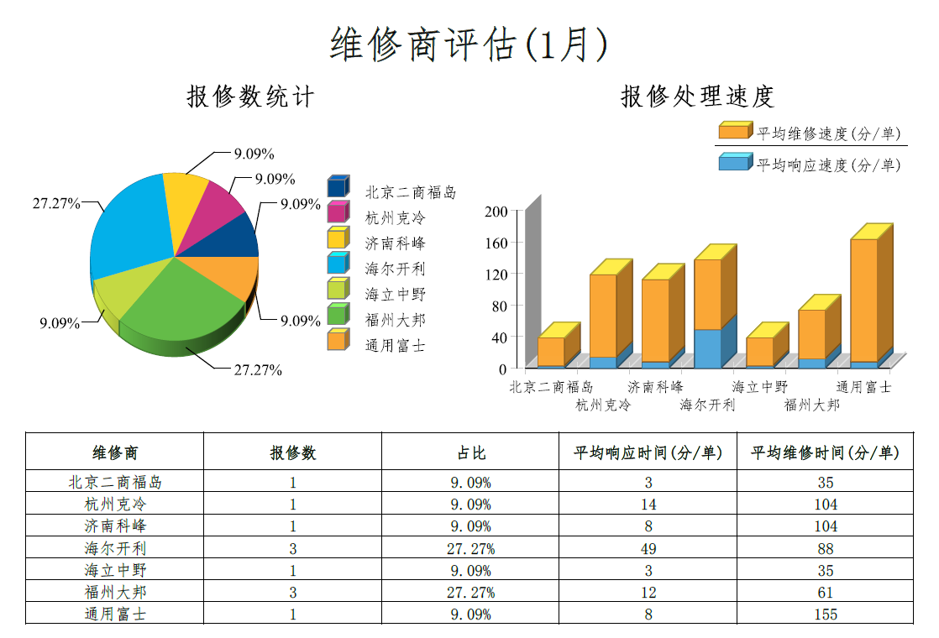
Smart reports
Daily energy consumption analysis
Average energy consumption analysis
Food quality report
Hourly energy consumption analysis
Monthly energy consumption analysis
Servicer performance evaluation
3

Slide 13
4
Smart Connect - WeChat
Smart Connect WeChat is a mobile application developed with WeChat platform. By following the “Emerson Intelligent Store” official account, users can access every stores details and check the parameters of each device. This application is perfect for device remote monitoring situation and it is now serving to C-store, Super markets, Quick Service Restaurant etc.
Smart Connect WeChat provides 4 major functions for users, including messages pushing, alarm receiving, device monitoring and maintenance order addressing.
Benefits for users
WeChat – a very mature application, widely installed on both Android and IOS phone. Users do not need to install separate app.
Realtime - Users can monitor the device status and energy information for all sites wherever and whenever
Connevient – Alarming message will be pushed to users right after it happened.
3

Slide 14
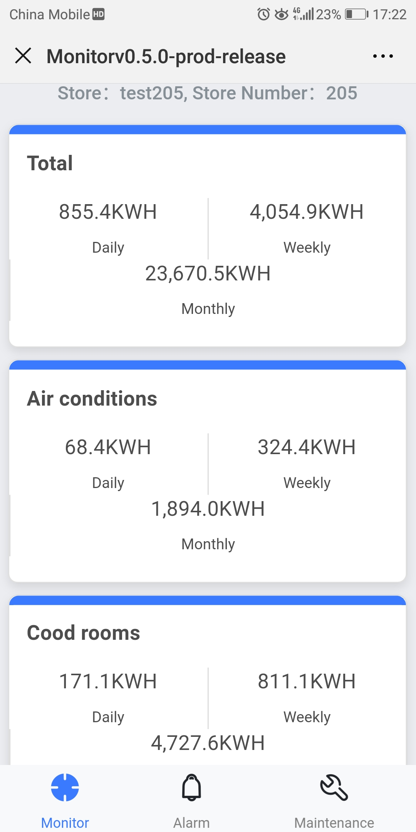
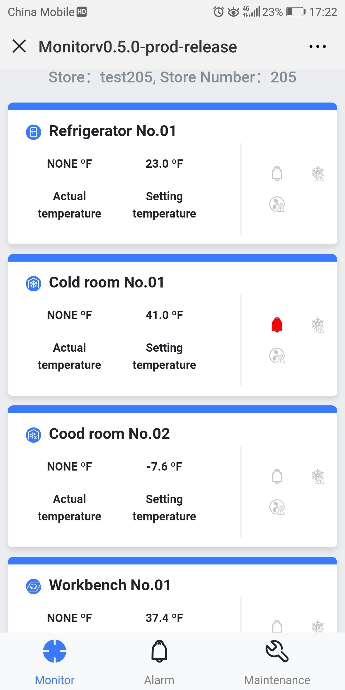
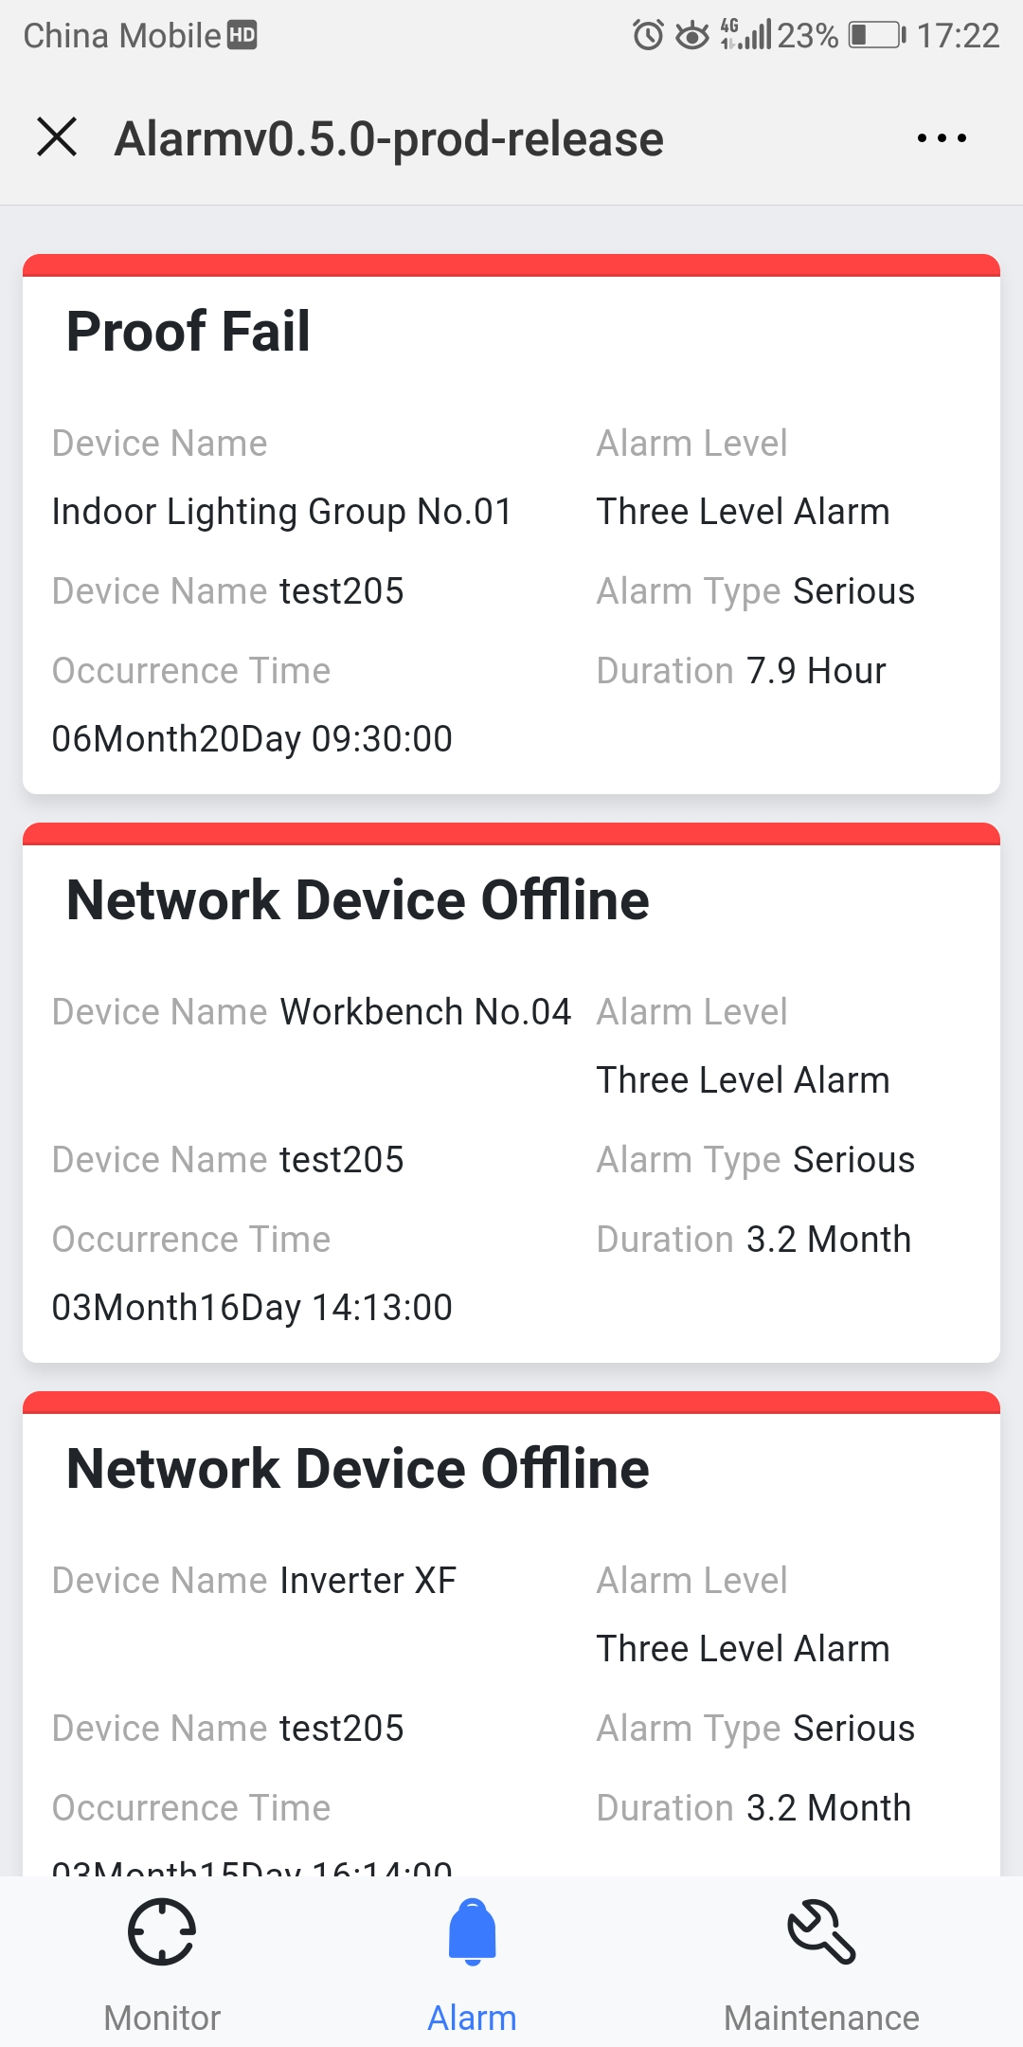
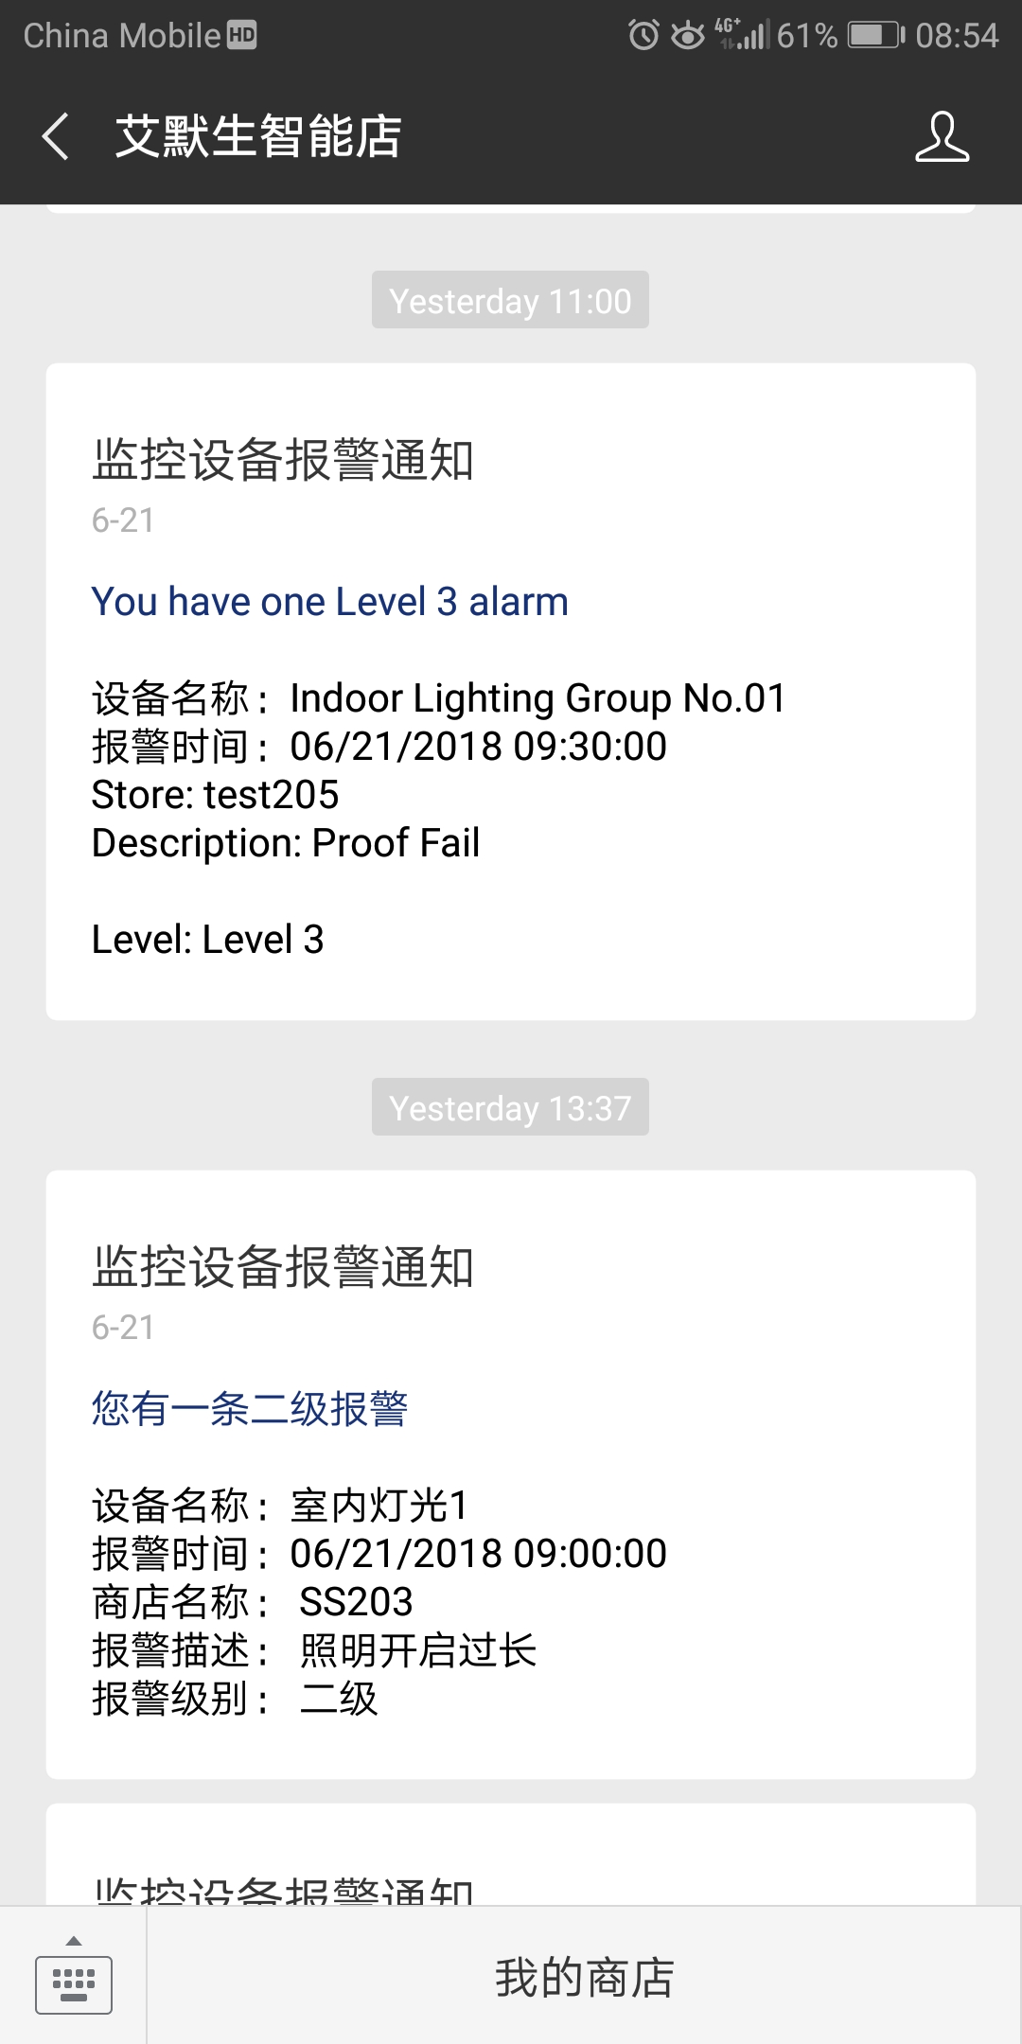
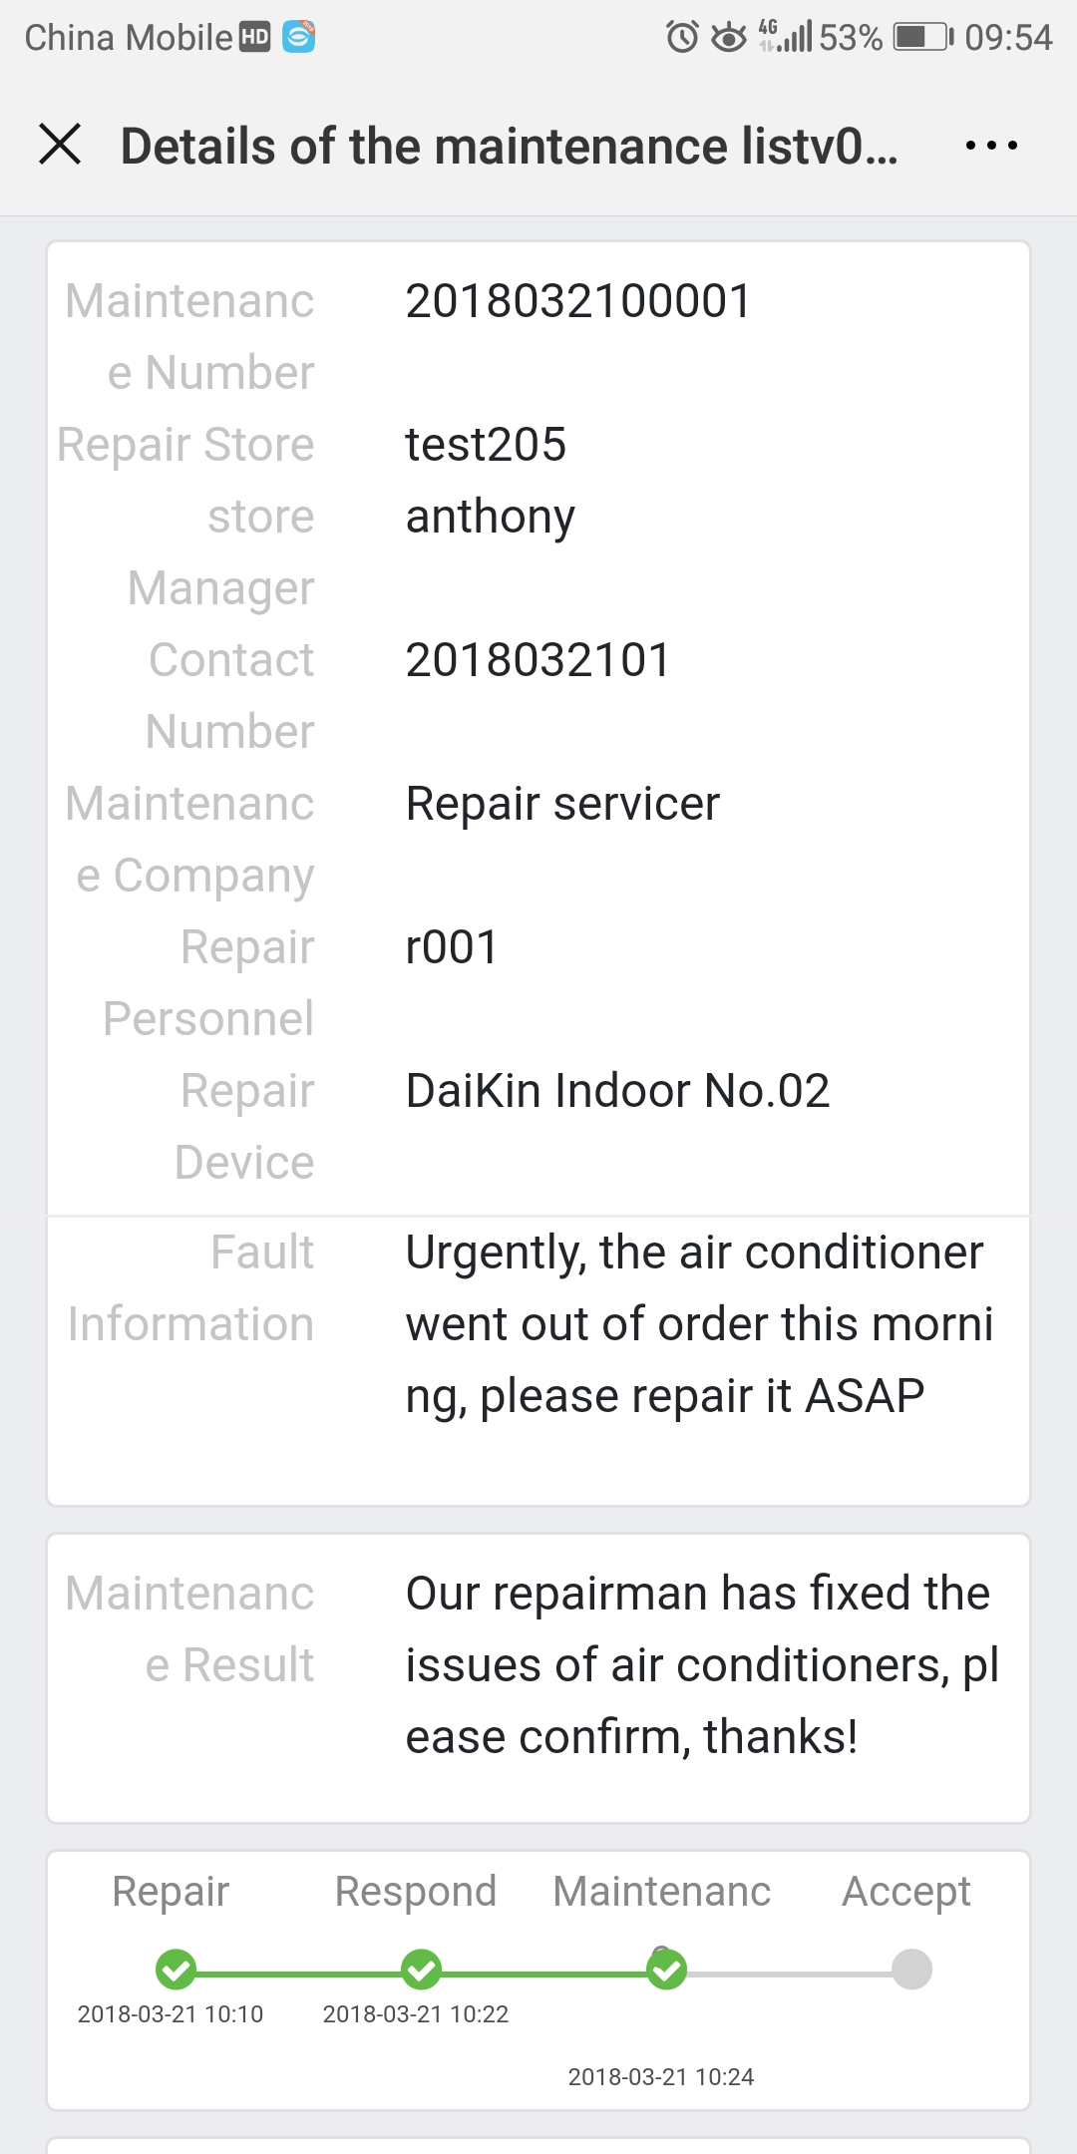
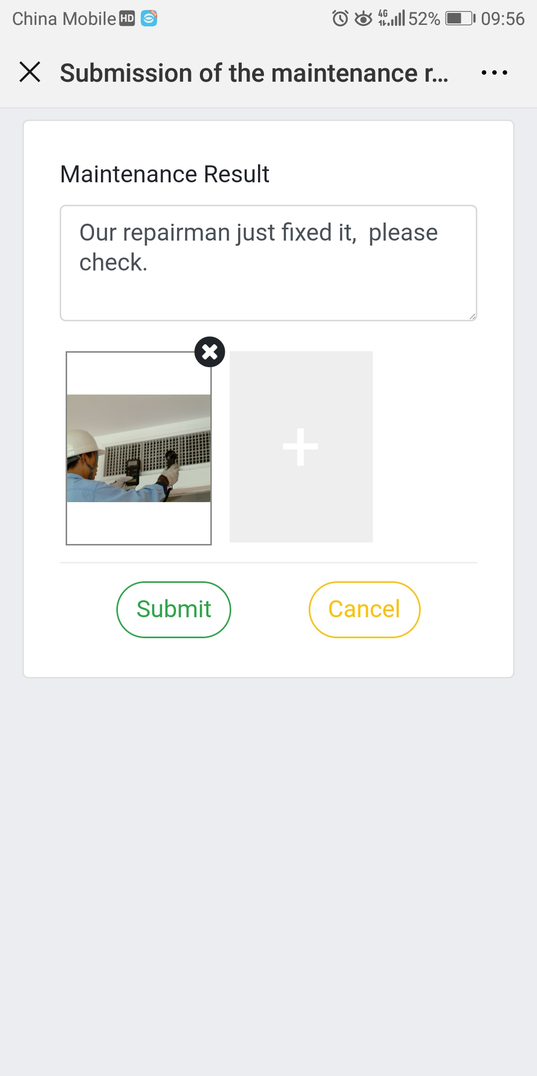
6
Smart Connect – WeChat Functions
Real-time monitoring
Alarm Monitoring
Work Order management
Real-time data reflecting for cooling, heating and utility devices
Displaying the detail information for each device, such as input, output, etc.
Pushing alarm message to store manager or upper management
Looking over alarms by device, store level and quick view the details of alarm happened
Creating and pushing new repair request to maintenance service provider
Reacting to the task assigned ( service provider)
Monitoring the progress of each maintenance task
3

Slide 15
7
Smart Connect – Customization
Interface
Any requirement of interface development between software platform and other brand’s main controller should be discussed with Product marketing and R&D department in advance.
Reports
We can develop new reports according to customer’s needs, but everything relating to it should be analyzed first. Please contact Product marketing department before making commitments to customers.
Customized feature
Any customized features need to be analyzed and evaluated by R&D team. Please contact Product marketing department for more details.
3

