Slide 1
Sensi Equipment Interface Module (Indoor + Outdoor)
For use with Touch 2 smart thermostat

Slide 2
Business and Product Overview

Slide 3
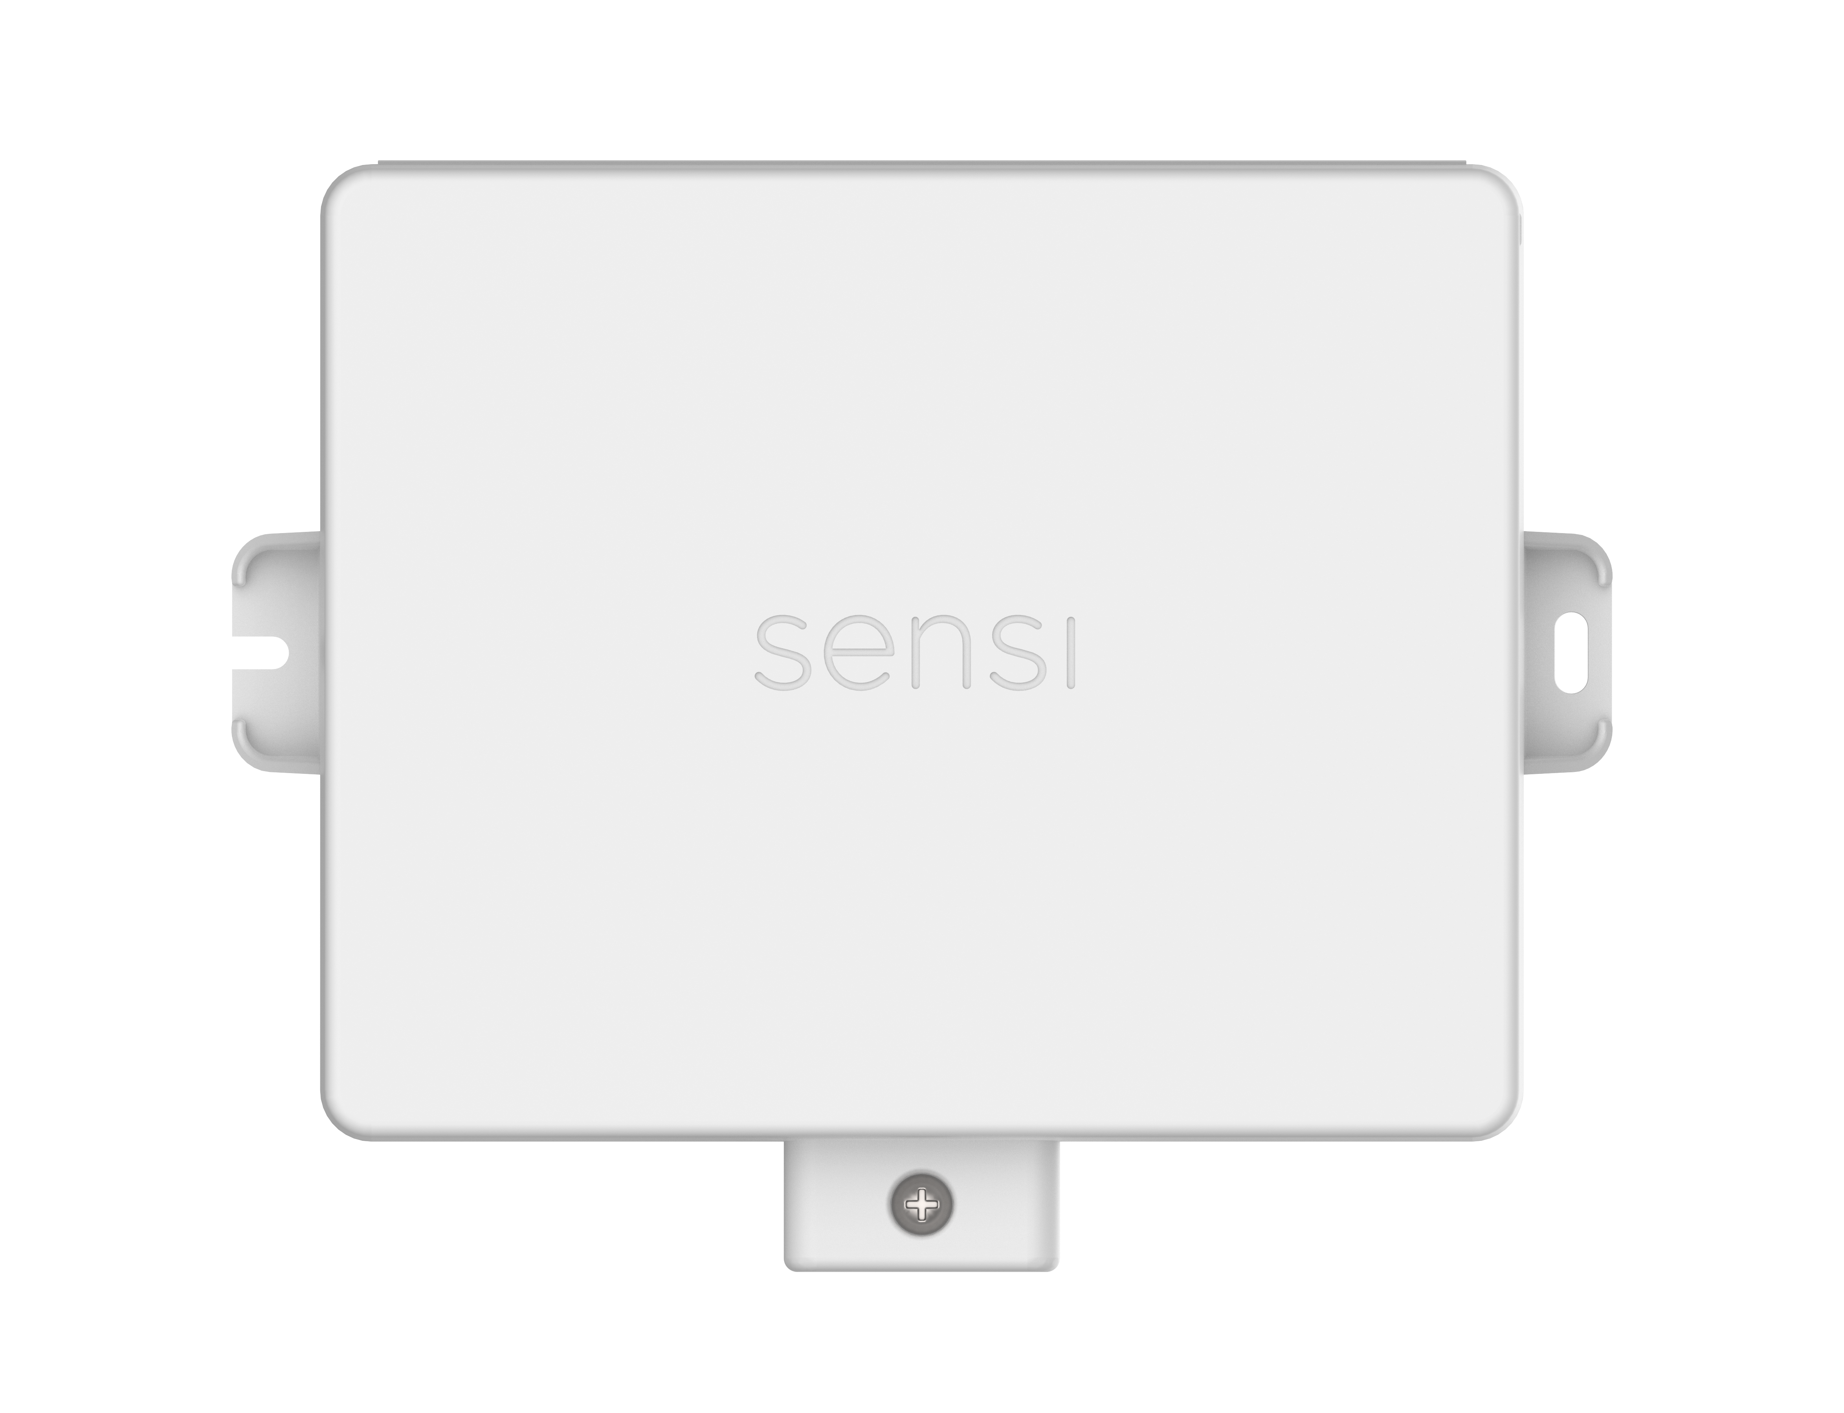
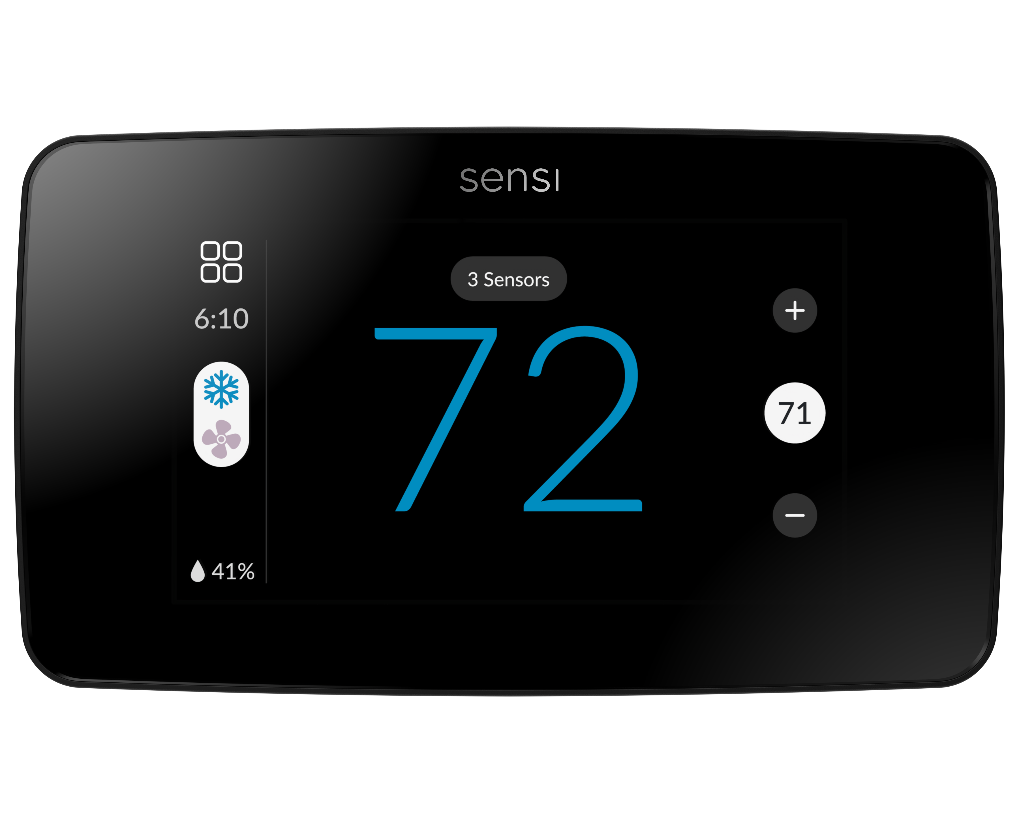
Introduction
The Sensi Equipment Interface Module (Indoor + Outdoor) simplifies thermostat and heat pump installations by reducing the need to pull additional wires when doing a system upgrade. Plus, 3 universal accessory terminals to control all your IAQ products (humidification, dehumidification, ventilation) from one device.
Waterproof and durable, the Sensi EIM is made for indoor or outdoor use, again lessening the number of products you need to stock on your truck. The cover is tightly secured on the product, keeping a clean look without wires popping out.
Compatible with any Sensi Touch 2 smart thermostat.
SA20
1F96U-42WFB (black)
1F96U-42WF (white)

Slide 4
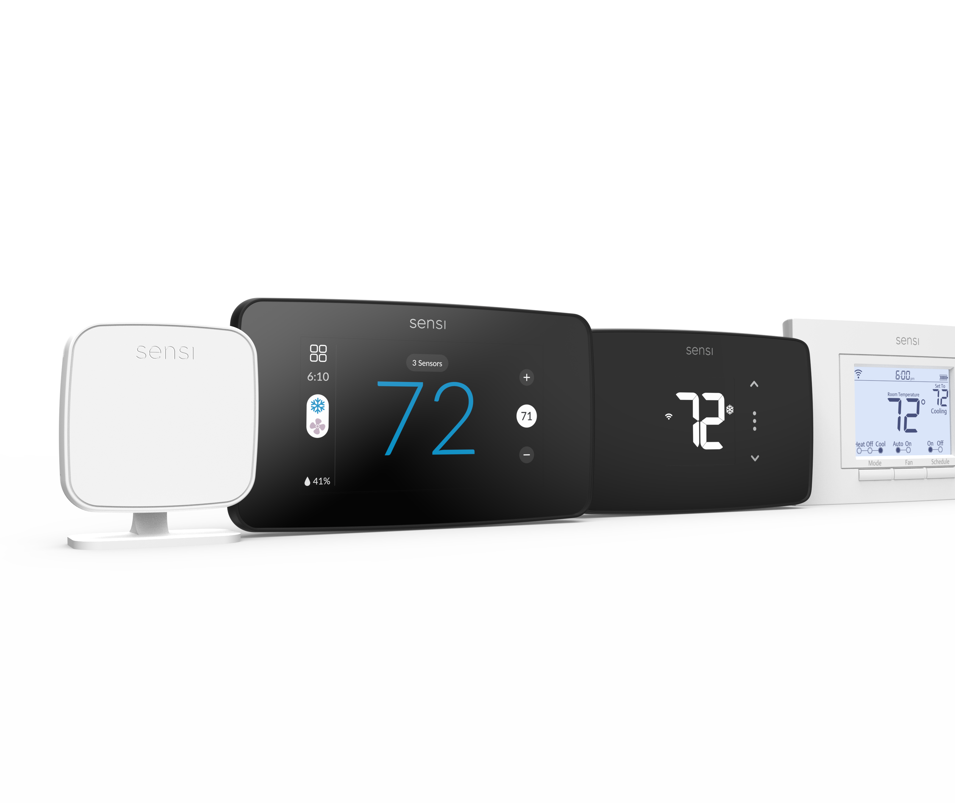
Award-winning Sensi smart products
The award-winning Sensi smart lineup keeps homeowners connected to comfort and keep you connected to your customers.
A Brand You Can Trust Sensi is highly-rated by customers for its simplicity. Our smart thermostats are ENERGY STAR® certified and the first to receive the ENERGY STAR Partner of the Year Sustained Excellence Award in 2022.
Connect to Customers Contractor branding in-app & smart alerts put your company information at your customers' fingertips. So, when they need service — you're just a tap away. Plus, connect with new customers through our Sensi Find A Pro tool.
Simple & Reliable Easy installation saves time and money on jobs, no matter the skill level of the technician. Reduce callbacks with a high-quality product that is easy for the homeowner to use.

Slide 5
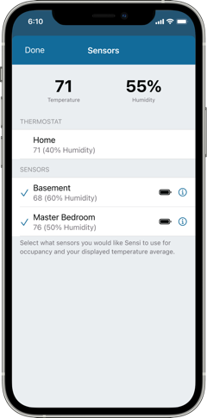
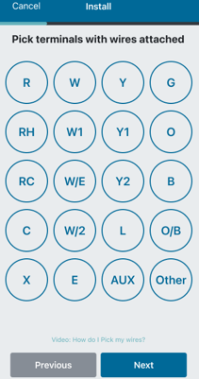
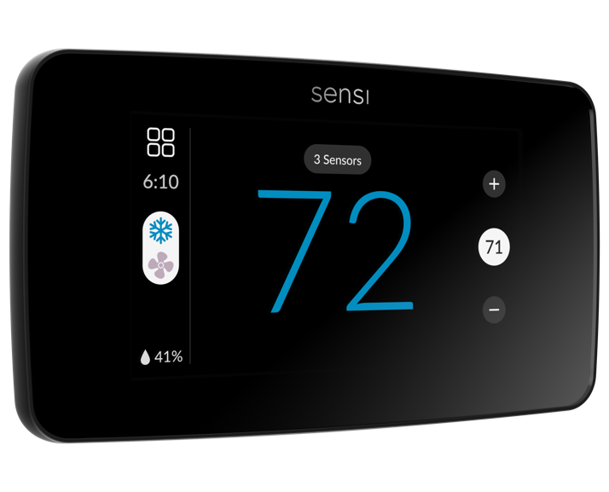
What makes Sensi different?
Easy to Install, Easy to Use
Our Privacy Promise to Customers
#1 Rated smart thermostat mobile app
Compatible with majority of home HVAC systems
Backed by 100 years of HVAC expertise
SENSI DOES NOT use your smart thermostat activity for targeting or advertising purposes.
SENSI DOES NOT sell your personal data to anyone, for any reason.
Your thermostat settings are yours, and yours alone. SENSI DOES NOT make changes based on assumptions about your priorities.
79%
of smart thermostat owners would switch to a different brand for more data privacy.
PRIVACY PROTECTION: For full details, review the Sensi Privacy Policy at sensi.copeland.com/en-us/legal. Note: if you sign up for a program with a third party, such as a utility or controller, details and terms for that program are between you and the third party, not Copeland, and may include additional data collection. Certain add-on services require additional data to operate as intended. These services are not required and are optional.

Slide 6
Why Sensi?
SUPER EASY!
Super easy to install! Took me literally 10 minutes!!! I just needed a basic on/off unit. I watched a video with suggestions to take a picture of the wires and label. Works just fabulous!
How did we live without it!
Got this for our home. So happy we did. We can control it from two phones, and our Alexa. So great. Before we arrive home, we can turn the heat up so we arrive home to a warm house!
Energy Star Partner
of the Year
2020 | 2021 | 2022
Dealer Design Awards
2014 | 2018 | 2019
First Smart Thermostat to win JD Power Award
Best Overall Smart Thermostat
2017 | 2018 | 2019 | 2020
Best Connected Thermostat
2022

Slide 7
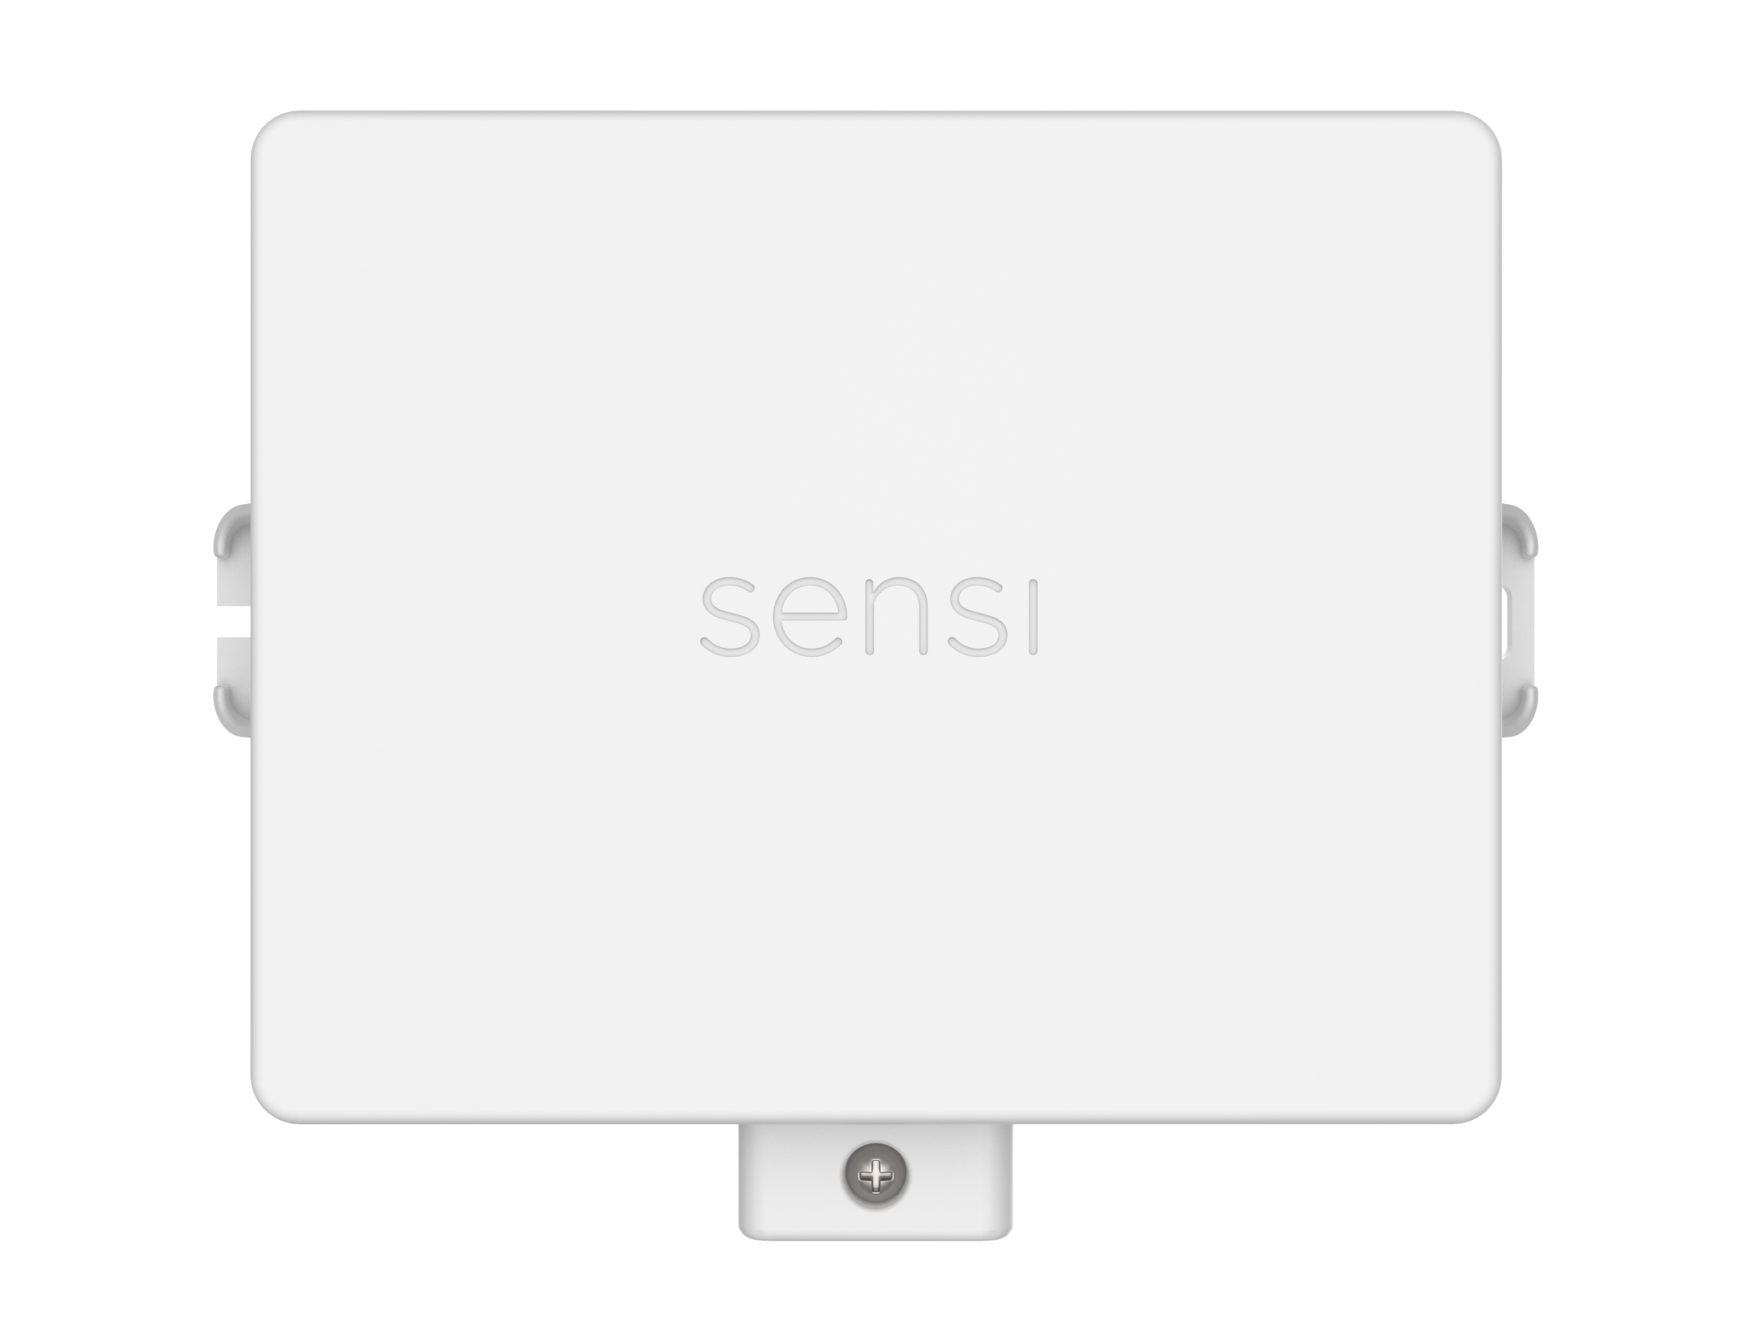
Sensi Equipment Interface Module (Indoor + Outdoor)
Features
Works with Sensi Touch 2 smart thermostat
Simplified install without pulling additional wires
Sensi Connect sub-GHz technology offers long range connectivity between products with less interference
Three universal accessory terminals for IAQ control
Same module for both indoor (EIM) and outdoor (ERM) applications

Slide 8
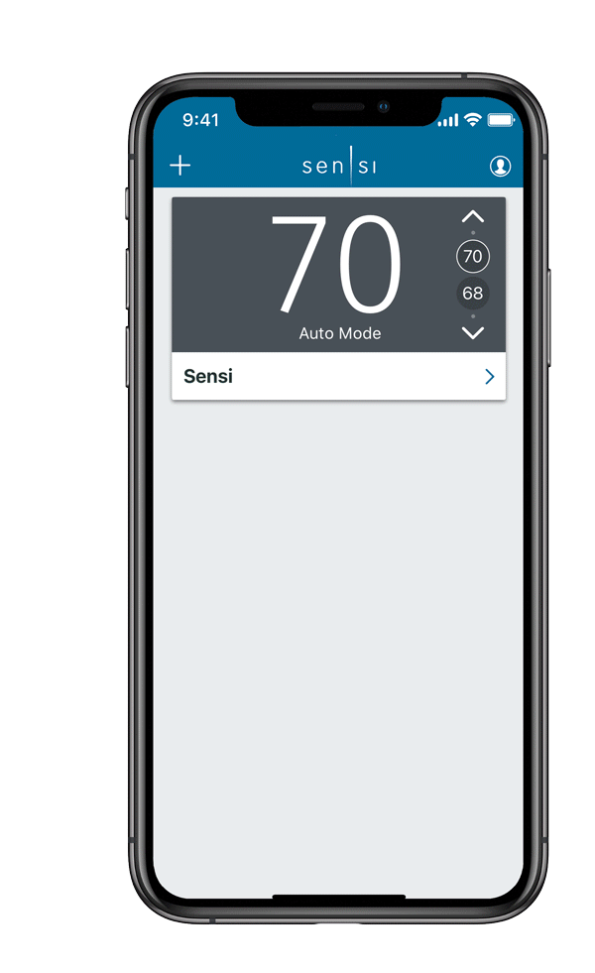
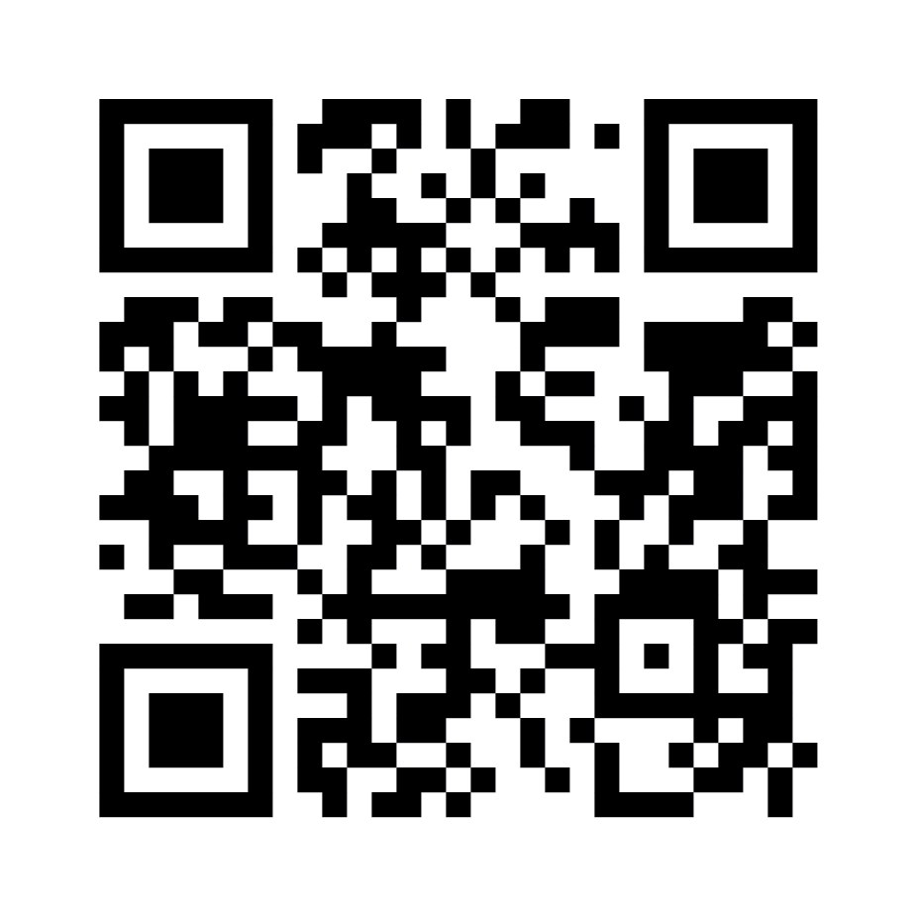
Sensi Partner Program Overview: Benefits
Use Contractor Mode to automatically add your digital branding to every Sensi smart thermostat you install, keeping you top of mind when a customer needs maintenance or service. Your branding will also be on monthly usage reports, service alerts, mobile app and service reminders.
EASY Steps to Register a Thermostat:
Download the Sensi App and sign into your Sensi account.
Press and hold the Sensi logo at the top of the app dashboard for five seconds. If you don’t already have a Sensi Partner Program account, tap Become a Sensi Partner. If you already have an account, tap OK.
Tap Contractor Mode at the top of the dashboard. The first time you use Contractor Mode, the Sensi app needs to find the company information that you supplied when you registered at sensi.copeland.com/en-us/support/contractor-mode. Enter the phone number used to register to proceed.
Select Register a Thermostat and scan the code on the back of the thermostat.
That’s it! You can register additional thermostats or select Back to return to the Contractor Mode menu.
Click here or scan this
QR code to sign up today!

Slide 9
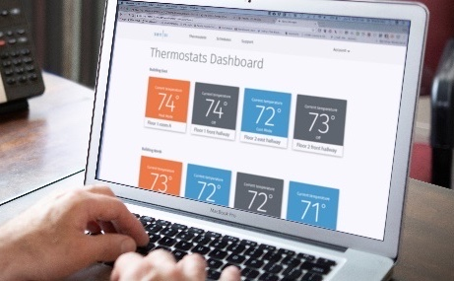
Sensi Family Overview
Sensi room sensor
Sensi Touch 2 smart thermostat
Sensi Touch smart thermostat
Sensi smart thermostat
SENSI SMART THERMOSTATS
SENSI MULTIPLE THERMOSTAT MANAGER
Easy install for you, upgraded features and convenient comfort for your homeowners.
The award-winning Sensi smart thermostats keep homeowners connected to comfort and keeps you connected to your customers. Sensi Partners get access to program benefits including homeowner leads, contractor branding, custom literature and free online training. Choose from Sensi smart thermostat, Sensi Touch smart thermostat Sensi Touch 2 smart thermostat. Sensi Touch 2 now works with Sensi room sensors and outdoor sensors.
Light commercial solutions for simple comfort control
Sensi Multiple Thermostat Manager gives facility managers the power to control all their Sensi thermostats in one place.
Sensi room sensor RS01-SG RS03-SG (3-pack)
Sensi Touch 2 smart thermostat Available in black and white 1F96U-42WFB, 1F96U-42WF
Sensi Touch smart thermostat Available in black, white and silver 1F95U-42WFB, 1F95U-42WF, 1F95U-42WFS
Sensi smart thermostat 1F87U-42WF

Slide 10
Why Switch to Sensi?
Easy to use – reduces callbacks
Universal system compatibility – Sensi accommodates most HVAC system types
Uses the highest rated smart thermostat app in the industry
Award-winning brand
Support team hours
Monday-Friday 7am-7pm (CST) Saturday-Sunday 8am-5pm (CST)
888-605-7131
SENSI SUPPORT WHEN & WHERE YOU NEED IT

Slide 11
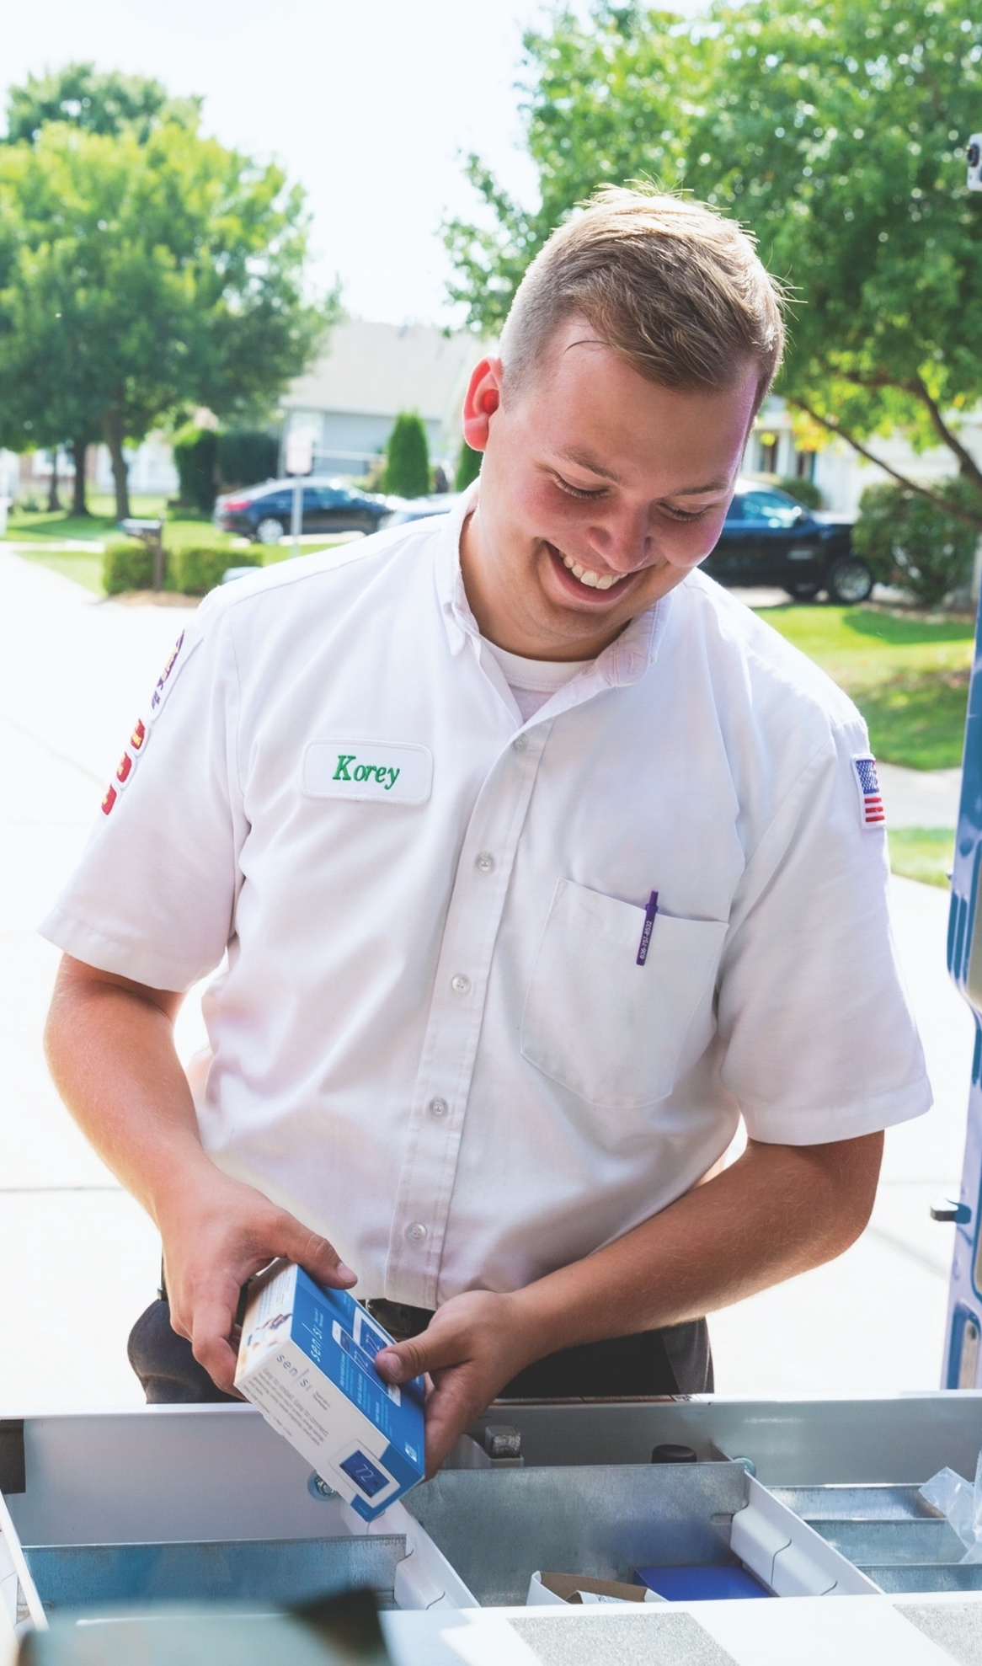
Leveraging Copeland’s HVAC Expertise
OVER 100 YEARS of HVAC experience
MAJORITY OF RESIDENTIAL HVAC SYSTEMS feature Copeland parts
ONE IN FIVE HOMES in the U.S. has an Copeland thermostat
SECOND-LARGEST MANUFACTURER of residential thermostats in the U.S

Slide 12
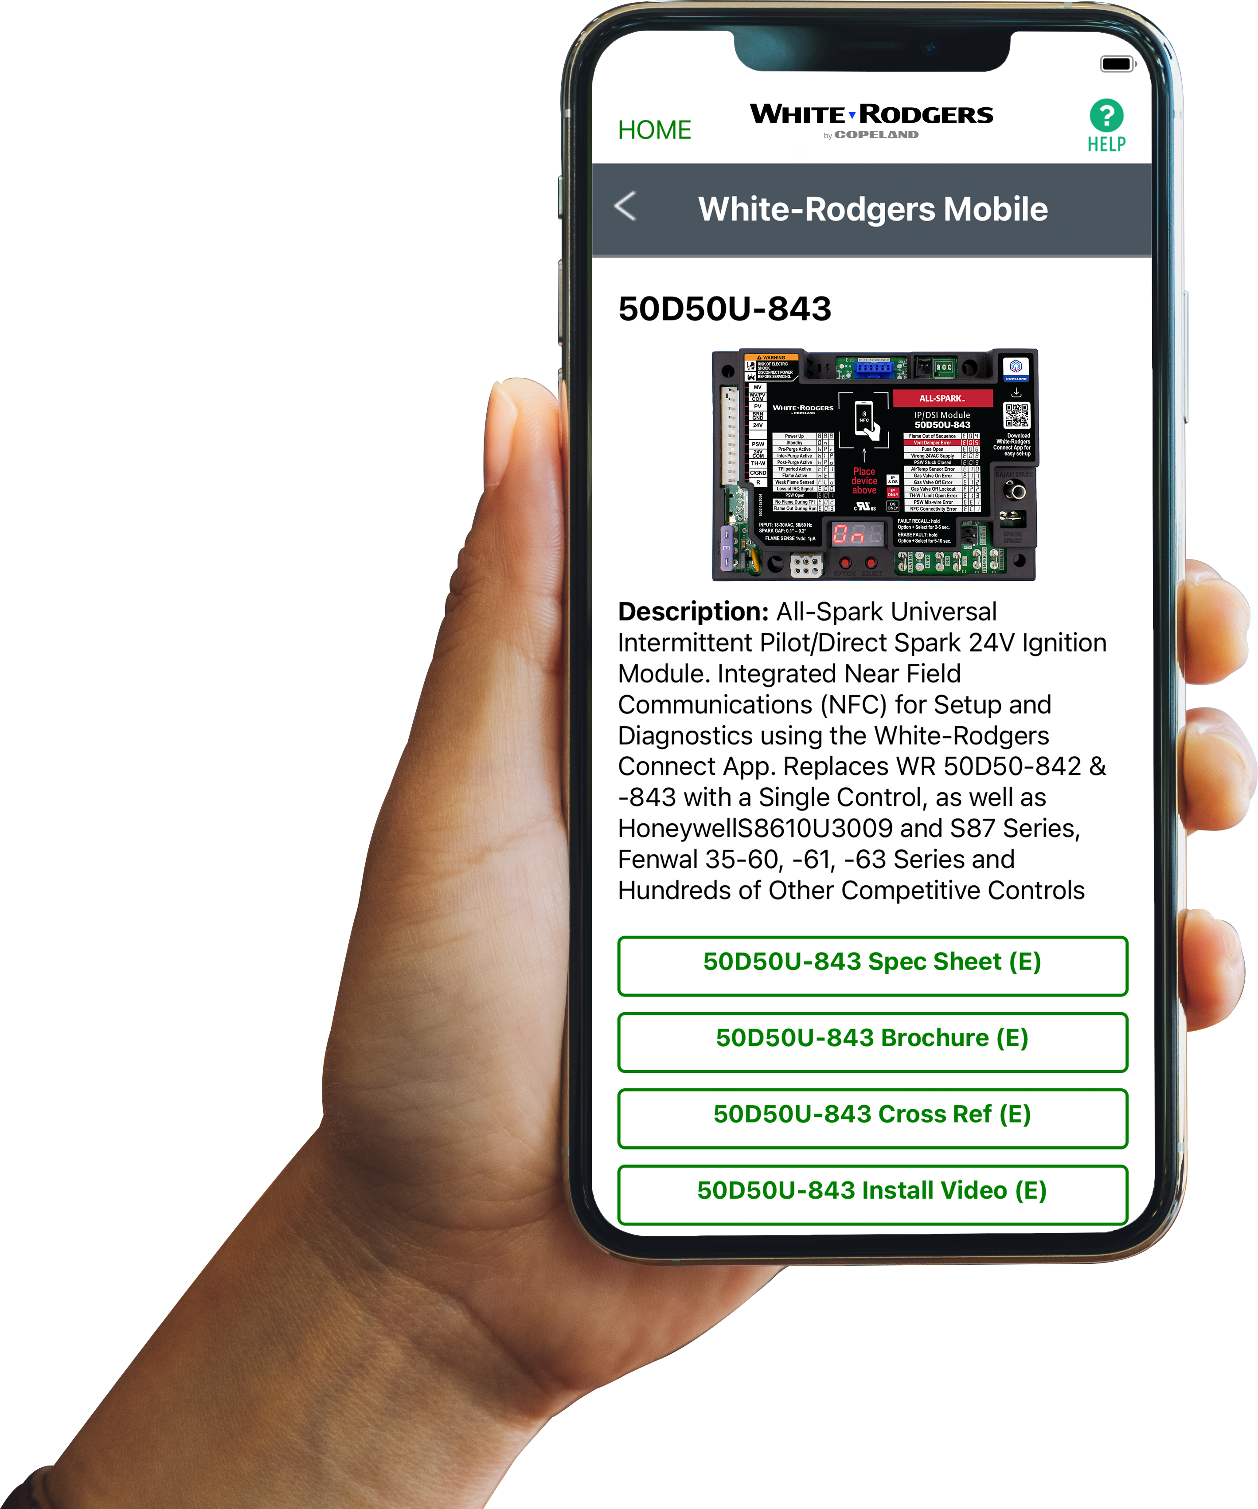
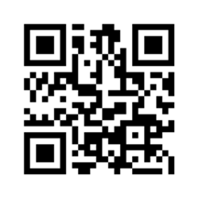
WR Mobile App
Find the right part while on the job.
Your on-the-go resource for:
Complete cross reference
Product information and spec sheets
Installation information and videos
Wiring diagrams
Select product by features
Priority technical support
WR Mobile App Search for “WR Mobile” in both Apple and Google Play Stores
Desktop Version Access the online version HERE
Search by OEM, Competitor and White-Rodgers part numbers.

Slide 13
White-Rodgers Cross Reference
Go to: https://webapps.copeland.com/wrproductselector/
Enter the Model Number or click on: Search Replacement Heating Controls by Major OEM Brand

Slide 14
Technical Overview

Slide 15
Sensi Equipment Interface Module at a glance
Universal (Single Stage, Multi-Stage, Heat Pump compatible)
Professional 5-year warranty on SA20 (EIM), SK20B (EIM + Touch 2 bundle)
Terminal Designations
Model | Program Options |  |  | Max Stages Heat/Cool |  |  | Applications |  |  |  | Power Source |  | Selectable Performance Features |  |  |  |  |  |  | Comfort & Convenience Features
Model Number | Wi-Fi Control Smart Home Compatible | 7 Day | Non-Programmable | Conventional | Heat Pump | Gas/Oil/Electric | 3 Wire Zone | Multivolt | PTAC Compatible | Battery | Hardwired (24V) | Auto Changeover | Circulating Fan | EMR/Early Start Program | Temperature Limits | Keypad Lockout | Humidity Control | Dual Fuel Control | Remote Sensor | Filter Change Reminder | Auto DST Adjust | Permanent Memory
SA20 SK20B |  |  |  | 2/2 | 4/2

Slide 16
Sensi Equipment Interface Module
1
6
7
1
Power Indicator Light | System LED Light Indicator
Mounting Tabs | 24V/AC Input Terminals
Application LED Light Indicator | Accessories Terminals
Cover Fastener | System Terminals
Reset Button | 24V Power to Thermostat
Accessories LED Light Indicator
7
2
8
3
9
4
10
2
2
5
11
3
6
5
8
9
4
10
11

Slide 17
Sensi Equipment Interface Module Connections
Terminal Descriptions
Terminal | Conventional System Connection | Heat Pump System Connection
RC | Power for cooling, 24V | Power for cooling, 24V
RH | Power for heating, 24V | Power for heating, 24V
C | Common wire, 24V | Common wire, 24V
U1-U3 | Accessory terminals | Accessory terminals
W/D | 1st stage heat | 1st stage auxiliary/emergency heat
W2* | 2nd stage heat or dehumidifier | 2nd stage auxiliary/emergency heat or dehumidifier
Y1 | 1st stage cool (compressor) | 1st stage heat and cool (compressor)
Y2 | 2nd stage cool (compressor) | 2nd stage heat and cool (compressor)
G | Indoor blower (fan) | Indoor blower (fan)
O/B | Heat pump changeover, zone panel or 3-wire hot water zone valve connection. (configurable as O, B or 6 in the installer menu) | Heat pump changeover (reversing valve) connection (configure as O or B in the installer menu)
R | Common wire, thermostat | Common wire, thermostat
C | System power, thermostat | System power, thermostat

Slide 18
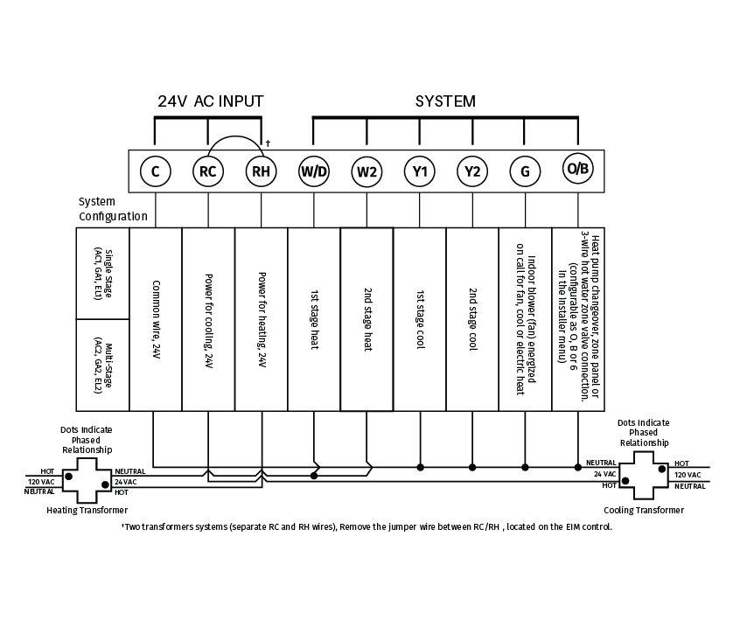
EIM Wiring Guide – Conventional Systems
Typical wiring of a conventional system with up to 3-stage heat and 2-stage cool with two transformers

Slide 19
EIM Wiring Guide – Heat Pump Systems
Typical wiring of a heat pump system with up to 4-stage heat and 2-stage cool with one transformer
Remove jumpers if using separate transformers.
The changeover valve will be labeled O if energized in cool or B if energized in heat.
The auxiliary heat stage(s) are labeled differently on different heat pump air handlers. Most heat pumps applications only have one stage of auxiliary heat.
19

Slide 20
EIM Wiring Guide
Wiring Humidification, Dehumidification and Ventilation
U terminals can be used for humidification, dehumidification or ventilation.
Any combination of relays (U1, U2, U3) can be used. They are set in the thermostat
Wire the U relay to the low speed fan for dehumidification control at the equipment. The EIM relay can be set to be normally-open or normally-closed in the thermostat installer setup
Normally-open, dry contacts
Normally-closed, dry contacts

Slide 21
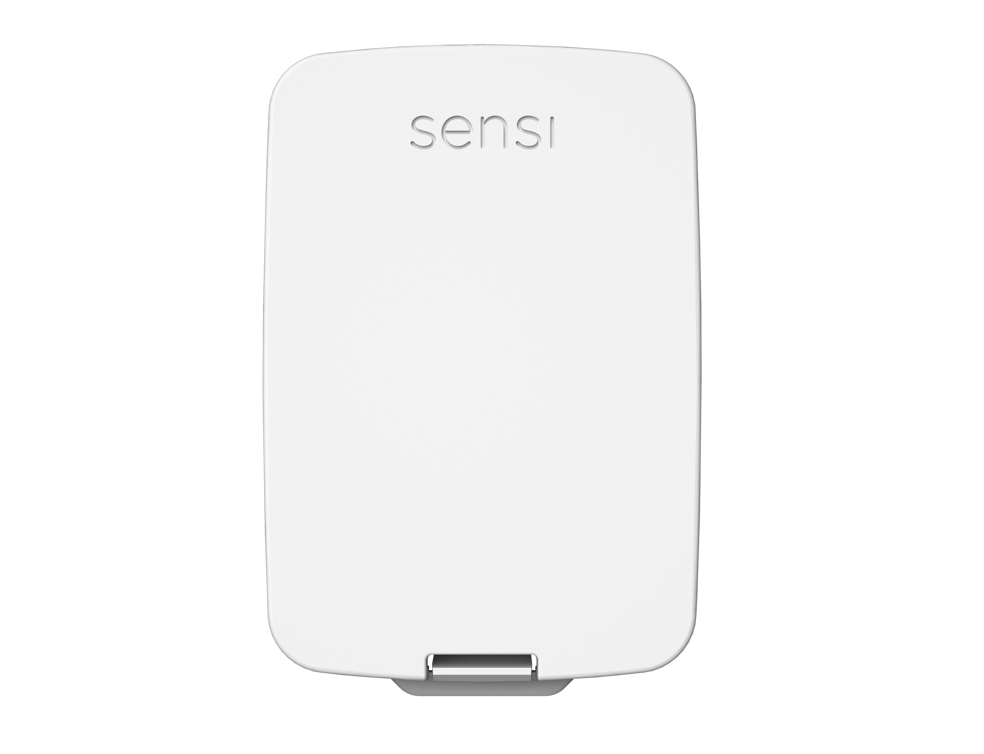
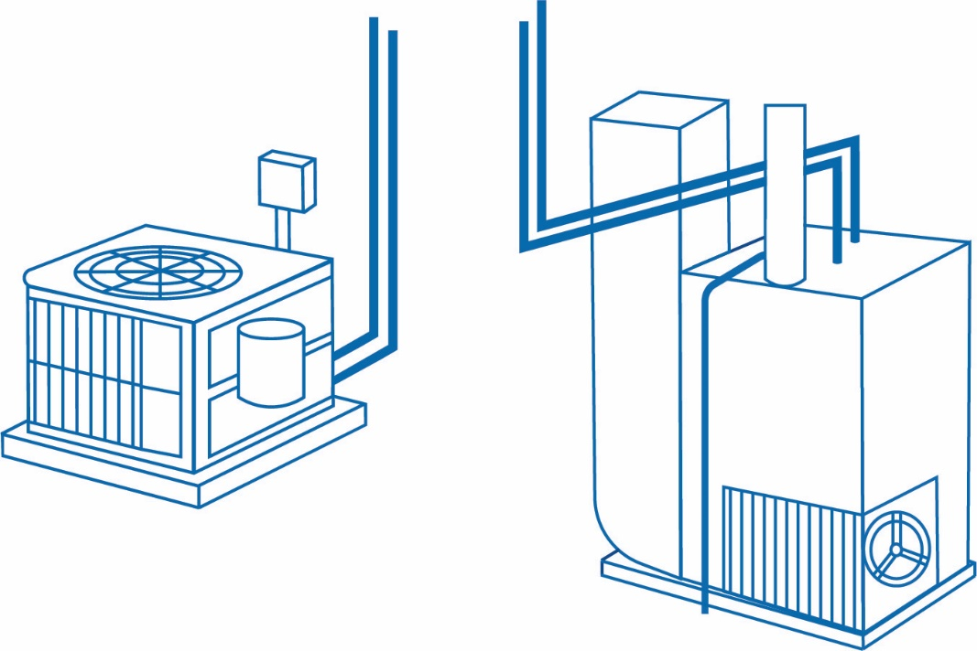
Sensi Outdoor Sensor/Dual Fuel
Dual fuel systems combine a heat pump and gas furnace. Sensi Touch 2 has four ways to control balance point and aux lockout:
Sensi Dual Fuel logic
Sensi outdoor sensor
Internet/zip code
EIM built-in temp sensor
Outdoor Sensor
Heat Pump
Gas Furnace

Slide 22
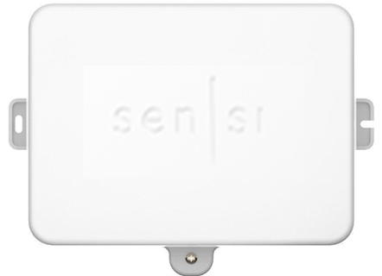
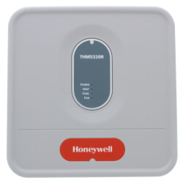
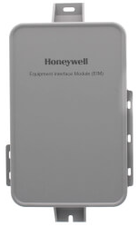
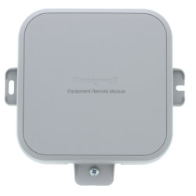
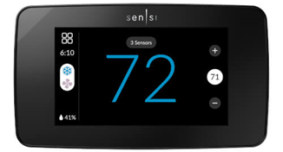
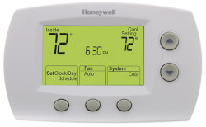
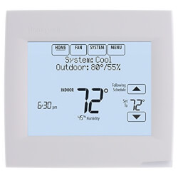
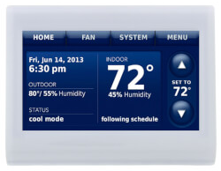
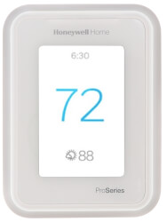
Competitive Features Comparison
Sensi EIM (indoor or outdoor)
RedLink EIM
RedLink EIM (Indoor)
RedLink ERM (Outdoor)
Stages | 4H/2C HP 3H/2C Conv | 3H/2C HP 2H/2C Conv | 4H/2C HP 3H/2C Conv | 4H/2C HP 3H/2C Conv | 4H/2C HP 3H/2C Conv
Dual Fuel | Yes | Yes | Yes | Yes | Yes
IAQ Control | Hum, Dehum, Ventilation | None | Hum, Dehum, Ventilation | Hum, Dehum, Ventilation | Hum, Dehum, Ventilation
Sensors | Outdoor & Indoor (wireless) | Outdoor (wireless) RAS (wired) | Outdoor & Indoor (wireless) 4 Inputs (wired sensors or dry contact devices) | Outdoor & Indoor (wireless) 4 Inputs (wired sensors or dry contact devices) | Outdoor & Indoor (wireless) 4 Inputs (wired sensors or dry contact devices)
Communication | WiFi 900Mhz | WiFi via Gateway RedLINK (900MHz) | WiFi via Gateway RedLINK (900MHz) | WiFi via Gateway RedLINK (900MHz) | WiFi RedLINK (900Mhz)
Programming | Touchscreen | Buttons | Touchscreen | Touchscreen | Touchscreen
Thermostat Power | 2-wire (or wall outlet – future) | 2-wire or batt | 2-wire or batt | 2-wire | 2-wire
Sensi Touch 2
Focus Pro
VisionPro 8000
Prestige IAQ
T10+

Slide 23
Installation Overview

Slide 24
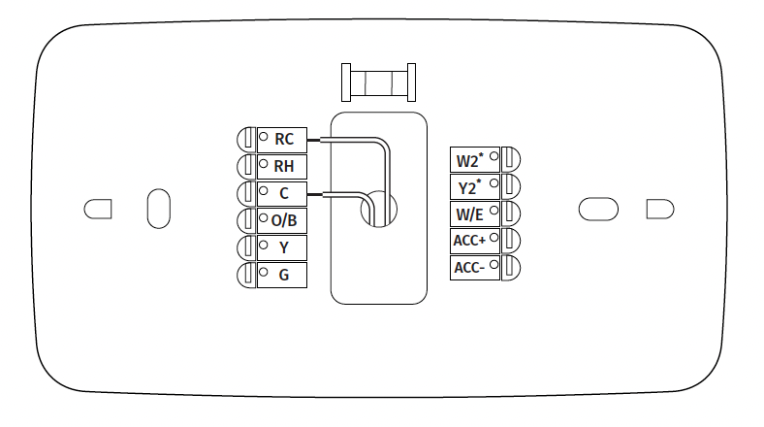
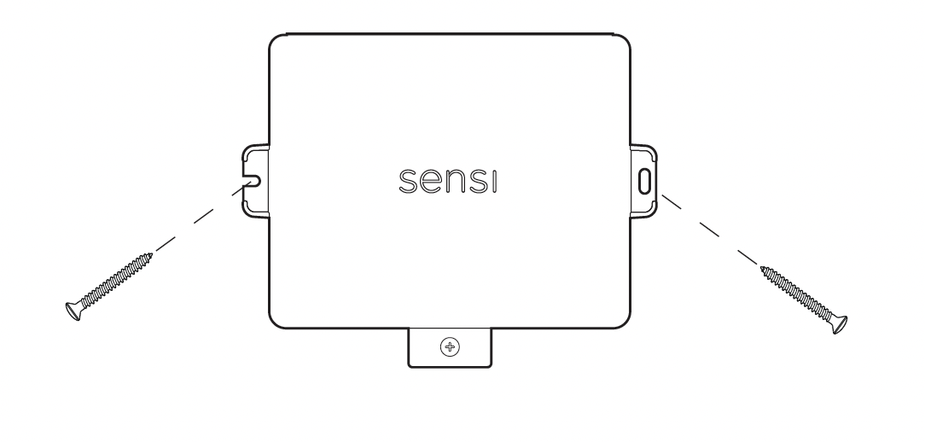
Mount the Thermostat & EIM
Turn off system power.
Mount your Sensi Touch 2 smart thermostat on the wall (if it is not there already), install a wire to the C terminal and another wire to either RC or RH terminal of the Sensi Touch 2 smart thermostat .
Using screws and anchors, mount the EIM near the HVAC equipment, or on the equipment itself.

Slide 25
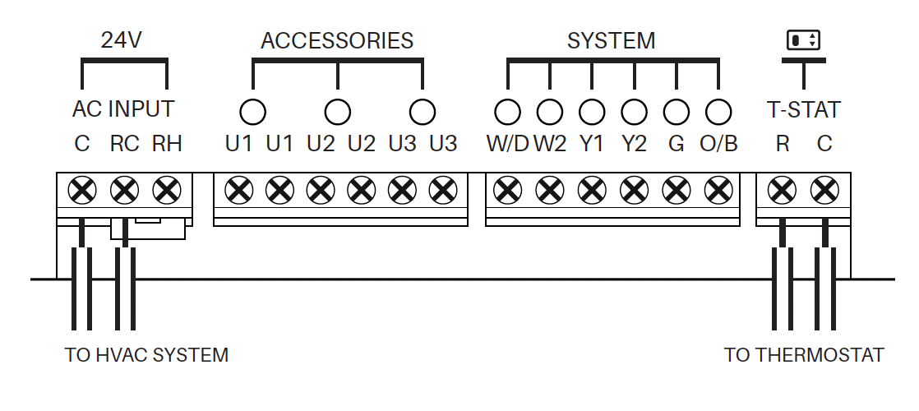
Wire the EIM
Remove the cover to the EIM.
Install wires coming from the thermostat to the R and C terminals (under T-STAT)
Install power wires coming from the HVAC system to the C and RC or RH terminals (under 24V).*
Install wires for the HVAC system and Accessories based on the wiring diagrams provided.
Power back on the HVAC system.
*Remove jumper if using separate transformers

Slide 26
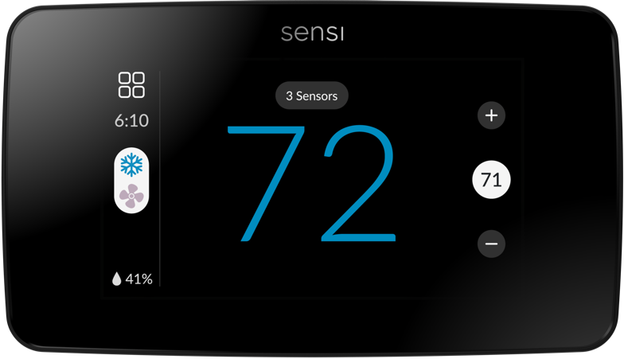
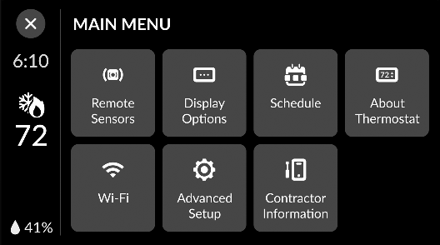
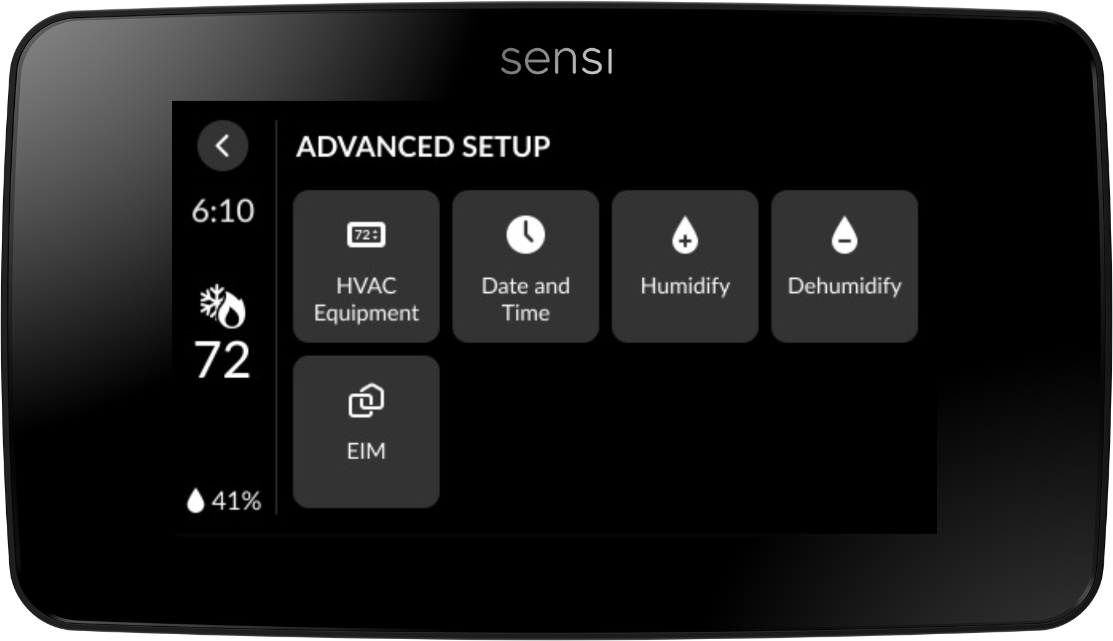
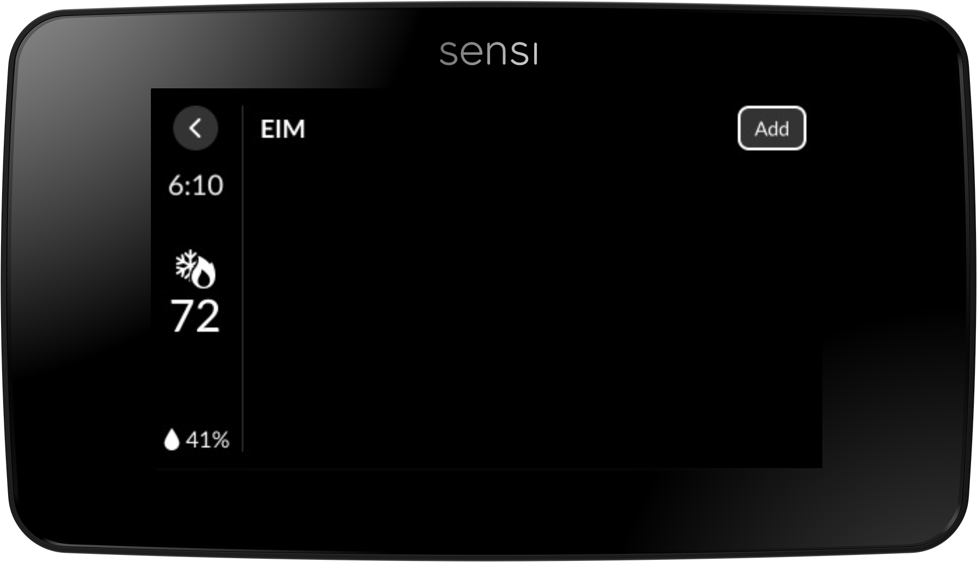
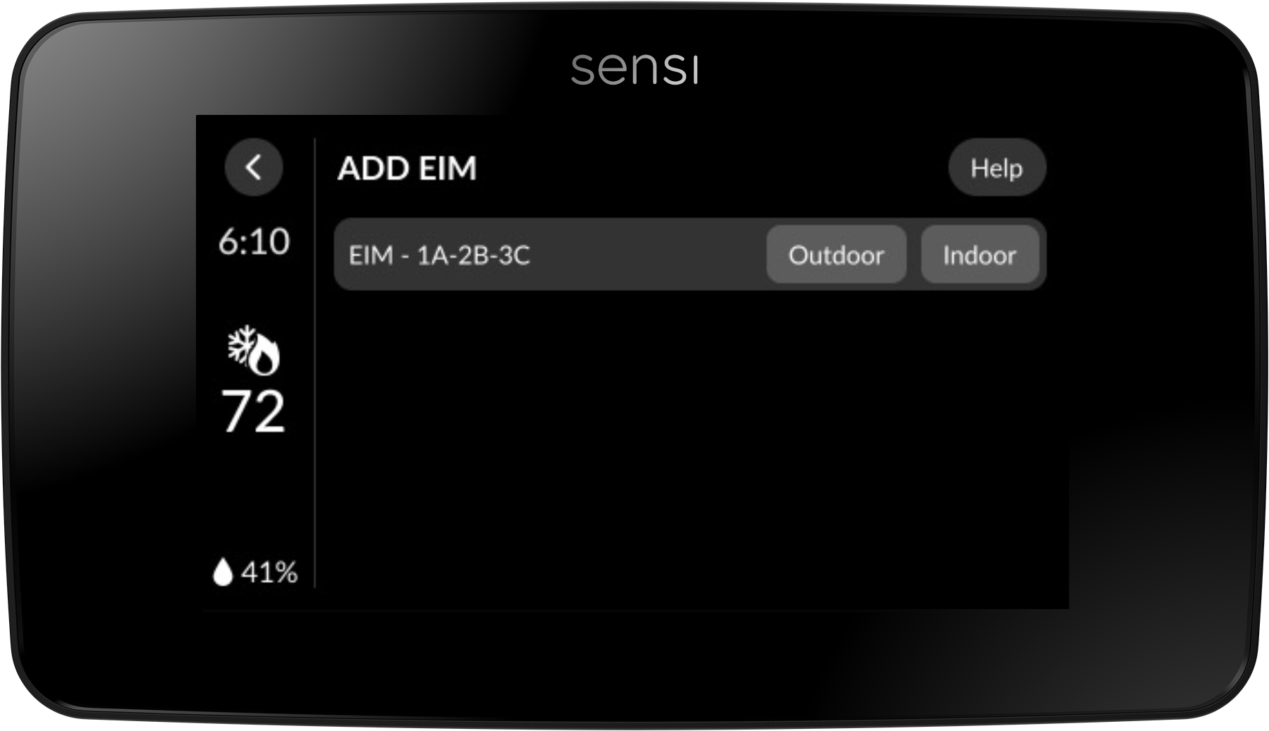
Connect EIM to Touch 2
When the Touch 2 is powered back up, Select Menu in the top left corner
Press Advanced Setup
Press EIM
This will display the EIM Configuration options. Press Add
Select if the EIM is being used indoors or outdoors
1
2
3
4
5

Slide 27
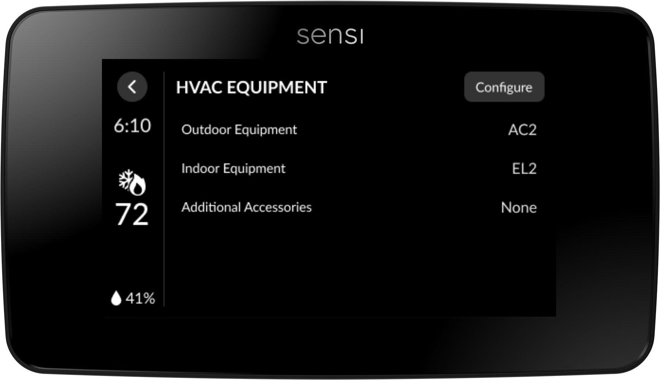
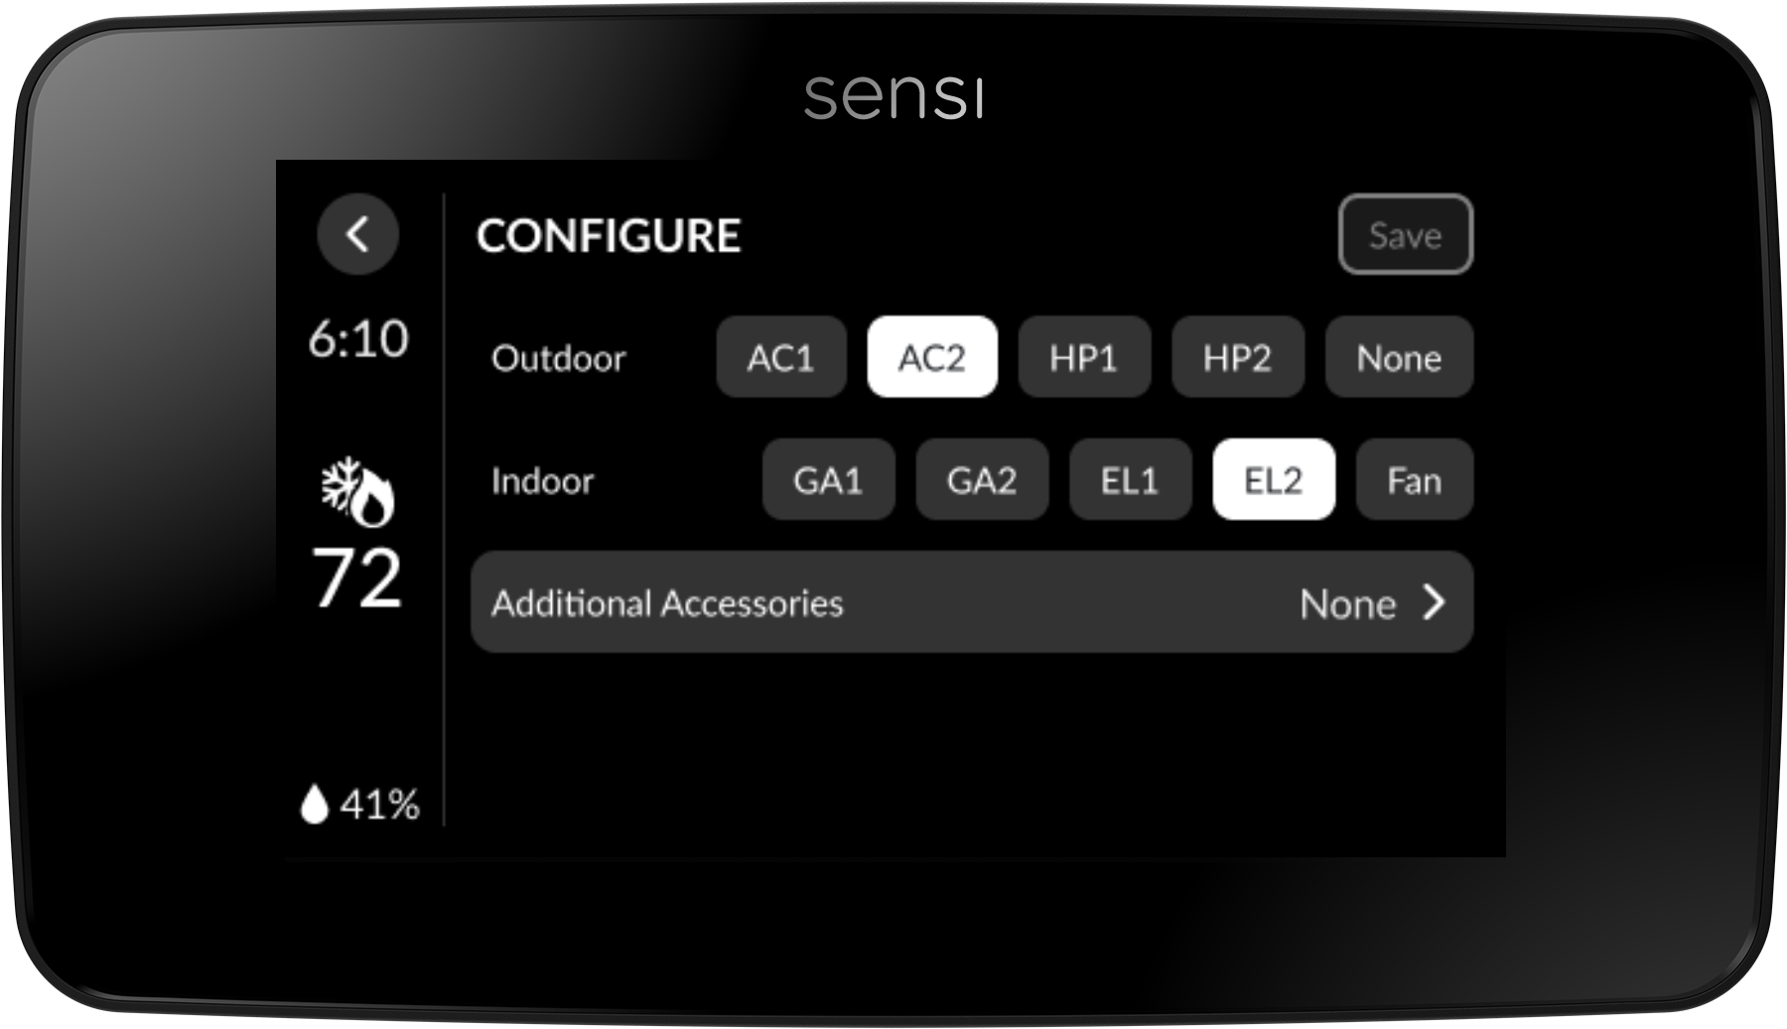
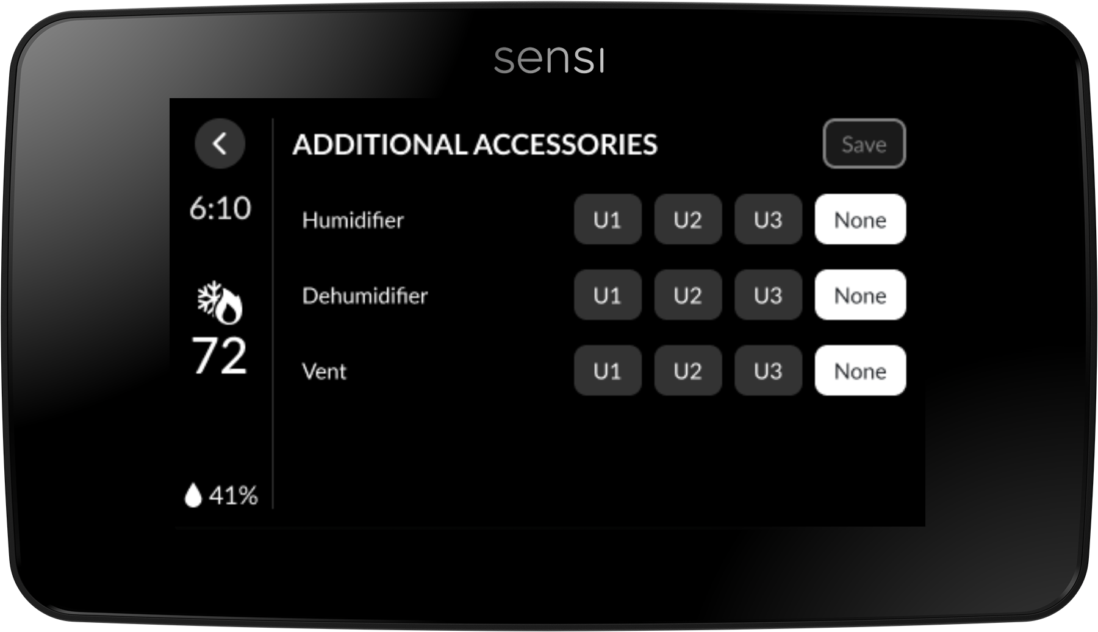
Configure Additional Accessories
Select Menu
Press Advanced Setup
Press HVAC Equipment
This will display the EIM Configuration options. Press Configure
Press Additional Accessories
For each accessory (hum, dehum, vent) that you wired to the EIM, select the terminal identifier next to it
1
2
3
4
5
6

Slide 28
System Troubleshooting
Symptom | Possible Cause | Corrective Action
EIM status LED light solid red | EIM is not connected | Press and hold the RESET button to restart the pairing process. Once the pairing process has started, the LED light will be flashing green. Once pairing process is complete, the LED light will be solid green.
EIM not connecting to Sensi Touch 2 smart thermostat | EIM may be located too far from the thermostat EIM signal is experiencing interference | Move the EIM closer and/or to a location that it gets better signal strength.
No Heat/ No Cool/ No Fan/ Blank Display (common problem) | 1. Blown fuse or tripped circuit 2. Furnace power switch to OFF 3. Furnace blower compartment door panel loose or not properly installed 4. Loose connection to thermostat or system | 1. Replace fuse or reset breaker 2. Turn switch to ON 3. Replace door panel in proper position to engage safety interlock or door switch 4. Tighten Connection
No Heat | 1. Heating System requires service or thermostat requires replacement | 1. Diagnostic: Set Mode to Heat and raise the setpoint above room temperature. Within five minutes the thermostat should make a soft click sound and “Heating” should appear on display. This sound indicates the thermostat is operating properly. If the thermostat does not click, try resetting the thermostat. If the thermostat does not click after being reset, contact your heating and cooling service person or place of purchase for a replacement. If the thermostat clicks, verify the heating system is operating correctly.
No Cool | 1. System not set to Cool 2. Loose connection to the thermostat or system 3. Cooling System requires service or thermostat requires replacement | 1. Diagnostic: Set Mode to Cool and lower setpoint below room temperature. Same procedures as diagnostic for “No Heat” condition except set the thermostat to Cool and lower the setpoint below the room temperature. There may be up to a five minute delay before the thermostat clicks in Cooling if the AC Protection feature is on.
Heat, Cool or Fan Runs Constantly | Possible short in wiring, thermostat, heat, cool, or fan system. | Check each wire connection to verify they are not shorted or touching other wires. If the condition persists, try resetting the thermostat.

Slide 29
Wi-Fi Troubleshooting
Symptom | Possible Cause | Corrective Action
No Wi-Fi Icon | Lost Wi-Fi credentials | Put Sensi in Wi-Fi setup mode and reconnect to Wi-Fi.
X Icon or X and Wi-Fi | 1. Unsuccessful Wi-Fi connection 2. Lost connection 3. Wi-Fi router incompatibility or high firewall setting 4. Servers down | 1. Incorrect home network password; retry with correct credentials. 2. Signal strength or interference. Reposition router and turn off additional devices until the cause is isolated. 3. Power cycle router off then on. Check router compatibility online at sensi.copeland.com and use recommended Wi-Fi settings. 4. Check server status online.
App Error | 1. Cannot Create Secure Connection/Unable to connect to Sensi Network 2. Can’t Connect to Sensi in Wi-Fi settings 3. Provisioning Error 4. Configuration Error 5. Authentication Error 6. Network Scan Error | 1. Check the security code is entered correctly, turn off mobile Data, turn off network switch, force close app, forget networks, ensure the correct path has been selected, reboot thermostat and phone, and reset Network Settings on the phone. 2. Spinning icon, reset phone and thermostat. 3. Reset router, phone, and thermostat. Make sure router security has recommended settings. Try another device. 4. Hard reset the thermostat and force close the app. 5. Check that the home Wi-Fi Network Password is correct. Forget network password and reconnect. 6. SSID needs to be reformatted to eliminate 'non-standard' characters or symbols.

Slide 30
Sensi Support
Available 7 days a week.
sensi.copeland.com/en-us/support
support@sensicomfort.com
888-605-7131
Mon.–Fri. 7am–7pm, Sat. –Sun. 8am–5pm (CST)

Slide 31
Our commitment to you
Reliable product with over 100 years of industry experience.
More cross references than the competition at comparable prices.
Trusted by more OEMs than any other brand.
Simple and fast installation through innovative technology and product features.
Contractor tools and support to ensure success.

Slide 32
Thank you.
R-6134. ©2025 Copeland LP.

