Slide 1
21V51D-751 Two-Stage Integrated Furnace Control

Slide 2
Business and Product Overview
21V51D-751 Two-Stage Integrated Furnace Control

Slide 3


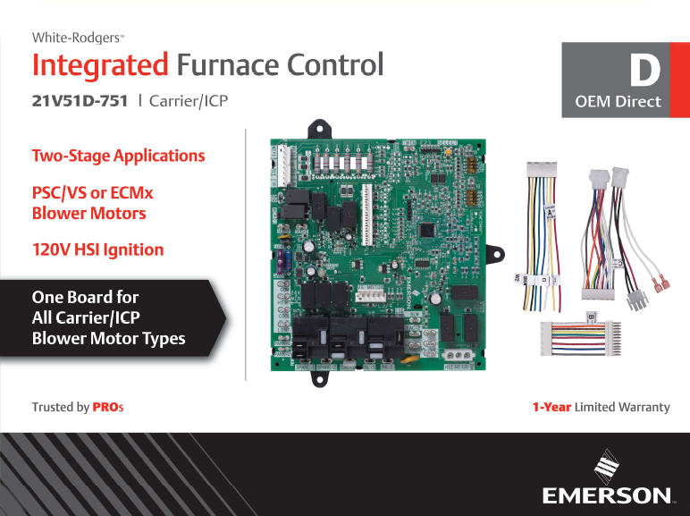









Introduction
The 21V51D-751 expands White-Rodgers' Carrier & ICP family Product Offerings
Provides an additional SKU for:

Slide 4
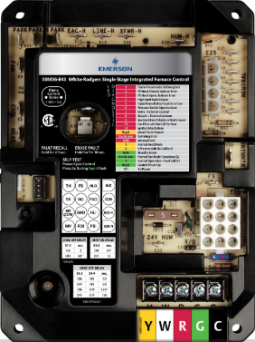
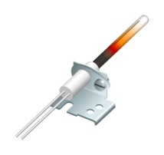
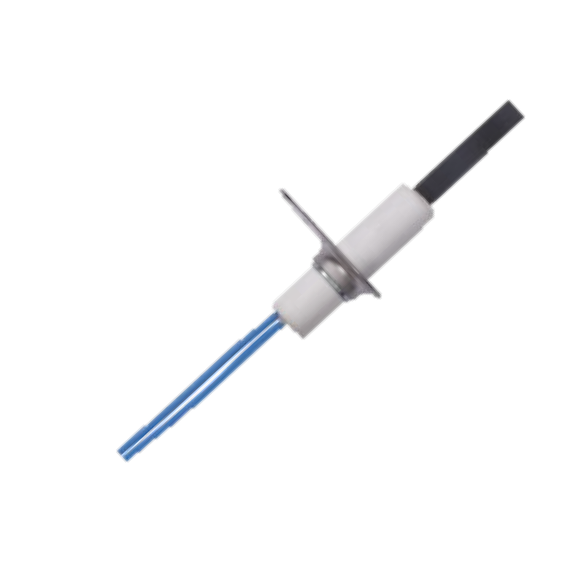
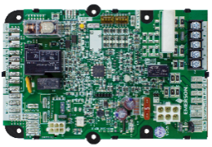
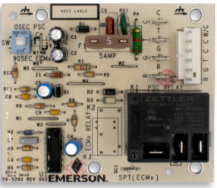
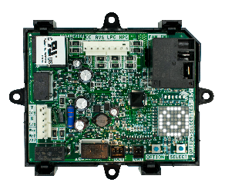
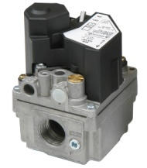
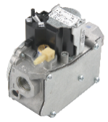
Extensive Carrier/ICP Offerings
Offering | Model Numbers | Replaces
Integrated Furnace Controls Single & 2-stage | 50M56U-751 21V51D-751 | HK42FZ004, 005, 007, 008, 009, 010, 011, 013, 015, 016, 017, 019, 020, 028, 034, 040, 041
Air Handler Controls | 48M55-751 48P55-751 | HK61EA002, 006, 010 1171734, 1172975
Ignitors, Nitride & Carbide | 767A-370 | LH33ZS001, 002, 003, 004
 | 789A-751A1 | LH33ZG001
 | 789A-751KT1/KT2 | 331930-751, 332505-751
Flame Sensor | 790-751A1 (Available August 2020) | LH33WZ511, 515, 517
 |  | LH680012, LH680014
 |  | LH33WZ521
Fan Timer - Universal | 50F06-843 | ST9120, ST9160 ICP Brand Intelligent Valve Systems
Defrost Control - Universal | 47D01U-843 | CES0110063, CES0130024 & 76 HK32EA series 1052757, 1069364, 1087952 & 53, 1093410, and many more
SureSwitch – Universal Contactor | 49P11-843 | 250+ Parts Replaced
Gas Valves | 36C03-333 36H32-423 36H33-412 36H64-463 36J22-214 36J54-214 36J24-214 | 1000+ Parts Replaced
Ignitors
Integrated Furnace Controls
Fan Timer
Air handler Controls
SureSwitch
Defrost Control
Gas valves

Slide 5
One SKU replaces 20 Carrier/ICP part numbers
The 21V51D-751 Kit includes all an installer needs for:
Two-stage applications
PSC/VS or ECMx blower motors
120V HSI Ignition

Slide 6
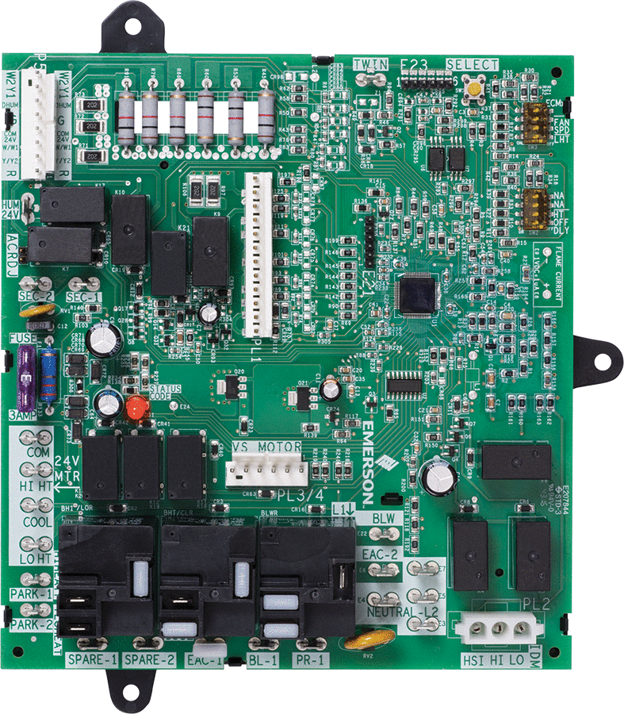
21V51D-751 Overview
First of its Kind to Replace PSC, Variable Speed and ECMx Applications
Reduces stocking SKUS
One SKU replaces several OEM and competitive models
Advance diagnostics for servicing
Tri-color LED shows operational status and fault codes
Simple push-button to retrieve fault codes
Premium home comfort
Continuous low-speed fan option for better temperature balance and full-time air cleaning
Easy dipswitch setup
Flame current test pads
Easy on-board checkout
Two-Stage 21V51D-751 replaces Carrier/ICP equipment brands Blower Motor Types-PSC, Variable Speed and ECMx with 120V ignition.

Slide 7
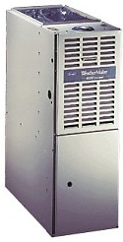
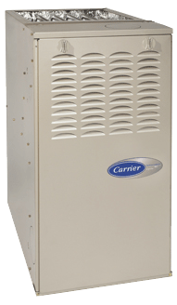
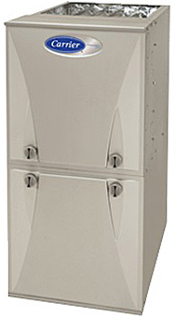
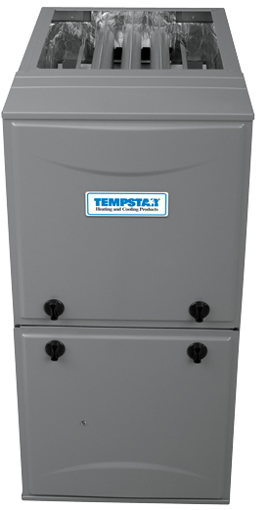
Installed Base
Suitable for many 2-stage furnaces from 1998 to present.
1998 | 2003 | 2009 | 2017
PSC, VS Units | PSC, VS Units | ECMx Units | Carrier ends production, ICP continues
“Block” style main harness | “Inline” style main harness

Slide 8


White-Rodgers is the Best Choice
Carrier/ICP Two-Stage 21V51D-751 Replaces 4 OEM SKUs
#1 Market Share equipment brand
A large installed base built since 1998 OEM product launch
Covers most applications
  20 cross references, OEM SKUs, all Carrier and ICP brands
Unique combination of the most install and service-friendly features
Competitive price, less expensive than OEM parts with more applications
White Rodgers | ICM | Honeywell
 | PSC/VS
 | ECMx
 | ICP

Slide 9
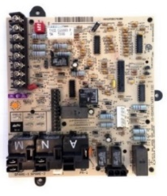
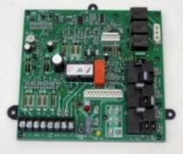
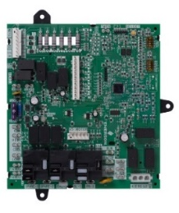
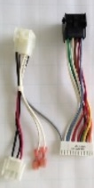

Replace More Parts with One SKU
Feature | Carrier/ ICP | ICM 2807 | WR 21V51D-751
Brands Serviced | Carrier & ICP | Carrier Only | Carrier & ICP
Capacity/ Cross Reference | 4 SKU for 20 Cross References | 1 SKU for 6 Cross References | 1 SKU for 20 Cross References
Blower Motors Supported | PSC, VS, ECMx | PSC, VS | PSC, VS, ECMx
PCB Material | Cheaper CEM-1 | Robust FR4 | Robust FR4
Flame Current Test Pads |  |  | Yes
LED | Single Color | Single Color | Tri-Color
Status Codes (Cool & Heat Stages, Fan) |  |  | 8 Codes
Retrieve & Clear Faults | Unplug Limit Wire | Easy-Push Button | Easy-Push Button
Control Field Self-Test | Harder-Wire Jumper | Harder-Wire Jumper | Easy-Push Button
Fan Only Speed Setup | By Thermostat Often Wrong | Jumper | Easy-Dipswitch

Slide 10

Customer Driven Packaging
Easy To Merchandise, Select, And Use
Direct OEM
Product Type & Color Code
  Red = Indoor Units
  Purple = Outdoor Units
  Gold = Commercial
Model Number
Large Product Image(s)
Key Attributes
  Stages
  Blower Motor Type
  Ignitor Voltage
  Other
Cross Reference on Carton
2
1
3
4
5
6

Slide 11

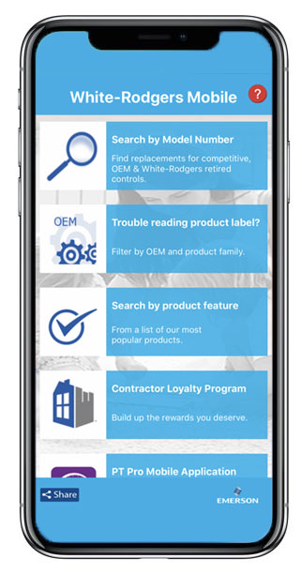



WR Mobile App
Always up-to-date and easy to use:
Mobile App
White-Rodgers Website
Your resource for:
Product information and spec sheets
Complete Cross Reference
OEM compatibility
Installation information and videos
Wiring diagrams
Download:
Go to your app store
Type in WR Mobile
Install the app
OR
Open your camera
Hold it over the QR code
Tap “Open” on the
pop-down
Install the app

Slide 12
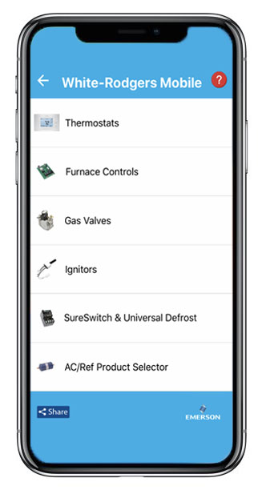
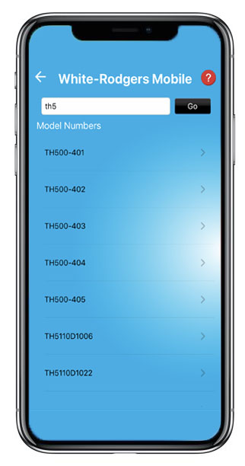
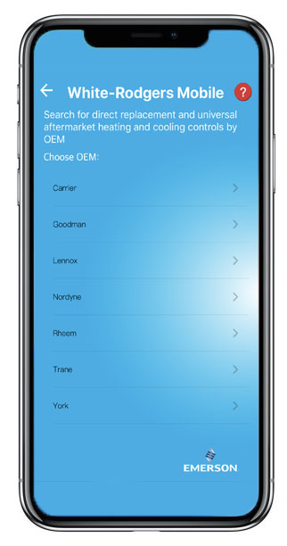
WR Mobile App
Easy to use!
Search by OEM, Competitive, or White-Rodgers Model Number
Product Number
Scrollable Product List
WR Replacement

Slide 13

White-Rodgers Cross Reference
Go to: www.whiterodgers.com
Hover over Tools & Resources
Click on: White-Rodgers Cross Reference/Product Information
Enter the Model Number or click on: Search Replacement Heating Controls by Major OEM Brand

Slide 14


Wholesale Resource Site
Access useful resources to grow your business.
Visit: https://climate.emerson.com/en-us/brands/white-rodgers/white-rodgers-wholesaler-resource-center
You’ll find videos, stocking lists and product launch information for the following product families:
Heating Controls
Cooling Controls
Sensi Smart Thermostats
Traditional Thermostats
Contractor Rewards
Product Merchandising

Slide 15

Why Contractors Trust White-Rodgers
Industry Leading Products
Used by more OEM’s
Offering the widest range of Universal Replacement Controls
Ease of Installation
Simple, easy to understand instructions
Product Reliability
Quality Control assures reliable products
Affordable
Competitive pricing
Supported by Knowledgeable Representatives
Contractor direct phone support

Slide 16
Technical
21V51D-751 Two-Stage Integrated Furnace Control

Slide 17
21V51D-751 Overview
First of its Kind to Replace PSC, Variable Speed and ECMx Applications
Reduces stocking SKUS
One SKU replaces several OEM and competitive models
Advance diagnostics for servicing
Tri-color LED shows operational status and fault codes
Simple push-button to retrieve fault codes
Premium home comfort
Continuous low-speed fan option for better temperature balance and full-time air cleaning
Easy dipswitch setup
Flame current test pads
Easy on-board checkout
Two-Stage 21V51D-751 replaces Carrier/ICP equipment brands Blower Motor Types-PSC, Variable Speed and ECMx with 120V ignition.

Slide 18
21V51D-751 Board Layout and Key Parts
Plastic mounting tray: 3 tabs
Twinning
Fault recall & test button
Thermostat connector
Main harness connector
PSC/VS or ECMx blower select dipswitch
(PSC/VS is default)
24V humidifier output
ACRDJ jumper
Option dipswitches including fan
only speed
Transformer 24V connections
Replaceable fuse, mis-wire protection
Flame current test pads
Tri-color LED
Variable speed motor connector. Interfaces to daughter board. (Carrier brands only) (set blower dipswitch to PSC/VS to utilize)
ECMx Blower: 3 relays and connections (24V)
3/16” spades
PSC Blower: 3 relays and connections (120V)
¼” spades
Electronic air cleaner output (remove safety cap)
Ignitor & inducer connector
NOTE: The 5 Capped terminals are never used

Slide 19
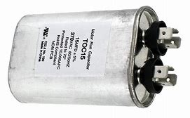
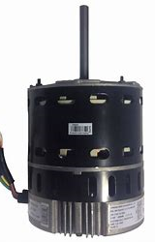
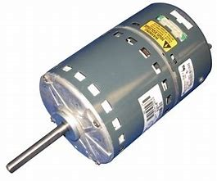
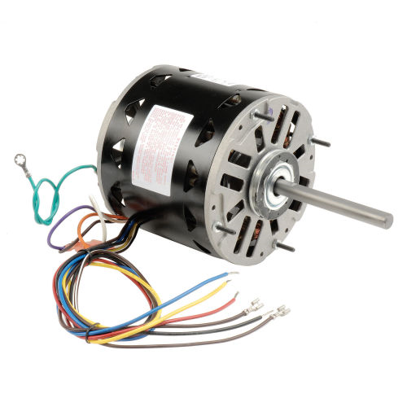
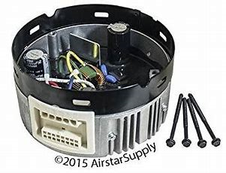
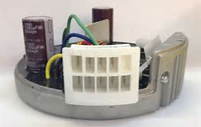
Supported Blower Motor Types
Feature | PSC | ECMx | ECM VS 16-Pin
Capacitor or Software | Capacitor | Software | Software
AC or DC Motor | AC | DC | DC
Efficiency | Lower | High | Higher
Supply / Control Power | Line / Line | Line / 24V | Line / 24V
Performance Feature | Base | Constant Torque | Constant CFM
Daughter Card | N/A | N/A | Yes*
NOTE: White-Rodgers does not support ICP VS applications due to an uncommon daughterboard scheme.
L1/L2 SUPPLY
24V CONTROL

Slide 20
Cross Reference
Carrier PSC/VS | Carrier ECMx | ICP PSC Only* | ICP ECMx | ICM PSC/VS
325879-751 | CEPL130948-01 | 1172551 | 1184408 | ICM2807
CEPL130455-01 | CEPL130948-02 | 1172809 | CEPL131043-01
HK42FZ005 | HK42FZ028 | HK42FZ019 | HK42FZ041
HK42FZ010 | HK42FZ040 | HK42FZ020
HK42FZ015 |  | CEPL130591-01
HK42FZ017 |  | CEPL130591-41
NOTE: White-Rodgers does not support ICP VS applications due to an uncommon daughterboard scheme.

Slide 21
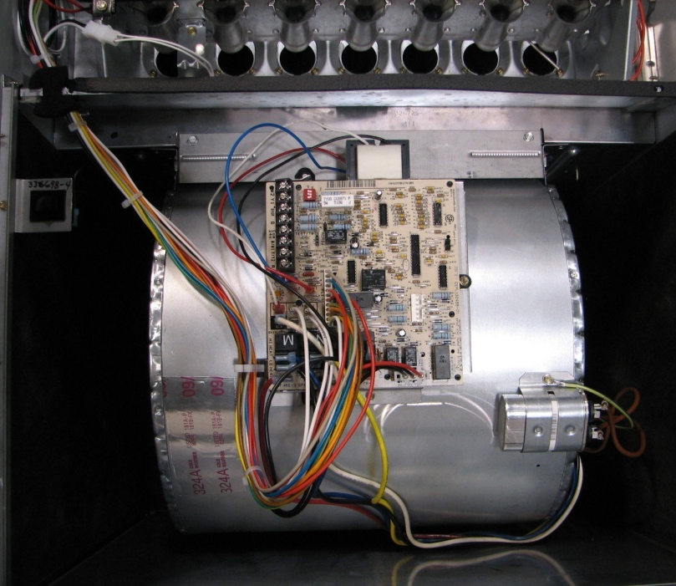
Easy Installation
Mounts exactly like OEM board
All key wiring connectors in the same location as original OEM board
120 VAC ignitor output
Confirms installation with push-button self-test routine
Easily-wired thermostat harness

Slide 22
Specs
Electrical Ratings
Voltage input: 18 to 30 VAC, 60 Hz
Current: 0.8 amp @25 VAC
Operating Temperature Range
-40° to 175°F (-40° to 80°C)
Humidity Range
5 to 95% relative humidity (non-condensing)
Gasses Approved
Natural, manufactured, mixed, liquified petroleum, and LP gas air mixtures are all approved for use.
Timing Specifications
(All times are in seconds unless noted otherwise)
Flame Current Requirements
Min current to insure flame detection: 0.25 μA DC*
Max current for non-detection: 0.1 μA DC
Max allowable leakage resistance: 150 Mohms
*Measuring with a DC voltmeter (1VDC = 2 μA)
Operating Temperature Range
-40° to 175°F (-40° to 80°C)
Mounting
Plastic tray
15 | 17 | 3 Times | 15 | 240 | 45/25 | 90/120*/150/180 | 3 | 3/90* | 60 Mins
Heat ON Delay
Low Heat/
High Heat
Ignitor Warm-Up
Lockout-Time
Heat OFF Delay
Cool OFF Delay
Post-Purge
Cool ON Delay
Auto Reset
Pre-Purge
Retries
*Default

Slide 23
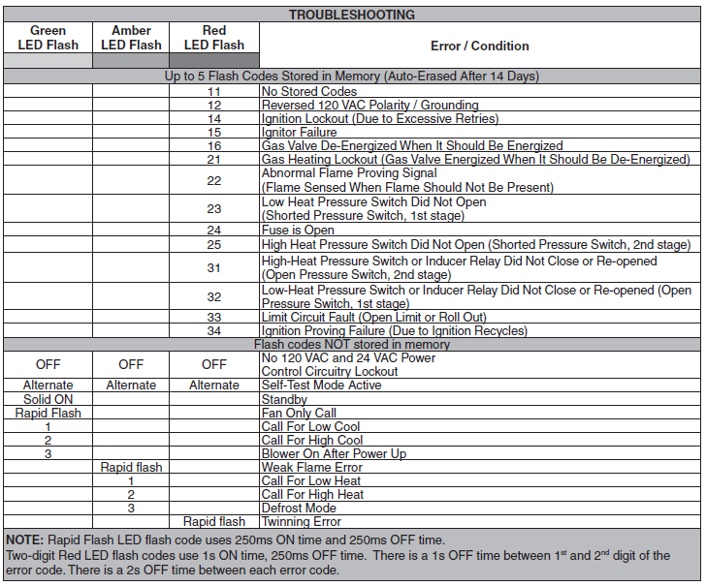
Troubleshooting
FAULT AND STATUS CODES
The LED will indicate fault or status codes as shown in the table below:

Slide 24
Install
21V51D-751 Two-Stage Integrated Furnace Control

Slide 25

Introduction
The 21V51D-751 is a Two-Stage HSI Integrated Furnace Control kit for many Carrier and ICP equipment brands with PSC, Variable Speed, and ECMx Blowers configured via dipswitch selection.
With 3 harness assemblies, the 21V51D-751 cross references 20 different OEM part numbers.
NOTE: 21V51D-751 CANNOT be twinned with any Carrier, ICP, or ICM brand controls. Both control boards must be from the same manufacturer for proper functionality.

Slide 26
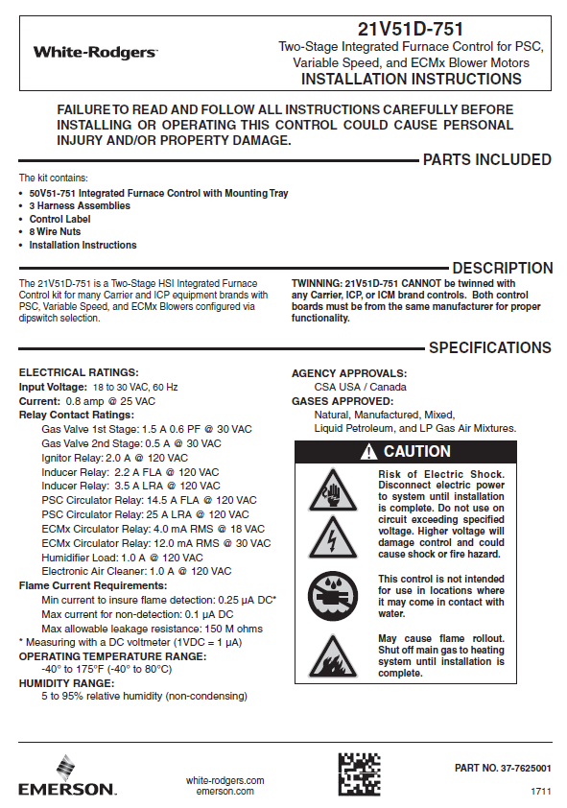
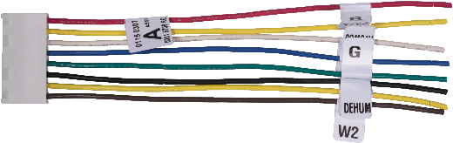
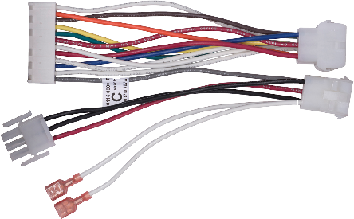
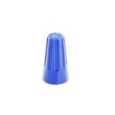
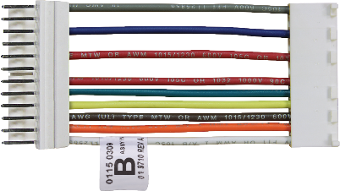
What’s in the Box?
1 - Carrier Two-Stage 21V51D-751 + Mounting Tray
1 - Instruction sheet available in three languages (SP online)
3 - Harness Assemblies
1 - Control Label
8 - Wire Nuts

Slide 27

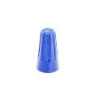
Feature and Design – Accessory Wiring Adapters
Harness “A” – Thermostat
Use with the included wire nuts to make the thermostat connections, then plug onto control. Wires are color coded and tagged for easy ID.
Easy wiring: make connections without working inside furnace, then plug-on when ready to finish install.

Slide 28
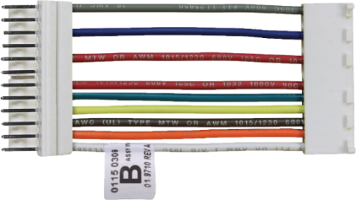


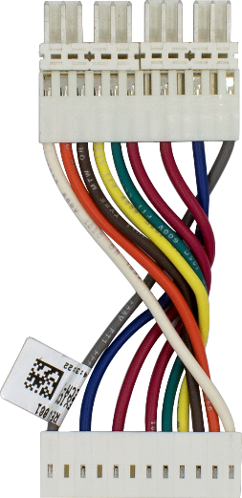
Feature and Design – Accessory Wiring Adapters
Harness “B” - the ICP “Flip”
Used to convert the Carrier control board inline main harness pinout to the reversed ICP pinout.
Because of the locking polarized tab on the mating connectors you can’t simply invert the existing wiring, but flipping our B harness allows the pins to match up perfectly.
The ICP “Flip”
1-2-3-4-5-6-7-8-9-10-11-12
The ICP “Flip”
12-11-10-8-7-6-5-4-3-2-1

Slide 29
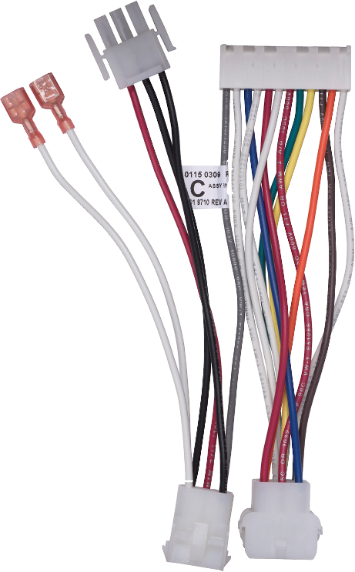
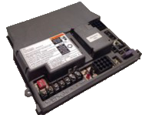
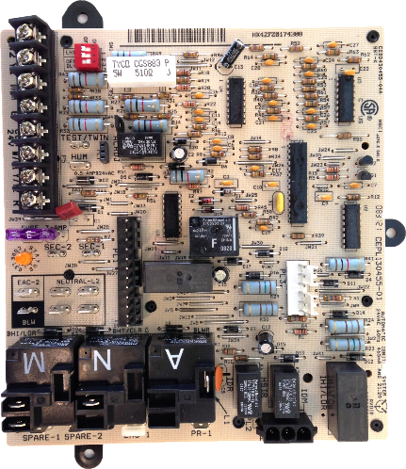
Feature and Design – Accessory Wiring Adapters
Harness “C” - Block to Inline Converter
Used with older style furnaces having “block” style main system connector. Converts wiring to use new style board with “inline” style connector. (Carrier and ICM have a similar harness in their kits.)
INLINE – Plugs into the board
BLOCK – Plugs into furnace wiring
“Block” style circa 1998
“Inline” style started 2003

Slide 30
Harness Selection Table
Control | Brand | Blower | Thermostat “A” | ICP Flip “B” | Old Style Carrier “C” | Control
CEPL130948-01 | Carrier | ECMx | ✓ |  |  | CEPL130948-01
CEPL130948-02 |  |  |  |  |  | CEPL130948-02
HK42FZ028 |  |  |  |  |  | HK42FZ028
HK42FZ040 |  |  |  |  |  | HK42FZ040
325879-751 |  | PSC / VS |  |  |  | 325879-751
CEPL130455-01 |  |  |  |  |  | CEPL130455-01
HK42FZ017 |  |  |  |  |  | HK42FZ017
HK42FZ005 |  |  |  |  | ✓ | HK42FZ005
HK42FZ010 |  |  |  |  |  | HK42FZ010
HK42FZ015 |  |  |  |  |  | HK42FZ015
ICM2807 | ICM | PSC / VS |  |  |  | ICM2807
1184408 | ICP | ECMx |  |  |  | 1184408
CEPL131043-01 |  |  |  |  |  | CEPL131043-01
HK42FZ041 |  |  |  |  |  | HK42FZ041
1172551 |  | PSC Only |  | ✓ |  | 1172551
1172809 |  |  |  |  |  | 1172809
CEPL130591-01 |  |  |  |  |  | CEPL130591-01
CEPL130591-41 |  |  |  |  |  | CEPL130591-41
HK42FZ019 |  |  |  |  |  | HK42FZ019
HK42FZ020 |  |  |  |  |  | HK42FZ020

Slide 31
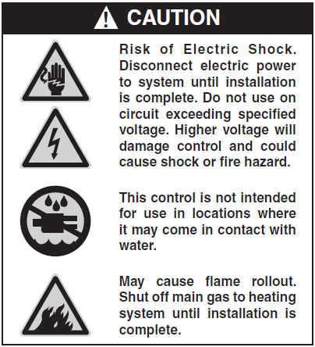
Pre-Install Steps
Pre-Install Steps
Disconnect electrical power and gas supply to unit, then remove unit access panel.
Mark and disconnect all wires from the existing control, then remove existing control. (It’s always a good idea to snap a quick picture).
Refer to the Harness Descriptions, Harness Table, Wiring Diagram, and Dipswitch Configurations to connect and setup new control board to unit.
NOTE: All wiring should be installed according to local and national electrical codes and ordinances.

Slide 32
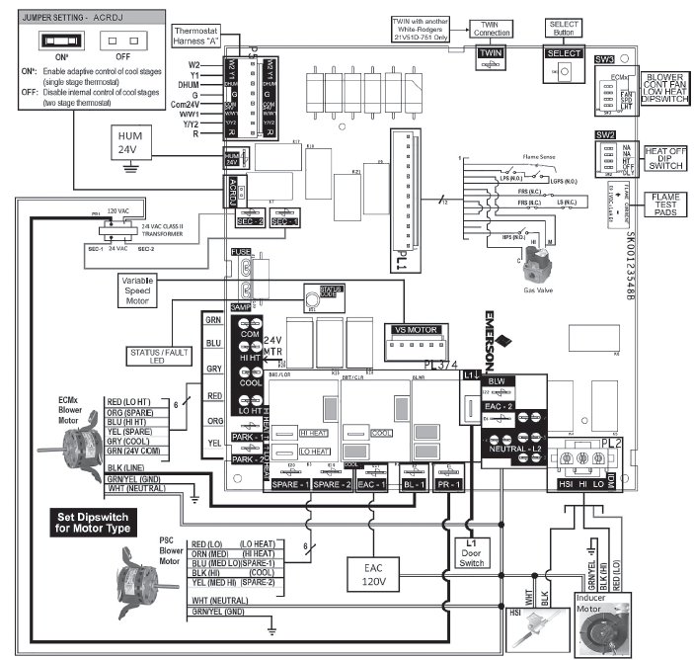
Wiring Diagram
A full-size wiring diagram is included within the instruction sheet in
every box.

Slide 33
Dipswitch Configuration
Blower Motor Type
  Default Operation PSC/VS
Low Heat Only Mode
  Default Operation OFF (Single Stage Thermostat)
Heat Off Delay
  Default Operation 120 seconds
Continuous Fan Speed
  Default Operation Low Heat Speed
To change settings break through yellow protective plastic film and make adjustments.
Shown switched to ECMx in this example)

Slide 34
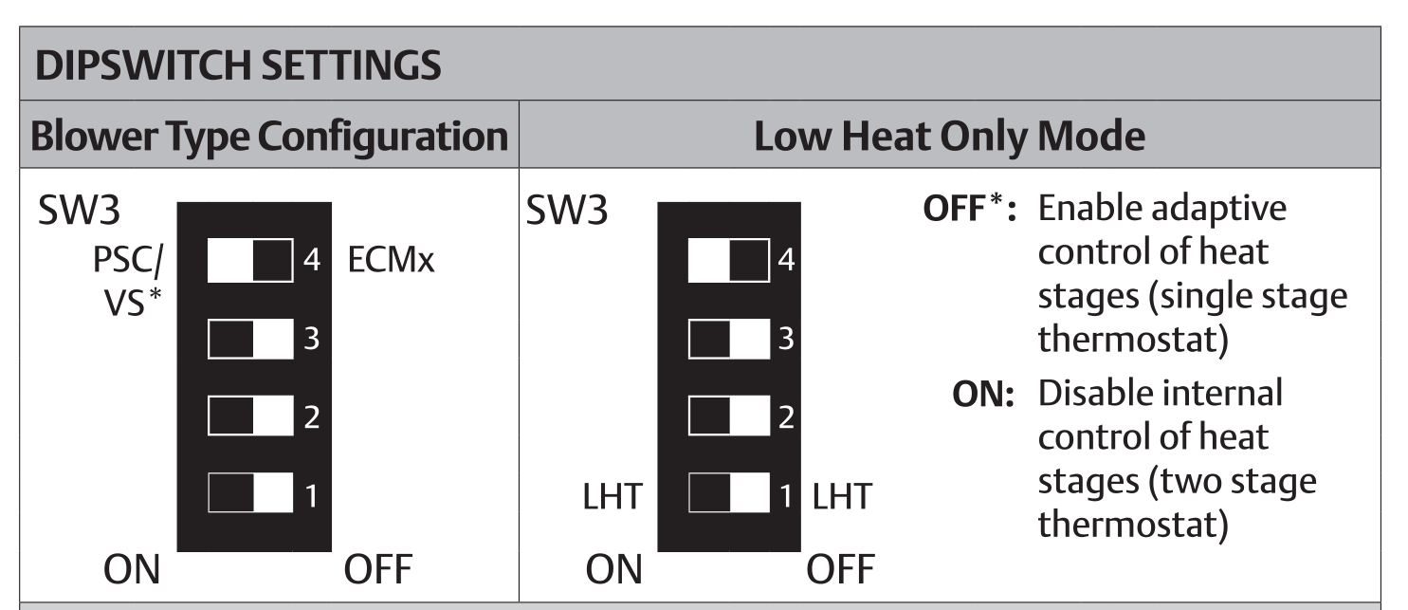
Dipswitch Configuration
Blower Type and Low Heat Only
Dipswitches must be set for blower type the board is being configured for.
NOTE: Cycle power after changes are made.
If configuring for ECMx, dipswitch must be switched to OFF position.
“Low Heat Only” dipswitch selection allows a single stage thermostat to remain installed, where traditionally a new thermostat would be required.

Slide 35
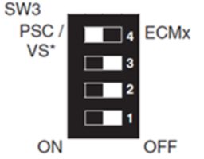
Variable Speed Notes
Carrier Brands Only – ICP Brands Not Supported
Ensure blower type dipswitch is set to PSC / VS.
The green DEHUM wire from the VS motor connects to G terminal (green wire of “A” harness) if previously connected to G on original control board. Cut the existing 1/4” spade terminal off, strip the wire and attach with a supplied wire nut.
NOTE: The green DEHUM wire from the VS motor may have been spliced to a thermostat wire connected to a Carrier Thermidistat™ DHUM terminal. Leave it this way and DO NOT connect it to the DHUM terminal (black wire of “A” harness) on new control board.
The 2 white wires previously connected to the 1/4” HUM spade terminal of the original control board need to be connected to the 1/4” HUM 24V terminal on the new control board.
NOTE: For Variable Speed units, plug existing 6-pin connector from daughter board to “VS MOTOR” PL3/4 on new control board.

Slide 36
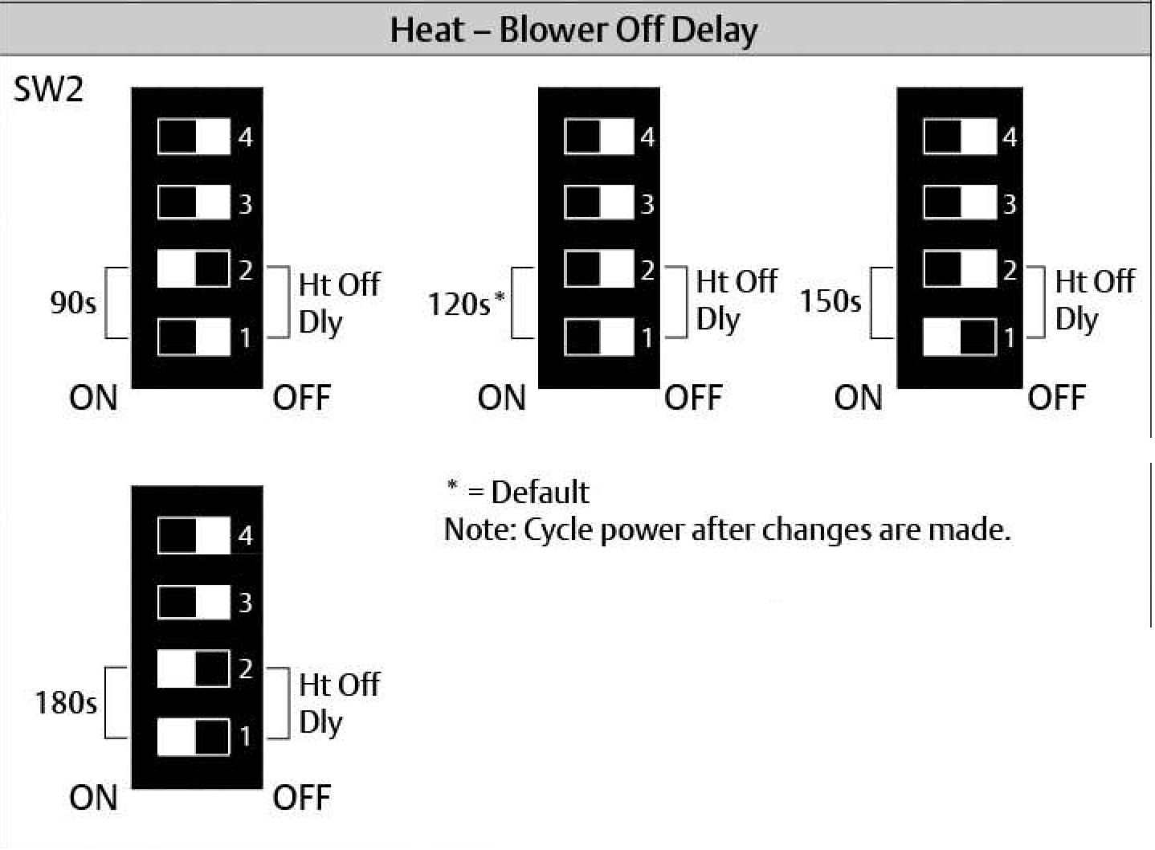
Dipswitch Configuration – Heat Off Delay
Set dipswitch for desired blower run time at the end of a heating cycle.

Slide 37
Dipswitch Configuration - Fan Only Speed
Carrier requires that continuous fan speed is set through the thermostat.
OEM control board installs can be accidentally set for an undesired fan only speed.
Occurs when the G terminal gets “toggled” with 24VAC by accident.
Can result in functional parts being replaced.
White-Rodgers 21V51D-751 uses easy-to-understand dipswitch to set fan speed setup which cannot get “toggled” accidentally.

Slide 38
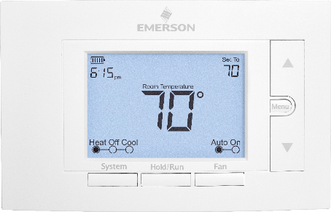
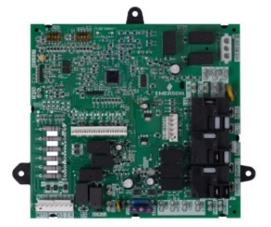
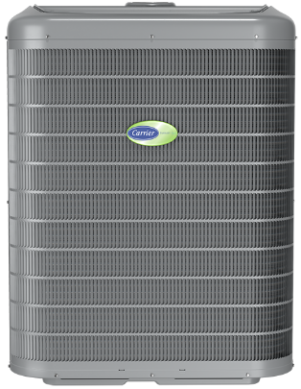
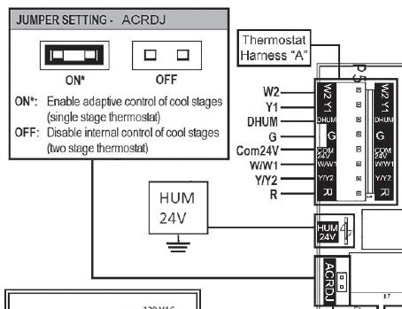
Air Conditioning Relay Disable Jumper (Adaptive Cooling)
The 21V51D-751 can operate a two-speed A/C unit with a single-stage thermostat using an adaptive algorithm which selects between low-cooling or high-cooling operation.
  MEANING: No need to replace a thermostat!
Control engages a two-stage cool operation, based on run time, without a two-stage thermostat.
For single stage thermostat applications with a two-stage outdoor unit, just ensure the ACRDJ jumper is present, to pass operation to the 21V51D-751.
NOTE: For adaptive cooling operation, connect thermostat cool input to Y1 terminal (yellow wire of “A” harness).

Slide 39

Operation Modes included in instruction sheet
Operation: Heat Mode
Amber LED: 1 flash
Amber LED: 2 flashes
Green LED: ON
NOTE: See instruction sheets in packaging for full list of operation modes.

Slide 40

21V51D-751 Self-Test
Self-Test Procedure:
Runs each component after install to ensure proper operation.
  Checks the functionality of the control, ignitor, inducer, and blower.
Easily-accessible push-button
Ensure the thermostat is turned OFF or thermostat wires are disconnected to enable.
NOTE: Self-Test is available after power up and until a solid green LED is present (5 seconds after power up). During this time, the control will ignore all active calls.
If a solid green LED is present, disconnect power for 10 seconds and retry.

Slide 41
21V51D-751 Self-Test Operation
Enter Self-Test by:
Turn on power and manually close blower door switch.
Wait 1 second.
Slowly double-click SELECT button within 3 seconds.
Sequence is as follows:
LED will flash in red the previous error code 4 times
Afterward, the LED will slowly flash alternate colors (red, amber, green) to indicate Self-Test is active and continue until Self-Test is complete
  Inducer motor will turn ON at HIGH speed and continue running until Self-Test is complete
  After 7 seconds, the ignitor will turn ON for 15 seconds, then OFF
  Blower motor operates on LOW HEAT speed for 10 seconds
  Blower motor operates on HIGH HEAT speed for 10 seconds
  Blower motor operates on COOL speed for 10 seconds
  Blower motor turns OFF
  Inducer motor goes to LOW speed for 10 seconds and then turns OFF
LED will display solid green to indicate Standby mode

Slide 42
Troubleshooting
FAULT AND STATUS CODES
The LED will indicate fault or status codes as shown in the table below:

Slide 43

Troubleshooting Fault Recall and Reset
Fault Recall
When the control is in standby mode (no call for heat or cool), press the "SELECT" button for approximately 2 to 5 seconds or until the diagnostic LED turns off. Up to 5 fault codes are stored.
NOTE: While displaying the stored fault codes, the control will ignore any new call for heat, cool or fan.
Reset
When the control is in standby mode (no call for heat or cool), press the "SELECT" button for 5 to 10 seconds or until the diagnostic LED begins to rapid flash.
NOTE: If the switch is held pressed for over 10 seconds the rapid flash will stop and the LED will be on to indicate return to normal status.

Slide 44



Troubleshooting Flame Current Test Pads
Flame current test pads
Flame Current Test Pad Feature
Easy access test pads provide valuable diagnostic information to technicians and improve service call performance.
Set meter to DC volt scale and place leads on test pads with the furnace burners on.
Reading results: 0.5 – 1.0 = marginal, 1.0 – 5.0 = good
Note: Lower than acceptable readings will cause furnace control to halt operation and display a rapid Amber LED flash code = Weak Flame Error (as shown on Control box label). Flame sensor should be cleaned or replaced as needed.
vs
Dirty
Clean
R-5088

