Slide 1
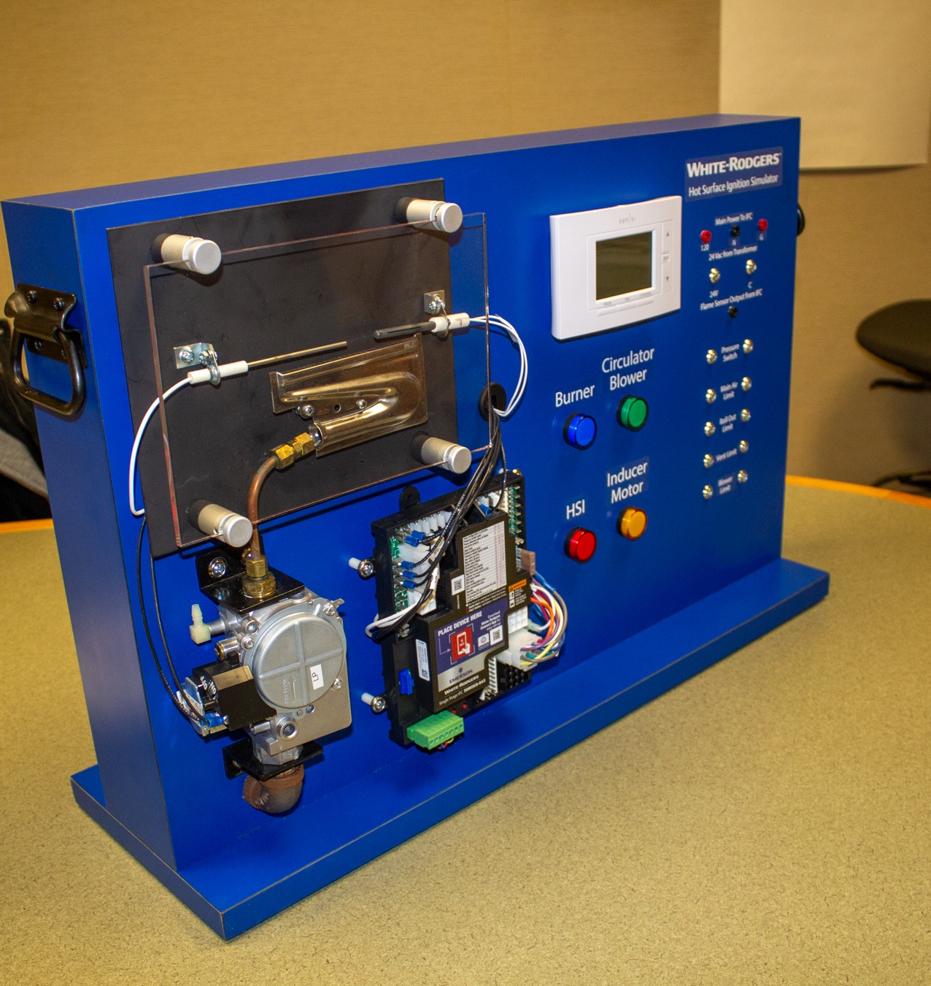
Integrated Furnace Controls
HSI Simulator Presentation

Slide 2
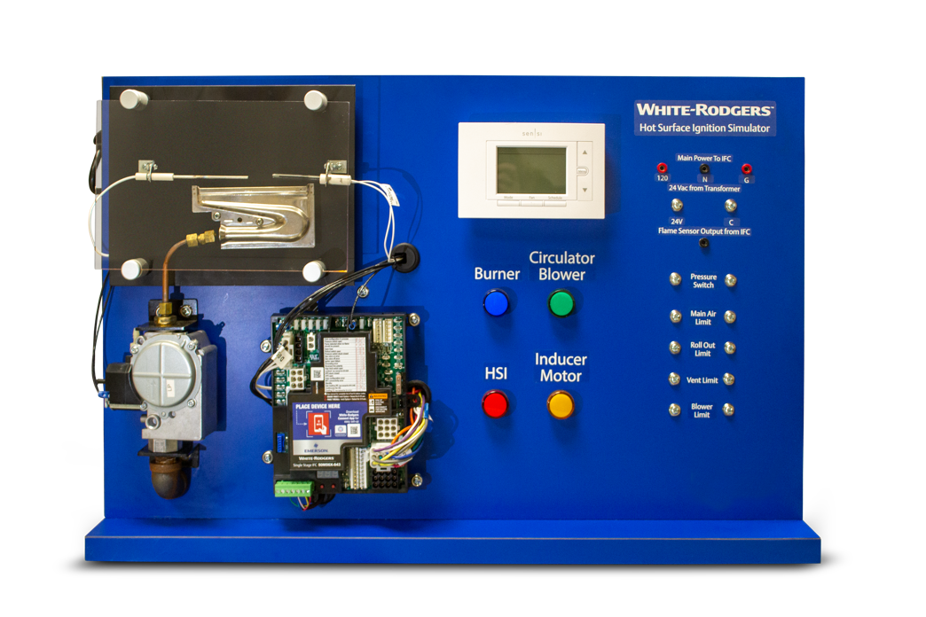
Course Agenda
Part One | Furnace Control Operation
Part Two | Understanding the Sequence of Operation
Part Three | Choosing the Correct Furnace Control
Part Four | Troubleshooting Furnace Controls

Slide 3
Furnace Control Operation
Part one

Slide 4
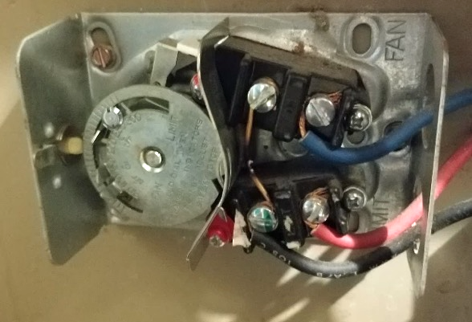
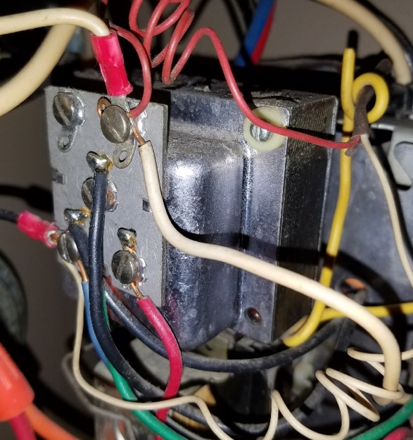
Furnace Operation
The development of printed circuit boards has advanced the technology, control, and efficiency in the HVACR industry
Mercury bulb thermostats, fan-limits, and other analog controls are switches that control loads—there is little to no communication between them
Modern integrated furnace controls, or IFCs, are the circuit boards within the furnace that control every function in a specific timing sequence, and monitor vital safety circuits while communicating with auxiliary equipment

Slide 5
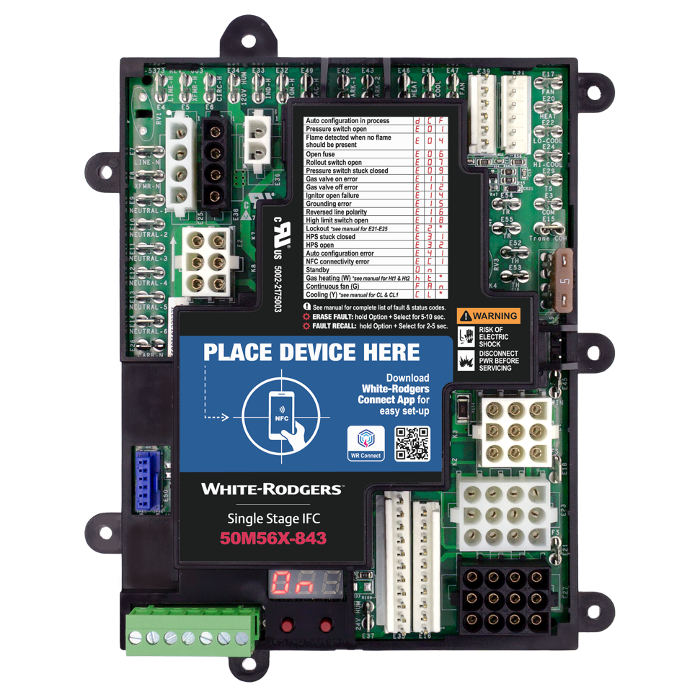
Furnace components and how they connect to an Ignition Control Board
White-Rodgers 50M56X-843
1
2
3
Humidifier
Electronic air cleaner
Blower motor:
  PSC Fan, Cool, Heat speed taps
  ECMx Fan, Cool, Heat speed taps
  ECMx Motor Inline Connectors
Thermostat terminals
Main Harness Connectors (5 Options*)
  Pressure switch
    Proof of venting
    Condensate
  Limit Switches
    Main air limit
    Vent limit
    Blower limit
    Rollout
  Flame sense
Inducer / Ignitor Connectors (4 Options*)
3
6
5
4
1
* Only 1 main harness and inducer / ignitor connector is utilized in a given application. Harness pinout configuration is determined by autoconfiguration process at startup, see instruction manual for additional details.

Slide 6
50M56X-843 Furnace Components and How They Connect to An Ignition Control Board
Humidifier
Electronic air cleaner
Blower motor:
  PSC Fan, Cool, Heat speed taps
  ECMx Fan, Cool, Heat speed taps
  ECMx Motor Inline Connectors
Thermostat terminals
Main Harness Connectors (5 Options*)
  Pressure switch
    Proof of venting
    Condensate
  Limit Switches
    Main air limit
    Vent limit
    Blower limit
    Rollout
  Flame sense
Inducer / Ignitor Connectors (4 Options*)
1
2
3
3
6
5
4
1
* Only 1 main harness and inducer / ignitor connector is utilized in a given application. Harness pinout configuration is determined by autoconfiguration process at startup, see instruction manual for additional details.

Slide 7
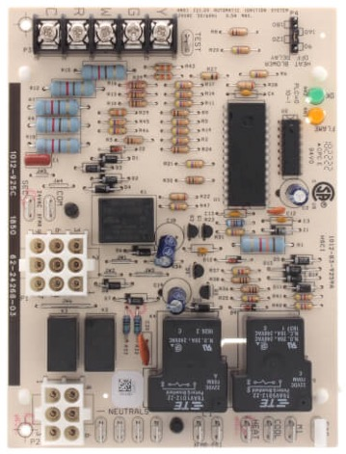
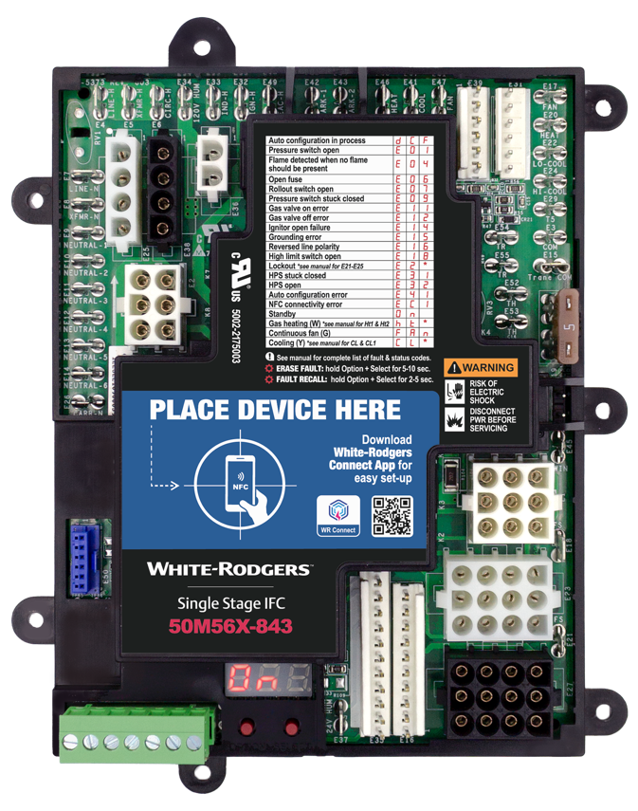
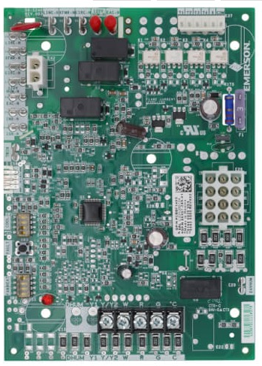
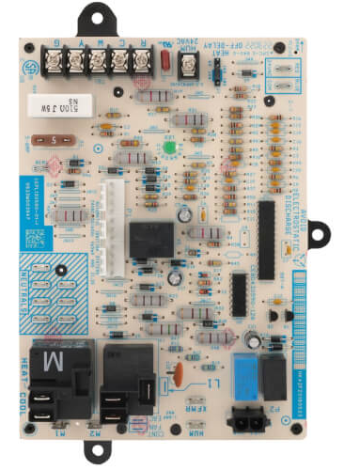
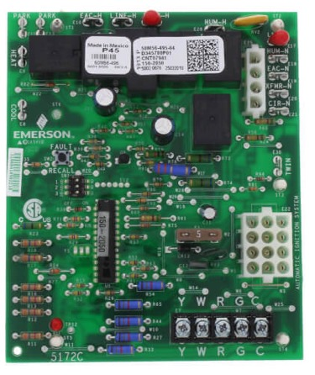
Universal Controls: Adaptors or multiple connectors used to connect to different OEM harnesses.
White-Rodgers 50M56X-843
Lennox/Allied
Rheem 62-24268-03
Goodman PCBBF145S
Carrier HK42FZ018
Trane CNT07941
Lennox/Allied
Identify connector types on control being replaced and plug the OEM wiring harness directly on to 50M56X-843. Not every connector will be used.

Slide 8
Understanding the Sequence of Operation
Part Two

Slide 9
Sequence of Operation
The sequence of operation is the set of functions performed by the integrated furnace control
Every IFC from every manufacturer follows the same sequence of operation
  Variations occur depending on the different types and numbers of safety switches and the wiring of the switches themselves
IDM Pre-Purge | Ignition Trial | IBM on Delay | Heat Off | IDM Post-Purge | IBM Off Delay
Limit
Circuit Closed
Pressure Switch Open
Pressure Switch Closed
Gas Valve Open
Blower On Delay (30-45s)
Gas Valve Off
Blower Delay Off (60-180s)
Thermostat Calls For Heat
Thermostat Satisfied
System Off
Rollout Circuit
Closed
Inducer Motor On
Ignition Means On
Ignition Proved
Inducer Delay Off
Presence of voltage (closed, not fault) on limit circuit and rollout circuit is monitored continuously throughout a call for heat
Output voltage from flame sense on IFC is present continuously throughout a call for heat
Voltage on pressure switch circuit is monitored for remainder of call for heat
Current on flame sense circuit monitored for remainder of call

Slide 10
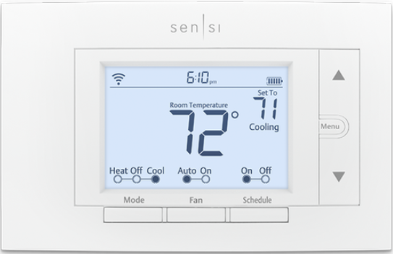
Sequence of Operation
1. Thermostat calls for heat: The room temperature drops, causing the switch between R and W to close, sending 24V on W to the IFC
2. Safety check: IFC applies voltage to safety circuit(s)
    Main air limit, vent limit, blower limit, and rollouts are all normally closed switches that open on a temperature rise
    Voltage returning through these circuits proves these safeties
    A fault in this circuit would result in the gas valve being deenergized while both the inducer motor and blower motor remain energized to deal with excess heat or combustible fumes
    The limit circuit is continuously monitored throughout a call for heat

Slide 11
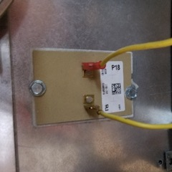
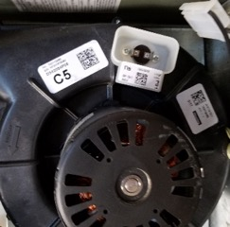
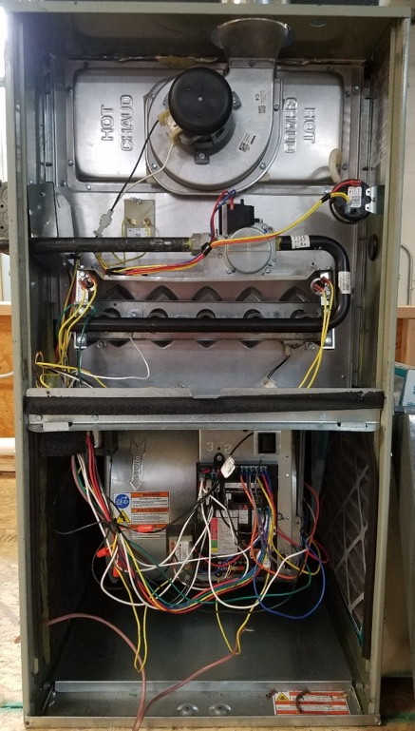
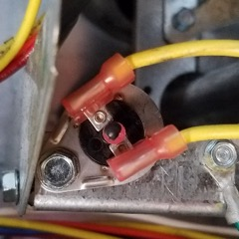
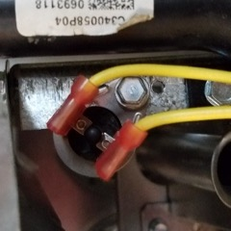
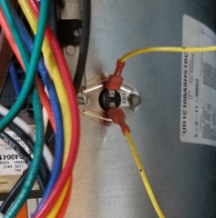
Component Call-Out: Limit Switches
Main Air Limit
Vent Limit
Rollout
Rollout
Blower Limit

Slide 12
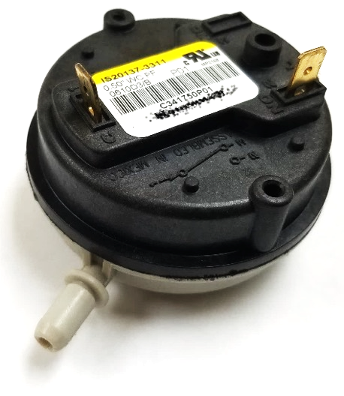
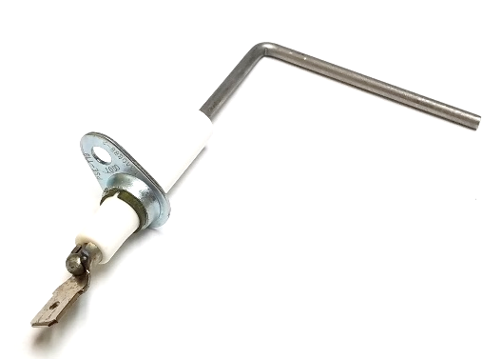
Sequence of Operation (Continued)
Safety check: IFC applies voltage to safety circuits
  The pressure switch is a normally open switch that closes under negative pressure in the heat exchanger
    Voltage should not return through this circuit—the presence of voltage indicates the switch is stuck closed and would not shut down the system due to a lack of draft
    A fault in this circuit, at this time, would halt the sequence of operation until the error has been corrected
      Common causes: stuck or bypassed switch
  Flame rectification circuit should be open at this time, due to the lack of a flame to complete the circuit
    Voltage should not return through this circuit—the presence of voltage indicates the circuit has a short-to-ground and would not be able to detect the presence or absence of a flame
    A fault in this circuit would result in the sequence halting and energizing the inducer motor deal with combustible fumes

Slide 13
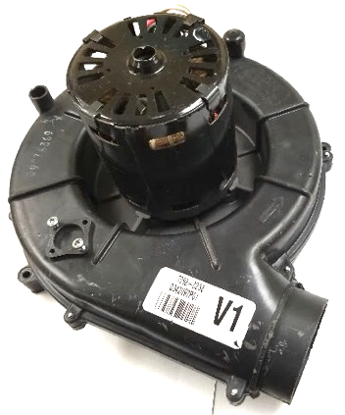

Sequence of Operation (Continued)
Inducer motor energizes: IFC applies 120V to draft inducer motor
  Draft inducer comes to full speed and creates a negative pressure in the heat exchanger—ready to draw products of combustion
Pressure switch closes: Negative pressure in the heat exchanger closes the pressure switch, allowing voltage to return to IFC
  A proven draft allows the ignition sequence to begin
    A fault in this circuit would result in the sequence halting and energizing the inducer motor to deal with combustible fumes (interpurge)
    The sequence of operation then starts over with a safety check and resumes
    A set number of unsuccessful retries will be attempted before entering into a hard-lockout state
    The IFC continually monitors the pressure switch circuit during a call for heat

Slide 14
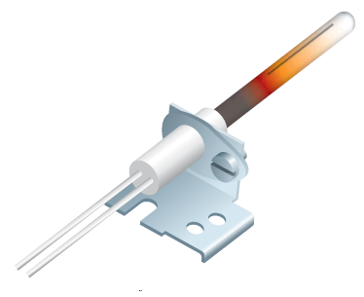
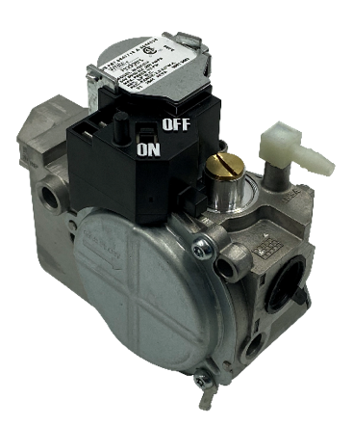
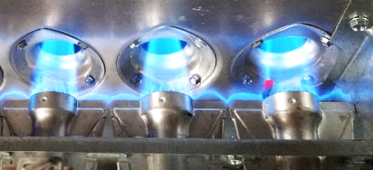
Sequence of Operation (Continued)
Ignitor energizes: IFC applies voltage to hot surface ignitor (120V or 80V, depending on manufacturer) or energizes direct spark ignition coil
  HSI has a brief delay time before progressing to next step to allow ignitor to come to full temperature (minimum 1,200°F)
Gas valve energizes: IFC sends 24V to gas valve solenoid
  Solenoid valve opens and allows fuel to pass through the manifold, the spuds, and into the burners
  Inducer motor draws the fuel vapors through the burners and across the path of the ignition source
Burners ignite: Fuel vapors contact the ignition source and combustion begins
  Flame carries over from burner to burner via channels, igniting all remaining burners in sequence
  Inducer motor draws the products of combustion through the heat exchanger and conveys them toward the flue

Slide 15
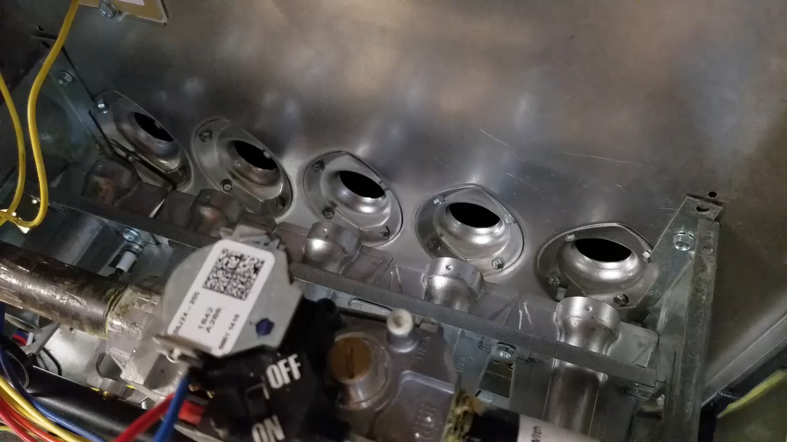
Ignition

Slide 16
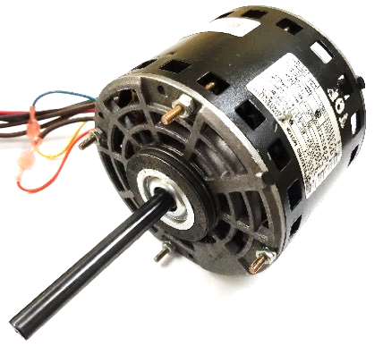
Sequence of Operation (Continued)
Flame rod proves: Flame completes the circuit between the flame rod (electrode) and the burner (ground)
  The high resistance of the flame and the difference in surface area between the flame rod and the burner partially rectifies the current and creates a low amperage DC signal
    The IFC interprets the quality of the current (either a strong or weak flame signal as communicated by the IFC) and holds the gas valve open for the duration of the call for heat
    If the current on the flame rectification circuit (measured in DC microamps or volts) is below the minimum required by the IFC, the flame is not sensed, and a fault occurs
    Sequence of operation is halted for an interpurge and then retries for ignition
    After multiple unsuccessful attempts, the IFC enters into a hard-lockout state
Blower motor energizes: After a predetermined amount of time the heat exchanger warms up (30-45 seconds) and the blower motor begins to circulate air across the heat exchanger and through the conditioned space
  Improper airflow can cause the high limit to open and halt combustion

Slide 17
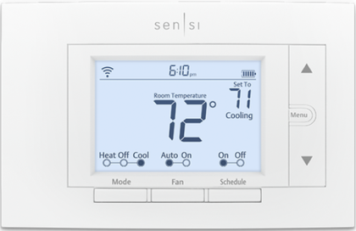
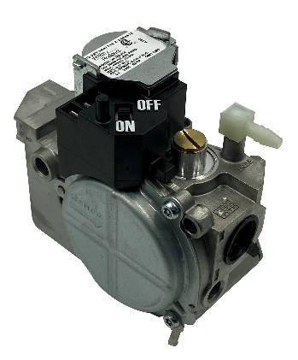
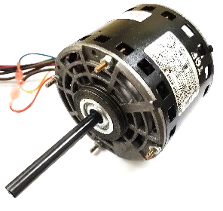
Sequence of Operation (Continued)
Thermostat satisfies: Normal furnace operation warms conditioned space to meet the thermostat setpoint and the switch between R and W opens
Gas valve deenergizes: With the loss of voltage on W, the IFC stops sending 24V to the gas valve
  Main solenoid snaps shut and flames are extinguished
Inducer motor deenergizes: After a predetermined post purge, the inducer motor stops
Blower motor deenergizes: The blower off delay time (60-180 seconds) expires after the heat exchanger has been cooled and the blower motor shuts down
Furnace waits in ready-state (stand-by) for the next call for heat

Slide 18

HSI Simulator Breakout – In Practice
Observe the Sequence of Operation In Live Fire Mode

Slide 19
HSI Simulator Breakout – In Practice
Observe the Sequence of Operation In LED Only Mode

Slide 20
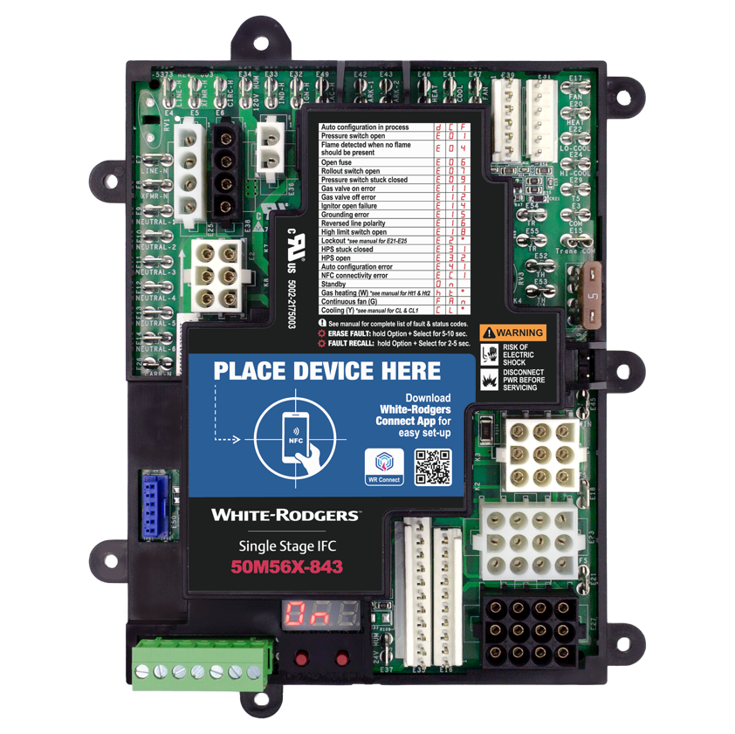
Key Takeaways
The sequence of operation is the key to troubleshooting electrical faults in a furnace.
It determines when switches open and close, which circuits are active, and which loads are energized.

Slide 21




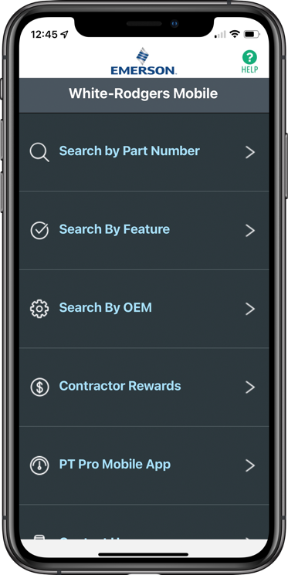
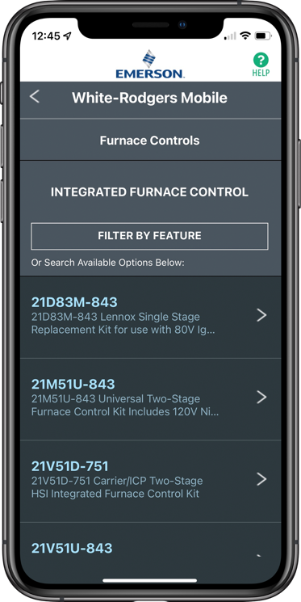
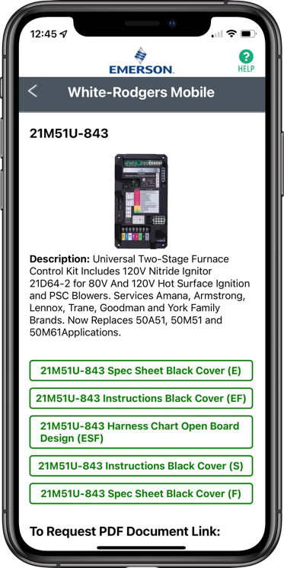
WR Mobile App
Scan the QR code to download from your app store.
Always up-to-date and easy to use
Search by OEM, competitive,
or White-Rodgers model number
Try the desktop version at https://wrcrossref.com
Your resource for:
Product information and spec sheets
Complete Cross Reference
OEM compatibility
Installation information and videos
Wiring diagrams
Priority technical help
Search
Scrollable
Product List
White-Rodgers Replacement

Slide 22
Choosing the Correct Furnace Control
Part Three

Slide 23

Furnace Control Failure
Two main causes for failure in an electronic circuit board:
Heat
  Controls are mounted too close to combustion surfaces
  Loose connections generate excessive heat
Moisture
  Overflowing condensate from evaporator or condensing furnace
  Flooding

Slide 24

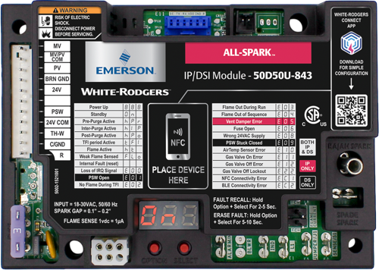
Choosing the Correct Furnace Control
The correct furnace control must match all four of the following characteristics
1. Logic
    Integrated or non-integrated
2. Ignition source
    Intermittent/proven pilot, hot surface ignitor, direct spark ignitor
3. Staging
    Single stage, multi-stage, modulating
4. Blower type
    PSC, ECMx, ECM
Integrated logic
Non-integrated logic

Slide 25
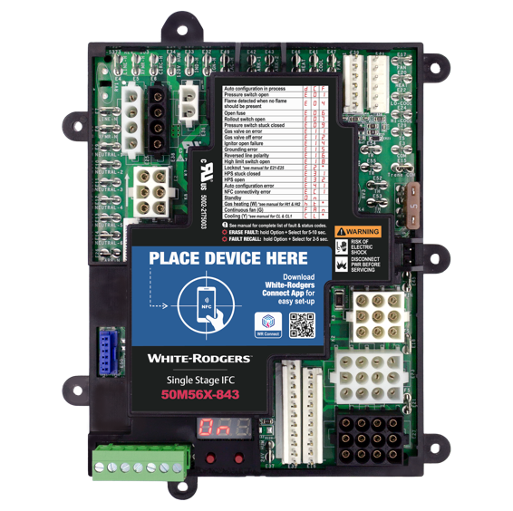
1. Control Logic
Integrated logic
All functions of the furnace are driven and monitored by the control
  Safety checks
  Ignition and burner supervision
  Blower control
  Auxiliary components (air cleaning, humidification)
Integrated Control
IDM Pre-Purge | Ignition Trial | IBM on Delay | Heat Off | IDM Post-Purge | IBM Off Delay
Limit
Circuit Closed
Pressure Switch
Open
Pressure Switch Closed
Gas Valve Open
Blower On Delay
(30-45s)
Gas Valve Off
Blower Delay Off (60-180s)
Thermostat Calls For Heat
Thermostat Satisfied
System Off
Rollout
Circuit
Closed
Inducer Motor On
Ignition Means On
Ignition Proved
Inducer Delay Off

Slide 26
1. Control Logic (Continued)
Non-Integrated logic
All functions of the furnace are driven and monitored by the control
  Safety checks
  Ignition and burner supervision
  Blower control
  Auxiliary components (air cleaning, humidification)
Non-Integrated Control
Gas Valve Open
Gas Valve Off
Thermostat Calls For Heat
Thermostat Satisfied
System Off
Ignition Means On
Ignition Proved
TECH TIP: If the blower motor plugs into the control board, it is an integrated logic control system. If the blower is energized by an external relay, the control is non-integrated.

Slide 27
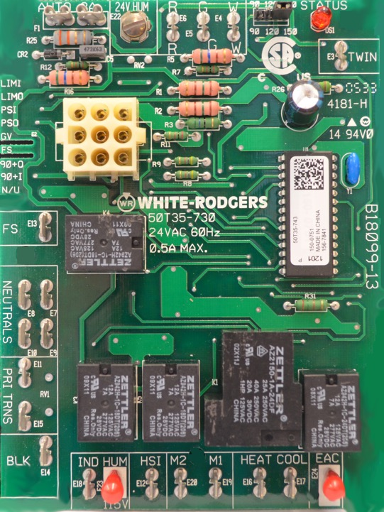
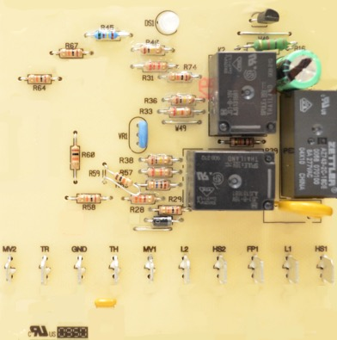
1. Control Logic (Continued)
2
A visual inspection of the current circuit board will identify the type of control logic
Integrated:
  A board-mounted blower relay with high
  voltage blower terminals
  Molex connector for safety circuits and
  control wiring bundle
Non-integrated
  Terminals and relays only control gas
  valve, ignition, and flame proving
1
3
Ignition and burner supervision only

Slide 28
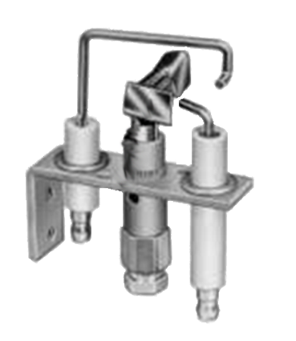
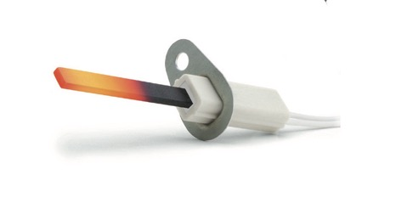
2. Ignition Source
Intermittent/Proven Pilot Ignition
  A pilot tube extends from the gas valve to the pilot burner
  Pilot flame is not standing, but automatically lit during a call for heat
  A flame sensing circuit proves the pilot flame to keep pilot valve open and allow main valve to open
Hot Surface Ignition
  Direct burner ignition system
  Current passes through resistive strip, causing it to heat to a minimum of 1,200°F
  Gas valve opens and passes fuel across ignition source
  Burner flame is proven through sensing circuit and allows gas
  valve to stay open for duration of call
Intermittent/Proven pilot ignition
Hot surface ignition

Slide 29
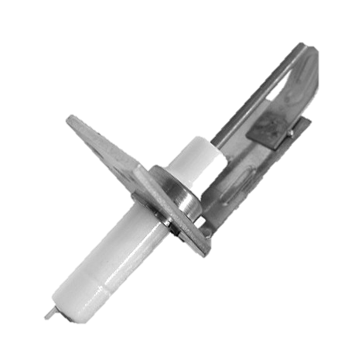
2. Ignition Source (Continued)
Direct Spark Ignition
  Direct burner ignition system
  Spark electrode is located near combustion surface of burner
  High voltage pulses (in excess of 10,000V) cause a spark to bridge the 1/8” gap between the spark ignitor and the burner ground
  Gas valve opens and passes fuel across ignition source
  Electronic spark is hot enough to ignite the burner
  Burner flame is proven through sensing circuit and allows gas valve to stay open for duration of call
Direct spark ignition

Slide 30

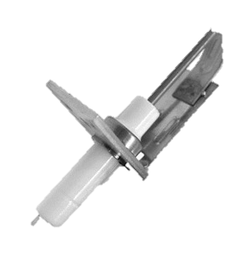
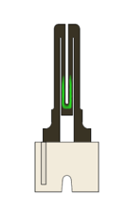
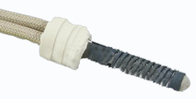
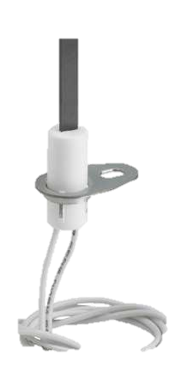


2. Ignition Source (Continued)
Proven Pilot | Direct Spark | Hot Surface Ignition
 |  | 120 VAC | 80 VAC
A traditional pilot burner to ground, with a spark electrode and a flame sensor | A ground electrode, with a spark electrode and a flame sensor | A resistive element that heats up to ignition temperature and lights the gas with flame sensing (direct or indirect). Can be 120v or 80v AC.

Slide 31

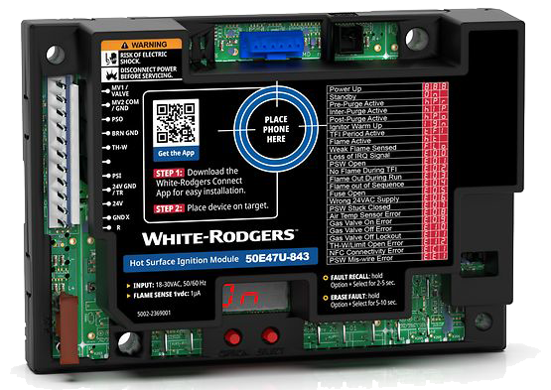
2. Ignition Source (Continued)
PV terminal
A visual inspection of the current circuit board will identify the ignition source.
PV is the Pilot Valve: Proven Pilot
HS1 or HS2: Hot Surface Ignition
No PV with Spark Ignitor terminal: Direct Spark
Spark ignitor terminal
Proven Pilot
Hot surface ignitor terminal
Hot Surface Ignition

Slide 32
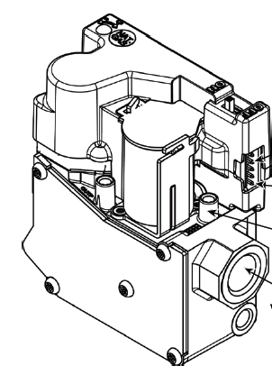
3. Staging
Single stage
  System energizes at full capacity when there is a call for heating or cooling
Two-stage
  System has a high-fire and low-fire mode
  System runs at partial capacity to satisfy load on mild days, but at full capacity as the need increases
  Systems can have two-stage cooling capacities as well
Modulating/variable speed
  System automatically adjusts Btu output, inducer speed, and blower speed to maintain constant temperature and comfort
36J Modulating

Slide 33
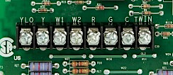
3. Staging
A visual inspection of the current circuit board will identify the heating and cooling stages
W and Y only: single stage
W1, W2, and Y1, Y2: two staged
  Multiple combinations of heating and cooling stages
Two stage cooling
Two stage heating
Thermostat terminals

Slide 34
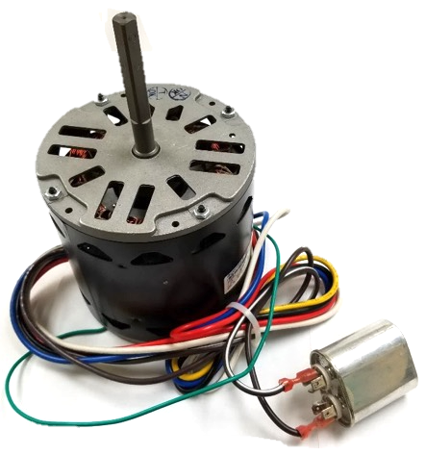
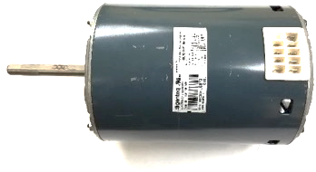
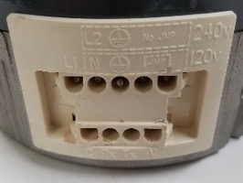
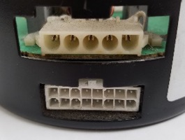

4. Blower Motor
PSC - Permanent split capacitor
  Motor powered by integrated relays
  Each speed of motor connected to different high voltage terminal
ECMx - X-series, constant torque electronically commutated motor
  Motor powered by continuous high voltage connection
  Speeds controlled by individual low voltage terminals
ECM
  Variable speed, constant volume
  Speeds controlled by 16- or 4-pin connector
PSC Blower Motor with Run Capacitor
Electronically Commutated Motor
ECM 3.0
ECM 2.3
ECMx (X-13)

Slide 35



4. Blower Motor (Continued)
High voltage speed taps
A visual inspection of the current circuit board will identify the blower motor type
High voltage speed taps: PSC
Low voltage speed taps: ECMx
4- or 16-pin control connector: ECM
PSC
Low voltage speed taps
16-pin control connector
ECMx
ECM

Slide 36


Choosing the Correct Furnace Control
Integrated Logic Control Family
Ignition Source | Blower Type | Heat Stages | White-Rodgers
HSI 120 VAC | PSC & ECMx | 1 | 50M56X-843
HSI 120 VAC | PSC | 2 | 21M51U-843
HSI 120 VAC | ECM | 2 | 21V51U-843
50M56X-843
Single-Stage Universal Integrated Furnace Control
for ECMx and PSC Blowers
21M51U-843 / 21V51U-843
Multi-stage PSC / ECM

Slide 37


Choosing the Correct Furnace Control
Non-Integrated Logic Control Family
Ignition Source | Stages | White-Rodgers
Proven Pilot / Direct Spark | 1 | 50D50U-843
HSI 24V, 120V, 240V | 1 | 50E47U-843
50D50U-843
All-Spark universal intermittent pilot/direct spark 24V ignition module
50E47U-843
Universal Hot Surface Ignition Module

Slide 38
Single-Stage Universal Integrated Furnace Control
50M56X-843 for ECMx and PSC Blowers
Technical Overview

Slide 39

Onboard Major OEM Connectors
Simplifying Installation
Inducer/Ignitor Connectors
ECMx Connectors
The 50M56X-843 has five main harness connectors, with both In-line and Molex plugs on the same control
Four inducer/ignitor Molex connectors on-board
Two ECMx connectors for Trane & Goodman direct plug-ins
Direct OEM plug-in allows for a quick installation with multiple OEM brand controls, simplifying the process and eliminating the need for harness adapters
Main Harness Connectors
During initial start-ups, the control will perform an auto-configuration sequence that takes approximately 30 seconds

Slide 40


Two Ways to Configure and Diagnose
The upgraded design now has on-board programming that allows for configuration.
Use the white-rodgers connect app and do all the programming from your smartphone
The White-Rodgers Connect app offers the fastest, easiest Configuration setup ever!

Slide 41




Quick Configuration & Diagnostics with the White-Rodgers Connect App
App provides simple configuration without power prior to installation
No login or username required
Configure with preloaded OEM settings or customize module configurations
Diagnose fault codes and troubleshoot confidently
View status and details about the module
Near-field Communication (NFC) creates an interface between the control and your mobile device with the White-Rodgers Connect app. Just place your mobile device on the control to enable a connection.
Once downloaded, the White-Rodgers Connect app does not require cellular/Wi-Fi service to use.

Slide 42



WR Connect Auto-set Feature
White-Rodgers Connect App
Configure with Auto-set
Enter replacement part number to automatically configure the All-Spark.
Type the replacement part number into the configuration tab of the White-Rodgers Connect app to automatically configure the control to the original default settings for the replacement part number.
This can be completed without power to the control and before installation.

Slide 43


Fully Customizable Configuration Programming in App
Both ignition and blower options are shown in the 50M56X-843 Configuration Settings
Quick Configuration Setup!
Blower Type
  Select between PSC & ECMx blowers with multiple speed options
Blower Timings
  Adjust blower heat on & off time
  Adjust blower cool on & off time
  Adjust blower fan on & off time
Inducer Purge Timings
  Comes set at default for most cross-reference SKU’s. Available for timing adjustments if needed.
Configuration

Slide 44




Update Configuration Settings from the App
White-Rodgers Connect
Easy to Update
After making configuration changes, tap “Update Control” and hold your smartphone over the module again
Once the new configuration is uploaded, a confirmation will display
The settings for the control have been updated. You can then share a .txt file via an email or by texting. This .txt file can be printed or stored electronically in a customer's records at the installation company’s office.
Tap
Update
Share
It takes 5± seconds to update when holding your phone steady over the module.

Slide 45



Additional App Features
White-Rodgers Connect
The app displays all the information shown on the 7-segment display and more!
Status
  See what is going on with voltage, configuration and operation
Diagnostics
  Look up current active errors as well as the last five errors that have occurred in the last 14 days
  View troubleshooting tips
About
  Get module-specific information, including the date code and the operating firmware
Status
Diagnostics
About

Slide 46




Understanding Near-field Communication
NFC
Connecting
Configuring
Updating
To connect to your NFC enabled control tap,
connect to control. Place
the NFC region of your mobile device on the
NFC marking of your
White-Rodgers control.
Keep your device in contact with the NFC marking until a check mark appears and the app transitions to the configuration tab. You can then move your device away from the control.
The text in pink shows your control settings. This text will change as you make modifications to each setting. If you tap on the name of a parameter, the app will display a description about each one for some controls.
Once you've chosen your desired settings, tap update control. Place the NFC region of your device on the NFC marking of your White-Rodgers control, keep your device in contact with the NFC marking until a checkmark appears.
On select White-Rodgers controls, the auto set feature allows you to enter the replacement part number to automatically configure the White-Rodgers control to the replacement parts original settings.

Slide 47



Three Easy-to-Install Mounting Options
Seven Mounting Tabs
Five Standoff Holes
Two-slot Slide-in Tabs
4 ½” self-tapping screws are supplied for multiple mounting options.
White-Rodgers’ molded tray base provides space between the board and the unit mounting plate. Five standoffs are included for snap-in mounting.
Utilize existing slots by using slide-in tabs molded into the tray.

Slide 48


Twinning Feature
Two 50M56X-843 controls can be connected to operate simultaneously.
Twinning requires a connection of the twin terminal on both boards using an 18ga wire.
The board with the thermostat connection will fully function, including the LED indicator and DIP switch settings. The twinned board will operate simultaneously as determined by the wired board unless “W” or “Y” are powered to it.

Slide 49



Easy On-board Setup Configuration
Configure Using the Option & Select Buttons
After the system is powered on, the display will read ON when in standby mode. To enter setup, press the “Option” button.
Refer to the installation instructions on page 2 for details on how to navigate the "Option" and "Select" buttons.
Match blower timer settings to the old control being replaced.

Slide 50





Universal Applications
80V Ignitor Controls
Blower Type Selection
Replacing Existing Universal Controls
80V ignition systems that must be upgraded to 120V by replacing the OEM ignitor with the included HotRodTM ignitor. See the installation instructions on page 5 or verify with WR Mobile for cross-reference numbers that apply.
With the 50M56X-843 able to replace both PSC & ECMx blowers, configuration must be set to the type of motor as well as the quantity of speeds.
The Configuration Menu setting #6 (bLr) must be set to match the equipment's blower.
When replacing a failed Resideo/Honeywell H9200U1000, ICM ICM2812-KIT & ICM-2812, or White-Rodgers 50M56U-843 & 50X57-843, identify and remove any wiring adapter harness between OEM furnace wiring and the failed universal control prior to installing a 50M56X-843.

Slide 51


Special Case Applications
Goodman Hybrid 2-Stage
OEM Wiring Connectors
Roll-Out Configuration
Flame Sensor Kit
A unique system known as the “Goodman Hybrid” system is a furnace with a two-stage gas valve paired with a single-speed inducer motor and a single stage blower.
50M56X-843 is able to operate these unique applications with the following cross-reference controls:
Some OEM furnaces, for example Trane and American Standard have a plastic connector housing that groups together line and neutral spade terminals.
When found, remove the block and install the supplied quick-connect spade terminals.
Certain Trane, American Standard, and York (including York P3UR/PCLU) furnaces do not have an individually monitored rollout switch in their main harness wiring configuration.
No shunt or jumper required.
The Configuration Menu setting #21 (rOb) to (yES) will digitally bypass the rollout input.
If the 1994 or earlier Rheem/Ruud control being replaced has two green lights (no amber light) and a date code of 3294 or earlier, a Flame Sensor Kit, RHEEM part number 62-24044-71, required (not available through White-Rodgers).
Goodman Controls
PCB00109 | PCBBF109
PCBBF109S | PCBBF122
PCBBF122S | PCBBF132
PCBF132S

Slide 52



Get Flame Current Reading Without Meter
NEW On-Board Read-out
During a call for heat when a flame is present, the digital display will display the flame sense in Microamps.
No more needing to pull out a meter to get a Microamp reading–just look at the display!
Standard Test Pins Also Available
Two pins can be found on the right edge
of the control board.

Slide 53


Thermostat Wiring Made Easy
Lift-off Thermostat Connector Block, Including Dehumidification
Connect thermostat wiring away from the board
No more getting into the furnace to get the wiring connected–just connect it out front, verify wires are secure in the block, then plug in!
When the dehumidification terminal on the block is used, the control will slow the blower down during cooling for increased humidity removal.

Slide 54




Onboard Status & Fault Codes for Troubleshooting
Easy-to-see digital display shows fault/error conditions
Troubleshooting is simplified with a fault code/status label on the control cover
The Option & Select Buttons Allow For:
  Menu configuration
  Recall of the last five faults
  Fault code erasure
2
1

Slide 55
Universal Integrated Furnace Controls Competitive Comparison
White-Rodgers Has More Features
FEATURE | RESIDEO / HONEYWELL S9200U1000 | ICM ICM2812-KIT | WHITE-RODGERS 50M56X-843
Stages / Blower Types | 1 - PSC Only | 1 - PSC Only | 1 - PSC & Ecmx
Mobile App, NFC, BLE* | No | No | Yes – WR Connect
Harnesses | 8 | 11 | None – OEM Harness Detected
Cross-references | 200+ | 150+ | 550+
Ignitor Voltage Serviced | 120V Only | 120V Only | 80v & 120v
Includes Universal Ignitor | No | No | Yes
Configuration Options | Limited - 4 Dipswitches | Limited - 2 Dipswitches | Unlimited App Or Push Buttons
LED Displays | Tri-color LED Light | Red LED Light | Digital LED Display
Rollout Accessory | Difficult Wire Jumper | Difficult Wire Jumper | Not Required
Flame Current Test | No | No | Digital Readout Or Test Pins
Full Cover W/ Fault Code Label | No - Tray Only | Yes | Yes
Fault Recall & Clearing | Jump R & D Terminals | Push Button | WR App / Push Buttons
Status & Diagnostics | Count LED Flashes | Count LED Flashes | Read On Display Or App
Humidifier Output | 120V Only | 120V Only | 24V Or 120V
2nd Stage Cooling & Dehumidification | No | No | Yes

Slide 56
Troubleshooting Furnace Controls
Technical Overview

Slide 57


Troubleshooting Integrated Furnace Controls
The two most common causes for failures in IFC boards are water damage and heat - either from combustion or from electrical overcurrent
The three greatest tools for diagnosing IFC failures are knowing the sequence of operation, interpreting the wiring diagram, and using your multimeter.

Slide 58
Troubleshooting Questions
At what step in the sequence of operation does the control fail?
  Every step in the sequence of operation results in energized circuits activating relays that energize new circuits
Which switches should be closed and passing power?
Where should voltage be supplied? And what voltage should it be?
Are any control or load wires grounded?
  A disconnected lead can easily touch the frame of the furnace and create a short-to-ground
  Foil backing from insulation can also ground wires

Slide 59



Sequencing and Troubleshooting
Every pin and terminal on the IFC is associated with a step in the sequence of operation.
IDM Pre-Purge | Ignition Trial | IBM on Delay | Heat Off | IDM Post-Purge | IBM Off Delay
Limit
Circuit Closed
Pressure Switch Open
Pressure Switch Closed
Gas Valve Open
Blower On Delay (30-45s)
Gas Valve Off
Blower Delay Off (60-180s)
1
0.0V
7
4
10
4
0.0V
10
7
24V
8
24V
Thermostat Calls For Heat
120V
0V
Thermostat Satisfied
System Off
5
0.0V
11
13
120V
15
14
16
14
16
Rollout Circuit
Closed
Inducer Motor On
Ignition Means On
Ignition Proved
Inducer Delay Off
12
9
11
5
13
10
7
4
1
14
15
16

Slide 60
Wiring Diagram
Discovering where each circuit and load connects to the IFC allows for testing and isolation
The status code LED provides troubleshooting assistance
Fault code retrieval
  When the control is in Standby mode (no call for heat or cool), press the fault recall button for approximately 2 to 5 seconds or until the diagnostic LED turns off
  Up to 5 fault codes are stored

Slide 61



Evaluating Fault Codes
The 50M56X-843 displays error codes on the digital display with guides on the product label as well as the instruction sheet.
For quick and easy diagnostics view error codes in the White-Rodgers Connect app which also displays troubleshooting tips.

Slide 62

HSI Simulator Breakout
Limit Circuit Fault
Notes:
SW4 simulates a main air limit that has opened
SW5 simulates a vent limit that has opened
SW6 simulates a blower limit that has opened
Stress 2 general categories for limit fault
Not enough airflow – and the myriad causes for that
Too much heat - and the myriad causes for that
These faults can occur at any time during a call for heat
Limits are normally closed switches that open when the temperature becomes excessive
The limit test points should read 0.0VAC (closed) throughout a call for heat
To simulate this fault, put SW4, SW5, or SW6 in the Down-Fault position at any time during a call for heat
The IFC will detect the limit circuit opening, immediately deenergize the gas valve, and energize the blower motor
The Diagnostic LED will flash a 4-Red code
The fault-causing limit will measure 24V across the test points (open)

Slide 63
HSI Simulator Breakout
Rollout Circuit Fault
Notes:
SW7 simulates a rollout switch that has opened
This fault can occur at any time during a call for heat
The rollout switch is a normally closed switch that opens when high temperatures are detected in the burner compartment
The Roll Out Limit test points should read 0.0VAC (closed) throughout a call for heat
To simulate this fault, put SW7 in the Down-Fault position at any time during a call for heat
The IFC will detect the rollout circuit opening, immediately deenergize the gas valve, and energize the blower motor
The Diagnostic LED will flash a 5-Red code
The Roll Out Limit will measure 24V across the test points (open)

Slide 64
HSI Simulator Breakout
Pressure Switch Fault
Notes:
SW2 simulates a pressure switch that is stuck closed
This fault will only occur at the initiation of a call for heat
The pressure switch is normally open at the beginning of a call and does not close until the inducer motor cause it to
The Pressure Switch test points should read 24VAC (open) at start up
To simulate this fault, put SW2 in the Up-Fault position and initiate a call for heat
The Diagnostic LED will flash a 2-Red code
The Pressure Switch will measure 0.0V across the test points (closed)
SW3 simulates a pressure switch that will not close
This fault can occur at any time during a call for heat once the inducer motor has been energized
The Pressure Switch test points should read 0.0VAC (closed) when the Inducer Motor LED is energized
To simulate this fault, put SW3 in the Down-Fault position at any time during a call for heat
The IFC will detect the Pressure Switch opening and immediately deenergize the gas valve
The Diagnostic LED will flash a 3-Red code
The Pressure Switch will measure 24V across the test points (open)

Slide 65
HSI Simulator Breakout
Flame Sense Fault
Notes:
SW9 simulates a voltage failure in the flame proving circuit
This fault can occur at startup
Around 40 VAC should be measured between the Flame Sensor Output from IFC and G
To simulate this fault, put SW9 in the Down-Fault position before energizing the HSI Simulator
The IFC will detect the lack of current, immediately deenergize the gas valve, and restart the ignition sequence
Around 4 VAC should be measured between the Flame Sensor Output from IFC and G
After 4 unsuccessful attempts, the IFC will enter a lockout state and the Diagnostic LED will flash a 7-Red code
SW14 Middle-None simulates no flame signal
This fault can occur at any time during a call for heat
The Flame Current Sense test pins at the IFC should measure around 3.5VDC when a flame is present or the Burner LED is illuminated (3.5VDC=3.5µA)
To simulate this fault, toggle SW14 to Middle-Off
The IFC will not detect any flame signal and will attempt to relight the burner
The Flame Current Sense will measure 0.0VDC across the test pins (0.0VDC=0.0µA)

Slide 66
HSI Simulator Breakout
Weak Flame Signal
Notes:
SW14 Down-Weak simulates weak flame signal
The Flame Current Sense test pins at the IFC should measure around 3.5VDC when a flame is present or the Burner LED is illuminated (3.5VDC=3.5µA)
To simulate this fault, quickly pass SW14 through Middle-Off (don’t stop) to the Down-Weak position at any time after the HSI energizes or HIS LED illuminates.
The IFC will detect the weak current
Diagnostic LED will flash a Rapid Amber code
The Flame Current Sense will measure 0.2VDC across the test pins (0.2VDC=0.2µA)

Slide 67
HSI Simulator Breakout
High Voltage Failures
Notes:
SW8 Middle-Off cycles the power as well as simulates a fault in the high voltage supply
This fault can occur at any time during a call for heat
The Main Power To IFC test points should read 120VAC anytime the HSI Simulator is energized (between 120 and N)
To simulate this fault, put SW8 in the Middle-Off position at any time prior to or during a call for heat
All power is lost, and nothing will operate
The Main Power To IFC will measure 0.0V across the 120 and N test points
SW8 Down-Rev Pol simulates a reversed polarity condition existing in the system wiring
This fault will only occur at power on
The Main Power To IFC test points should read 120V between 120 and G and 0.0V between N and G
To simulate this fault, put SW8 in the Down-Rev Pol position to energize the HSI Simulator
The IFC will detect the reversed polarity and energize the inducer motor momentarily
The Diagnostic LED will flash a 9-Red code
The Main Power To IFC test points should read 0.0V between 120 and G and 120V between N and G

Slide 68
HSI Simulator Breakout
Low Voltage Failures
Notes:
SW11 simulates a fault in the low voltage supply
This fault can occur at any time during a call for heat
The 24 Vac from Transformer test points should read 24VAC anytime the HSI Simulator is energized
To simulate this fault, put SW11 in the Down-Fault position at any time prior to or during a call for heat
Nothing will operate, including Diagnostic LED on IFC and Thermostat (if there are no batteries in thermostat)
The 24 Vac from Transformer will measure 0.0V across the 24V and C test points
The Main Power To IFC will measure 120V across the 120 and N test points

Slide 69

Key Takeaways
A proper understanding of the sequence of operation is a valuable tool in the technician’s troubleshooting kit.
Having a wiring diagram of the IFC and the furnace helps the technician trace wiring and find faults.
Most IFC boards display fault codes which assist the technician in troubleshooting.
For additional information, consult the manual included with the replacement universal controller or visit White Rodgers Education Central https://go.bluevolt.com/whiterodgers

Slide 70

White-Rodgers Comprehensive Solutions Delivered
Industry Leading Products
Used by more OEM’s
Offering the widest range of Universal HVAC parts
Ease of Installation
Simple, easy to understand instructions
Standard wiring nomenclature
Reliability of Product
Quality control provides reliable products
Affordable
Competitive prices
Supported by Knowledgeable Representatives
Contractor direct phone support
R-5827 (11/23)

