Slide 1
White-Rodgers
Furnace Controls

Slide 2
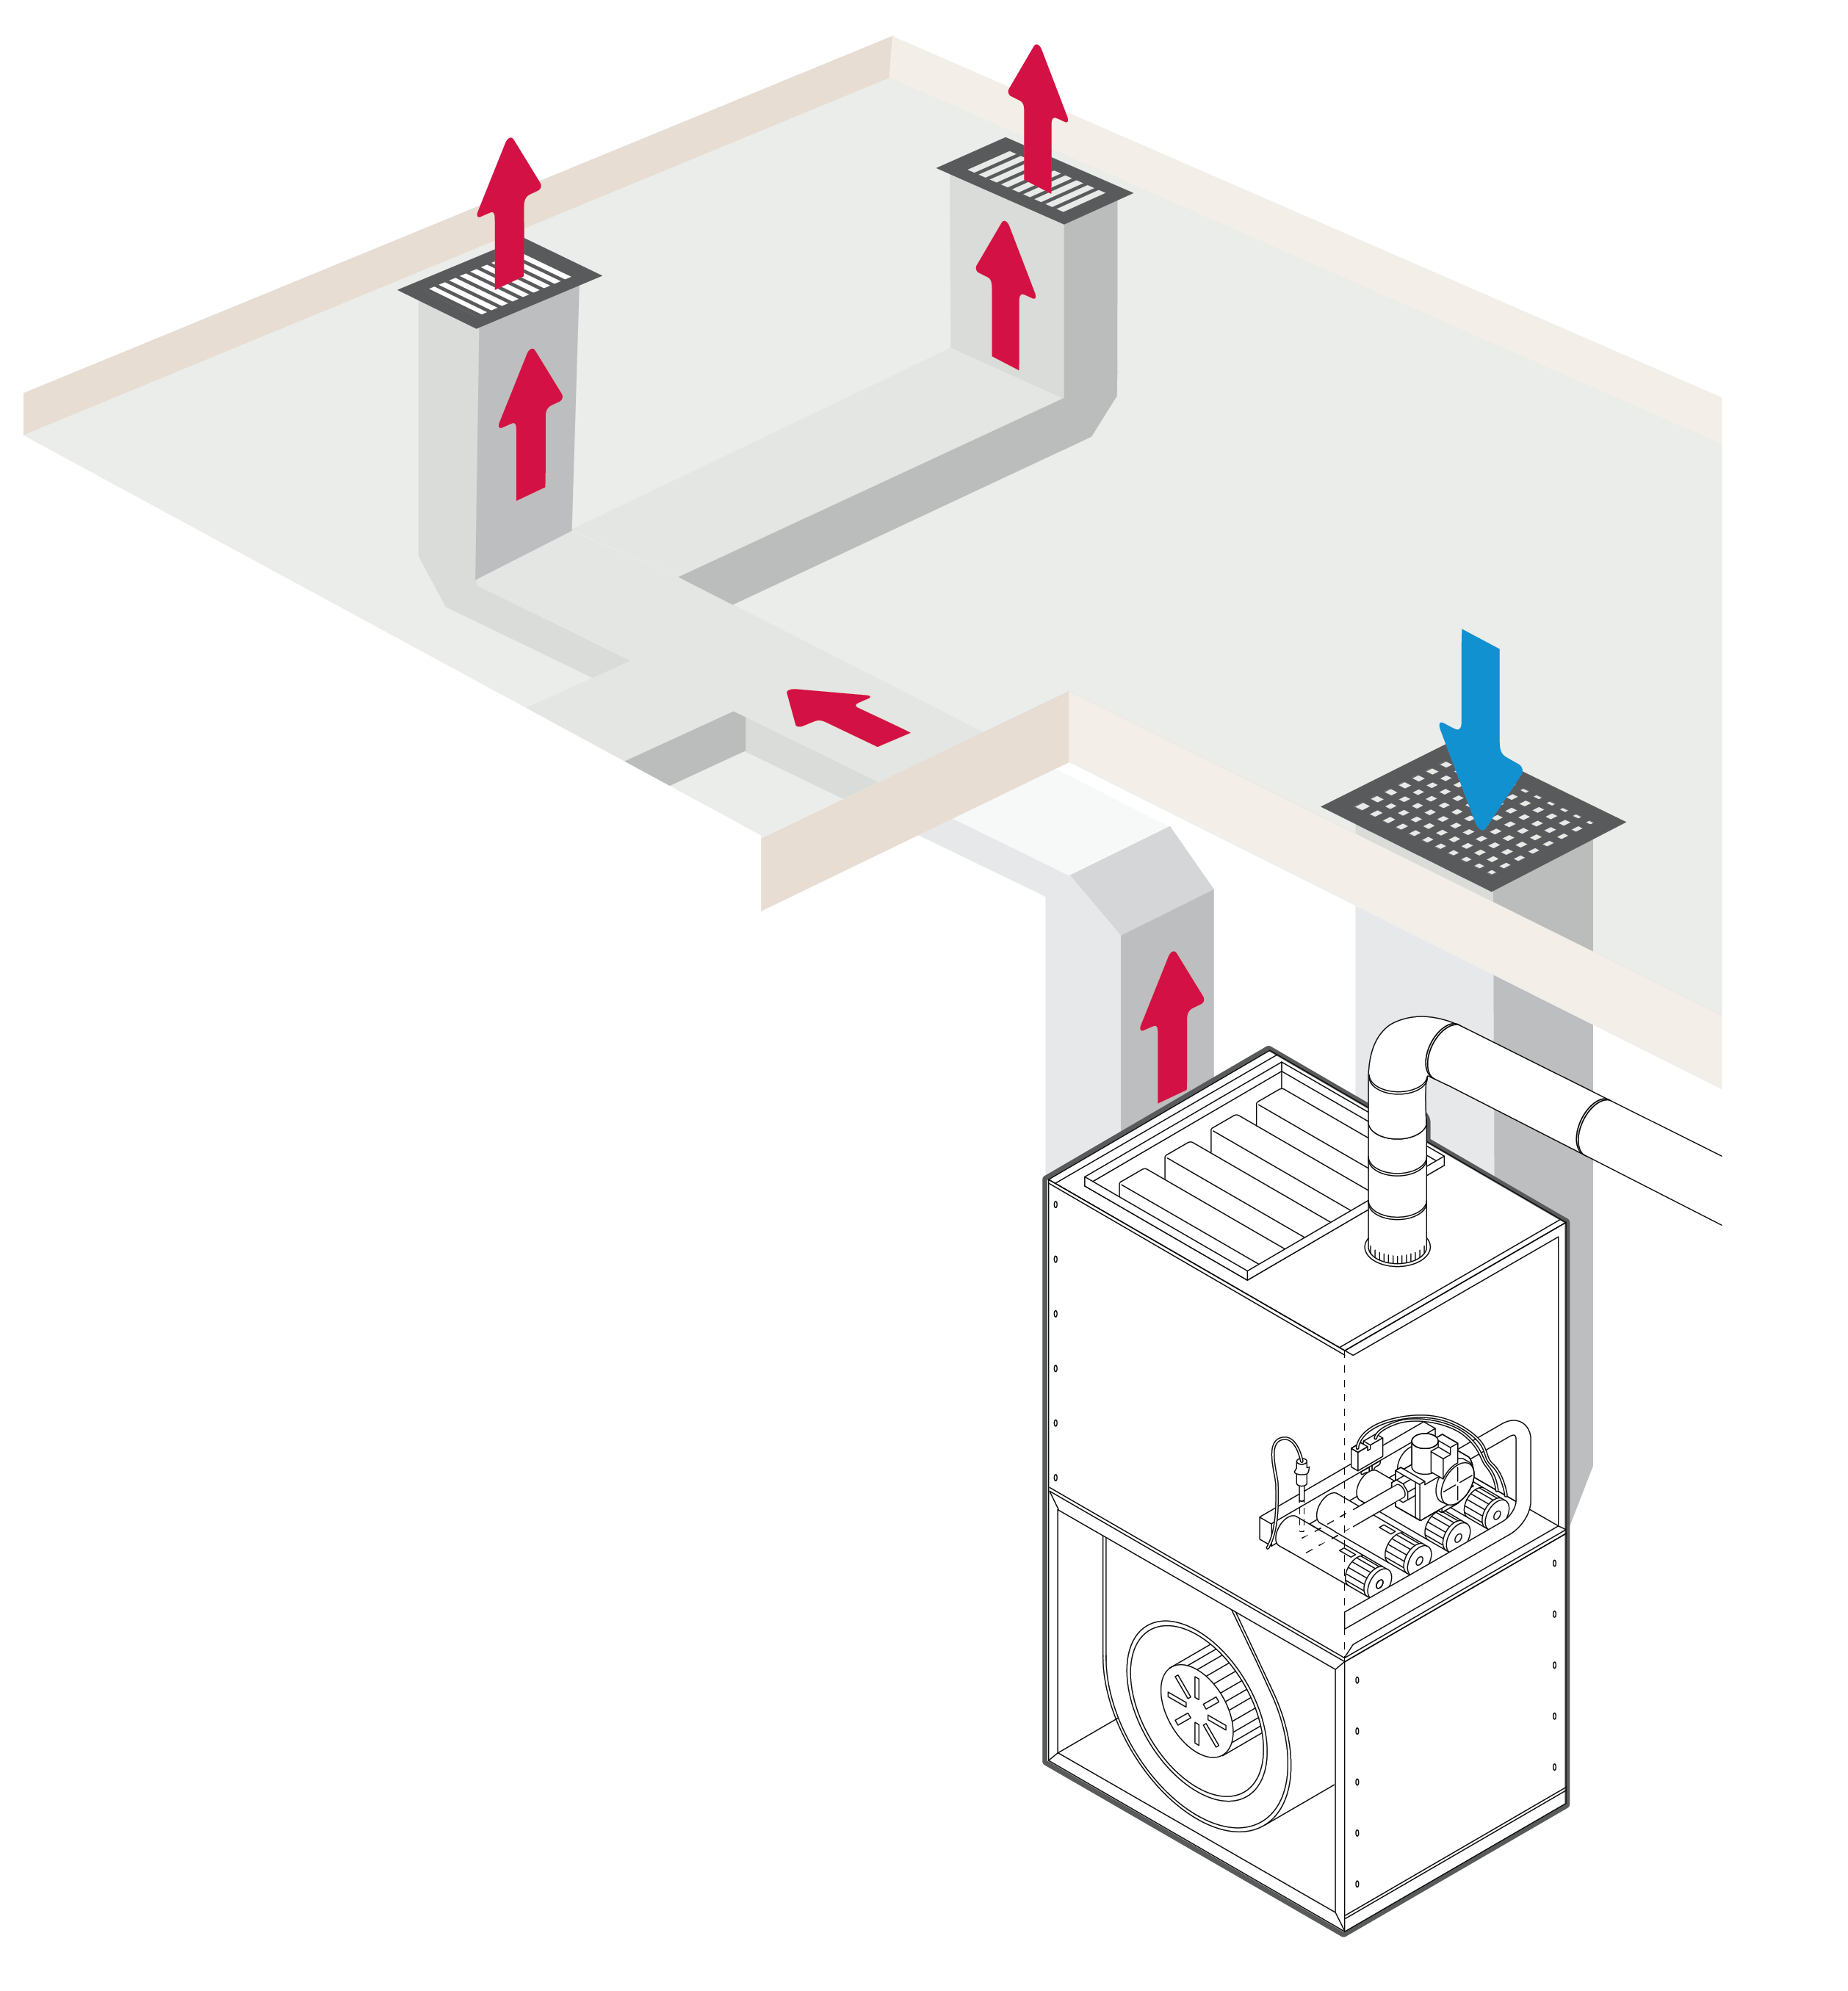
Course Agenda
There are three common furnace control systems in forced hot air gas furnaces:
Standing Pilot
Non-Integrated
Integrated

Slide 3
Part One
Furnace Controls Overview
Part One

Slide 4
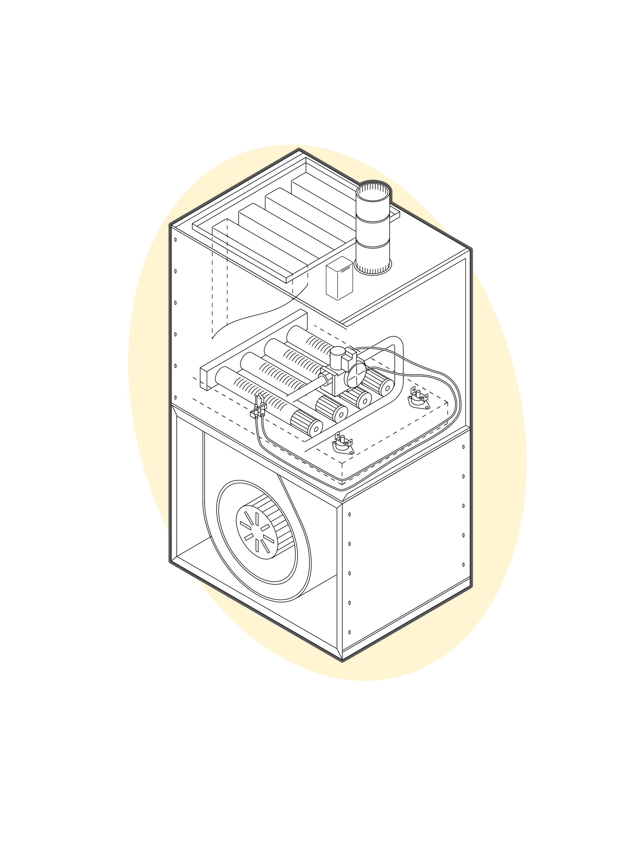
Furnace Controls Overview - Standing Pilot
Standing Pilot Systems are Commonly Found On Older Gas Furnaces and Boilers
Standing Pilot Operation
Standing pilot systems require lighting the pilot flame by hand which remains lit until the valve is manually turned off or the pilot flame accidentally blows out
When pilot flame is lost, the thermocouple in the pilot burner assembly cools off, no longer producing the electrical power required to keep the pilot circuit inside the gas valve open
To reduce energy consumption standing pilot furnaces were superseded by more modern non-integrated ignition controls that automatically light the burner at the beginning of each heating cycle
Blower control on a standing pilot system is accomplished with a separate blower control

Slide 5
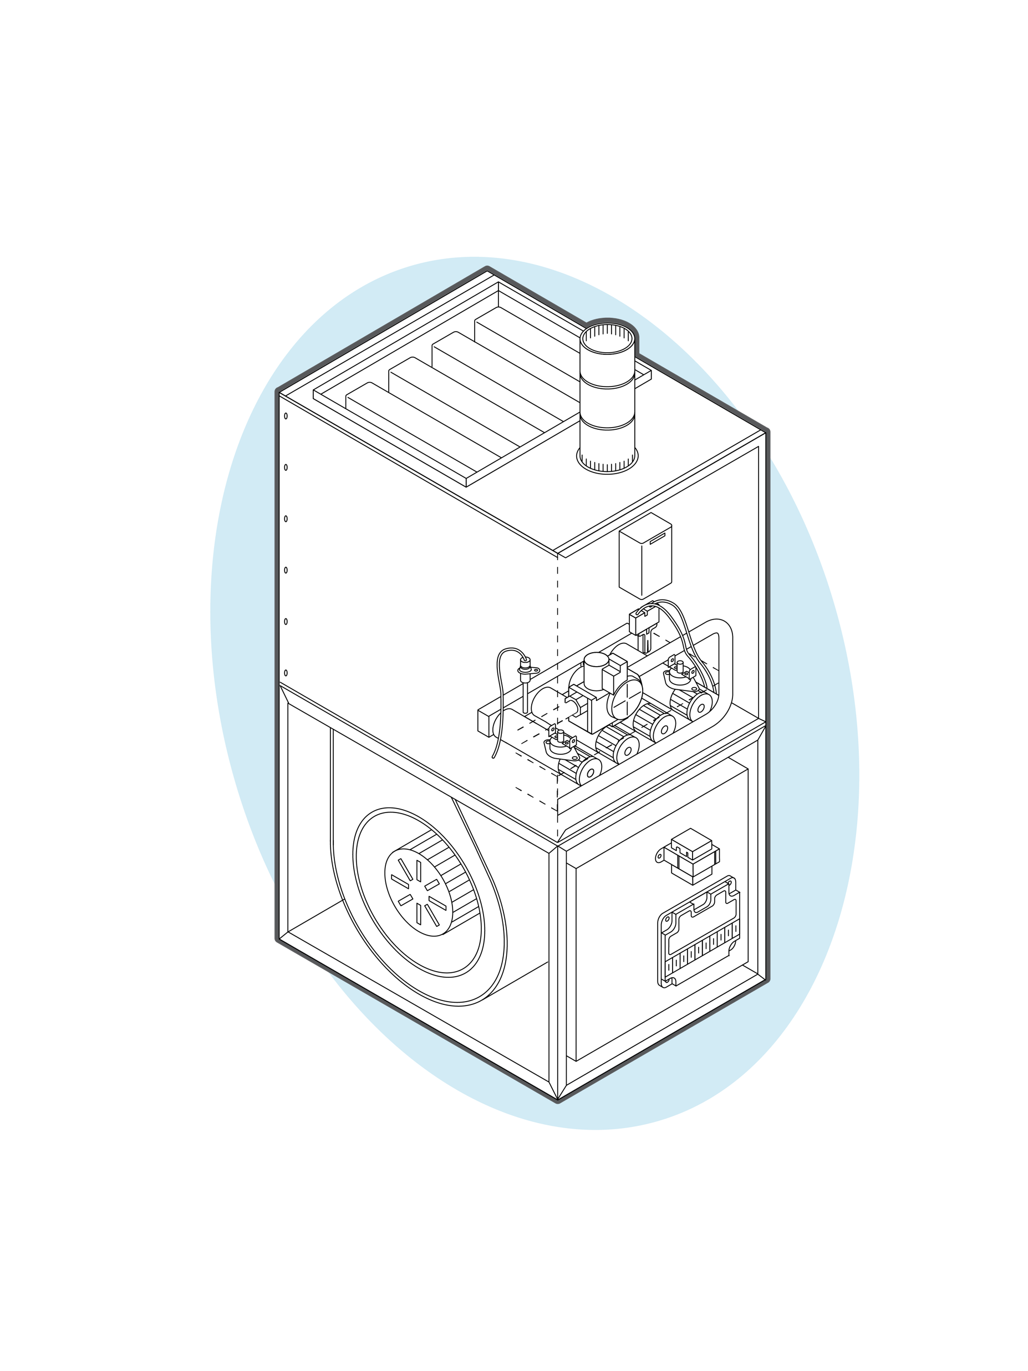
Furnace Controls Overview – Non-Integrated Furnace Controls
Non-integrated Ignition Modules Superseded Standing Pilot Systems and Light the Burners Each Heating Cycle
Non-Integrated Ignition Modules provide ignition, proof of ignition and precise control timings.
Common non-integrated ignition types include hot surface ignition and direct spark ignition both of which directly light the main burners
The fan or fan and combustion blower are not integrated into the ignition control
Separate controls in the system provide inducer and blower control

Slide 6
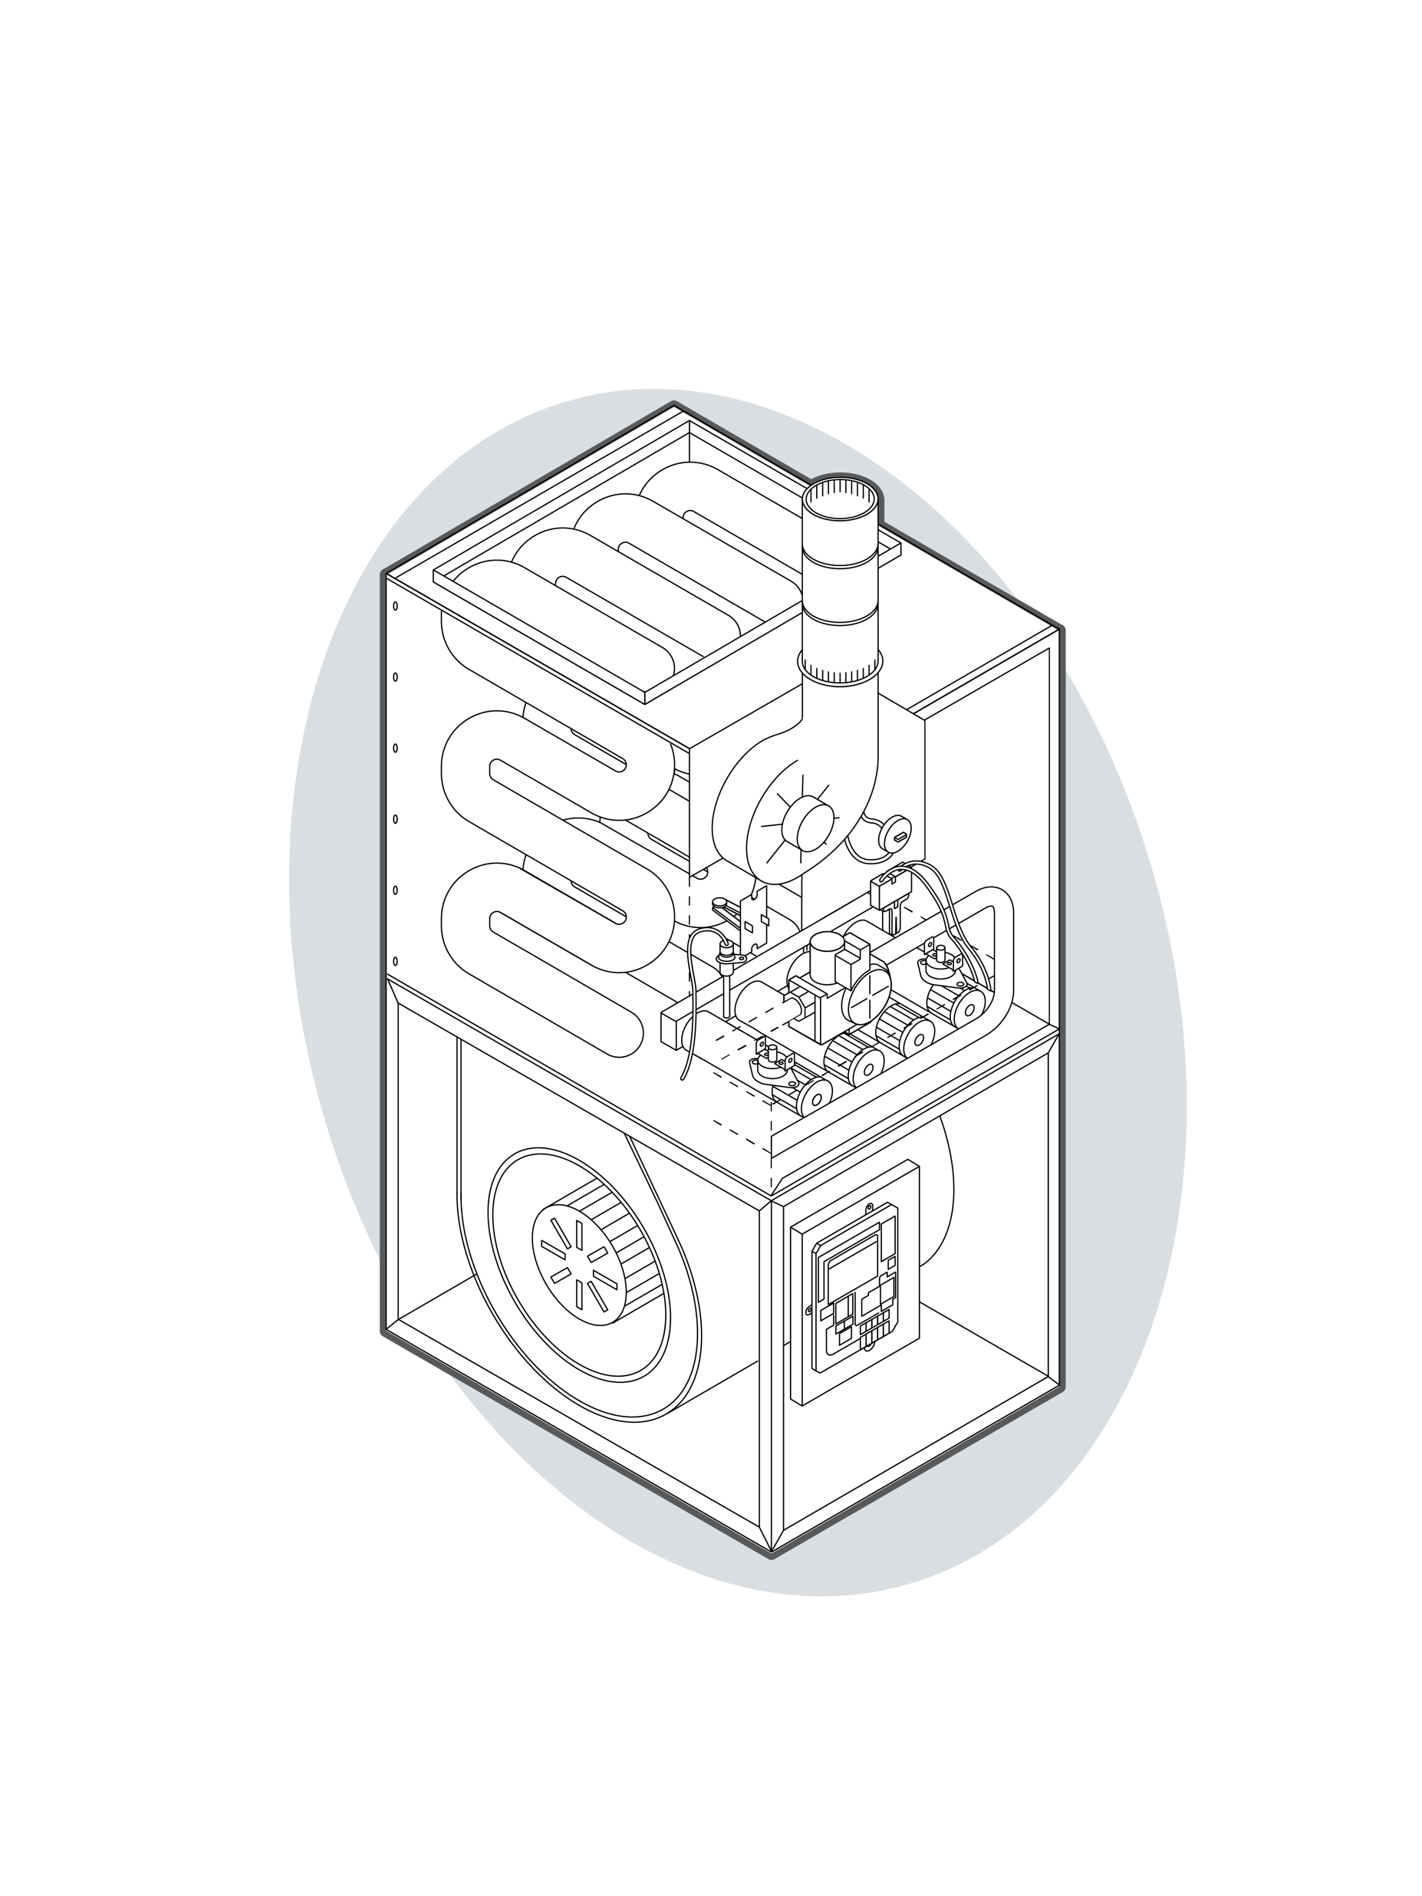
Furnace Controls Overview – Integrated Furnace Controls
Integrated Furnace Controls (IFC’s) Integrate Ignition, Fan, Inducer and Safety Controls onto One Central Control Board
Integrated Furnace Controls provide ignition, proof of ignition, precise control timings with integrated inducer and circulator blower control
Common integrated furnace control ignition types include hot surface and direct spark ignition to directly light the main burners as well as intermittent/proven pilot styles that light a pilot flame each heating cycle
Integrated controls are designed for a specific motor type with PSC, Variable Speed, ECM(x) Inducers and Blower motors among the most common

Slide 7
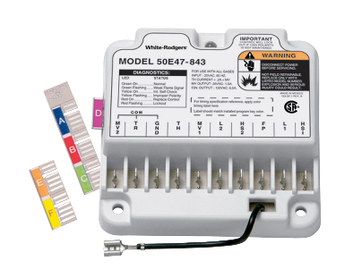
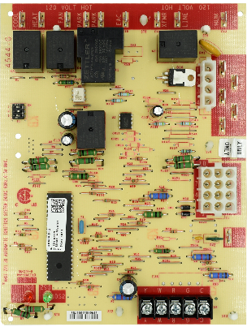
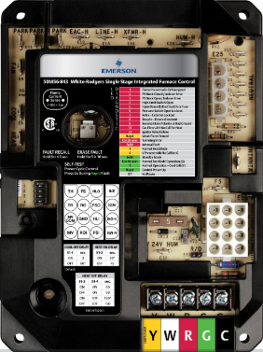
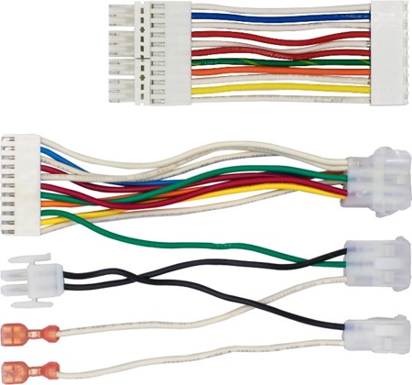
Universal and Direct Replacement Controls
Universal Vs. Direct Replacement Wholesale Controls
Universal Controls
Universal models replace multiple brands of original equipment and include wiring harnesses and adjustable timings customizable to multiple applications and furnace brands.
Direct Replacement Controls
Direct replacement models are designed for direct drop-in replacement of existing OEM controls
Ignition Types
Hot Surface Ignition directly lights the burner using a hot surface ignitor
Direct Spark Ignition directly lights the burner using spark electrode
Proven/Intermittent Pilot Spark Ignition lights a pilot burner which then lights the main burner
50E47-843
Non-Integrated Ignition Modules (Universal)
21D83M-843
Integrated Furnace Control (Direct OEM Replacement)
50M56U-843
Integrated Furnace Control (Universal)

Slide 8
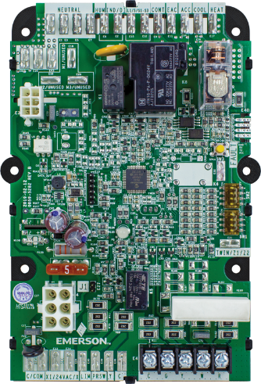
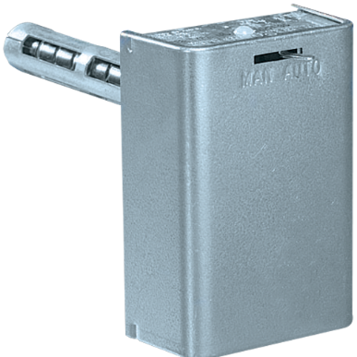
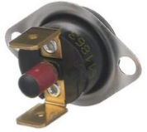
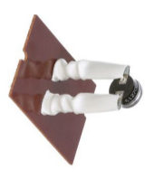
Fan and Limits
Electronic Fan Timers
Electronically times and controls the blower motor and inducer on non-integrated furnaces
Plenum Mount Bimetal Fan & Limits
Thermostatically controls the fan on and off cycle and includes a high temperature limit control on non-integrated and standing pilot furnaces
Flame Rollout and Temperature Limit Controls
Flame rollout controls sense flame if it rolls outside of the combustion chamber and turns the gas valve off
Temperature limits shut down combustion if the heat exchanger overheats
50F06-843
Furnace Electronic Fan Timer Control
5D51-90
Fan and Limit Control
Manual Reset Flame Rollout Control
Temperature Limit Control

Slide 9
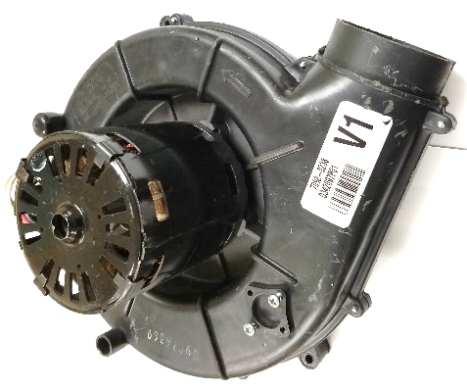
Inducer Blower and Pressure Switches
Inducer Blower
Each heating cycle the inducer blower purges the combustion chamber and creates and maintains a steady draft to push the combustion byproducts safely out of the building
Pressure Switches
Pressure Switches are connected to a hose connected to a port on the inducer blower/flue. Negative pressure in the combustion chamber (created by the inducer blower) closes the pressure switch contacts. This communicates to the furnace control that the pressure switch is functioning correctly, the flue is not blocked or obstructed and the heat cycle can continue safely on through to the gas ignition phase.
Inducer Blower
Pressure Switches
Notes:
Many models of condensing furnaces have separate pressure switches
One detects the proper pressure for venting
One detects condensate buildup in the heat exchanger (buildup of water blocks path to switch)
The condensate pressure switch will also fail to close if the condensate trap allows too much airflow (no water in trap, airflow through open trap doesn’t allow negative pressure in heat exchanger)
Both are closed by the negative pressure in the heat exchanger

Slide 10
Part Three
Standing Pilot
Part Two

Slide 11
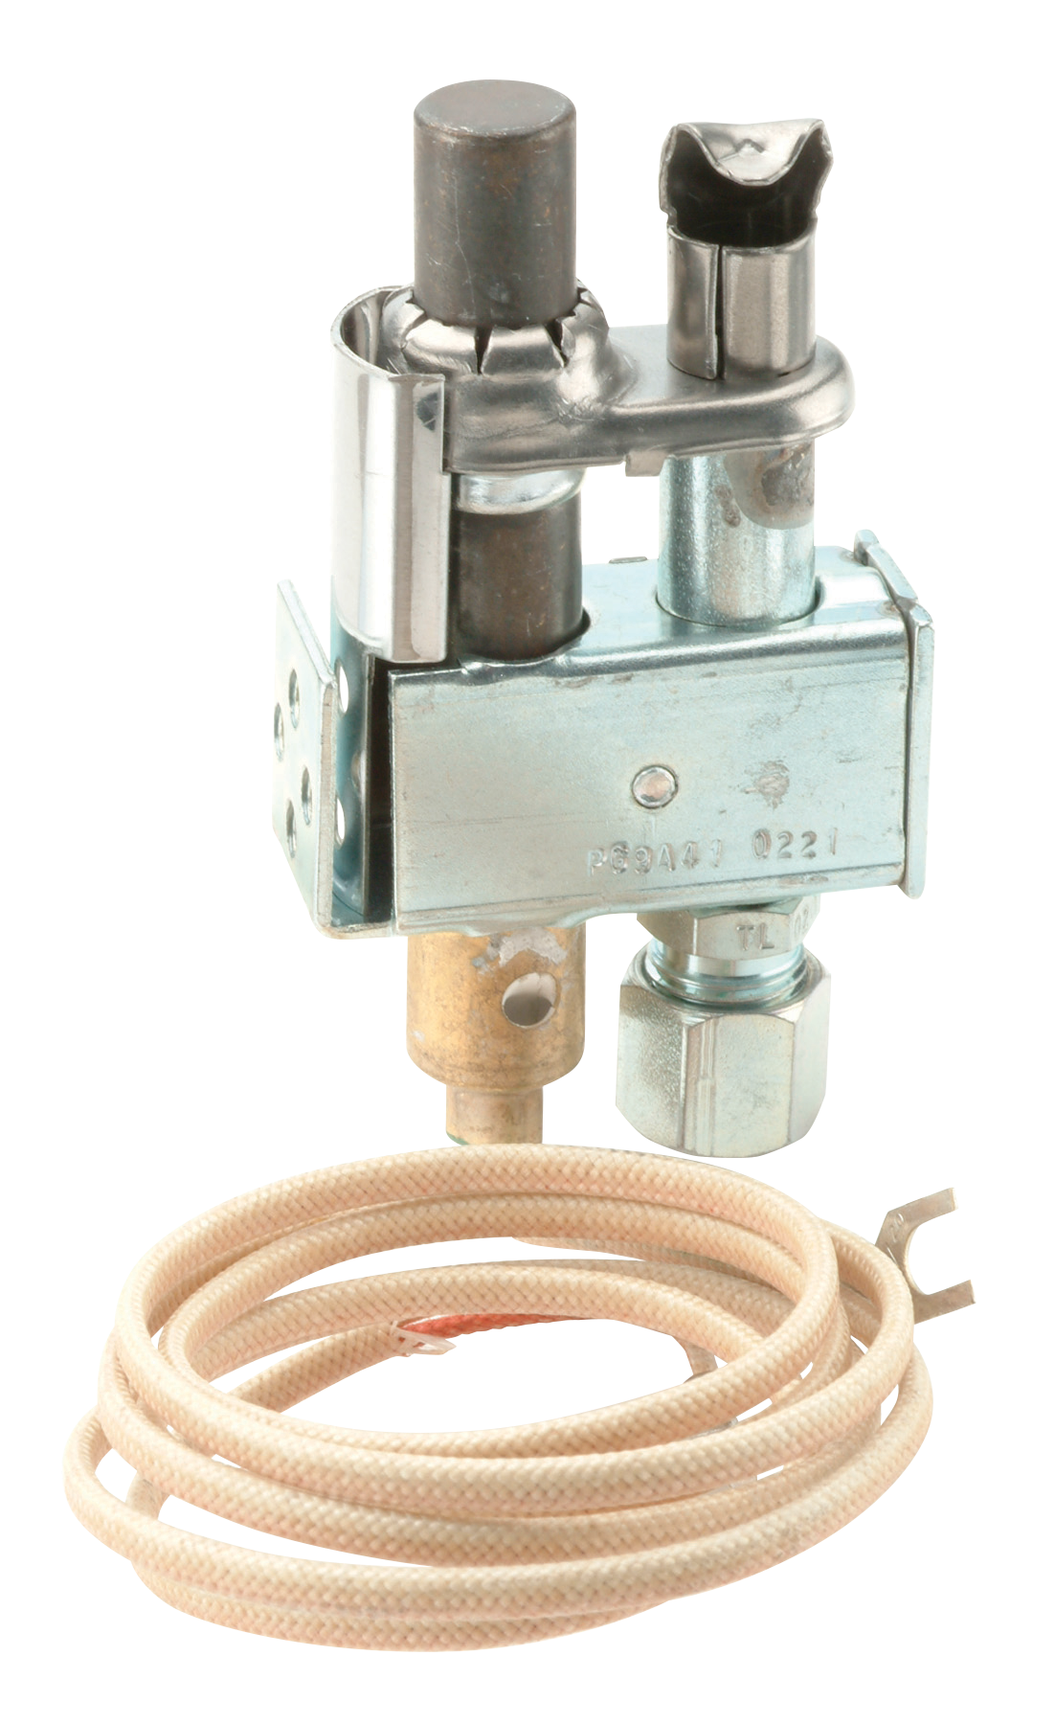
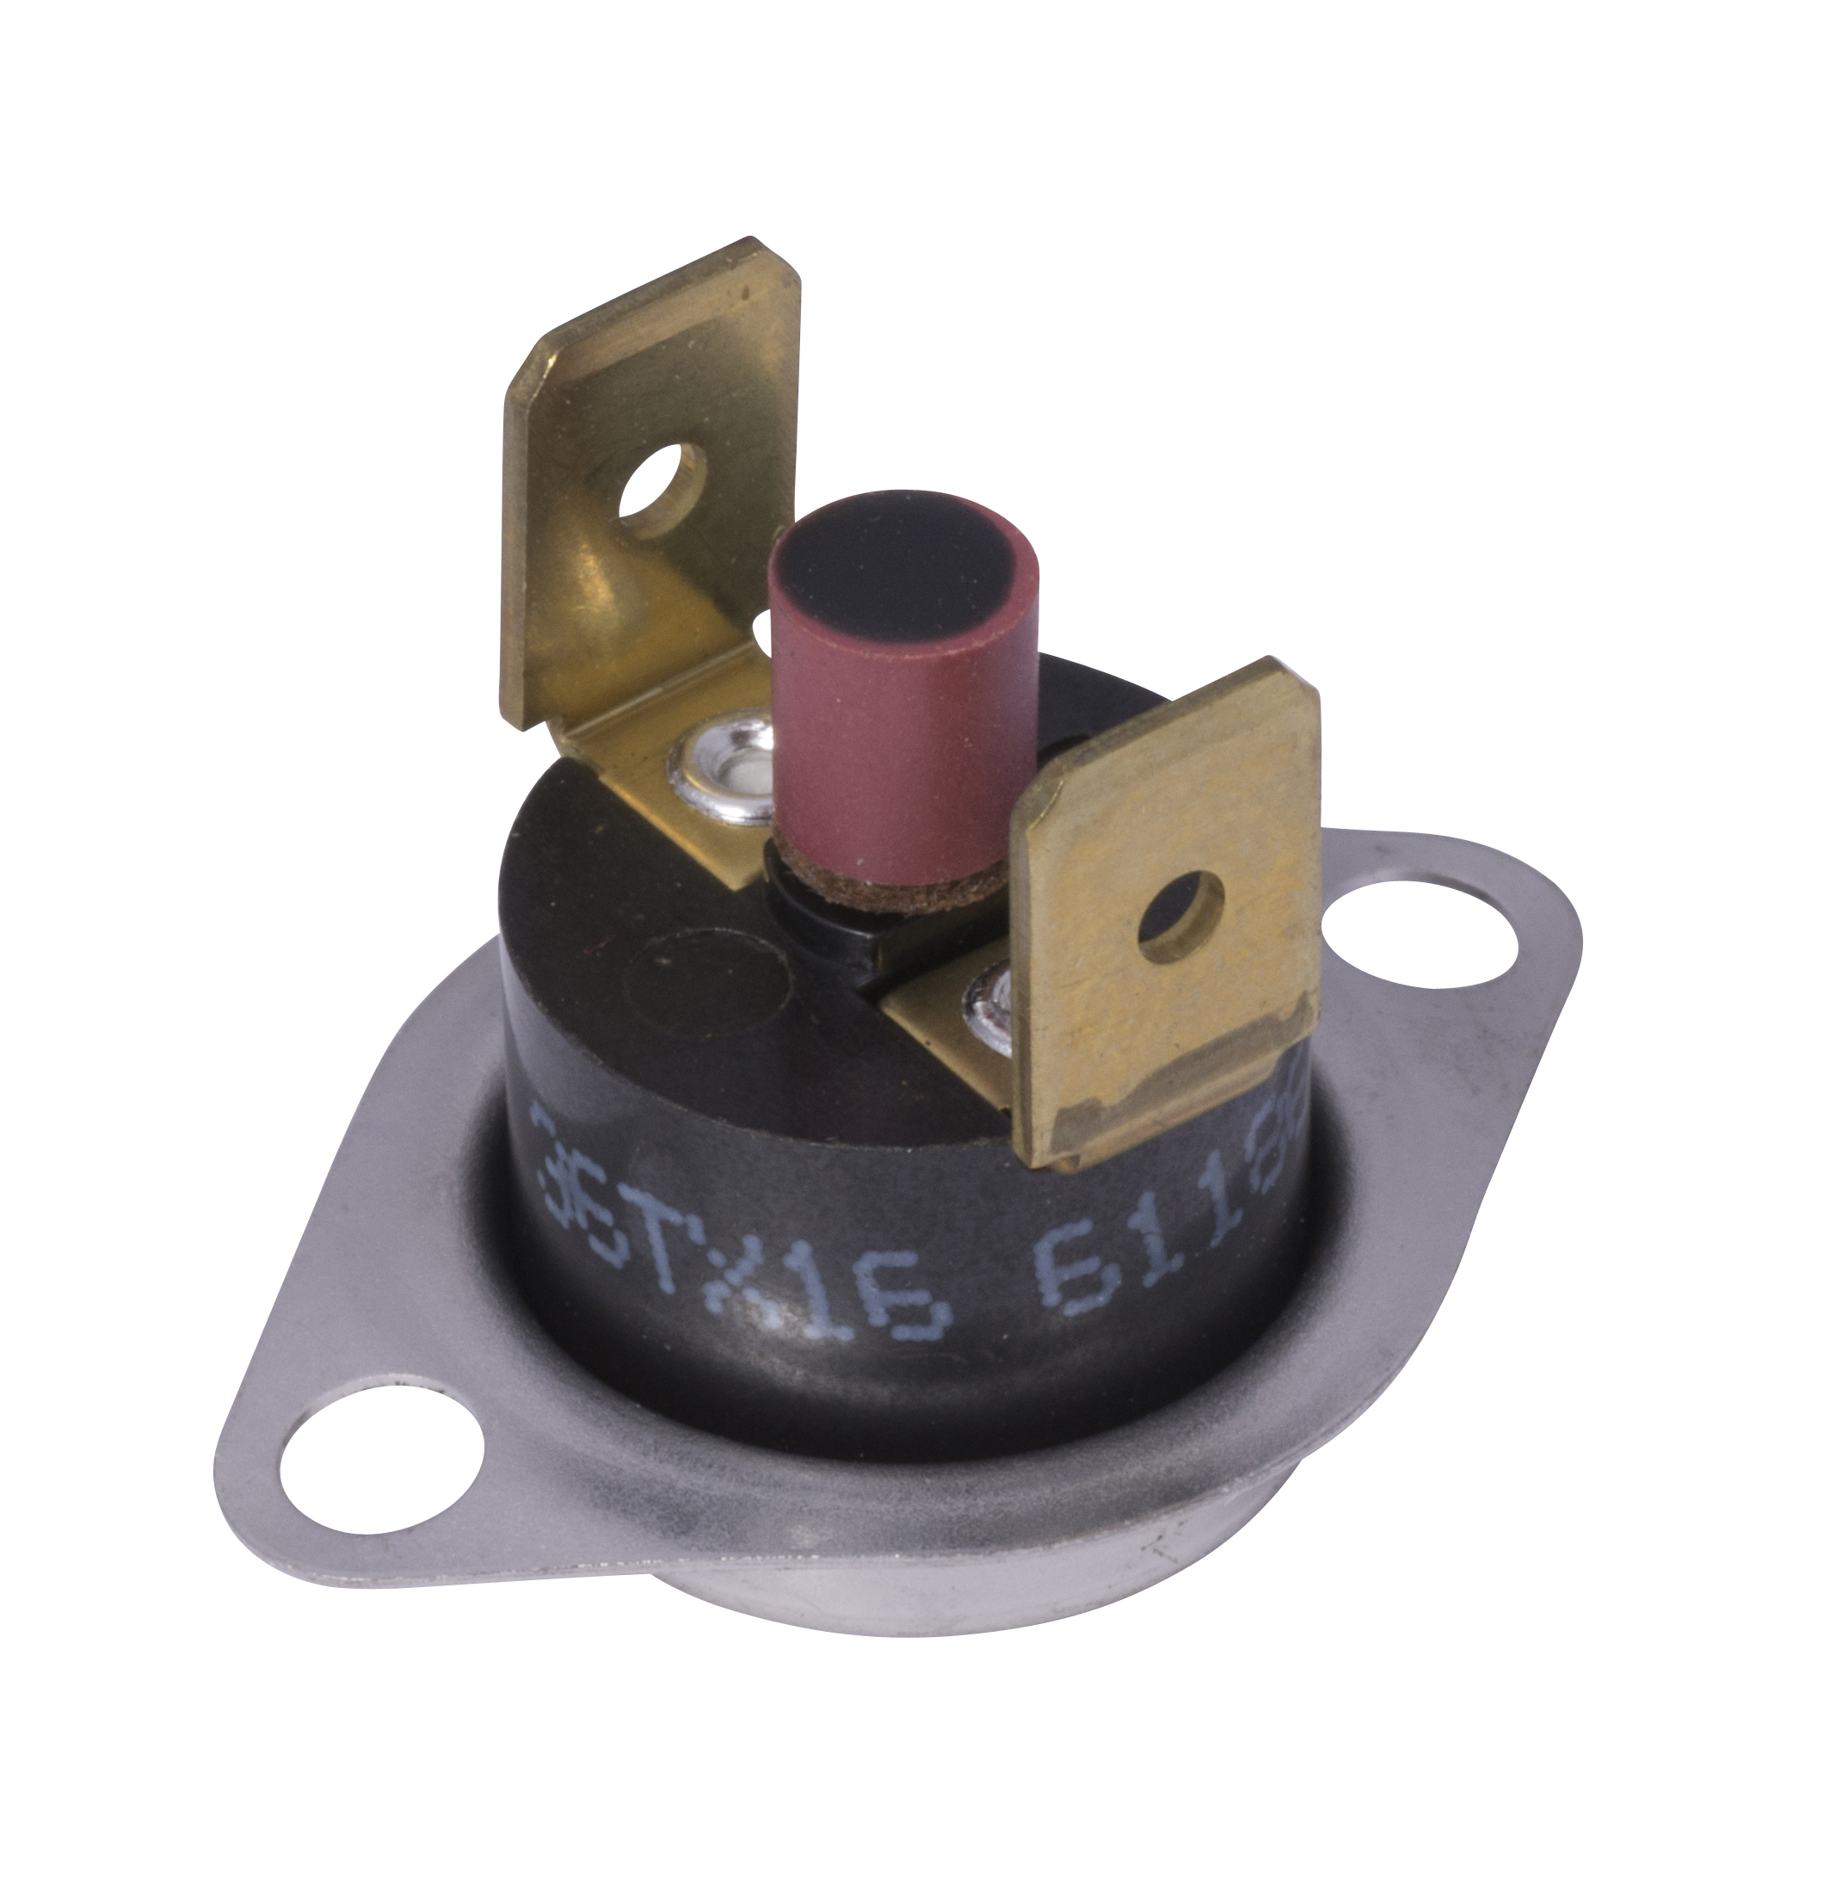
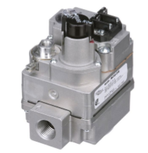
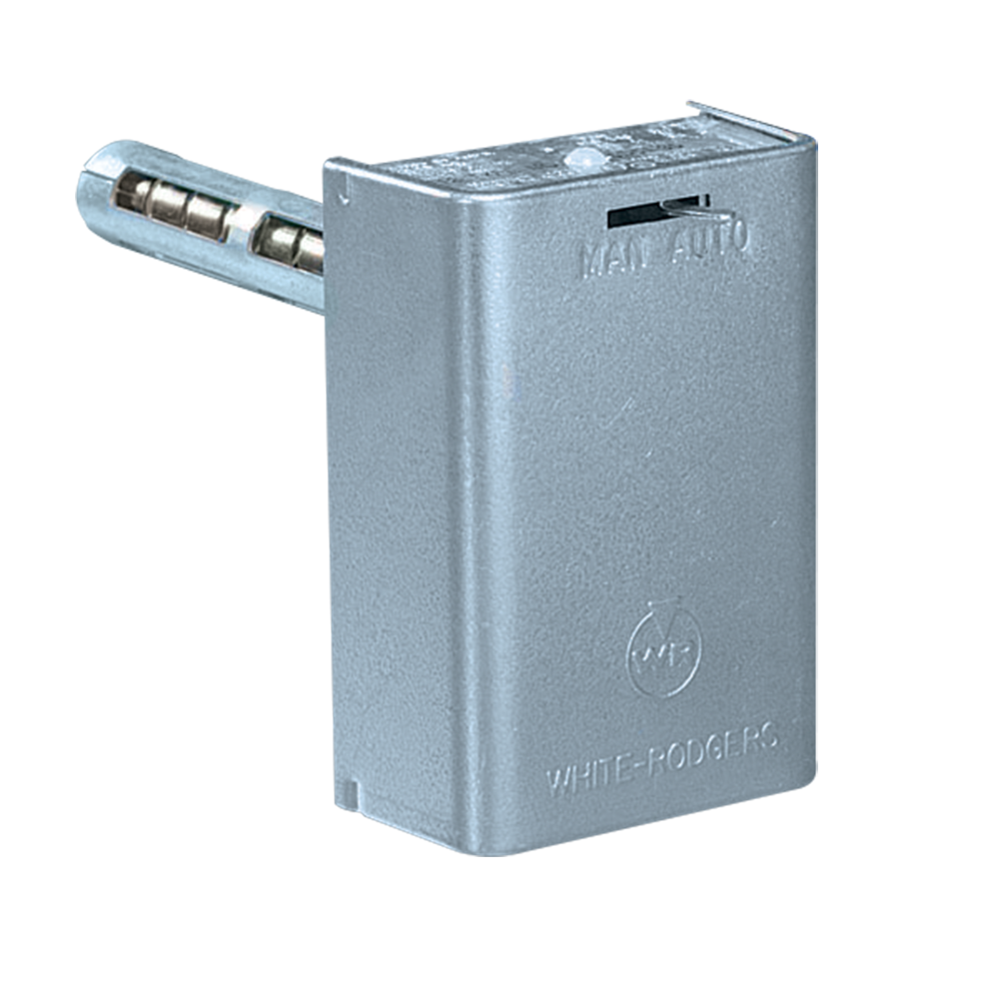
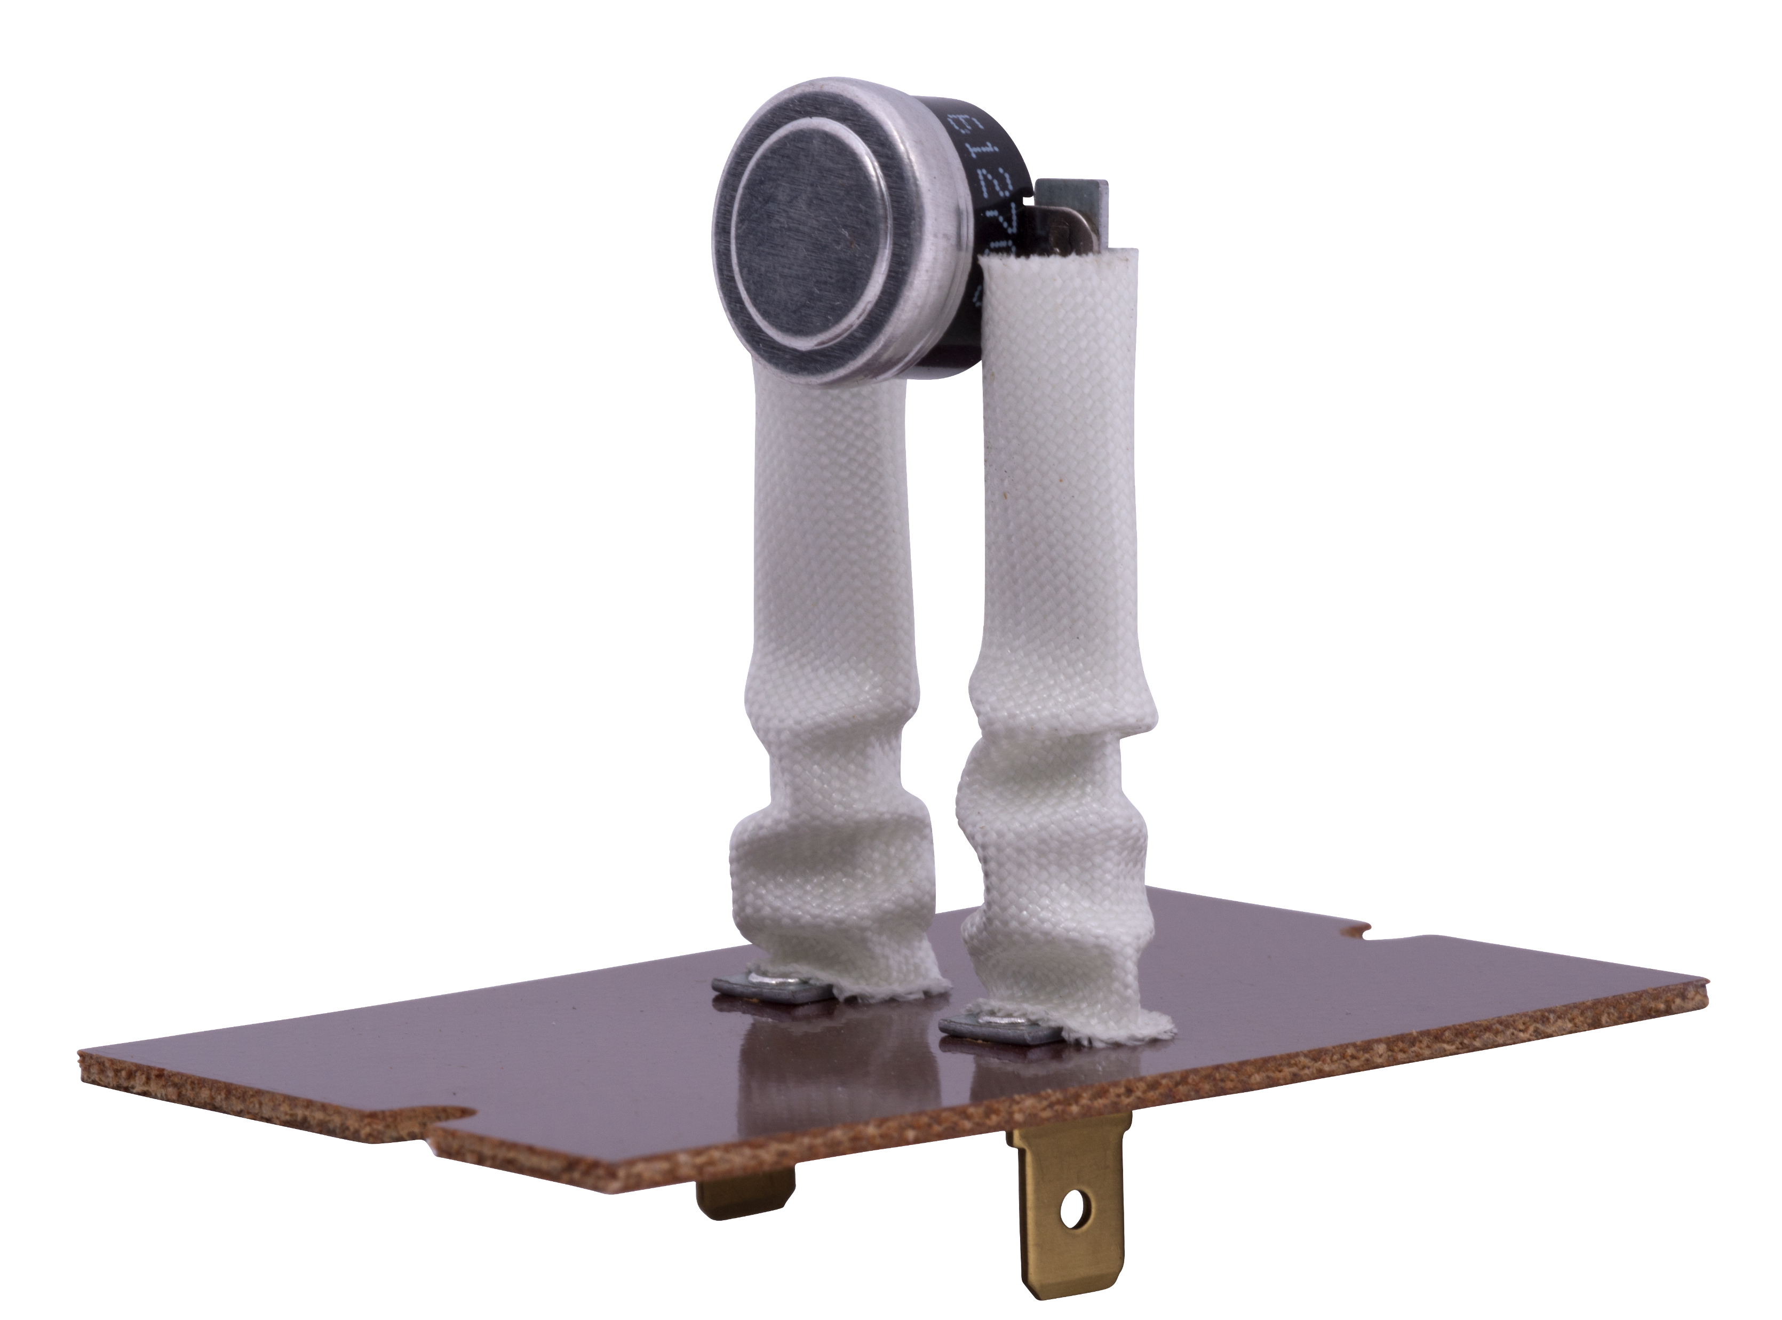
Standing Pilot Operation
On standing pilot systems, the gas valve and pilot assembly assure main burner ignition and safety if the pilot blows out. The blower circuit and temperature limits operate independently of valve
Standing pilot valve and
pilot assembly responsible for:
Fan and limit controls
responsible for:
Main Burner Ignition
Pilot Safety
Blower
On / Off Delay
Temperature Safety Limits

Slide 12
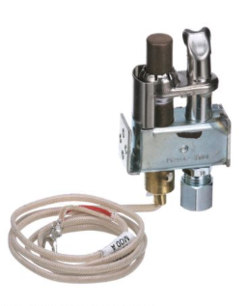
Standing Pilot Diagram
1
Pilot Assembly
2
Gas Valve with Pilot Safety Valve
4
3
Manual Reset Flame Rollout Control
Fan and Limit Control
2
4
1
3

Slide 13
Part Three
Non-Integrated Ignition Modules
Part Two

Slide 14
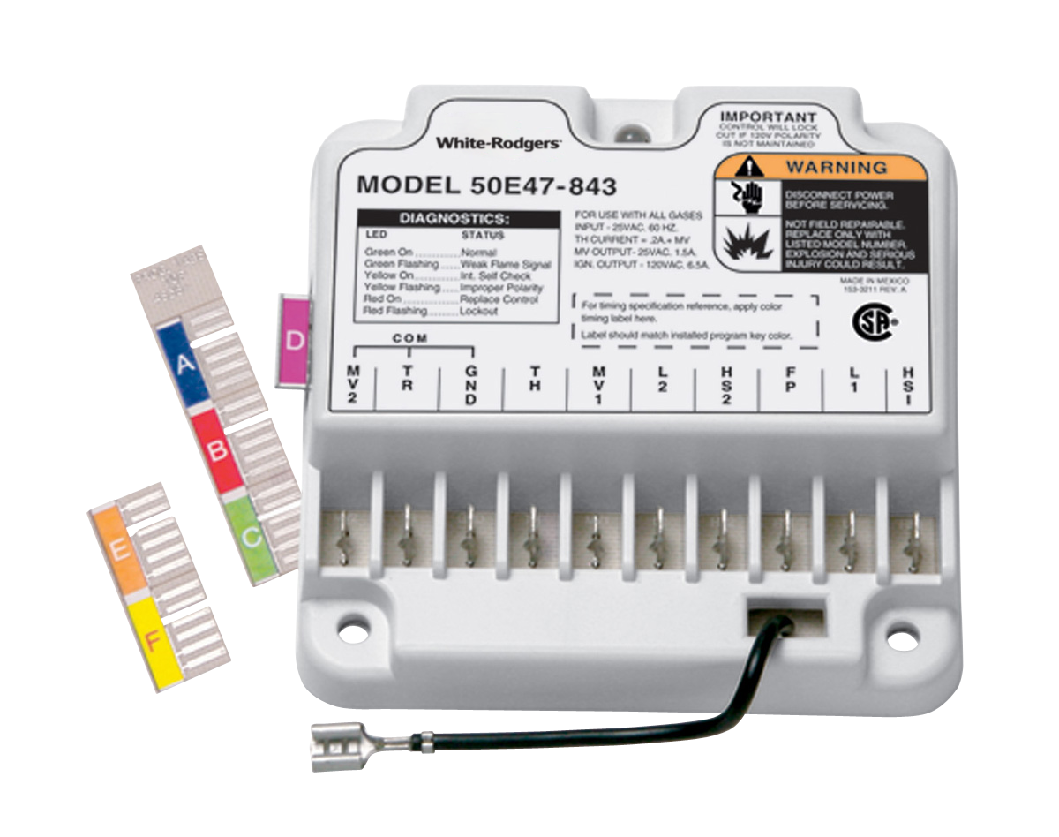
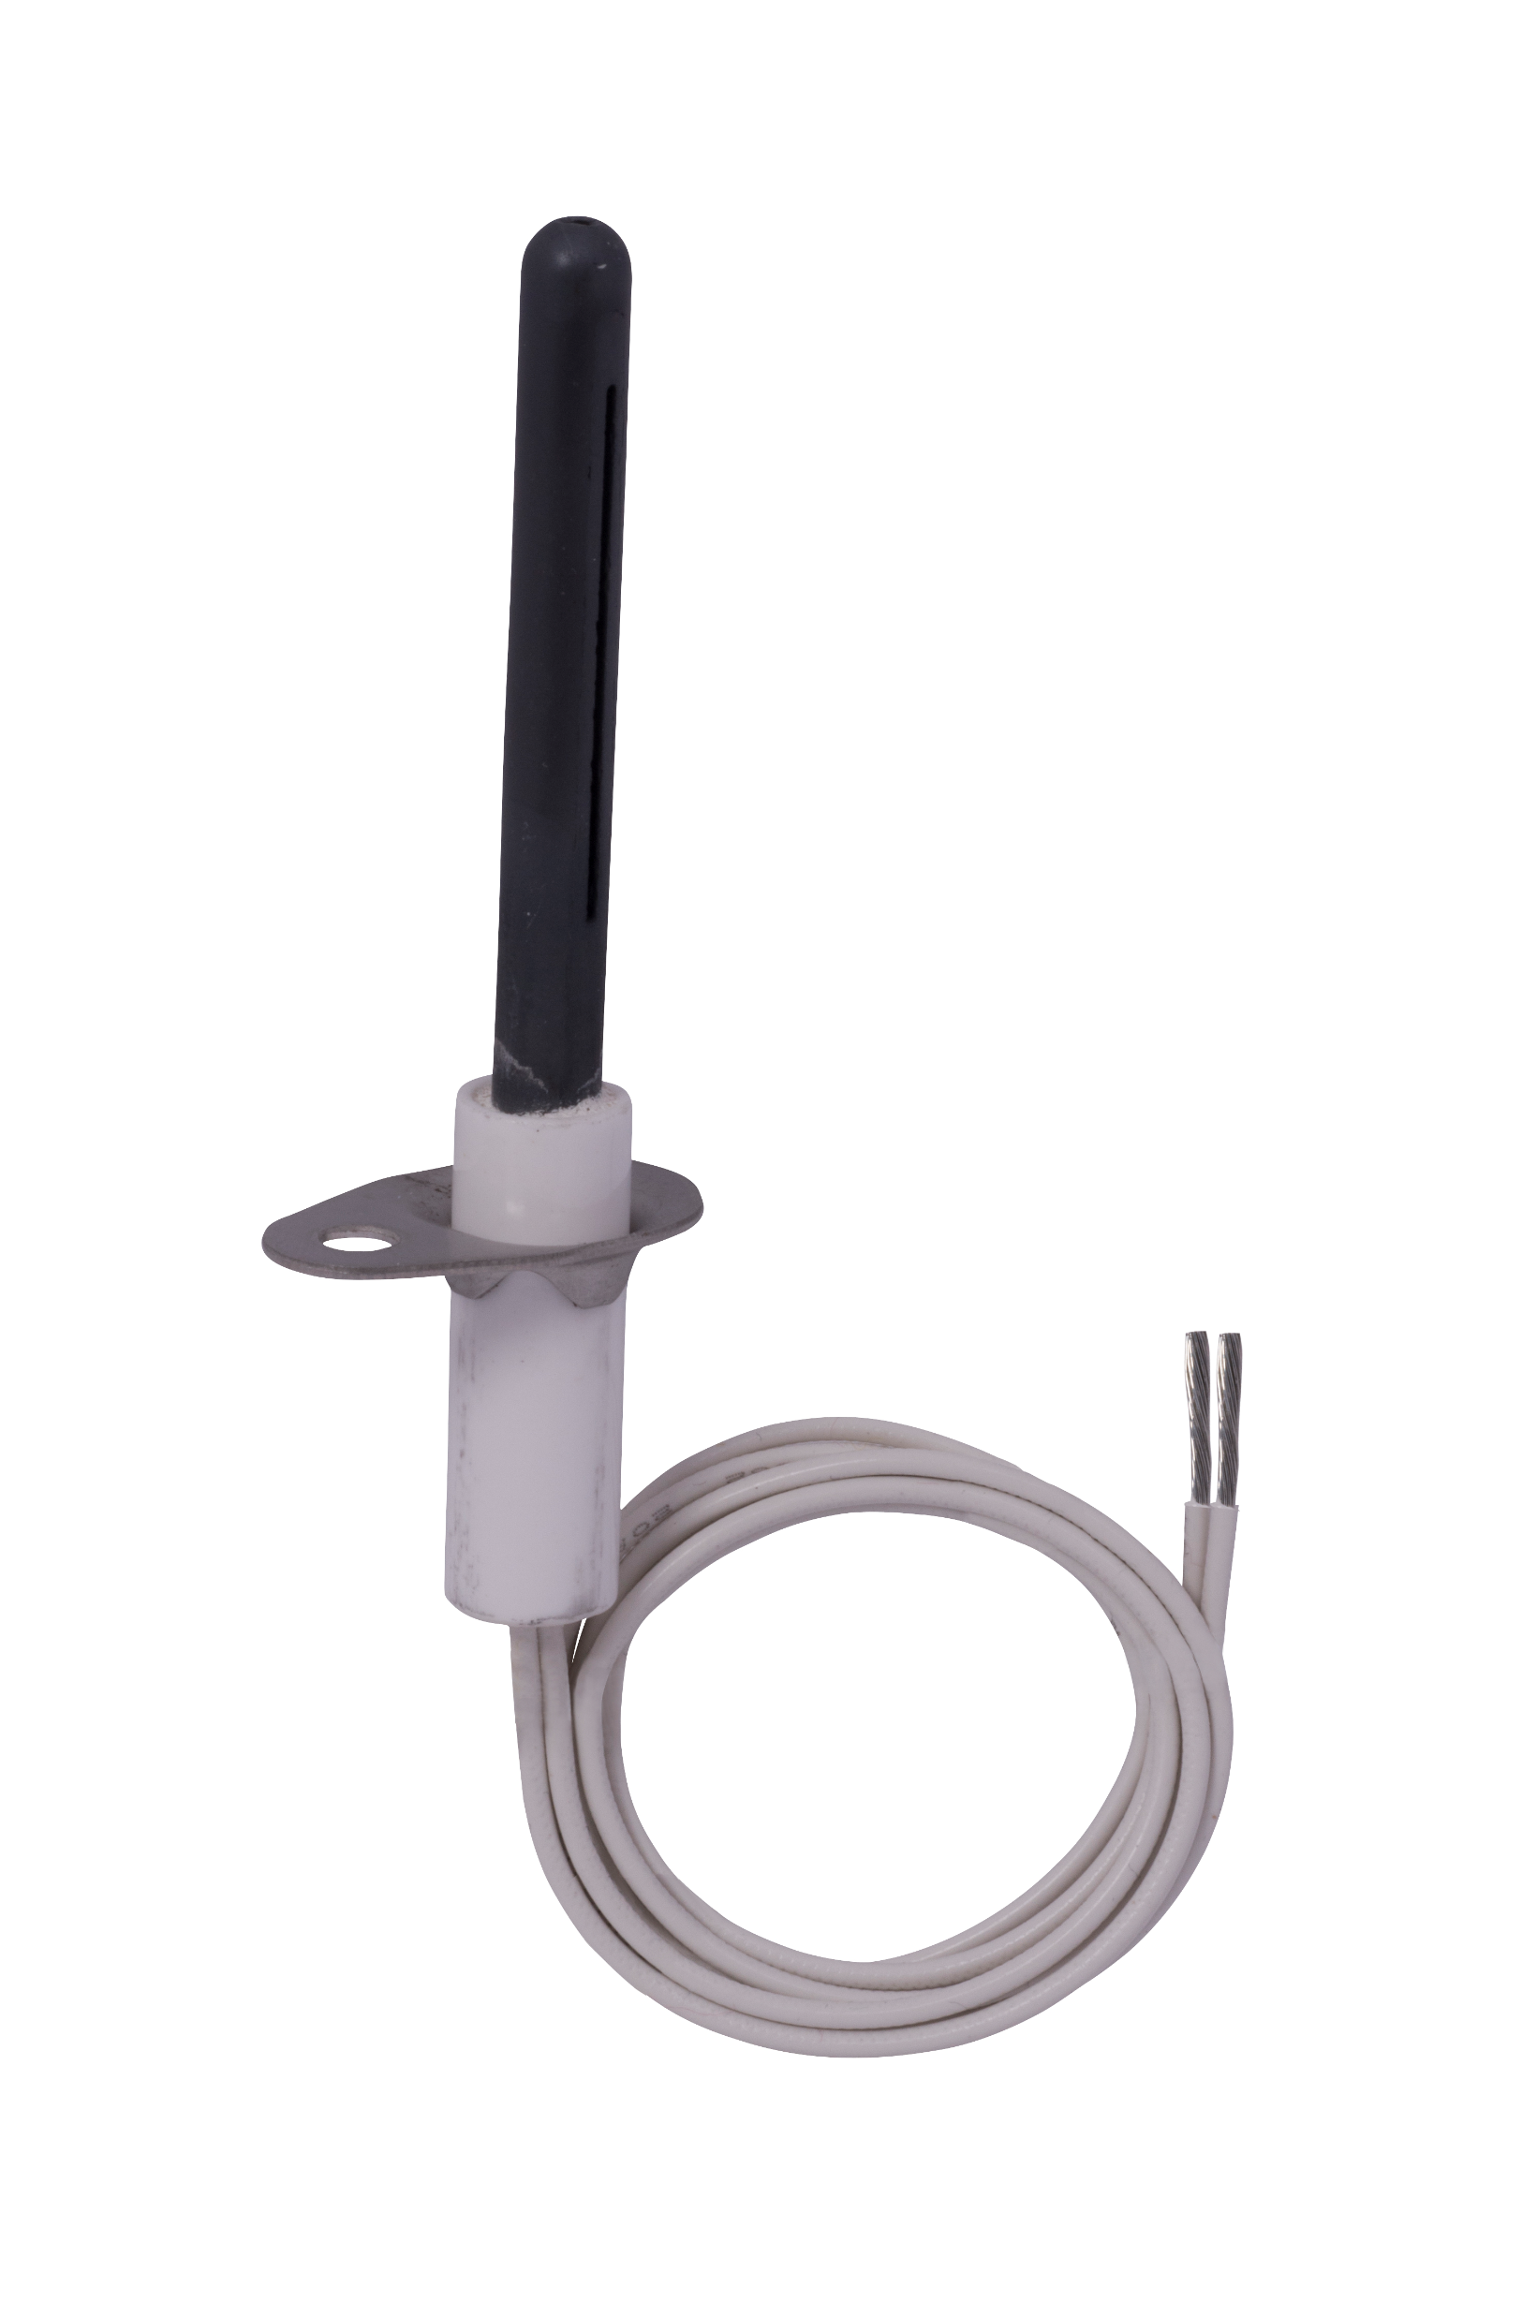
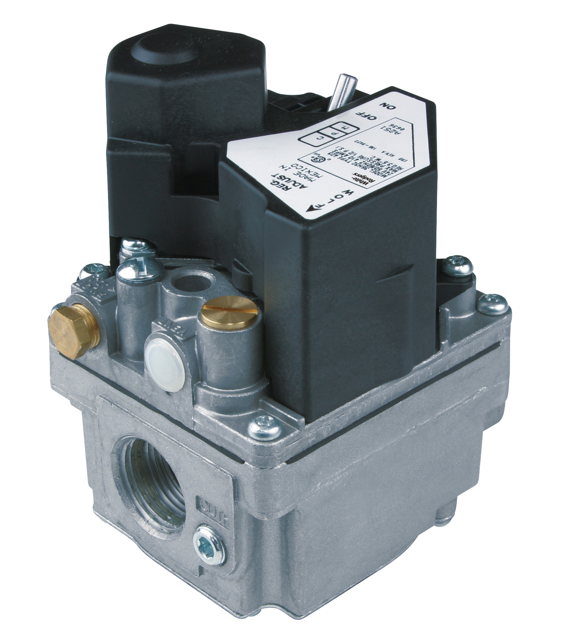
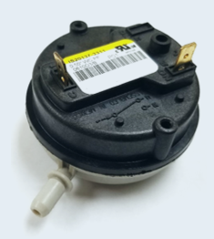
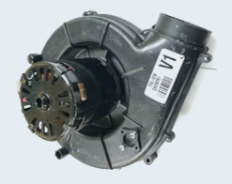
Non-Integrated Ignition Operation
Non-integrated ignition modules initiate ignition (HSI/DSI/Proven Pilot) and supervise gas valve and burner flame. Inducer circuit, blower circuit and temperature limits operate independently of the ignition control
Independent controls responsible for:
Non-integrated ignition module responsible for:
Fan and limit controls responsible for:
Inducer Motor and Flue Pressure Safety (If So Equipped)
Ignitor Control
Gas Valve
Flame Sense
Blower
On / Off
Delay
Temperature Safety Limits

Slide 15
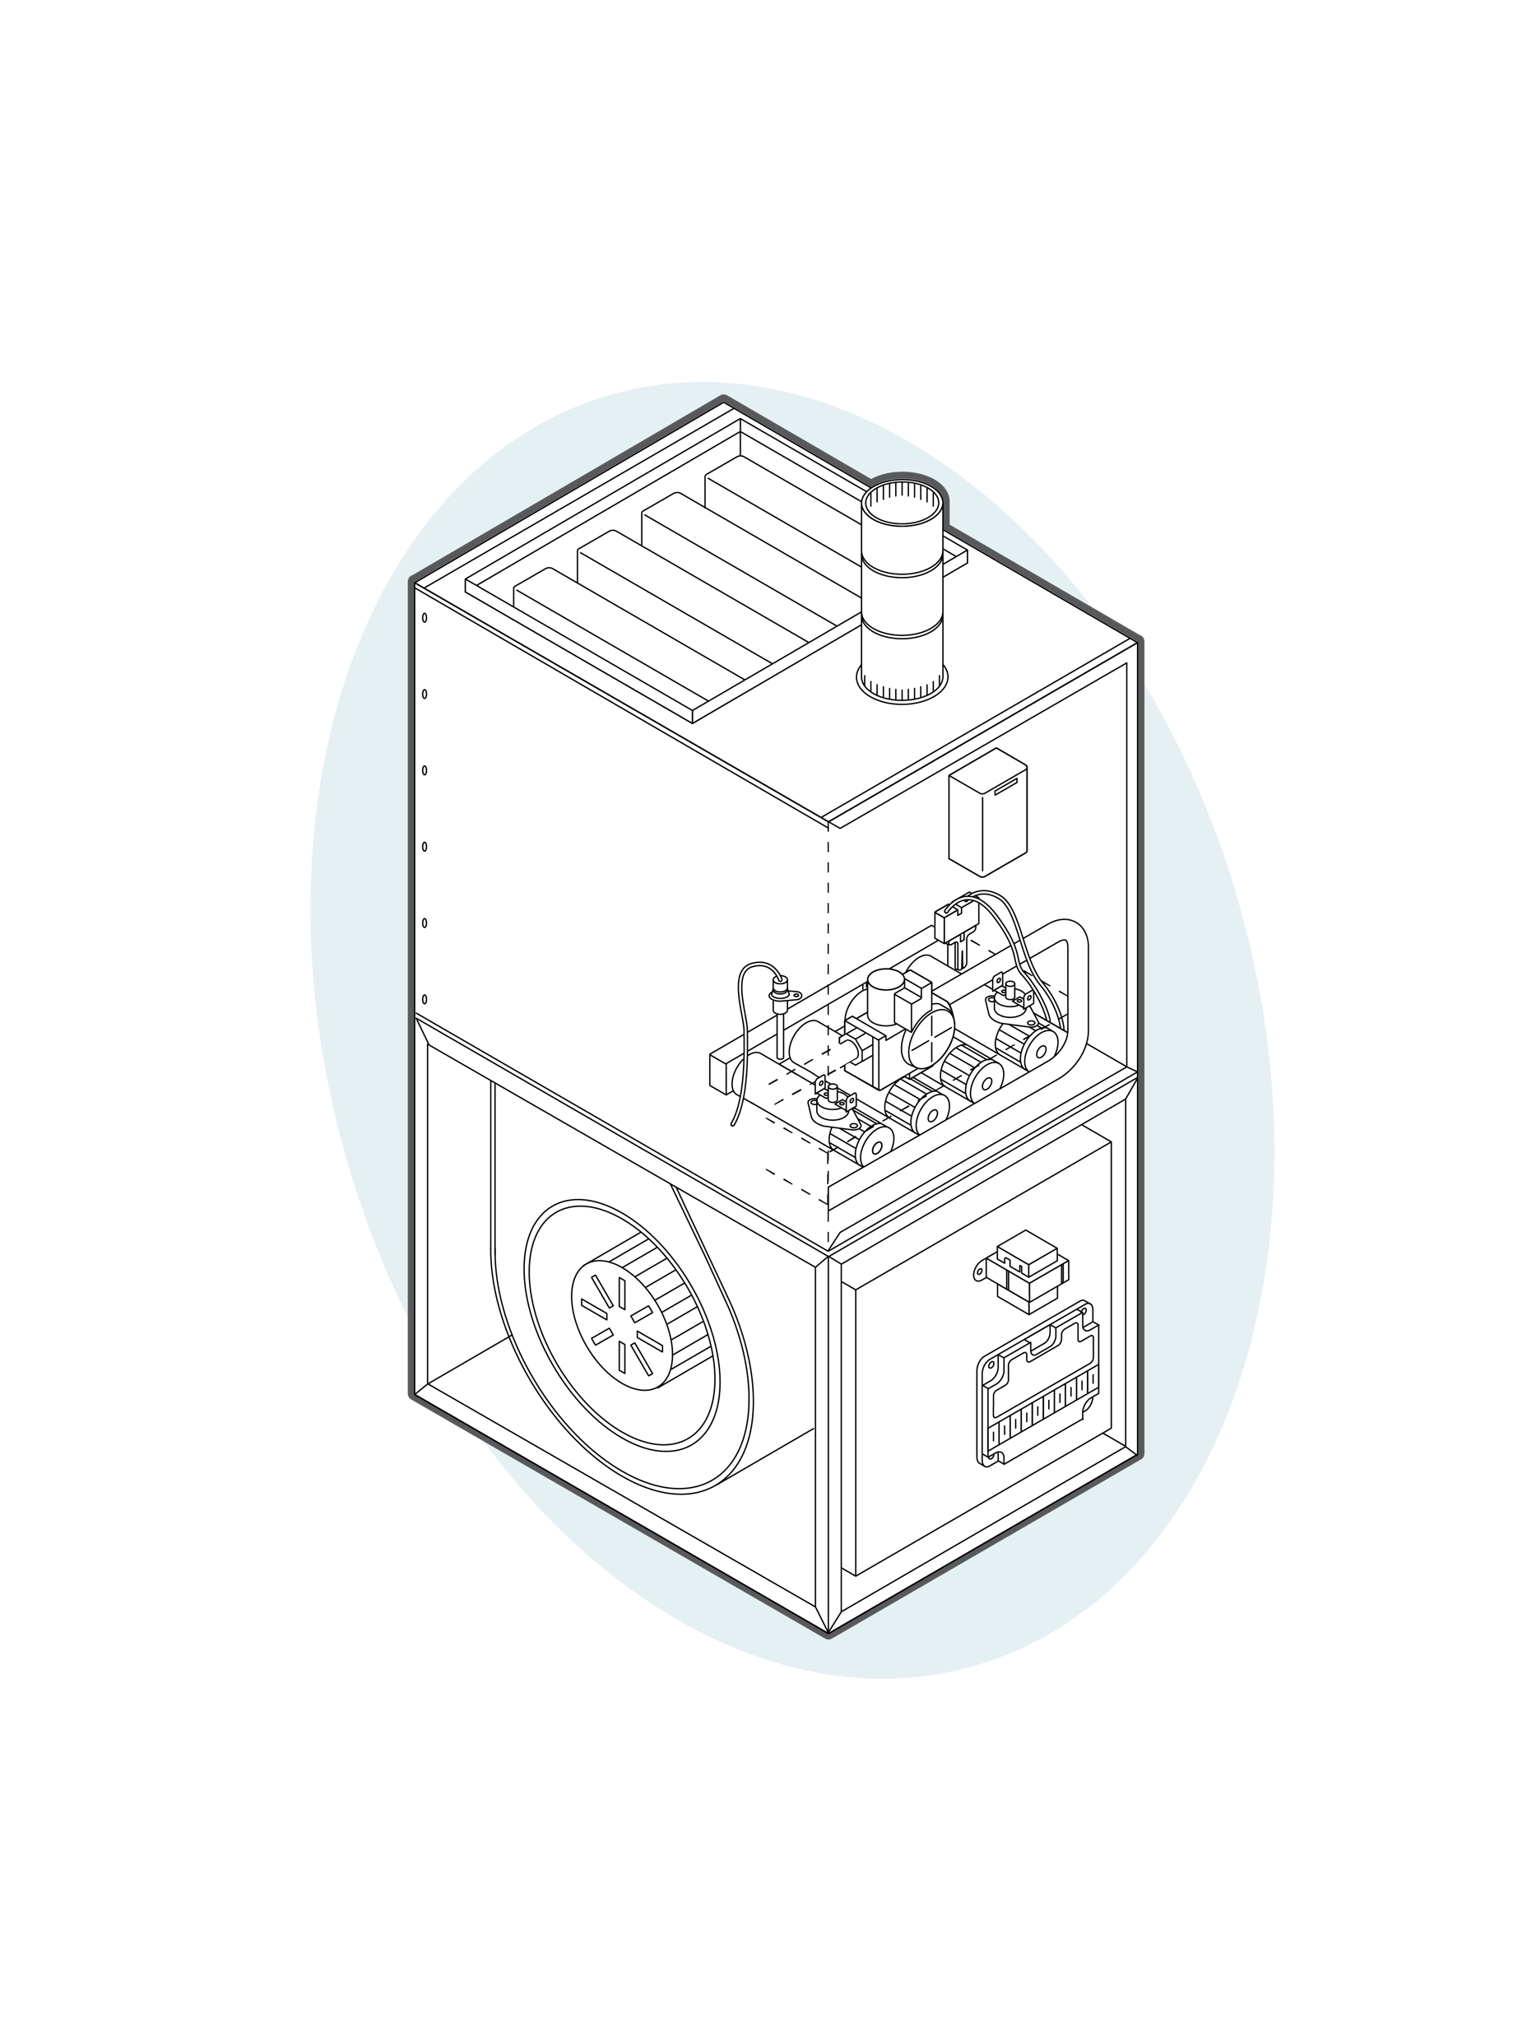
Non-Integrated Diagram
1
Ignitor
2
Gas Valve
3
Flame Sensor
4
Fan and Limit Control
1
4
2
3
5
Non-Integrated Ignition Modules
6
6
Manual Reset Flame Rollout Control
5

Slide 16
Part Three
Integrated Furnace Controls (IFC’s)
Part Two

Slide 17
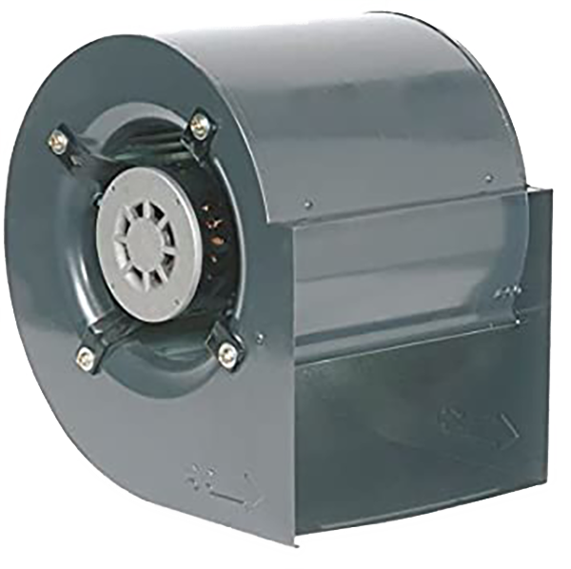
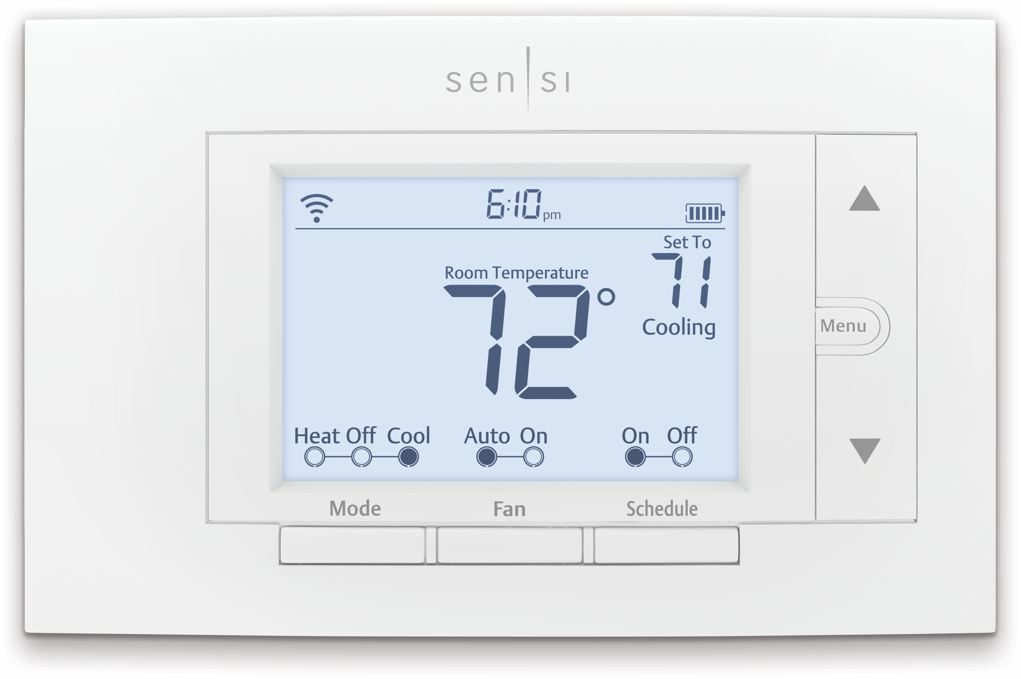
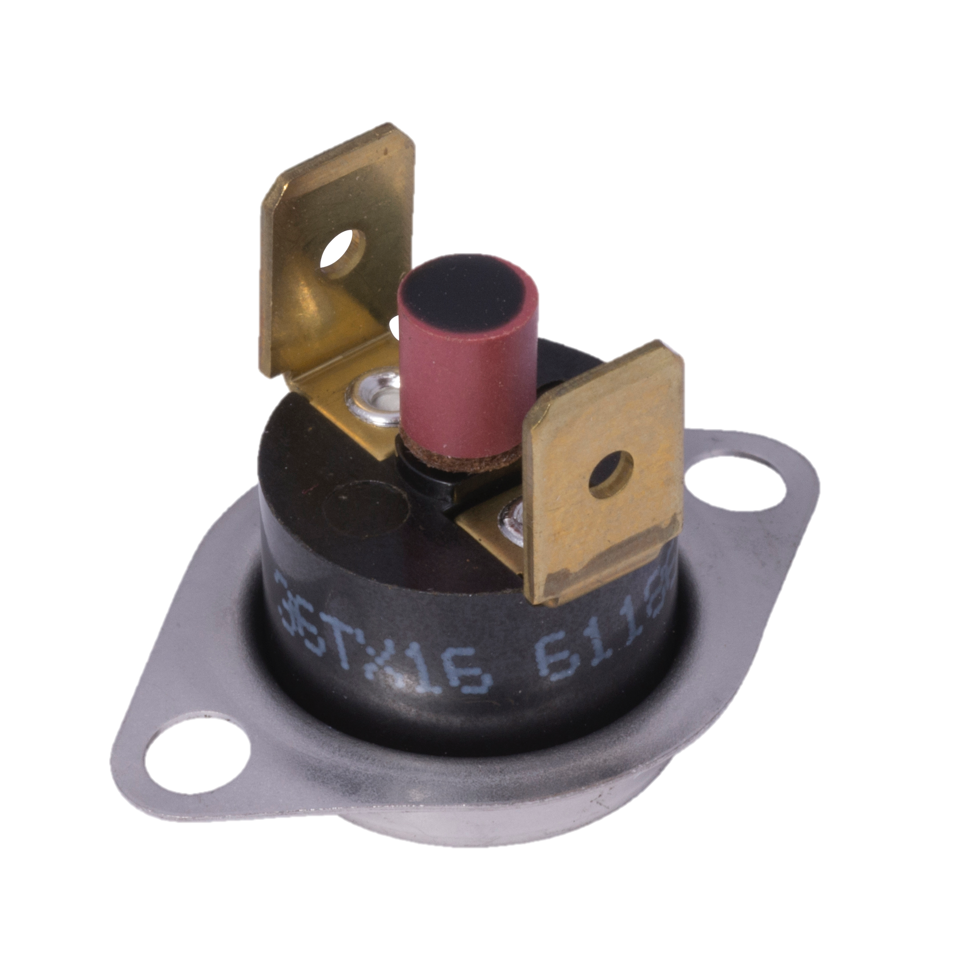
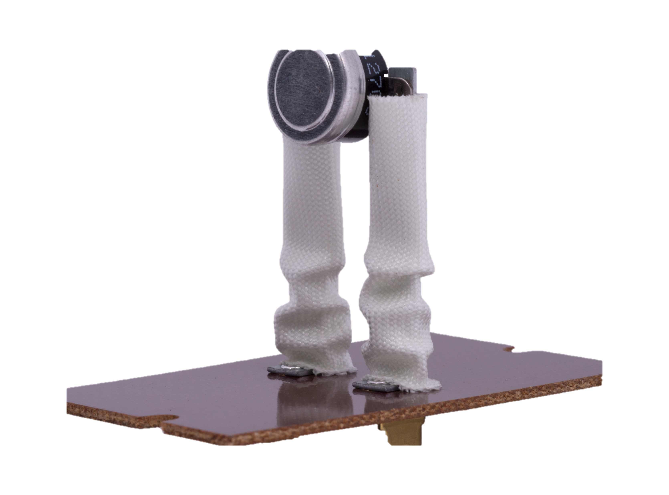
Integrated Furnace Control Operation
Gas furnaces follow a standard sequence of operation with minor variations in fan control timings and the number or circuit position of limit devices.
Thermostat Calls for Heat
IFC Verifies Temperature and Rollout Limits are Closed/Flue Pressure Switch is Open
Inducer Motor Energizes
Flue Pressure Switch Closes
Ignitor Circuit Energizes
Gas Valve Energizes
Control Senses Flame
Ignitor Off
Blower on Delay
(30-45s)
Blower On
Heat Continues Until Thermostat Satisfied or a Fault Occurs
Thermostat Satisfied – Drops Call For Heat to Control
Gas Valve
De-Energized
Inducer Delay Off
Blower Delay Off (60-180s)
Blower Off
System Off –
Waiting Next Cycle

Slide 18
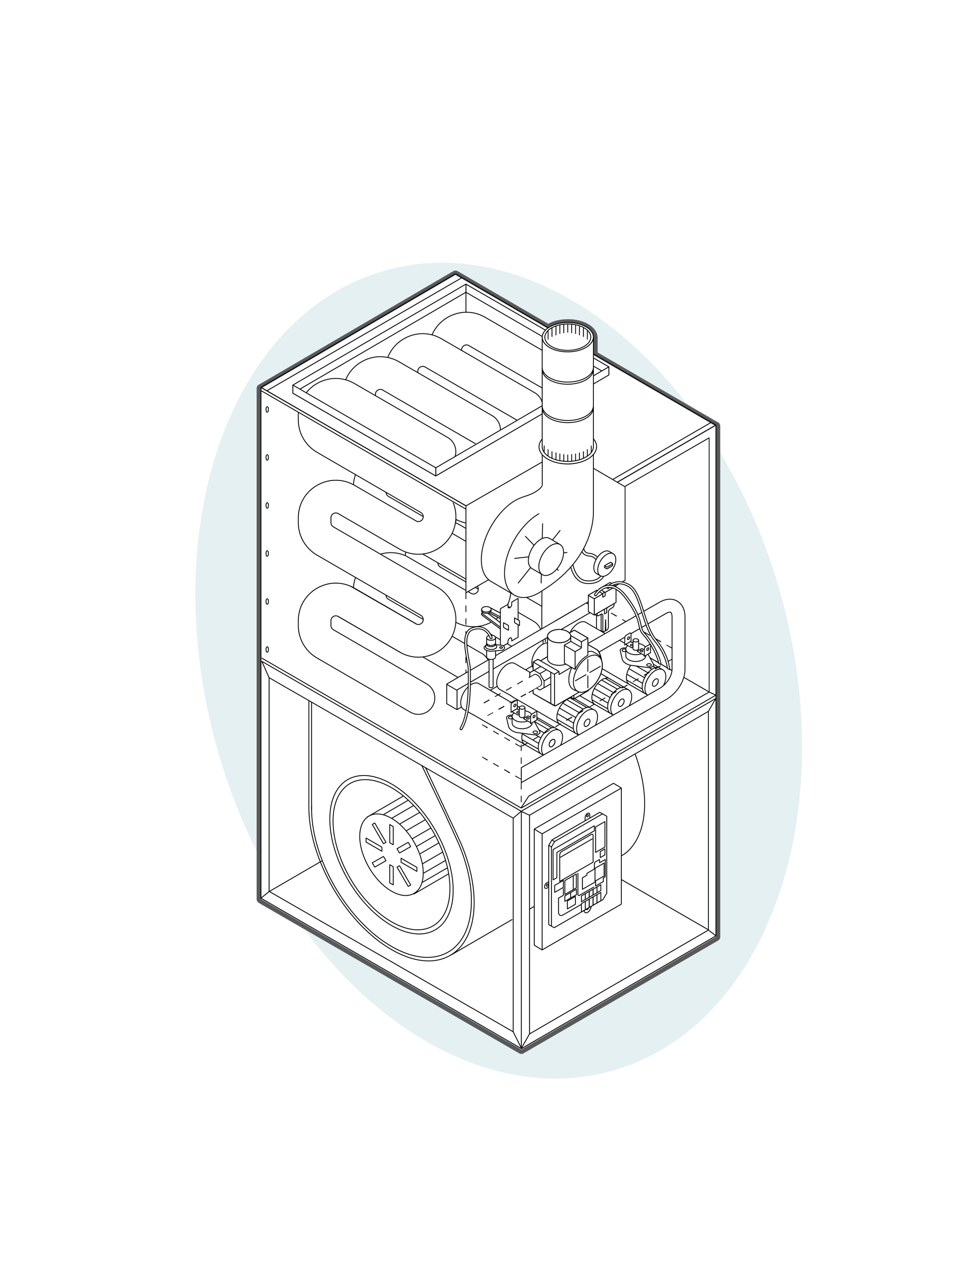
Integrated Furnace Diagram
1
Ignitor
2
Gas Valve
3
Flame Sensor
7
4
Flue Pressure Switch
4
1
5
Integrated Furnace Control
8
3
6
Manual Reset Flame Rollout Control
2
6
7
Inducer Motor
8
Temperature Limit Control
9
5
9
Blower

Slide 19
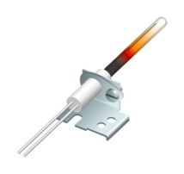
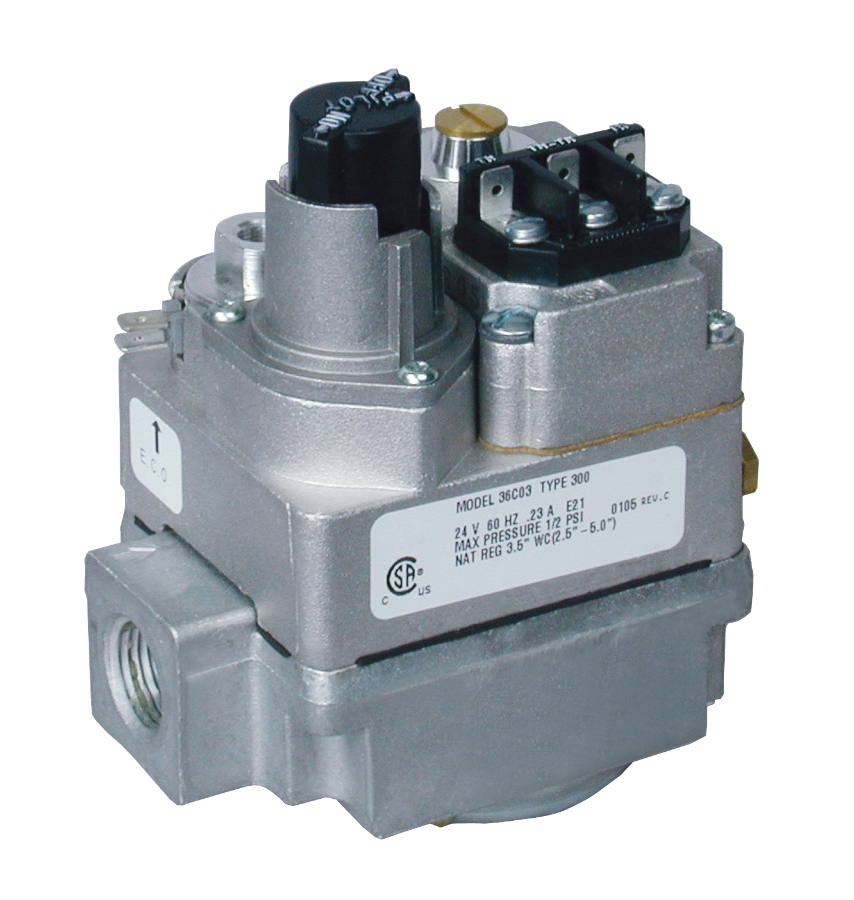
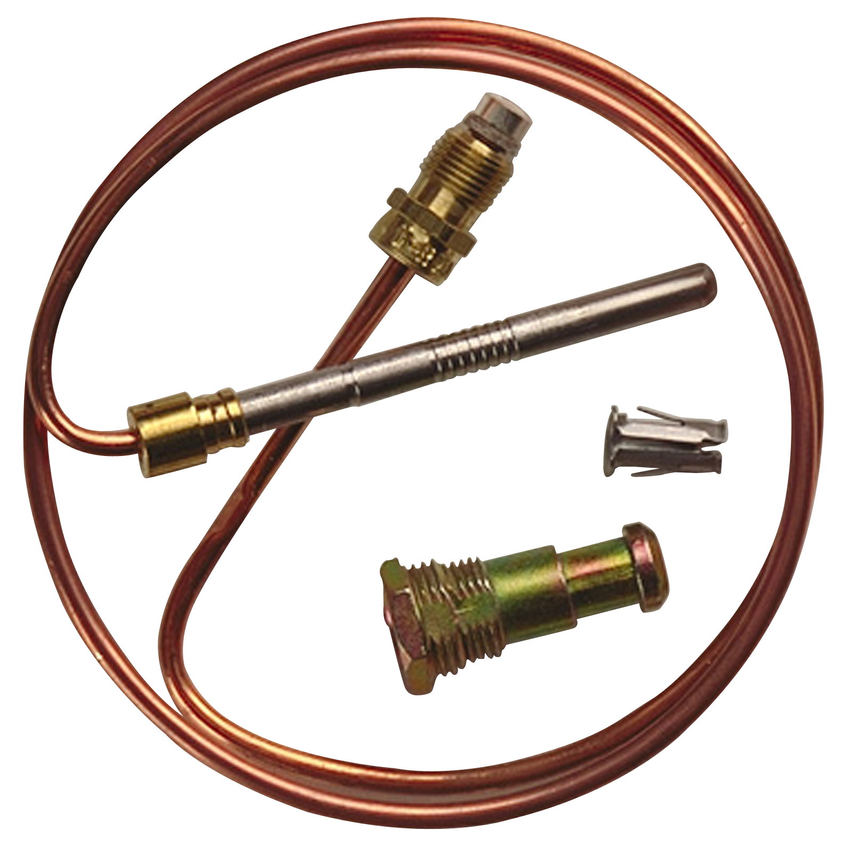
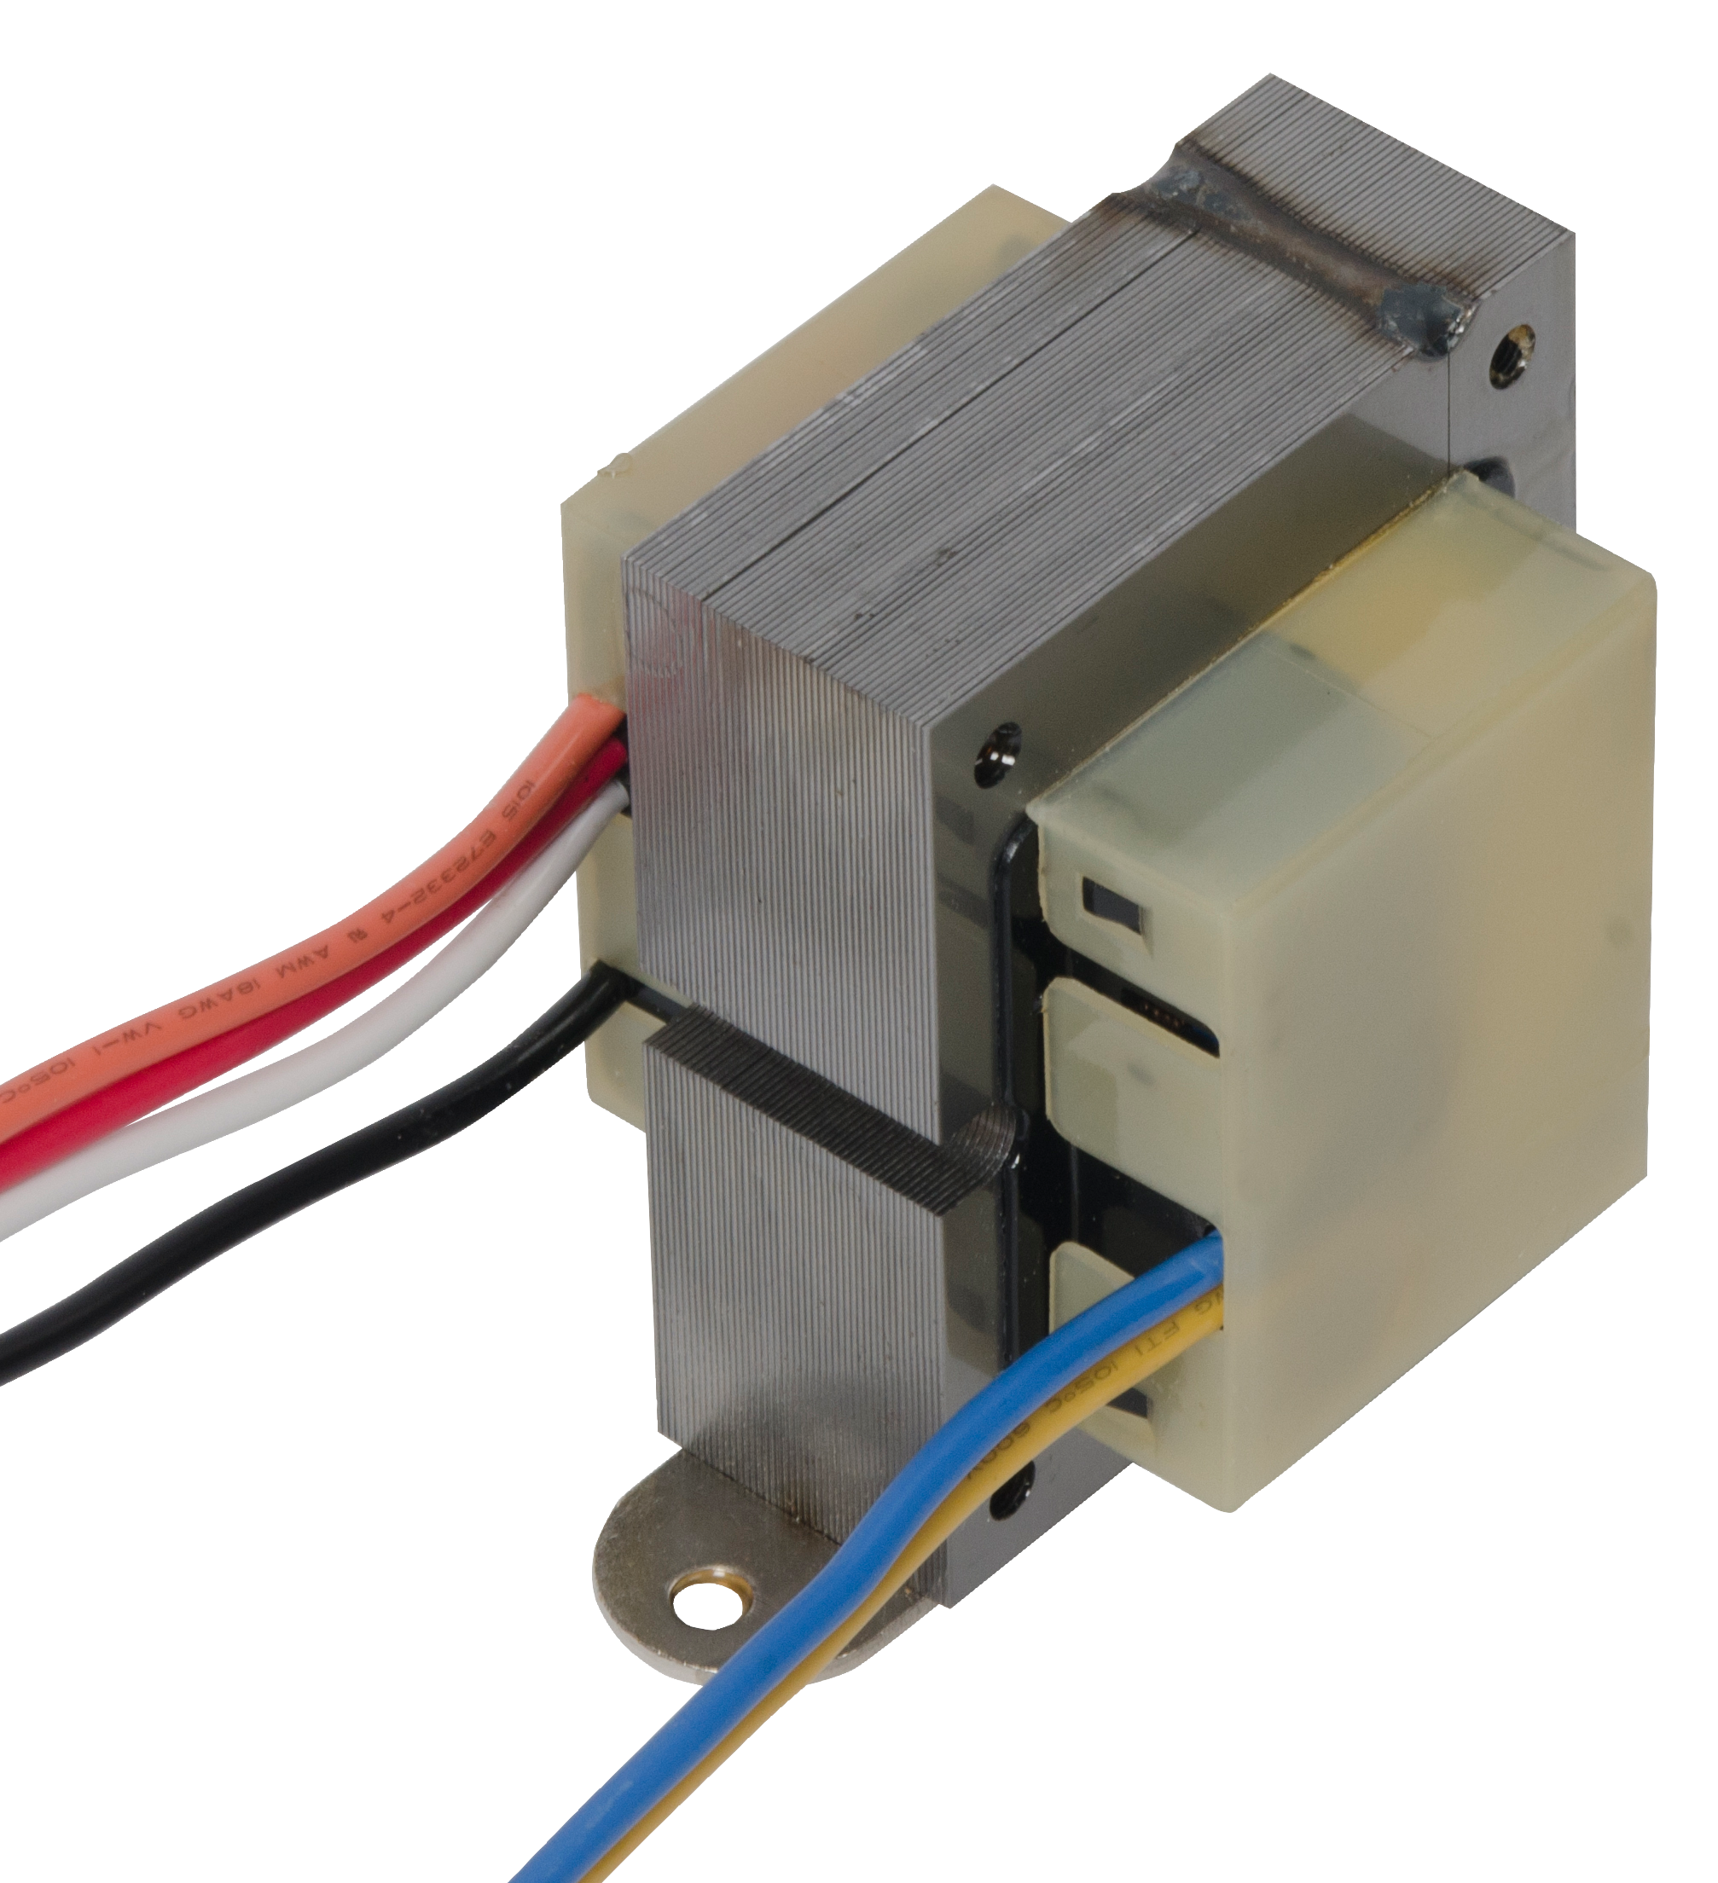
Common Replacement Parts
Furnace Control Group | Furnace Control Sub-Group
Furnace Controls | Integrated Furnace Controls (IFC's)
 | Non-Integrated Ignition Modules
 | Furnace Fan Blower Controls
 | Commercial Rooftop and Package Unit Controls
Gas Valves | Standing Pilot
 | HSI/DSI
 | HSI/DSI/Intermittent Proven Pilot
Hot Surface Ignitors | 120V Nitride Universal
 | 120V Carbide Direct OEM Replacement
 | 80V Nitride Direct OEM Replacement
Thermocouples and Generators | Thermocouples
 | Generators
 | Generators and Pilot Burners
Flame Sensors | Flame Sensors-Universal and Direct OEM Replacement
Warm Air Fan/Limit Controls | Plenum Fan and Limit
 | Snap Disc Fan and Limits
Relays and Transformers | Relays & Transformers
50E47-843
Non-Integrated Ignition Module
50M56U-843 Universal IFC
50E47-843
Hot Surface Ignitor
36C03-300
Standing Pilot
36H32-423
HSI/DSI/
Intermittent Proven Pilot
790-843A1
Universal Flame Sensors
PG9A27JTL22
Generator Pilot Burner
H06E-24
mV Thermocouple
5D51-35
Plenum Fan and Limit
3L12-130
Snap Disc Rollout Limit
90-T40F3
24 Volt Transformer

Slide 20
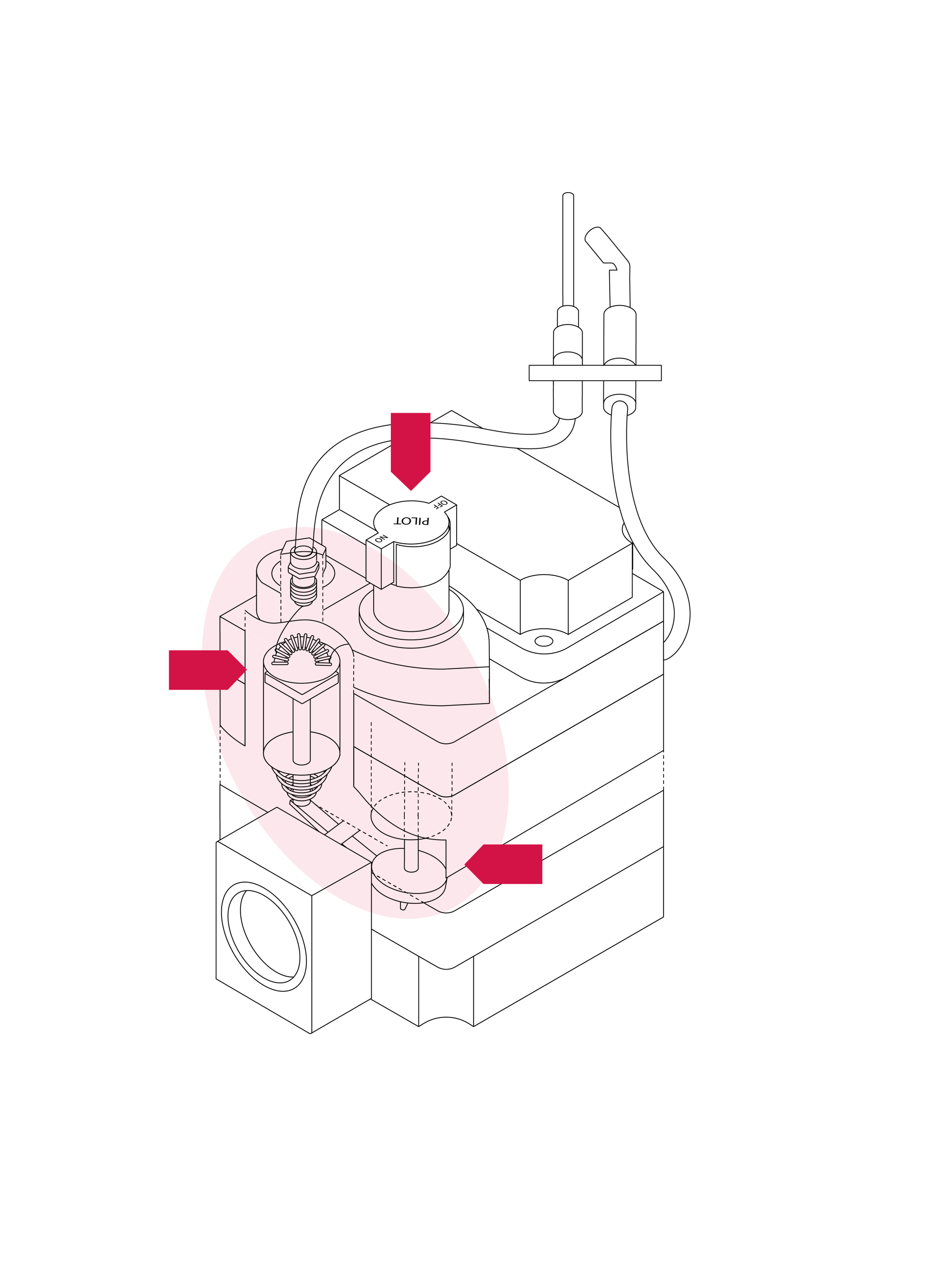
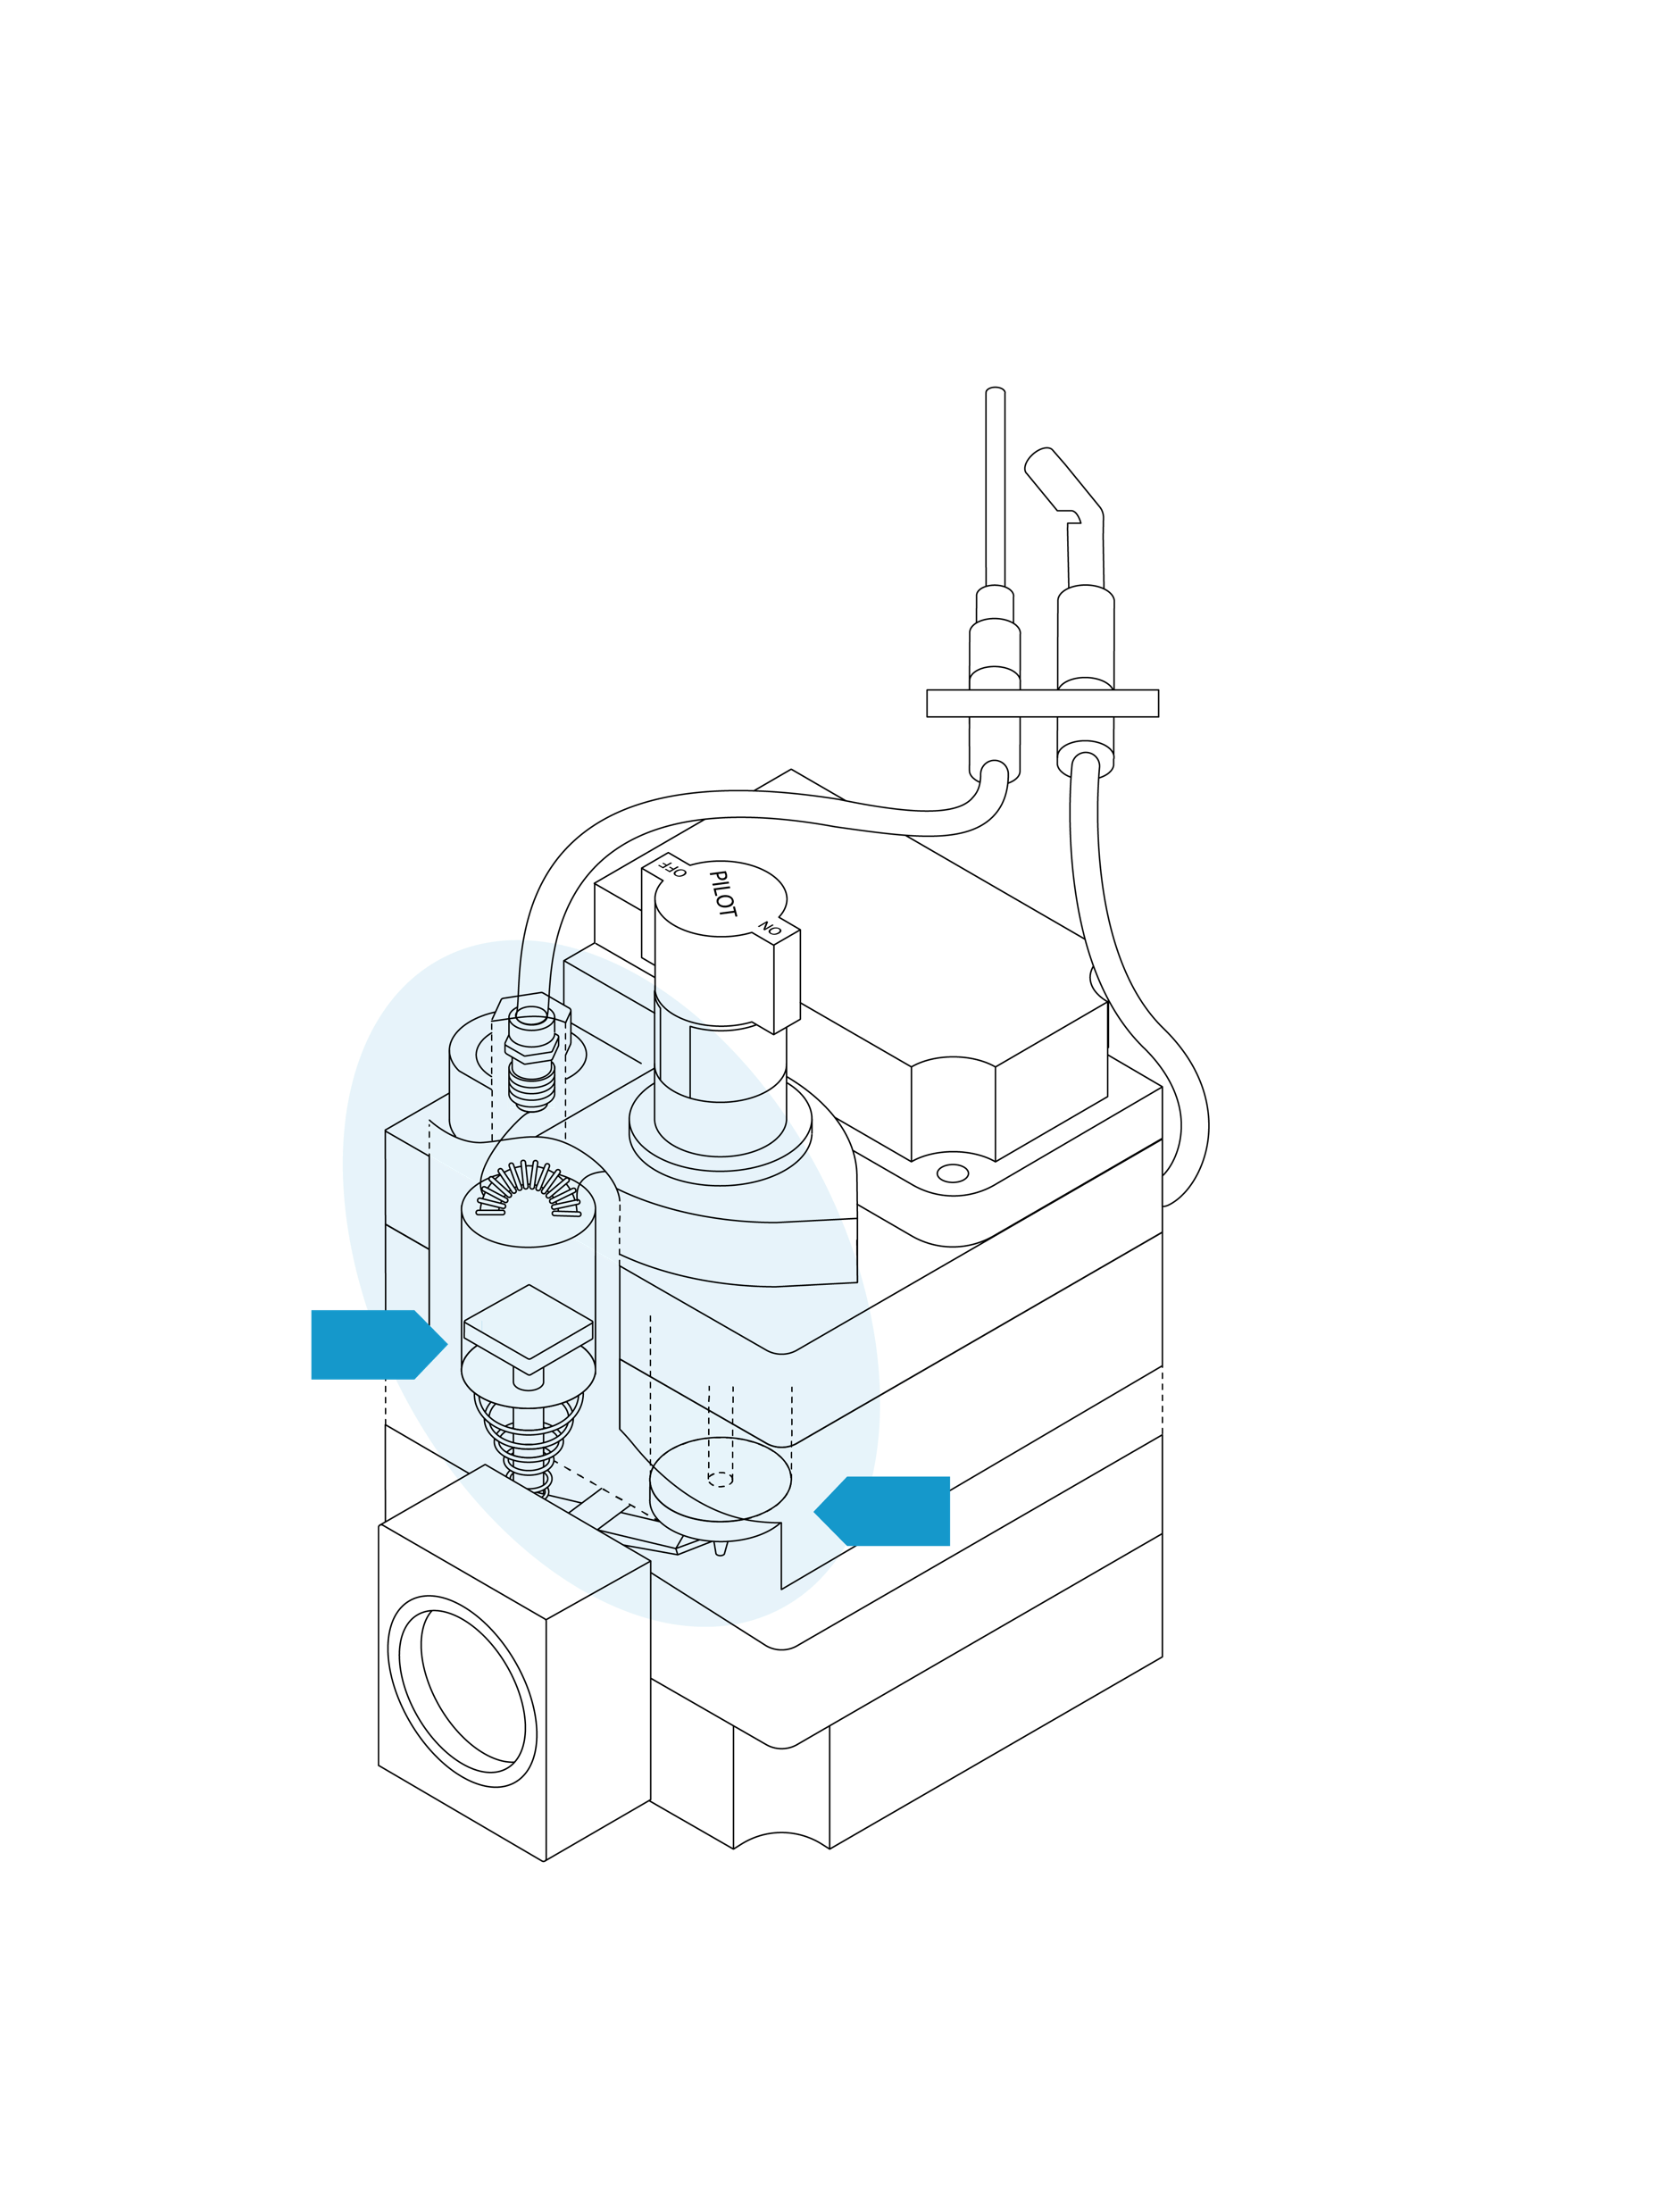
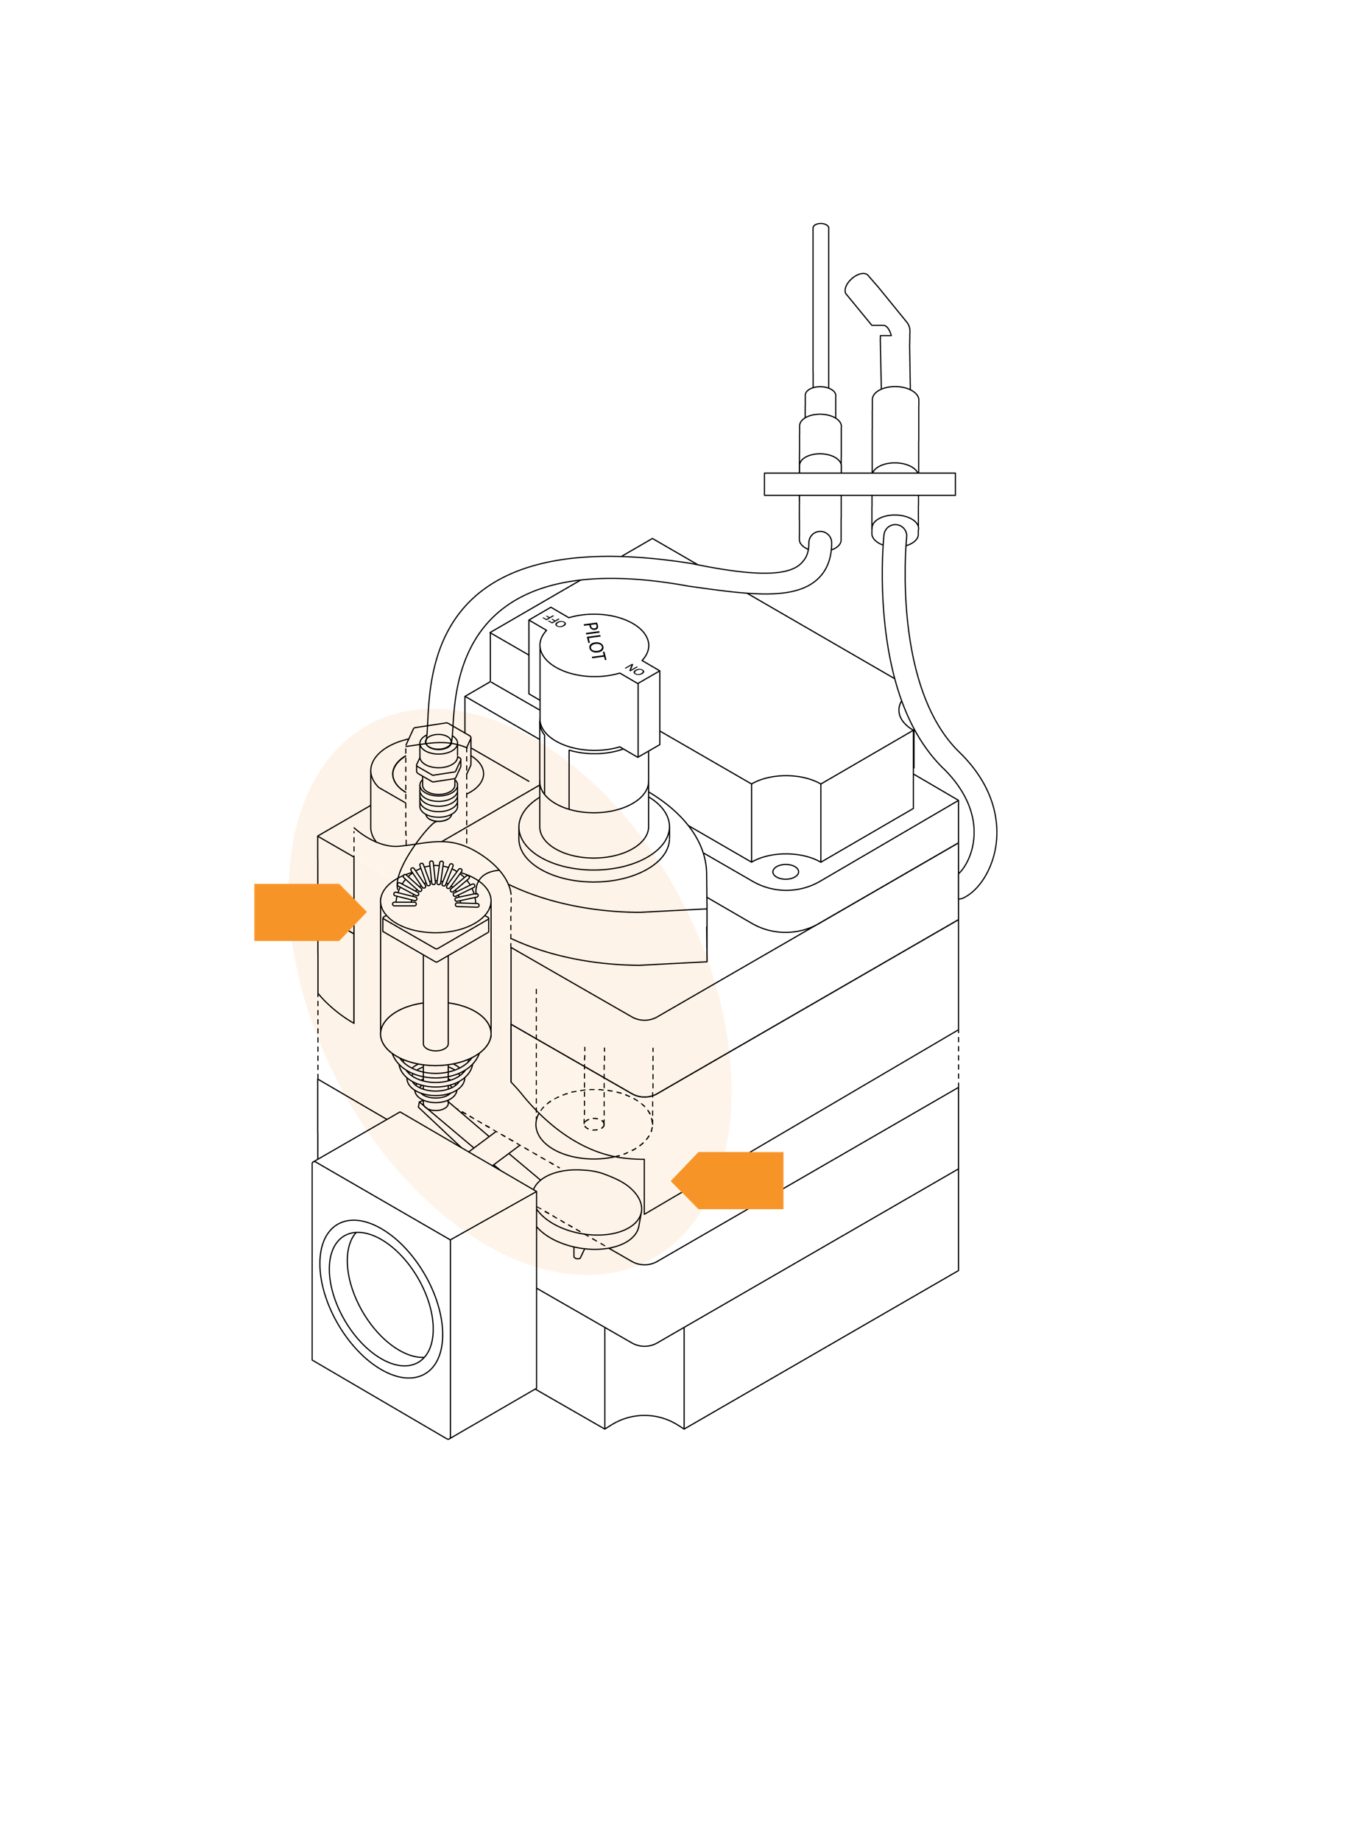
Standing Pilot System - Pilot Safety Valve
1. Turning the manual knob to Pilot and pressing down opens the pilot valve allowing gas to the pilot burner only.
2. Lighting the pilot gas heats up the thermocouple which produces enough electricity to magnetize the pilot safety coil and hold it open as long as pilot flame is present.
Turning the manual knob to On allows the regulator and main burner to operate on a call for heat.
3. If the pilot flame blows out the thermocouple cools off and stops generating electricity causing the pilot valve to snap closed.

Slide 21
Non-Integrated Hot Surface Ignition Module Connections
Note: Spark Ignition systems are similar, replacing the ignitor circuit with a spark connection. Intermittent/Proven Pilot systems also include a pilot connection to the gas valve.
Features:
Status Code LED
Program Timing Keys
Indirect Flame Sense Lead
Module Terminals
1
4
2
Mv2
Gas Valve
Transformer Return
Ground
T-Stat (W)
Gas Valve
Neutral or Ground
Ignitor Neutral
Flame Probe
Line Hot
Ignitor Hot
Tr
Gnd
3
Th
Mv1
50E47-843
Non-Integrated Ignition Module
L2
Hs2
Fp
L1
Hs1

Slide 22
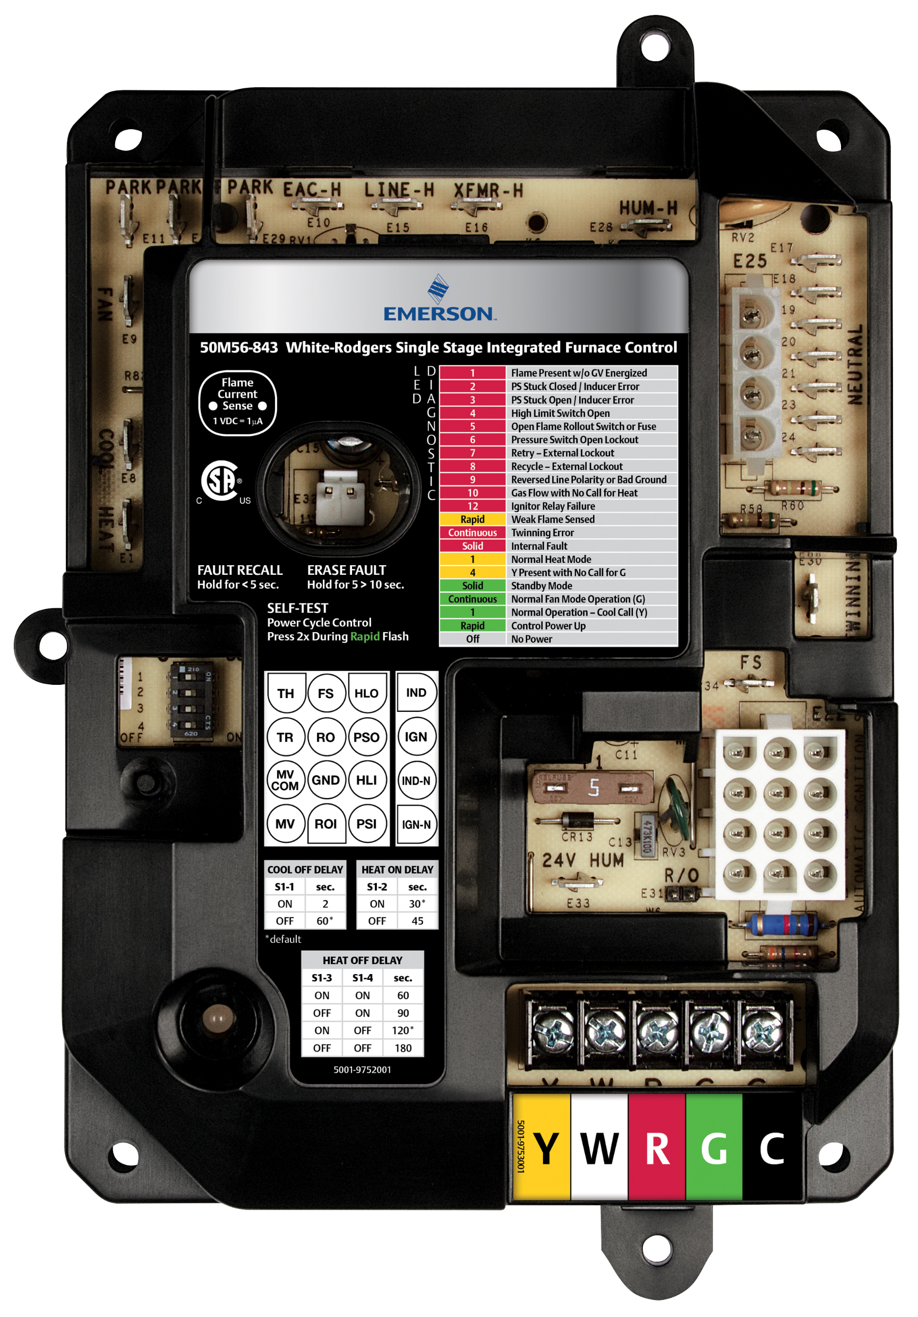
Integrated Furnace Control Connections
Fan speed terminals identify this control as an Integrated Furnace Control.
Features:
Fan Speed Terminals
Line Power, Optional Air Cleaner, Humidifier Terminals
Harness Connection Inducer Blower/Ignitor
Harness Connection
Low Volt Power
Gas Valve
Limit Circuits
Flame Sense
Thermostat Connections
Status Code LED
2
3
1
4
6
5
50M56U-843 Universal IFC

Slide 23
WR Mobile App
Always up-to-date and easy to use:
Mobile App
White-Rodgers Website
Your resource for:
Product information and spec sheets
Complete Cross Reference
OEM compatibility
Installation information and videos
Wiring diagrams
Download:
Go to your app store
Type in WR Mobile
Install the app
OR
Open your camera
Hold it over the QR code
Tap “Open” on the
pop-down
Install the app

Slide 24
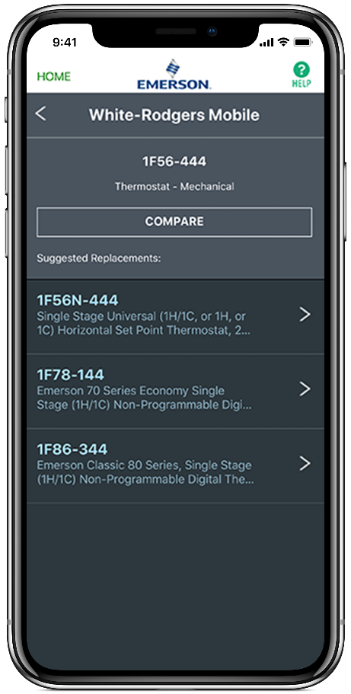
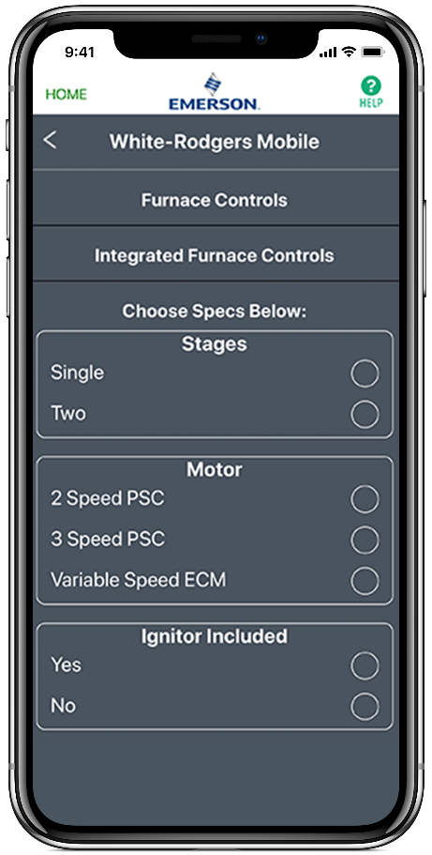
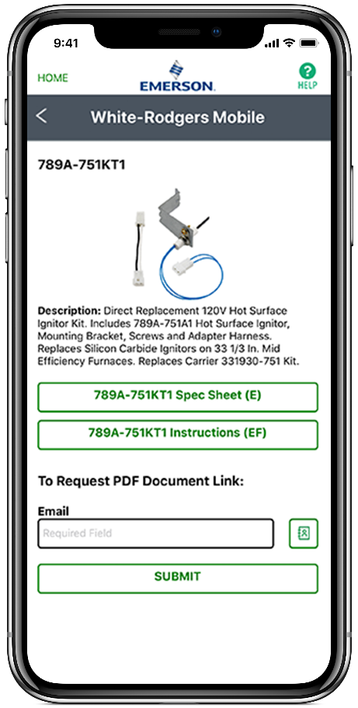
WR Mobile App
Easy to use!
Search by OEM, Competitive, or White-Rodgers Model Number
Product Number
Scrollable Product List
WR Replacement

Slide 25
White-Rodgers Cross Reference
Go to: www.whiterodgers.com
Hover over Tools & Resources
Click on: White-Rodgers Cross Reference/Product Information
Enter the Model Number or click on: Search Replacement Heating Controls by Major OEM Brand

Slide 26
Wholesale Resource Site
Access useful resources to grow your business.
Visit: https://climate.emerson.com/en-us/brands/white-rodgers/white-rodgers-wholesaler-resource-center
You’ll find videos, stocking lists and product launch information for the following product families:
Heating Controls
Cooling Controls
Sensi Smart™ Thermostats
Traditional Thermostats
Contractor Rewards
Product Merchandising

Slide 27
Why Contractors Trust White-Rodgers
Industry Leading Products
Used by more OEM’s
Offering the widest range of Universal Replacement Controls
Ease of Installation
Simple, easy to understand instructions
Product Reliability
Quality Control assures reliable products
Affordable
Competitive pricing
Supported by Knowledgeable Representatives
Contractor direct phone support

